Slide 1
FIND YOUR
WAY FASTER
Notes:
Most of you at this point have taken the YouScience career assessment. We’re meeting today so that you can make the most of understanding your results and later in the PPT we’ll be talking about your

Slide 2
Q&A| What will I get from my YouScience results?
You will be able to answer these questions:
What careers are the
right fit for me based on my natural strengths?
What am I going to do
after high school?
Where do I fit in the world of work and careers?
How can I describe myself and who I am with confidence?

Slide 3
THE YOUSCIENCE EXPERIENCE | Results Overview
Notes:
GA public school students MUST log in through SLDS (not through our website).

Slide 4
THE YOUSCIENCE EXPERIENCE | Know your strengths
After review your YouScience results, make a short list: What are some of your greatest strengths?
They can relate to school, another activity or club outside of school, or even qualities relating to your personality.
For example:
I’m a visual scanner- I have a natural talent for editing and proofreading.
I like routines because they help me perform my best.
I’m interested in artistic work where I can be creative.
Brainstorm- how can I use these strengths at school and in my future career?
Discover what career fields are most closely linked to your natural gifts & abilities.

Slide 5
THE YOUSCIENCE EXPERIENCE | Explore your Career Matches
Next, explore your best fit career matches based on your aptitudes and interests, and make a list of your top choices:
Ex: Top 3 Best Fit Careers based on Aptitude fit
Occupational Therapy Assistant
Sound Engineering Technician
Landscape Architect
Ex: Top 3 Best Fit Clusters based on Overall fit (aptitude + interest)
Secondary School Counselor
Preschool Teacher
Graphic Designer
Brainstorm: What educational path(s) do you need to look at pursuing based on your career matches?
Discover what career fields are most closely linked to your natural gifts & abilities.

Slide 6
GETTING STARTED| Questions?
The chat tool is available to you in the bottom right-hand corner of the screen as soon as you log in. Use it any time if you have questions about the test.
Inappropriate chats and those not related to YouScience
will be reported to your school.

Slide 7
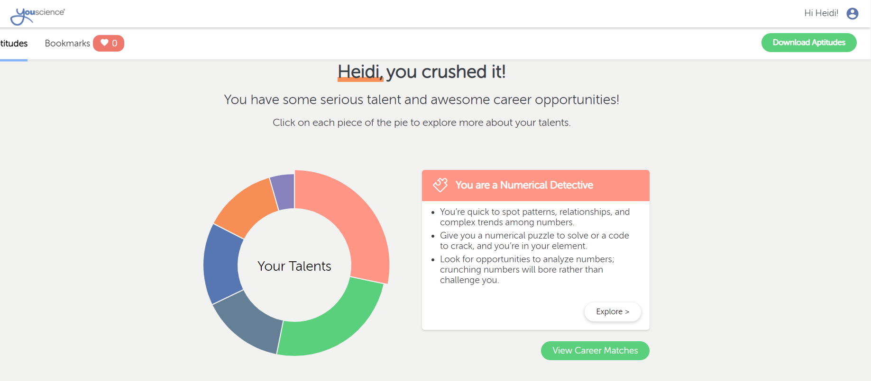

Slide 8
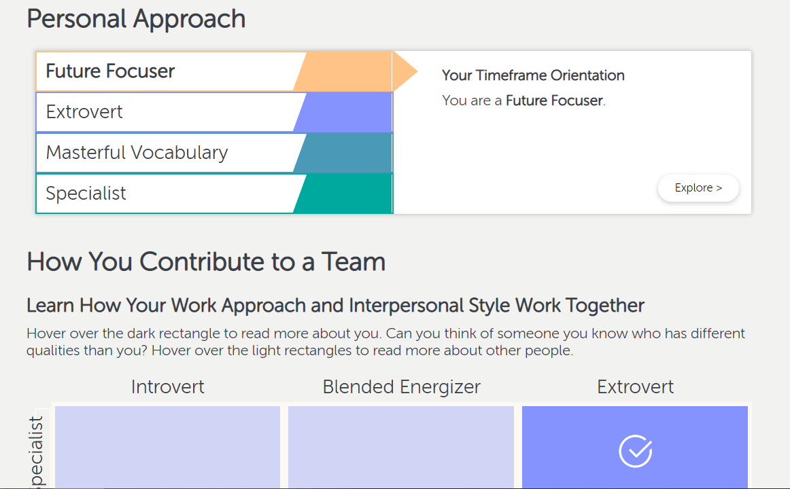

Slide 9
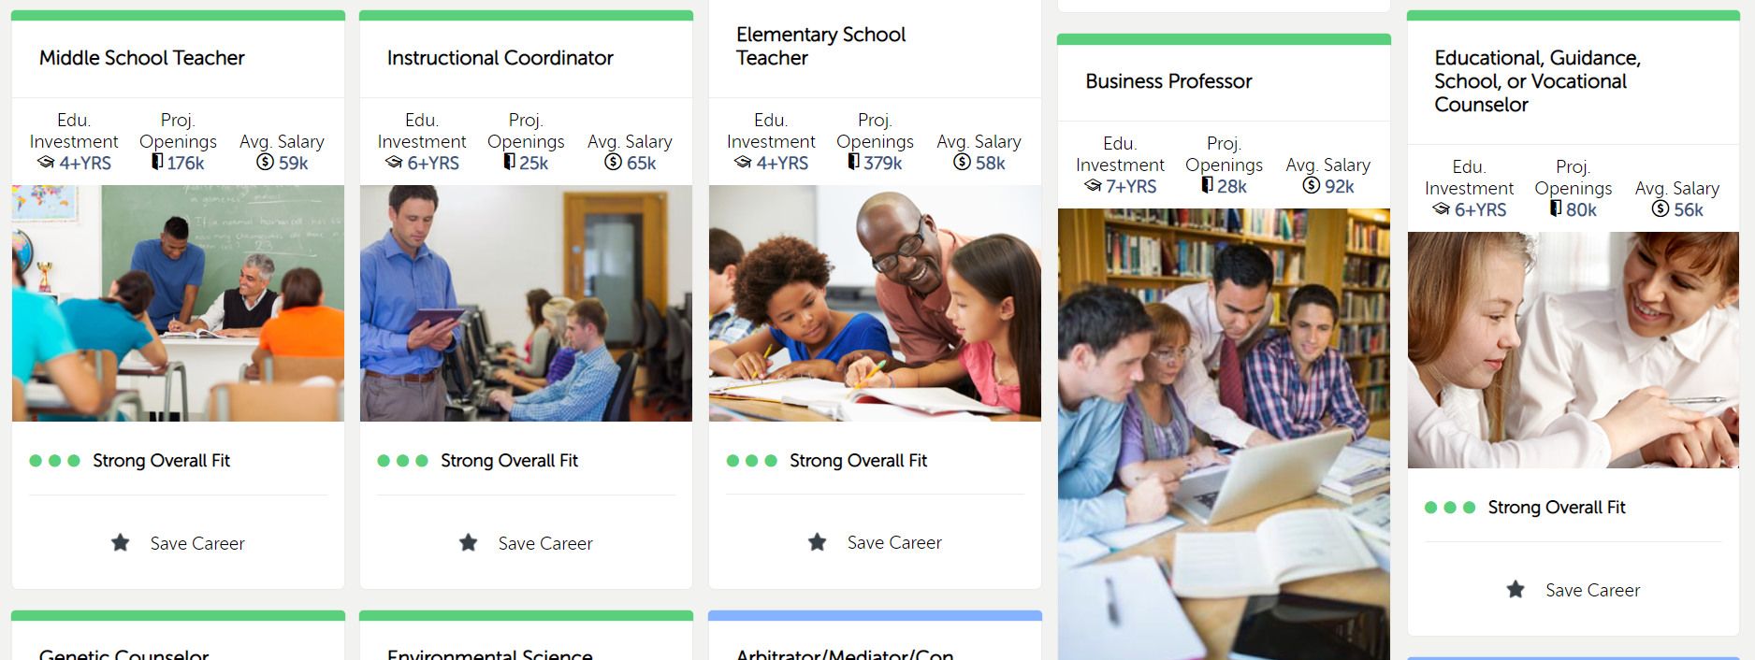

Slide 10
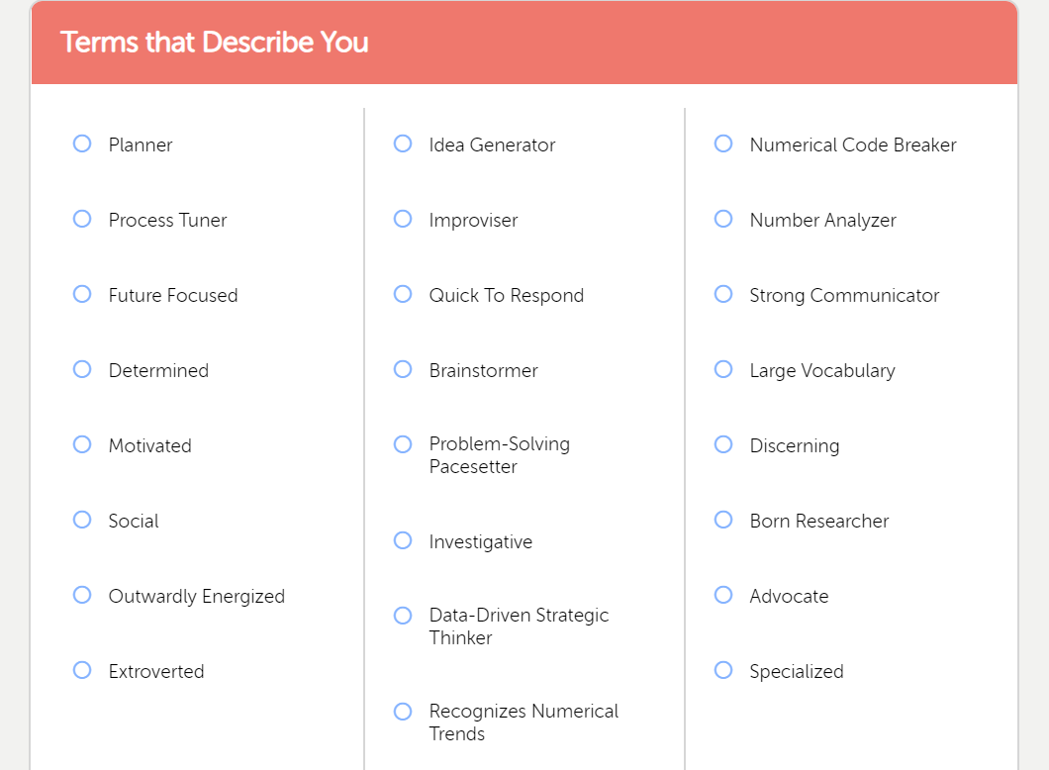

Slide 11
Thank you taking your Youscience Assessment!
Your School Counselors will use this information in your 11th and 12th grade years to help you:
Find colleges of interest
Talk about career interests
Align your talents with your future goals

