Slide 1

Class of 2017 Senior Classroom Guidance
Centennial HS Counseling

Slide 2
Centennial School Counseling
A-C Ms. Beaty beatyz@fultonschools.org
D-Gol & AVID Ms. Marino MarinoS1fultonschools.org
Gom-Mart Ms. Graver graverH@fultonschools.org
Maru-Sam Ms. Freeman freemanMA@fultonschools.org
San-Z Ms. Peart peart@fultonschools.org
Grad Coach
Ms. Jiram jiramM@fultonschools.org

Slide 3

Question…
What fears do you have about applying to college?
On a scale of 1-10 rank your
level of anxiety
(10 being the most anxious)

Slide 4

Overcoming the Fears About College…
One Step at a Time
Applications
Transcripts
Letters of Recommendation
SAT/ACT scores
Essay
Track Your Progress

Slide 5
The Online Application
Step 1:

Slide 6
KNOW YOUR DEADLINES!!!
Meeting Your Deadline = ALL Required Documents have been Submitted
Early Decision
Binding (Cannot Apply to Other Colleges)
Early Action
Not Binding
UGA and GA Tech
Regular Decision
Not Binding
Rolling Admissions
Review of application is on-going
Kennesaw State; May deadline/notifications on-going
Open Admissions
Review of application is on-going
Deadlines and Notifications vary
UGA and Georgia Tech
Emory
If Deferred, student can reapply under Regular Decision

Slide 7

the College’s Admission Webpage
Create an account
Review the list of required documents
Use your application checklist
Parts of an application are not typically sent or received at the same time

Slide 8

Completing the Application
Personal Data (address, citizenship, demographic info)
Education (schools you attended)
Test Info
Family History
Extracurricular Activities
Academic Honors
Work Experience
Essay/Personal Statement
Digital Signature

Slide 9

for Completing your application
Print out a hard copy to fill out as a rough draft
Have all info you need on hand
resume
Save your work as you go
Check Spelling and Grammar
list of school & community activities
contact info for letters of recommendations
family/parent history
SUBMIT!
Include Application Fee
GPA on a 100 point scale (Student Access Center)

Slide 10

CLASS ACTIVITY: PUTTING THE TOOLS INTO ACTION

Slide 11

Practice: KSU

Slide 12
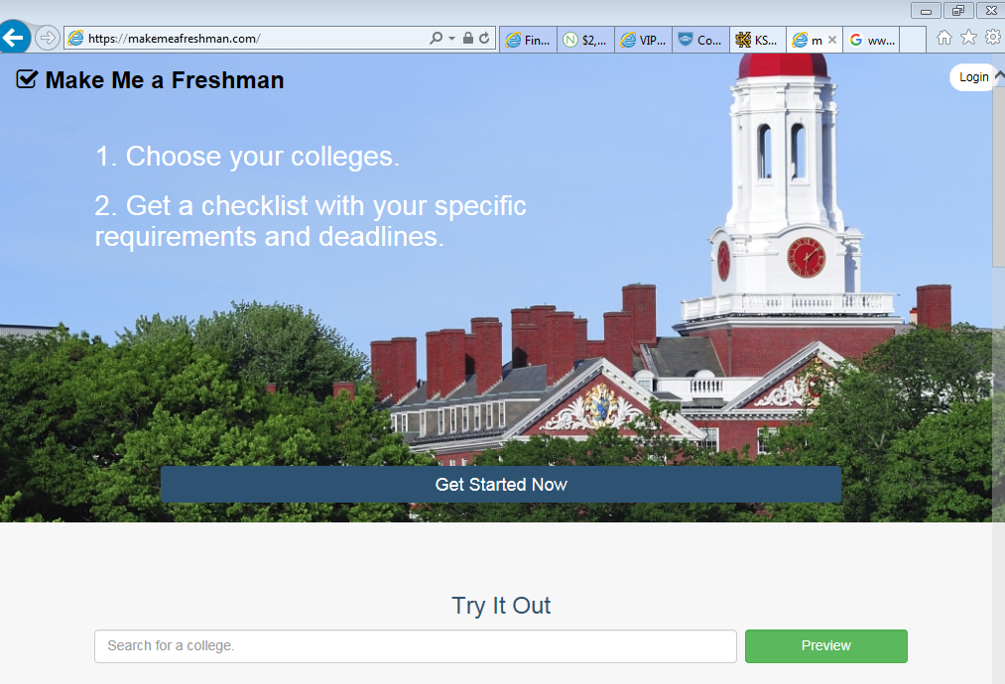
www.maakemeafreshman.com

Slide 13
Official Transcripts
Step 2:

Slide 14
When Requesting Official Transcripts…
Requests must be made a minimum of 10 school days before deadline
It is YOUR responsibility to follow up with the college to make sure transcript was received
A hard copy of an official transcript is available for pick up

Slide 15
Letters of recommendation
Step 3:

Slide 16

What colleges want in a letter of rec
Classroom Contributions
Interest in Learning
Academic Achievement
Personal Challenges/ Hardships
Personal Anecdotes
Impact on School
Leadership Ability
Interests Outside School
You
Painting a Complete Picture
of YOU

Slide 17
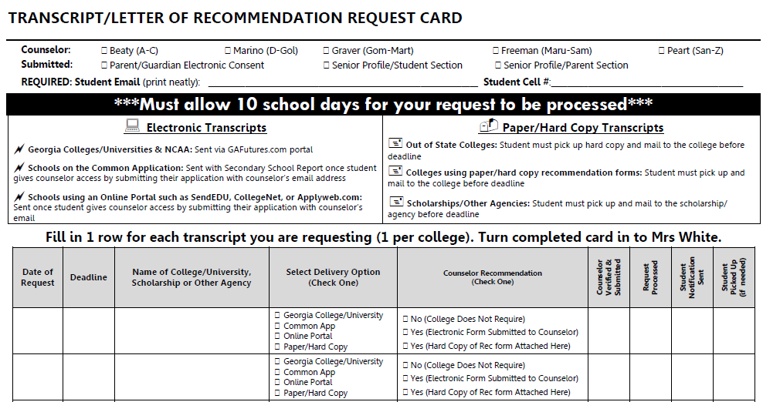
Requesting a TRANSCRIPT AND letter of recCOMENDATION
Submit Recommendation Request in the Counseling Office
      Submit your counselor’s name & email into your online application
      Fill out Recommendation Request card
      Attach Senior Profile (both Student and Parent portions)
Minimum of 10 School Days in Advance
  WE WILL NOT COMPLETE A RECOMMENDATION WITHOUT A WRITTEN REQUEST

Slide 18

Other Recommendation Writers
Teachers, Coaches/Club Sponsors, Mentors, Administrators, etc.
Ask the person first
Provide copy of senior profile
Minimum of 10 School Days in Advance
Submit recommenders name & email into online application
If the college does not require a letter of recommendation, they will not accept or review any letters submitted.

Slide 19
Test Scores
Step 4:

Slide 20

Entrance Exams: SAT, ACT & COMPASS
SAT (www.collegeboard.org) and ACT (www.actstudent.org)
Register for test (select date, location, and make payment)
Receive test scores
Send scores to selected colleges (before and/or after exam)
Create your account
COMPASS Test
Placement test accepted at most 2 year colleges
Given free of charge at the college
We will NOT be offering a free SAT at CHS this year

Slide 21

I haven’t tested yet…can I still apply?
Still Need to Test?
Register for a test in the fall
Need to boost your score?
Test Prep Classes
Free Online Tutorials
Practice Tests
Daily Practice SAT App
Applications are incomplete until EVERYTHING has received by the college.

Slide 22
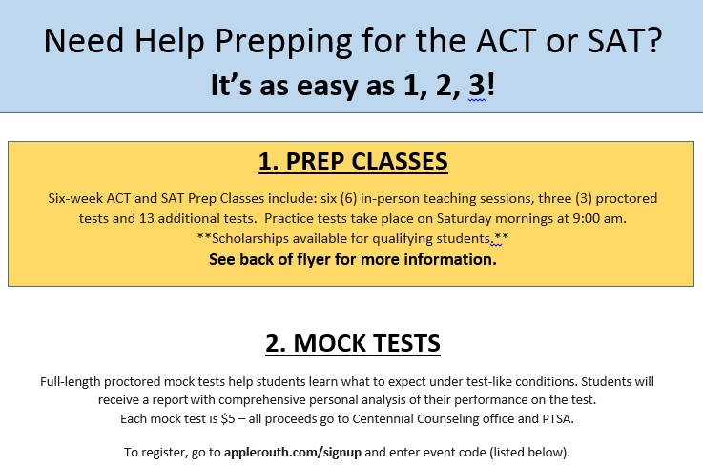
SAT and ACT Preparation

Slide 23
The Essay
Step 5:

Slide 24

The College Application Essay
Tips
Select the Best Topic & Subject for you
Answer the Question
Skip the Volunteer Trip
Check Your Ego at the Door
Accentuate the Positive
Research the College Before Writing the Essay
Invest in a Strong Intro
Mistakes
Don’t Exceed the Requested Essay Length
Don’t Appear Self-Interested or Materialistic
Don’t Rely on Your Computer’s Spell Check
Don’t Rehash the Resume
Don’t Fall in Love with the Thesaurus
Don’t Wait until the Last Minute

Slide 25
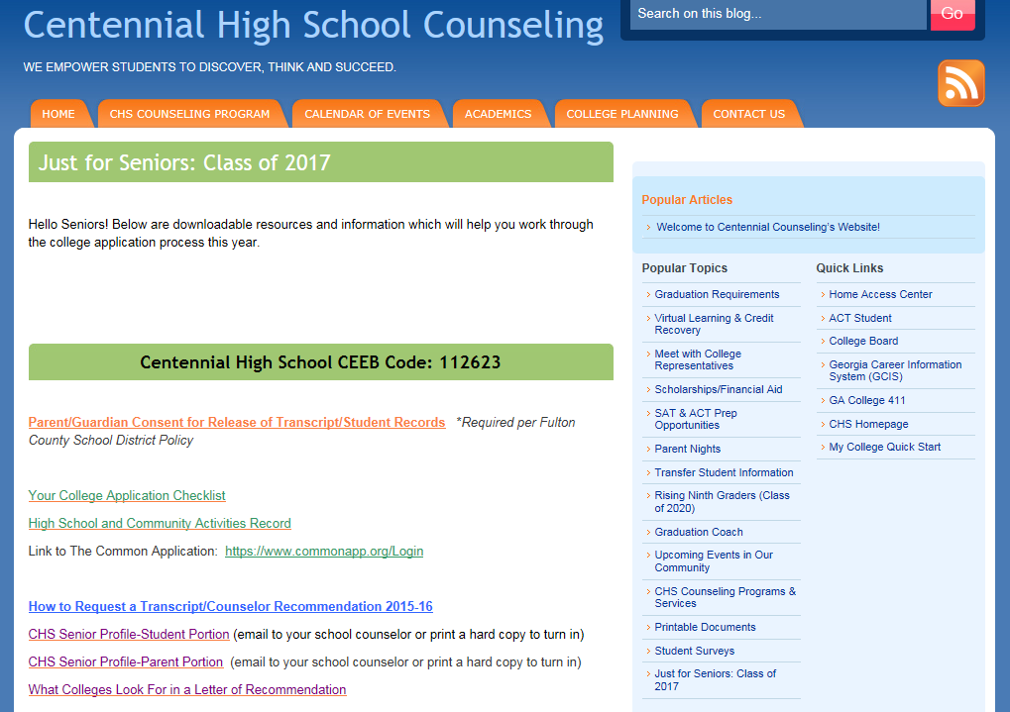
www.mycentennialcounseling.com

Slide 26


2016 COLLEGE WEEK: octOBER 24-28
Centennial’s Apply to College Day
Thursday, October 27th
All Senior English Classes
College Week Events
of Special Interest to Seniors

Slide 27
What Is YOUR Next Step??
Finalizing Your List of Colleges?
College Reps
College Campus Visits
College Fairs
Preparing to Apply?
Fill in College Application Checklist for each college
Ready to Get Started?
Designate time to complete application
Create a timeline to complete each required component
Follow up on any areas you have not started yet
Submit each separate application requirement
After you submit, monitor your application status
Contact the college’s office of admissions with application status questions
www.makemeafreshman.com is a useful tool to determine keep track of deadlines
Websites: College admissions websites and www.gcic.peachnet.edu
Financial Aid Questions?
Counselors will be going into senior classrooms again in January for a Financial Aid lesson
Complete FAFSA
www.finaid.org has a lot of great information regarding financial aid options

Slide 28
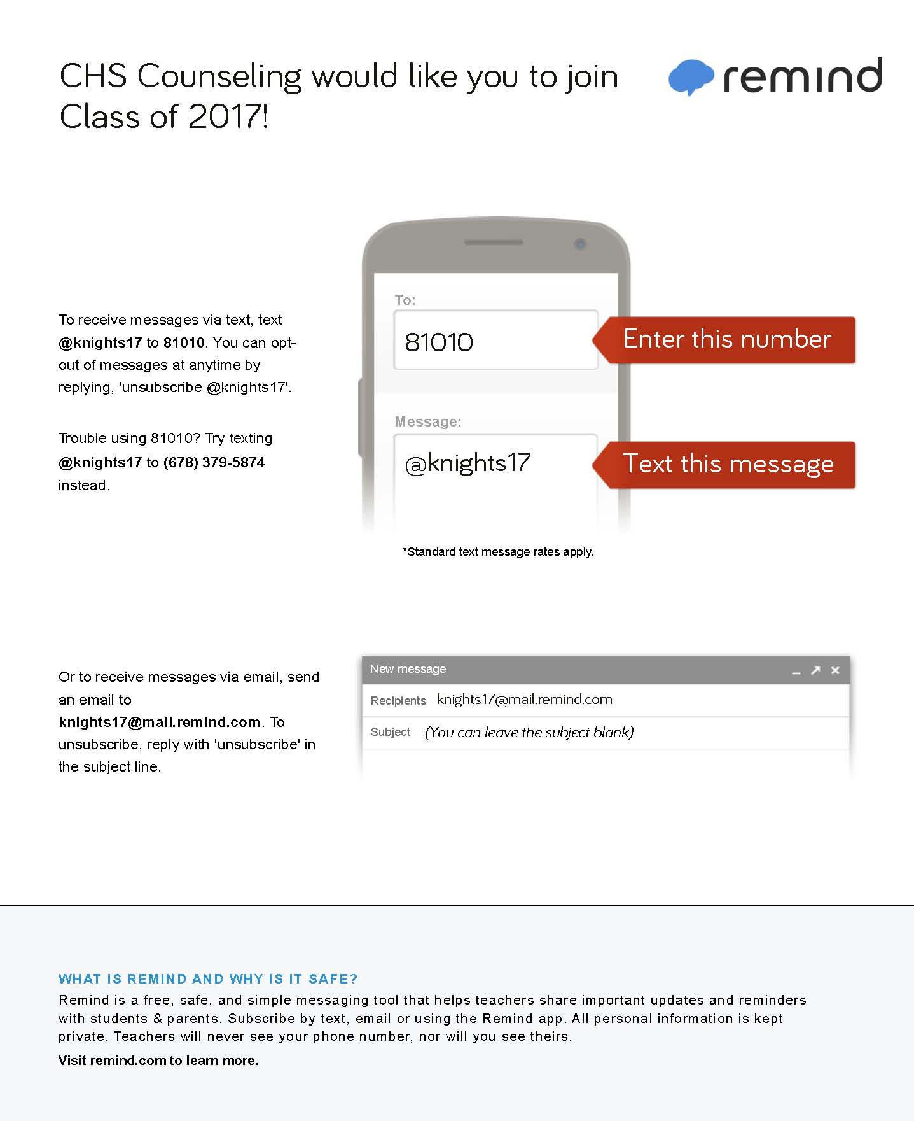

Slide 29

We are looking forward to a great year!

