Slide 1


Class of 2019 Senior Classroom Guidance
Centennial HS Counseling

Slide 2

POST-SECONDARY OPTIONS:
2-YEAR OR 4-YEAR COLLEGE/UNIVERSITY
TECHNICAL COLLEGE/TRADE SCHOOL
MILITARY ENLISTMENT
EMPLOYMENT

Slide 3
CENTENNIAL COUNSELING DEPARTMENT
A-Cas Ms. Beaty beatyz@fultonschools.org
Cat-Harp
Ms. Ekpo EkpoN@fultonschools.org
Harq-Mep Ms. Graver graverH@fultonschools.org
Meq-Sal
Ms. Freeman freemanMA@fultonschools.org
Sam-Z Ms. Peart peart@fultonschools.org
Grad Coach
Mrs. Rigsbey RigsbeyA@fultonschools.org

Slide 4

QUESTION….
What fears do you have about applying to college?
On a scale of 1-10 rank your
level of anxiety
(10 being the most anxious)

Slide 5

OVERCOMING THE FEARS ABOUT COLLEGE
ONE STEP AT A TIME
THE APPLICATION
REQUESTING A TRANSCRIPT
Letters of Recommendation
SAT/ACT/ACCUPLACER tests
Essay
Track Your Progress

Slide 6
The Online Application
Step 1:

Slide 7


THE APPLICATION PORTALS
Create an account
Review the list of required documents
Use your application checklist
Parts of an application are not typically sent or received at the same time

Slide 8
Meeting Your Deadline = ALL Required Documents have been Submitted
KNOW YOUR DEADLINES
Early Decision
Binding (Cannot Apply to Other Colleges)
Early Action
Not Binding
UGA and GA Tech *UGA will require an essay; counselors will need your senior profile/resume*
Regular Decision
Not Binding
Rolling Admissions
Review of application is on-going
Kennesaw State; May deadline/notifications on-going
Open Admissions
Review of application is on-going
Deadlines and Notifications vary
UGA and Georgia Tech
Emory
If Deferred, student can reapply under Regular Decision

Slide 9

COMPLETING THE APPLICATION
Personal Data (address, citizenship, demographic info)
Education (schools you attended)
Test Info
Family History
Extracurricular Activities
Academic Honors
Work Experience
Essay/Personal Statement
Digital Signature

Slide 10

for Completing your application
Print out a hard copy to fill out as a rough draft
Have all info you need on hand
resume
Save your work as you go
Check Spelling and Grammar
list of school & community activities
contact info for letters of recommendations
family/parent history
SUBMIT!
Include Application Fee
GPA on a 100 point scale (Student Access Center)

Slide 11
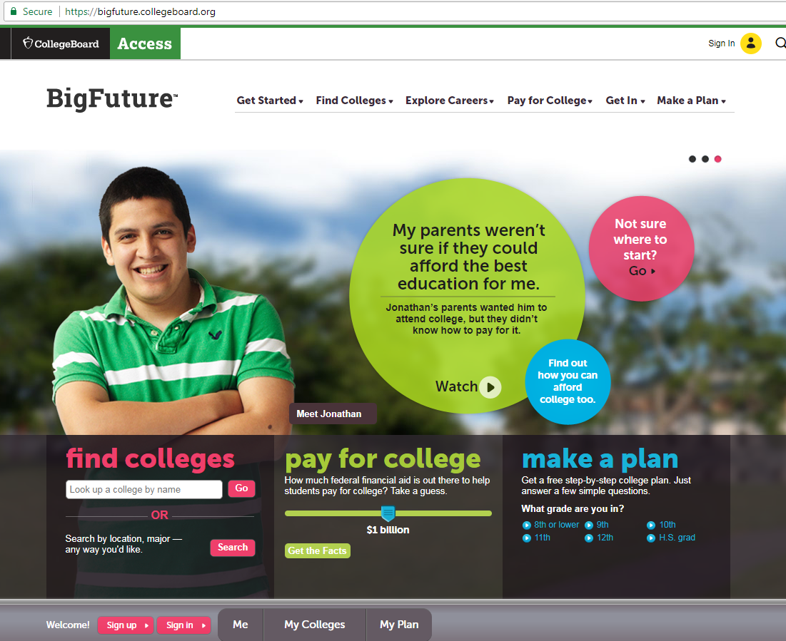
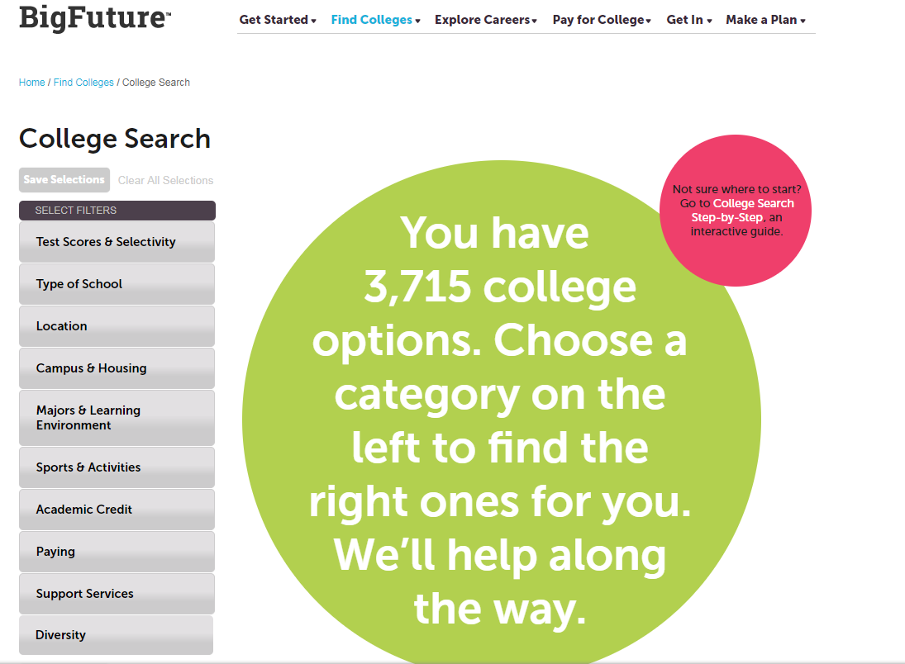
HELPFUL RESOURCES
https://bigfuture.collegeboard.org

Slide 12
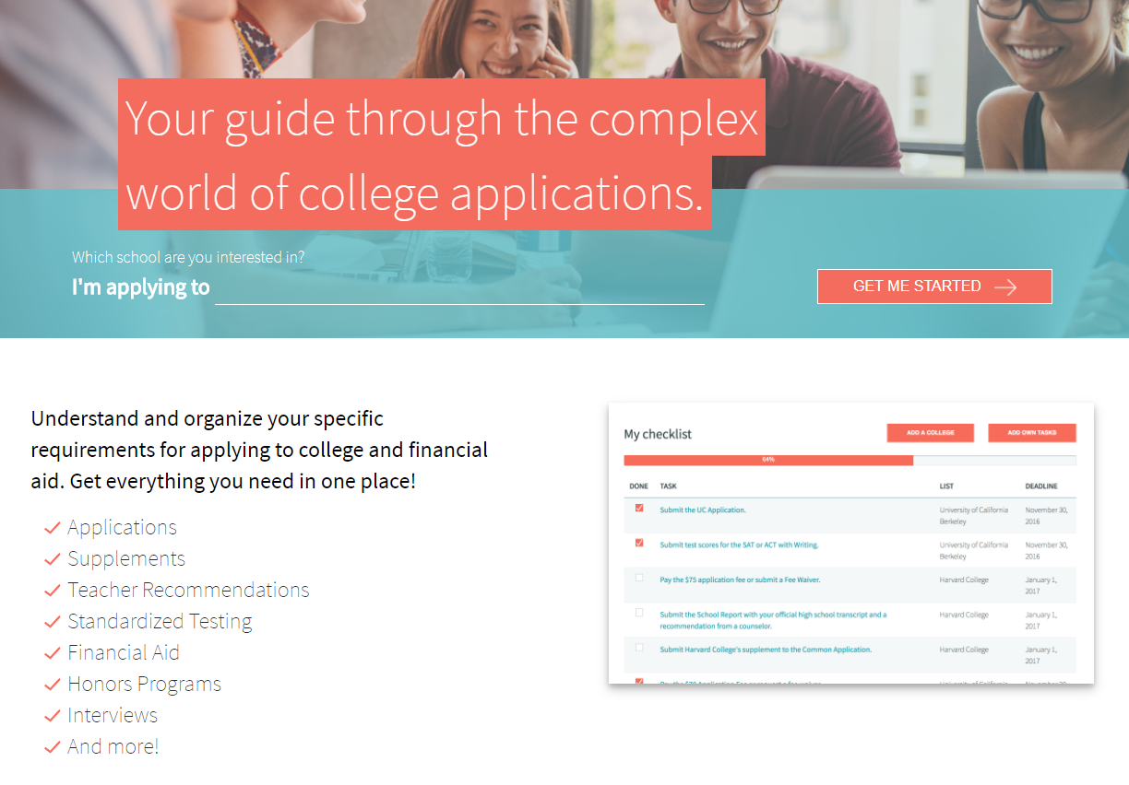
HELPFUL RESOURCES
http://www.makemeafreshman.com

Slide 13


NEW MINIMUM PLACEMENT REQUIREMENTS
SAT, ACT, ACCUPLACER or MILESTONE ELA SCORES
PSAT SCORES TAKEN AFTER MARCH 2016
HOPE GPA OF 2.6 OR HIGHER, FOR 11TH & 12TH GRADERS
TEST SCORE AGE LIMIT HAS BEEN REMOVED FROM POLICY
ENTRY LEVEL WORKFORCE CERTIFICATES REQUIRES 2.0 MIN GPA
*SOME TECHNICAL COLLEGES MAY STILL REQUEST HIGHER REQUIREMENTS*

Slide 14
Official Transcripts
Step 2:

Slide 15

REQUESTING TRANSCRIPTS
THE PROCESS
ALL TRANSCRIPTS WILL BE REQUESTED & RELEASED THROUGH PARCHMENT

Slide 16
REQUESTING TRANSCRIPTS
THE PROCESS
STEP ONE:
PICK UP YOUR PARCHMENT REGISTRATION CODE FROM THE COUNSELING OFFICE
STEP TWO:
ENTER THE PARCHMENT WEBSITE VIA www.Parchment.com
STEP THREE:
FOLLOW THE SCREEN INSTRUCTIONS FOR ACCOUNT REGISTRATION AND
TRANSCRIPT RELEASE

Slide 17

REQUESTING TRANSCRIPTS
THE PROCESS
PARCHMENT PREVIEW:
START HERE
& CLICK
‘ORDER MY TRANSCRIPT OR CREDENTIALS’

Slide 18
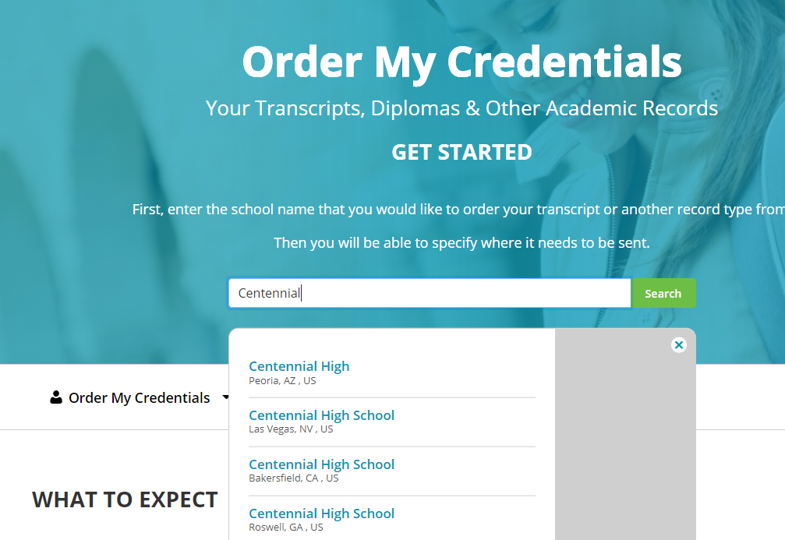
REQUESTING TRANSCRIPTS
THE PROCESS
PARCHMENT PREVIEW:
ENTER CENTENNIAL
HIGH SCHOOL
IN THE SEARCH
BOX.
BE SURE TO CLICK THE CHS OF ROSWELL, GA

Slide 19
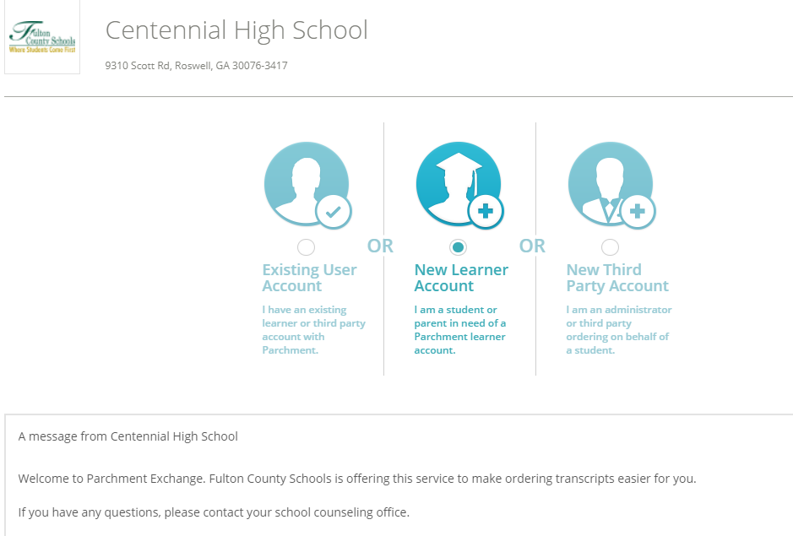
REQUESTING TRANSCRIPTS
THE PROCESS
PARCHMENT PREVIEW:
REQUEST A NEW LEARNER ACCOUNT

Slide 20
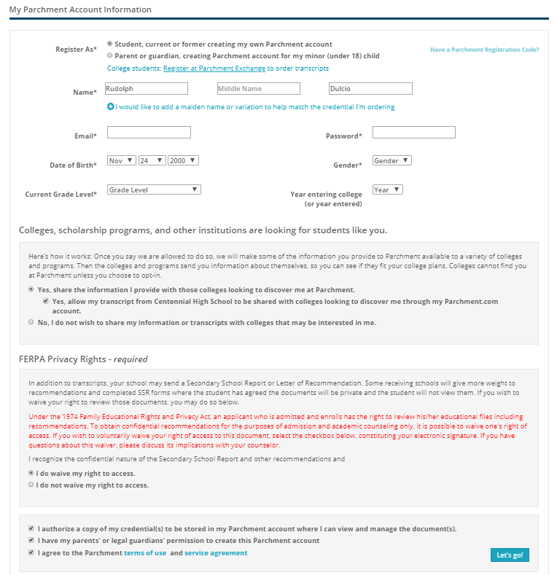
REQUESTING TRANSCRIPTS
THE PROCESS
PARCHMENT PREVIEW:
ALLOW CHS
TO SEND YOUR TRANSCRIPT TO COLLEGES OF YOUR CHOICE
ANSWER THE
FERPA QUESTION
REGARDING PRIVACY RIGHTS

Slide 21
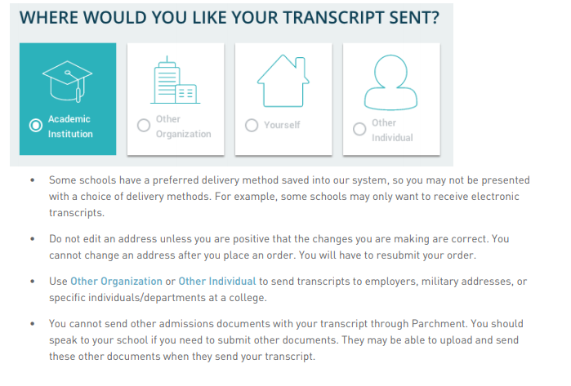
REQUESTING TRANSCRIPTS
THE PROCESS
PARCHMENT PREVIEW:

Slide 22
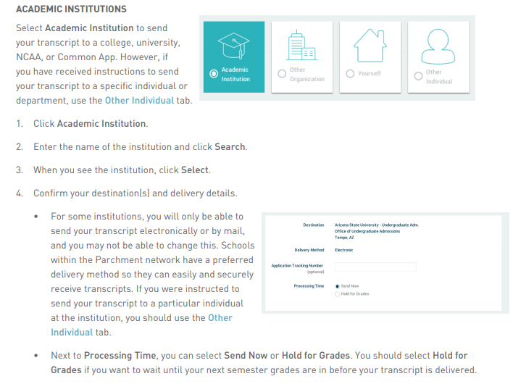
REQUESTING TRANSCRIPTS
THE PROCESS
PARCHMENT PREVIEW:
SELECT THE INSTITUTION(S)
THAT SHOULD RECEIVE
YOUR TRANSCRIPT AND THEN SELECT
‘CHECKOUT’ TO COMPLETE YOUR REQUEST

Slide 23
Letters of recommendation
Step 3:

Slide 24
REQUESTING
LETTERS OF RECOMMENDATION
THE PROCESS
Enter your counselor’s name & e-mail address in the online college application where counselor information is requested
Complete the
RECOMMENDATION REQUEST CARD
(located in the Counseling Office)
Attach a copy of the SENIOR PROFILE
(both student & parent portions)to the transcript/recommendation request card

Slide 25

REQUESTING LETTERS OF RECOMMENDATION
THE PROCESS
IMPORTANT NOTICE:
THE LETTER OF RECOMMENDATION REQUEST CARDS ARE BEING AMENDED TO BETTER MEET YOUR NEEDS. YOU MAY STILL SUBMIT ELECTRONIC LETTER OF RECOMMENDATION REQUESTS THROUGH THE COLLEGE APPLICATION PORTAL: COALITION APPLICATION, COMMON APPLICATION, SENDEDU, ETC. YOU WILL BE NOTIFIED WHEN THE CARDS ARE AVAILABLE.

Slide 26

OTHER RECOMMENDATION WRITERS
Teachers, Coaches/Club Sponsors, Mentors, Administrators, etc. may serve as recommenders
Ask the recommender for permission first
Provide the recommender a copy of your senior profile
Provide a MINIMUM notice of 10 School Days
Submit recommenders name & e-mail into online application
If the college does not require a letter of recommendation, they will not accept or review any letters submitted.

Slide 27
REQUESTING TRANSCRIPTS & LETTERS OF RECOMMENDATION
THE RULES
Requests must be made AT A MINIMUM OF 10 school days before the deadline
It is YOUR responsibility to follow up with the college to make sure they have received the transcript & LOR
A hard copy of an official transcript is available for pick up

Slide 28
REQUESTING TRANSCRIPTS & LETTERS OF RECOMMENDATION
THE RULES
Track the delivery of your transcript & LORs through your college account
Counselors will not complete a
recommendation without a written or
electronic request

Slide 29
Entrance exams
Step 4:

Slide 30

ENTRANCE EXAMS:
SAT, ACT & ACCUPLACER
SAT (www.collegeboard.org) and ACT (www.actstudent.org)
Register for the test (select a date and location, upload a picture, and make the payment)
Receive test scores
Send scores to selected colleges (before and/or after exam)
Create your account
ACCUPLACER Test
Placement test accepted at most 2 year colleges
Colleges proctor this exam on their campuses

Slide 31


SAT/ACT PREP

Slide 32

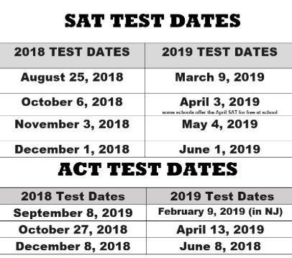
I HAVEN’T TESTED YET…CAN I STILL APPLY?
REGISTER FOR ONE OF THE UPCOMING TESTS:
YES
NO
Applications are incomplete until EVERYTHING has been received by the college, INCLUDING TEST SCORES

Slide 33
The Essay
Step 5:

Slide 34

The College Application Essay
Tips
Select the Best Topic & Subject for you
Answer the Question
Check Your Ego at the Door
Accentuate the Positive
Research the College Before Writing the Essay
Invest in a Strong Intro
Mistakes
Don’t Exceed the Requested Essay Length
Don’t Appear Self-Interested or Materialistic
Don’t Rely on Your Computer’s Spell Check
Don’t Rehash the Resume
Don’t Fall in Love with the Thesaurus
Don’t Wait until the Last Minute

Slide 35
WHAT IS YOUR NEXT STEP…
Finalizing Your List of Colleges?
College Reps
College Campus Visits
College Fairs
Preparing to Apply?
Fill in College Application Checklist for each college
Ready to Get Started?
Designate a time to complete the application
Create a timeline to complete each required component
Follow up on any areas you have not started yet
Submit each separate application requirement
After you submit the application, monitor your application status
Contact the college’s office of admissions with application status questions
www.makemeafreshman.com is a useful tool to keep track of deadlines
Websites: College admissions websites and www.gcic.peachnet.edu
Financial Aid Questions?
Counselors will be entering senior classrooms again in January for a Financial Aid lesson
Complete FAFSA (starting in October)
www.finaid.org has a lot of great information regarding financial aid options

Slide 36


2018 COLLEGE WEEK:
OCT. 15, 2018-OCT. 19, 2018
Centennial’s Apply to College Day
OCTOBER 18, 2018
All Senior English Classes
College Week Events
of Special Interest to Seniors

Slide 37

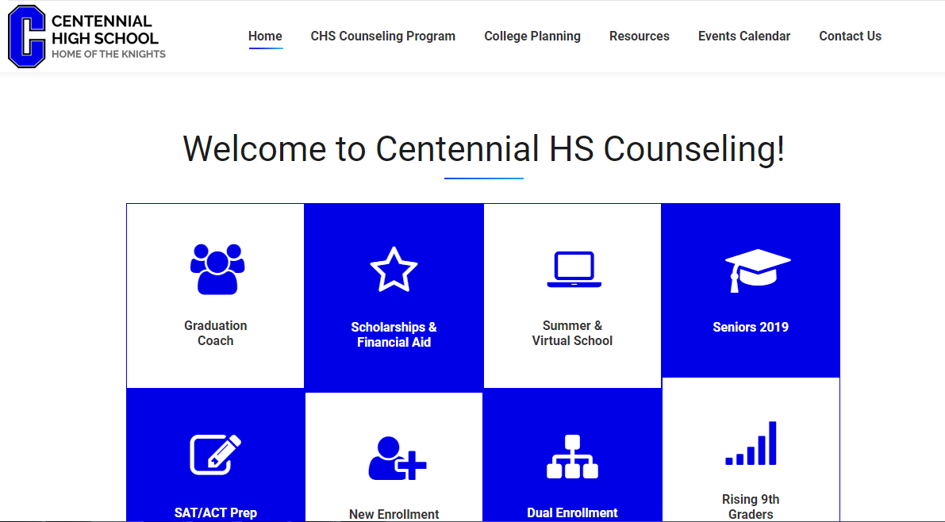

www.mycentennialcounseling.com

Slide 38
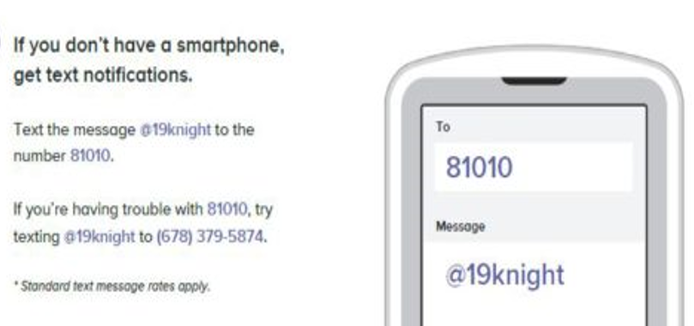
JOIN THE CLASS OF 2019 REMIND

Slide 39

SUMMATIVE CLASS ACTIVITY:
PUTTING THE TOOLS INTO ACTION

Slide 40


We are looking forward to a great year!

