Slide 1
Senior Blitz

Slide 2
WELCOME!
Fill out
The Senior Profile Required for letters of recommendation
Meet
Your counselor Are you on track for graduation?
Check out
The SAT/ACT Prep Class Opportunities
Important Reminders
REMIND 101 & Follow our social media
Tell us about your post-secondary plans

Slide 3
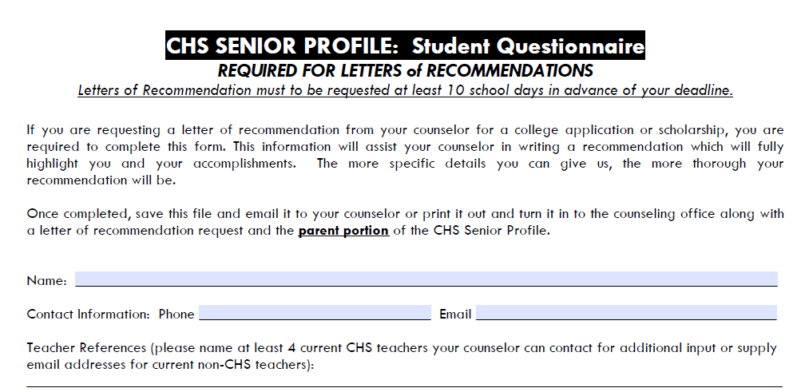
Senior Profile

Slide 4
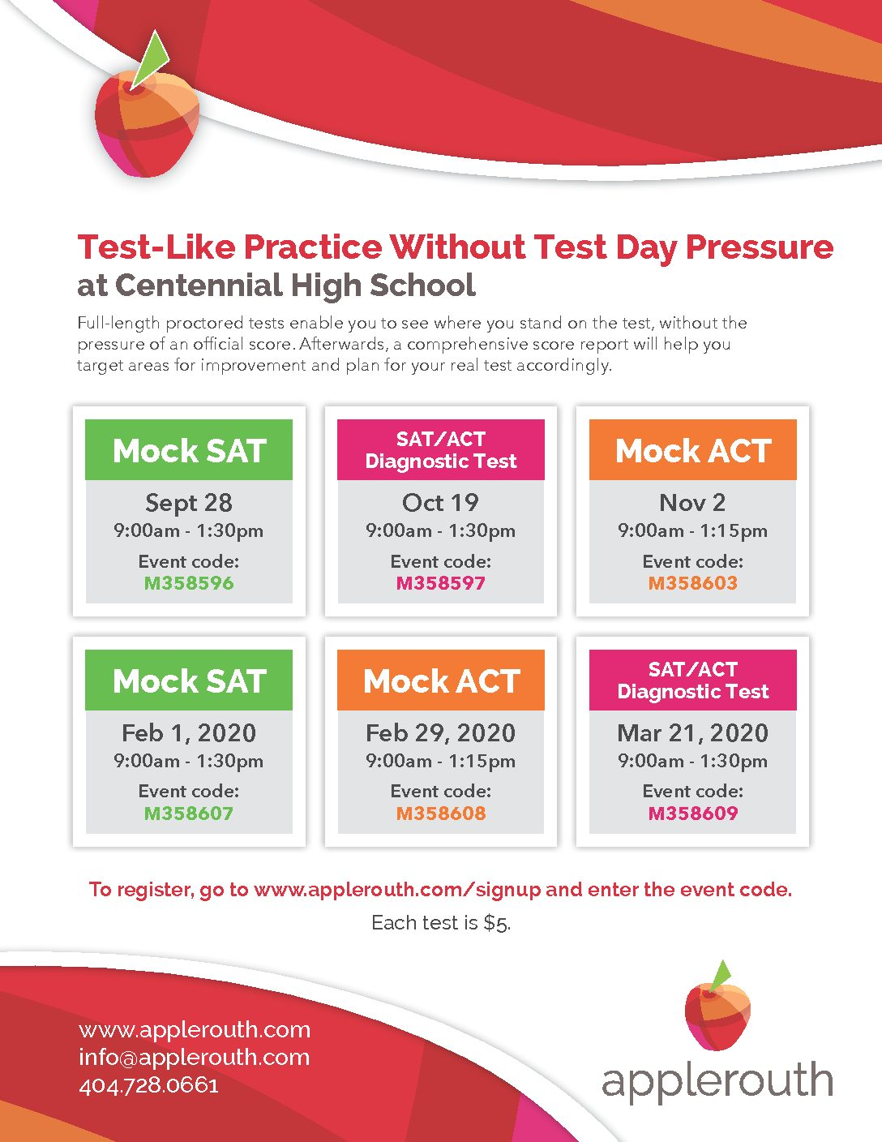
Sign up to take a Mock Test through AppleRouth! Come to the Counseling office to get a flyer & register.

Slide 5
Future Thinking
More information coming 9/18-9/20 in your English classes
post-secondary options
the college application process
scholarships/financial aid, etc.
This is simply a check-in!

Slide 6
GAFutures
Create a myfutures account and stay up-to-date on your hope gpa & required classes of rigor

Slide 7
Follow Us
@ Knights_scholar

Slide 8
2 minute survey: www.surveymonkey.com/r/LFD9NHZ Remind 1010 TEXT @2020chskni to 81010
Help Us help you

Slide 9
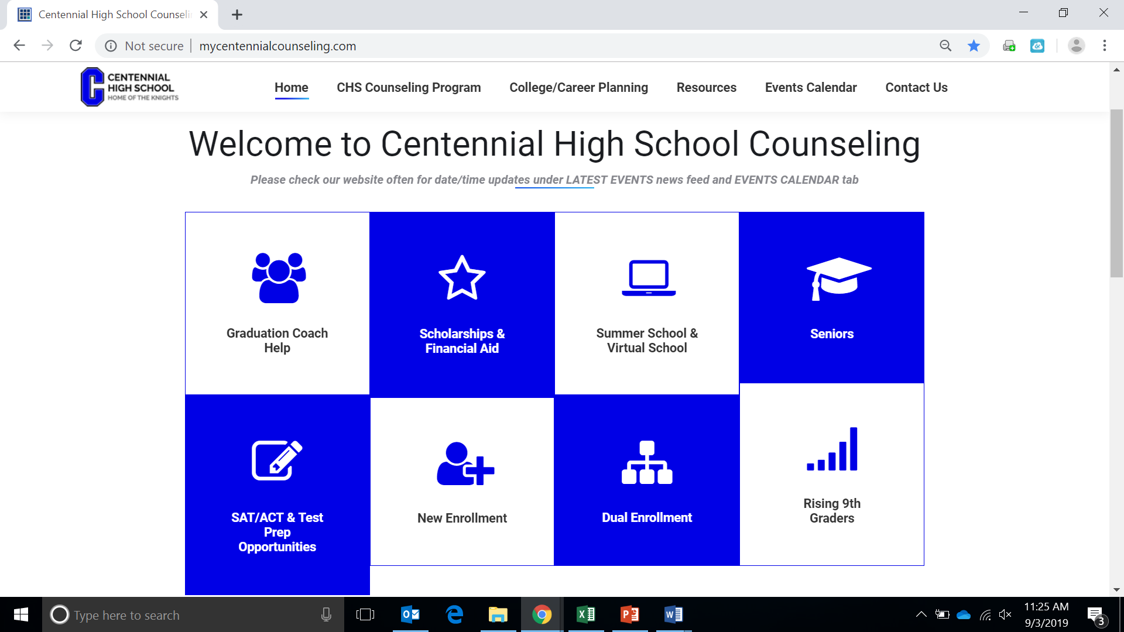
www.mycentennialcounseling.com/
Senior Take Away
Resources
SAT: kaptest.com/sat/test-dates
ACT: kaptest.com/act/test-dates
Scholarship info: Follow us on Twitter & Instagram @ Knights_scholar
Mock Test Through AppleRouth: applerouth.com/calendar/
GAFutures: gafutures.org/
Remind 101: TEXT @2020chskni to 81010
college visits: QR Code Needed
2 minute survey: www.surveymonkey.com/r/LFD9NHZ

