Slide 1

CareerWorx connects exceptional education to future careers. GTC is inviting the community to see their 140+ programs, academic and student services which lead to career pathways and rewarding jobs. CareerWorx will be hosted on Gwinnett Technical College’s Alpharetta-North Fulton campus Wednesday, September 18, 2019, 4 – 7 p.m.
This interactive event features all of Gwinnett Tech’s programs from Cybersecurity and Welding to Nursing and Business! This is a great event for families with 9th to 12th grade students, transfer students, and adults looking to enter or return to college. Guests can explore what their futures could look like through interactive activities and tours.

Slide 2

CLASS OF
2020
Senior parent meeting
CENTENNIAL HS COUNSELING

Slide 3
CENTENNIAL COUNSELING DEPARTMENT
A-Cas Mr. Jones
JonesW3@fultonschools.org
Cat-Harp
Ms. Ekpo EkpoN@fultonschools.org
Harq-Mep Mrs. Ruppe
Ruppe@fultonschools.org
Meq-Sal
Ms. Freeman freemanMA@fultonschools.org
Sam-Z Ms. Peart peart@fultonschools.org
Grad Coach
Mrs. Rigsbey
RigsbeyA@fultonschools.org

Slide 4
PARENT MEETING GOALS:
TO EQUIP YOU WITH THE INFORMATION & RESOURCES NECESSARY FOR YOU TO ASSIST YOUR STUDENT(S) THROUGH CAREER EXPLORATION, AND THE COLLEGE APPLICATION PROCESS
TO ANSWER SENIOR-RELATED QUESTIONS IN AN EFFORT TO ADDRESS SENIOR-RELATED FEARS &CONCERNS
TO PROVIDE TIPS FROM COLLEGE RECRUITERS ABOUT THE APPLICATION PROCESS AND WHAT PARENTS SHOULD KNOW

Slide 5

FEARS….
Most students and families have fears/concerns about the college application process
THE OUTCOME
AFFORDABILITY
APPLICATION TIMELINE

Slide 6
the Class of 2020 has received much instruction and many Resources to prepare them for senior year & their POST-SECONDARY PURSUITS
Sophomore Classroom Guidance (2 parts)
Junior Classroom Guidance (2 parts)
Junior One-on-One Advisement
Senior Guidance & Senior Blitz
Freshman Classroom Guidance (2 parts)

Slide 7

OVERCOMING THE FEARS ABOUT COLLEGE
ONE STEP AT A TIME
Identify the college/university of best fit
Complete & SUBMIT THE APPLICATION
REQUEST & SUBMIT A TRANSCRIPT/ letter of recommendation
Take & submit the SAT/ACT/ACCUPLACER
COMPLETE & SUBMIT ALL REQUIRED ESSAYS
Track Your Progress

Slide 8
Choosing a college
Step 1:

Slide 9






COLLEGE QUICK TIPS:
COLLEGE SELECTION
“Pay attention to the college environment and not your friends. Consider your options, not your friends’ options.”
“Be sure the student is paying attention to the campus opportunities: opportunities to lead, grow & develop. Help them plan a PLAN B.”
“Help plan student’s college visits. Make sure they are happy with their choice. Happiness effects grades & performance.”
“Visit the college.”
“Help your student self-assess ahead of time so that the student knows what they want from a college/university.”

Slide 10
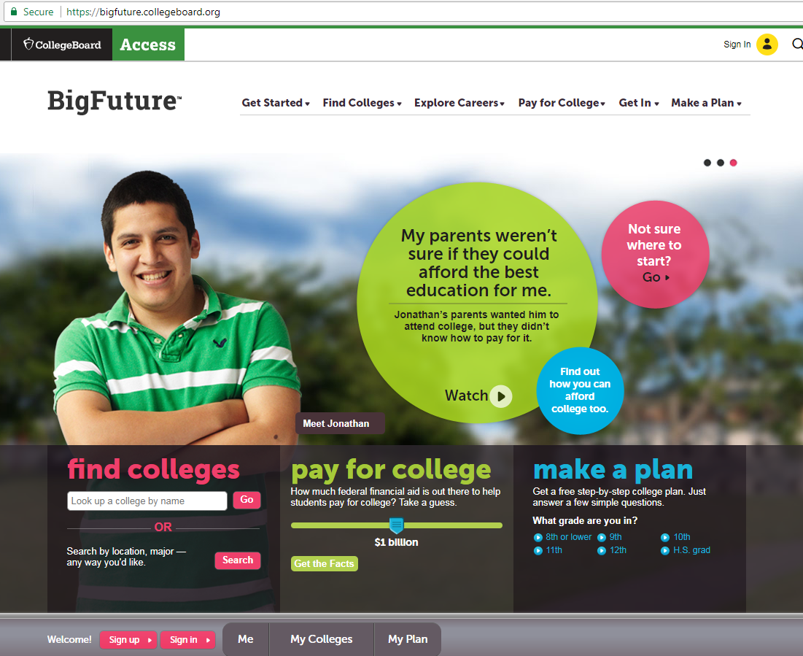
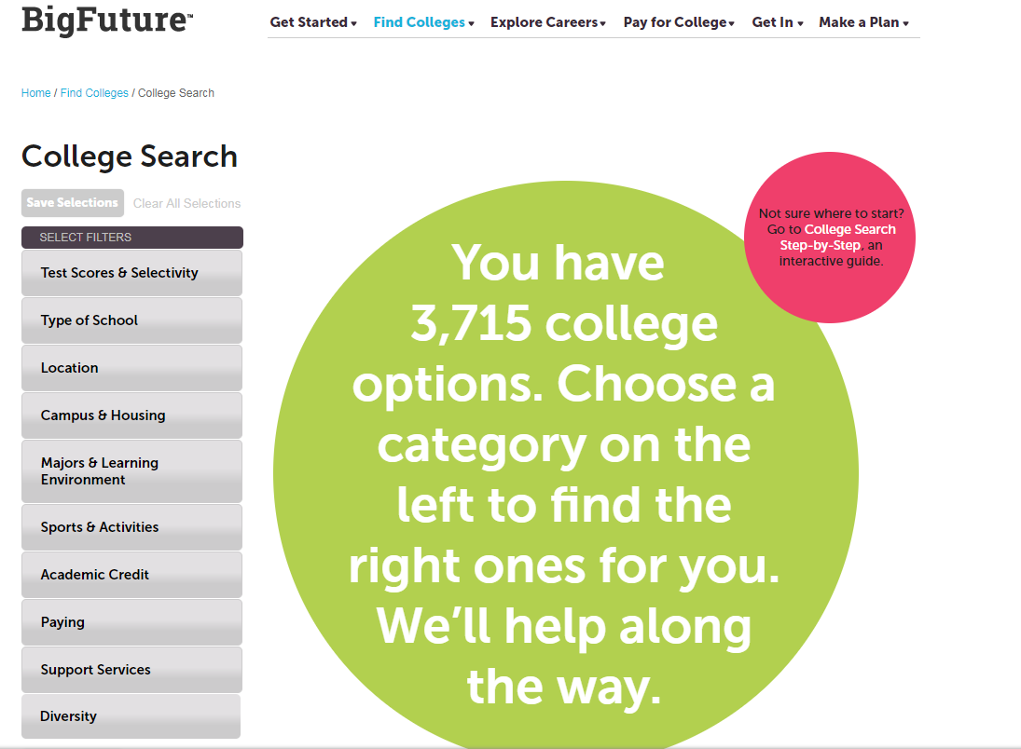
HELPFUL RESOURCE
https://bigfuture.collegeboard.org

Slide 11

UPCOMING COLLEGE FAIRS
SEPTEMBER 15, 2019
HARVARD/PRINCETON/YALE
Information Session (7:00pm- 8:30pm)
WALTON HIGH SCHOOL
REGISTRATION REQUIRED: HPUWY.com
SEPTEMBER 29, 2019
NACAC STEM FAIR (1pm - 4pm)
GEORGIA INSTITUTE OF TECHNOLOGY
REGISTRATION REQUIRED: www.gotomystemfair.com
OCTOBER 28, 2019
NACAC PERFORMING & VISUAL ARTS FAIR (7pm - 9pm)
Cobb Energy Performing Arts Center
REGISTRATION REQUIRED: www.gotomypvafair.com

Slide 12


Slide 13
Completing the application
Step 2:

Slide 14



COLLEGE QUICK TIPS:
THE APPLICATION
“Deadlines….pay attention!”
“Parents, make the student do the work.”
“Let the student go through the process; it teaches them self-advocacy.”
“Tell your student not to wait until the last minute; deadlines are hard.”

Slide 15
Meeting Your Deadline = ALL Required Documents have been Submitted
KNOW YOUR DEADLINES
Early Decision
Binding (Cannot Apply to Other Colleges)
Early Action
Not Binding
UGA and GA Tech
Regular Decision
Not Binding
Rolling Admissions
Review of application is ongoing
Kennesaw State; May deadline/notifications ongoing
Open Admissions
Review of application is ongoing
Deadlines and Notifications vary
UGA and Georgia Tech
Emory
If Deferred, student can reapply under Regular Decision

Slide 16

THE COLLEGE’S ADMISSION WEBPAGE
Create an account
Review & submit the required documents
Use the application status check
Parts of an application are not typically sent or received at the same time

Slide 17

COMPLETING THE APPLICATION
Preview the application so that you know what to have on hand
Have all info you need on hand
resume
Save your work as you go
Check Spelling and Grammar
list of school & community activities
contact info for letters of recommendations
family/parent history
SUBMIT!
Include Application Fee
GPA on a 100-point scale

Slide 18
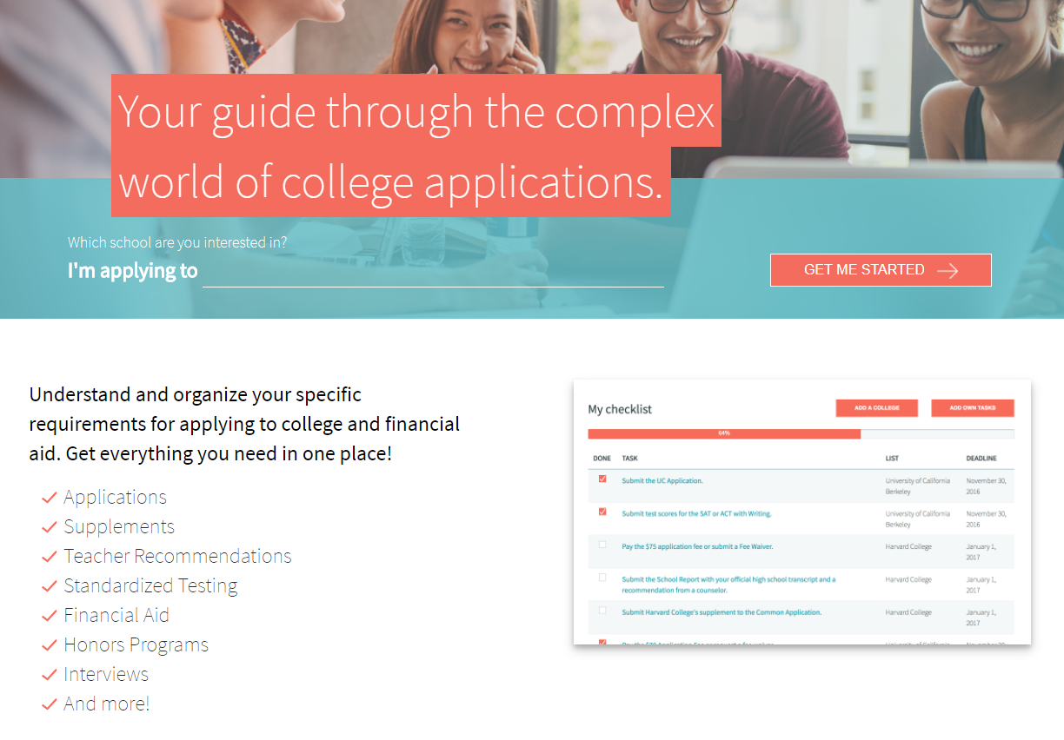
HELPFUL RESOURCE
http://www.makemeafreshman.com

Slide 19
Official Transcripts & Lor’s
Step 3:

Slide 20



COLLEGE QUICK TIPS:
THE APPLICATION
“Colleges don’t always recognize a super early college submission as demonstrated interest. There are better, and more effective ways to show demonstrated interest. ”
“College applications are like job applications; you can only submit them once! It is better to take your time and submit a thorough application than it is to try and beat the crowd of applicants within your same application pool.”
“We are more focused on student admissibility than we are focused on the order in which applications are received.”

Slide 21

REQUESTING TRANSCRIPTS
THE PROCESS
STEP ONE:
STUDENTS WILL PICK UP THEIR PARCHMENT REGISTRATION INFORMATION FROM THE COUNSELING OFFICE ON SEPTEMBER 20, 2019
STEP TWO:
STUDENTS WILL ENTER THE PARCHMENT WEBSITE VIA www.Parchment.com
STEP THREE:
STUDENTS WILL FOLLOW THE SCREEN INSTRUCTIONS FOR ACCOUNT REGISTRATION AND TRANSCRIPT RELEASE

Slide 22
REQUESTING TRANSCRIPTS & LORs
TRANSCRIPTS | LORs
All transcript releases will occur through PARCHMENT. | If the college/university requires a COUNSELOR letter of recommendation, enter the counselor’s name & e-mail address, in the online college application, where counselor information is requested. If a TEACHER letter of recommendation is required, enter the teacher’s name & e-mail address in the application where requested.
 | Complete the SENIOR PROFILE . E-mail/hand-deliver the form to the counselor directly.
Students should track the delivery of their transcript and/or LORs, through their college account, to ensure that they have been received by the college/university.

Slide 23
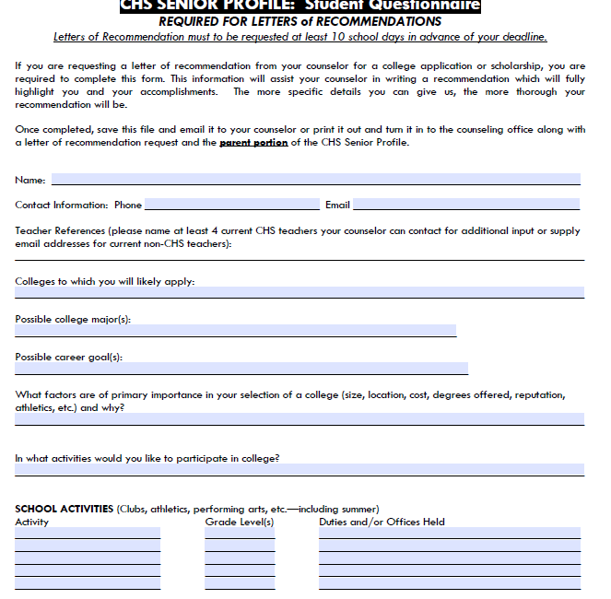
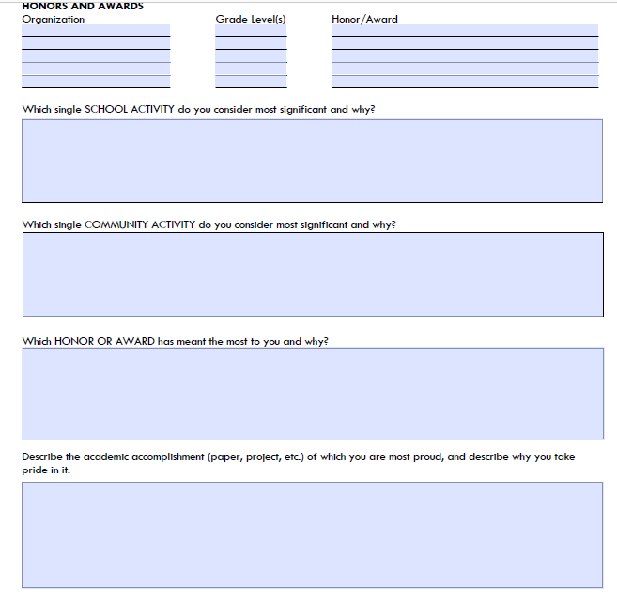
SENIOR PROFILE FORM
www.mycentennialcounseling.com

Slide 24

What colleges want in a letter of rec
Classroom Contributions
Interest in Learning
Academic Achievement
Personal Challenges/ Hardships
Personal Anecdotes
Impact on School
Leadership Ability
Interests Outside School
You
Painting a Complete Picture
of YOUR STUDENT

Slide 25

OTHER RECOMMENDATION WRITERS
Teachers, Coaches/Club Sponsors, Mentors, Administrators, etc. may serve as recommenders
Ask the recommender for permission to use them as a recommender
Provide the recommender a copy of your senior profile
Provide a MINIMUM notice of 10 School Days
Enter your recommender’s name & e-mail address into the online application
If the college does not require a letter of recommendation, they will not typically accept or review any letters submitted.

Slide 26
Entrance exams
Step 4:

Slide 27


COLLEGE QUICK TIPS:
ENTRANCE EXAMS
“Test early and shoot for SCHOLARSHIP scores, not just admission scores.”
“Test early for early application and scholarship opportunities.”

Slide 28

ENTRANCE EXAMS:
SAT, ACT & ACCUPLACER
SAT (www.collegeboard.org) and ACT (www.actstudent.org)
Register for the test (select a date and location, upload a picture, and make the payment)
Receive test scores
Send scores to selected colleges (before and/or after exam)
Create your account
ACCUPLACER TEST
Placement test accepted at most 2-year colleges
Colleges proctor this exam on their campuses

Slide 29

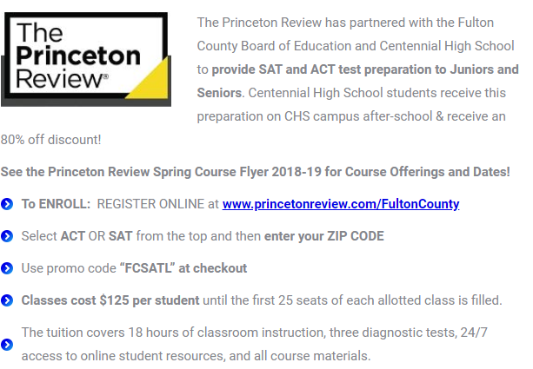
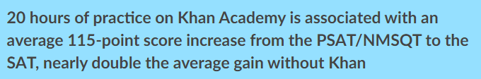

SAT/ACT PREP

Slide 30

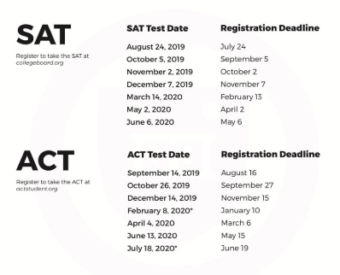
I HAVEN’T TESTED YET…CAN I STILL APPLY?
REGISTER FOR ONE OF THE UPCOMING TESTS:
YES
NO
Applications are incomplete until EVERYTHING has been received by the college, INCLUDING TEST SCORES

Slide 31
The Essay
Step 5:

Slide 32

The College Application Essay
Tips
Select the Best Topic & Subject for you
Answer the Question
Accentuate the Positive
Research the College Before Writing the Essay
Invest in a Strong Intro
Mistakes
Don’t Exceed the Requested Essay Length
Don’t Rely on Your Computer’s Spell Check
Don’t Rehash the Resume
Don’t Overuse the Thesaurus
Don’t Wait until the Last Minute

Slide 33
WHAT IS YOUR NEXT STEP…
Help your student FINALIZE their list of colleges
College Campus Visits
College Fairs
Assist your student with the COLLEGE APPLICATION
Review the College Application Checklist for each college
Help your student outline a timeline for the completion of each required component
Use the college’s Status Check feature to follow up on submitted/outstanding application items
College Websites
REVIEW FINANCIAL AID OPTIONS & OPPORTUNITIES
Complete the FAFSA (starting in October)
www.finaid.org has a lot of great information regarding financial aid options
FINANCIAL AID NIGHT: NOV. 20, 2019 @ 6:00 PM in the CHS AUDITORIUM
Counselors will be entering senior classrooms again in January for a Financial Aid lesson on scholarships, loans and grants.

Slide 34

SENIOR SERVICE SCHOLARSHIPS (PTSA)
There will be two information sessions for students who are interested in applying for PTSA scholarships. These sessions typically occur in January and will answer questions regarding the application process. The PTSA will review applications and will determine 3-6
applicants to honor with scholarships.

Slide 35
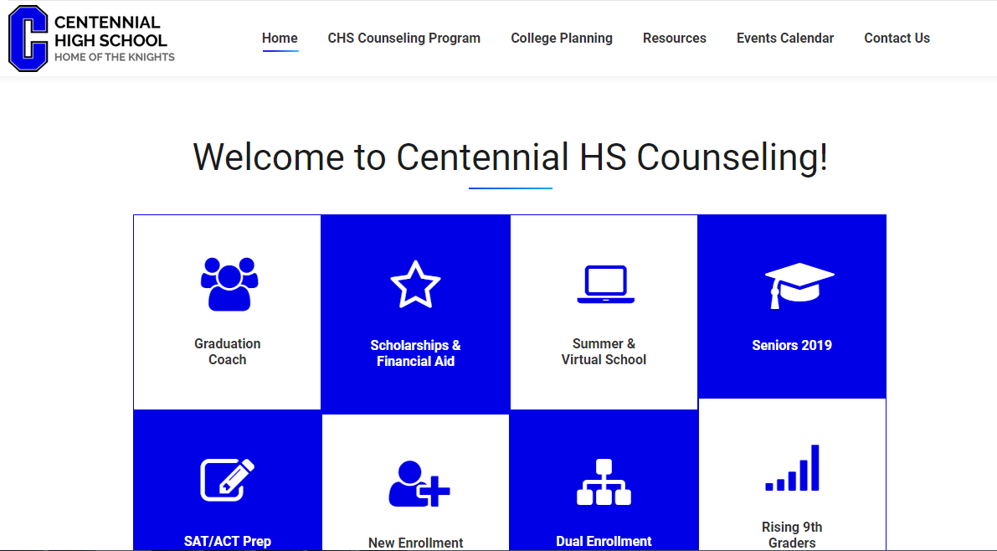


www.mycentennialcounseling.com

Slide 36


2019 COLLEGE/CAREER MONTH
OCTOBER 2019
Centennial’s Apply to College Day
Thursday, October 24, 2019
All Senior English Classes
COLLEGE/CAREER-FOCUSED FRIDAYS will occur throughout the month

Slide 37
JOIN THE CLASS OF 2020 REMIND & GOOGLE CLASS
JOIN Counseling Remind 101 for Class 2020 – Text @2020CHSkni to 810-10 to get important senior updates from the Counseling office on your phone!
Join Senior Class Google Classroom –
Use Class Code: mcyffn to get information on Senior Treats, Senior Week, Graduation & more

Slide 38



COLLEGE QUICK TIPS:
GENERAL ADVICE
“Encourage students to read each application carefully as the answers to their questions will most likely be in the application.”
“Talk to your college admissions counselor. We are your most underutilized resource.”
“Students are always encouraged to ASK if they do not understand something about the application process – we are here to aid them in that!”

Slide 39


We are looking forward to a great year!

Slide 40

https://www.surveymonkey.com/r/20ParentMtg

