Slide 1
Agenda & Feedback Forms
Grab an agenda packet and feedback form from one of the carts – 1 packet per family, please!
After the presentation,
please complete the feedback form
Turn in your feedback form to one of the crates
as you leave
Thank you!

Slide 2
Rising Freshman Parent Night
Class of 2022

Slide 3

Agenda
Kibbey Crumbley, Principal
Ms. Jennifer Lee & Ms. Amy Hastings, PTSA Co-Presidents
Heidi Graver, School Counselor
CHS Teachers: AP Human Geography,
Honors Science, Accelerated Math, TAG
Program, IB Program, CTAE Department,
Band/Music Department
Jeff Burch, Athletic Director
Caroline Miley, Assistant Principal
Tonight’s PowerPoint will be posted on CHS’s counseling website under Events Calendar -‘Parent Nights’:
www.MyCentennial Counseling.com

Slide 4
Welcome to Centennial High School!
Holcomb Bridge Middle School
Haynes Bridge Middle School
Private Schools
Home Schools
Fulton County Non-Feeder Schools
Non-Fulton County Public Schools

Slide 5
Centennial High School PTSA
Welcome Parents
of the
Class of 2022

Slide 6
Some Current Programs:
  Mini grants
  Teacher appreciation
  Mock SAT/ACT
  Accident Avoidance Workshop
  Red Ribbon Week
  Senior Treats
  Student Council Liaisons for each class
  Front Office/Learning Commons Volunteers

Slide 7
Communications
eNewsletter emailed to parents monthly
Special edition for incoming freshman parents in July
Website: www.centptsa.org
Facebook:
Centennial High School – Home of the Knights
  Twitter: @GoCHSKNIGHTS

Slide 8
Ways to Contribute
Join CHS PTSA
Add Centennial PTSA to your Publix card
Volunteer to help out weekly, monthly or annually

Slide 9
Membership Information
Watch for email over the summer
Join early to secure a top locker

Slide 10


Want a SNEAK PEEK into life at Centennial High School?
Visit centptsa.org
Press this button
Register to receive the monthly eNews – the #1 news source at CHS!

Slide 11
Class of 2022
Be Informed
Be Engaged
Be PTSA

Slide 12


Coach Jeff Burch, Athletic Director
Centennial’s Personal Fitness Exemption
Exempt Personal Fitness through participation in 1 of 3 possible CHS activities:
● Athletics/Fencing  Marching Band  JROTC
Once criteria has been met, student will pick up a Personal Fitness Exemption form in the Centennial High School Assistant Principal’s Office.
Exemption Form requires a signature from the designated school staff for their activity verifying the student completed the participation criteria.
Intent to Exempt Contract: In 8th Grade, students indicate their plan to exempt on the back of their elective sheet. Those students will not be scheduled for Personal Fitness course in grades 9-11.
Deadline to meet criteria and submit completed Exemption Form to the CHS Assistant Principal’s Office: Last Day of School Junior Year

Slide 13

Curriculum FAQs
Counseling Department Programs,
Credits and Graduation Requirements
Heidi Graver,
School Counselor

Slide 14
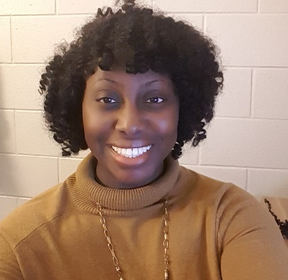
2017-18 Counseling Dept. Staff
Zyer Beaty
Head Counselor A - Cas
Nsikan Ekpo
Cat - Harp
Heidi Graver
Harq - Mep

Slide 15
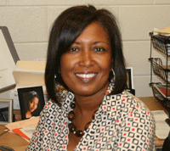
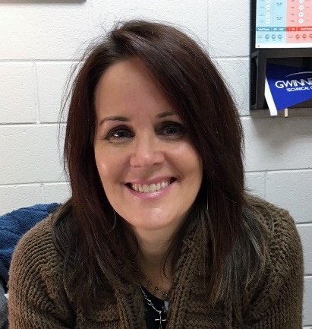
2017-18 Counseling Dept. Staff
Melissa Freeman
Meq - Sal
Hella Peart
Sam - Z
Anne Rigsbey
Graduation Coach

Slide 16
Centennial Counseling Curriculum
9th Grade
10th Grade
11th Grade
4-Year Academic Plan (Lesson)
Signs of Suicide
Intro to Counseling Services & Goal Setting (Lesson)
Cyber-Safety (Lesson)
College Admissions Criteria (Lesson)
12th Grade
College Application Process (Lesson)
Junior Advisement
Georgia “Apply to College Day”
Spring Parent Night
Fall Parent Night
10th Grade BRIDGE Benchmark Activity: Dual Enrollment Opportunities
PSAT Score Interpretation; Online Resources for College Searches (Lesson)
Senior Blitz – Graduation Status Checks
Finding the Right College Fit (Lesson)
11th Grade BRIDGE Benchmark Activity: Virtual College Search
Fall Parent Night
12th Grade BRIDGE Benchmark Activity: Documenting Post-Secondary Plans
Scholarships and Financial Aid (Lesson)
Fall and Spring Parent Nights
9th Grade BRIDGE Benchmark Activity: Career Interest Inventory

Slide 17
Counseling Program Resources
ALL NEW Website
www.MyCentennialCounseling.com
Scholarship Information
College Representative Visits
SAT/ACT Test-Prep Opportunities
Credit Recovery/Virtual Learning
Consultations & Collaboration

Slide 18
Graduation Requirements
Students must earn a total of 23 credits:
4 English
4 Mathematics
4 Science
3 Social Studies
1 Health/Physical Education
3 “Pathway” Credits: CTAE and/or World Language and/or Fine Arts
4 additional elective credits
CHS Counselors deliver classroom guidance lessons and supplementary parent nights to support students in meeting these requirements.

Slide 19
General Grading Policies
Interim progress reports will be issued to students at the 6 week and 12 week progress marks.
A = 90 or higher
B = 80-89
C = 70-79
F = 69 or below
Grade Level Placement:
Freshmen = Less than 5 credits
Sophomore = 5 – 10.5 credits
Junior = 11 – 16.5 credits
Senior = 17 or more credits
Honors, AP, and college courses receive an additional 7 points added to the final passing grade.
Fulton County Grading Scale:

Slide 20
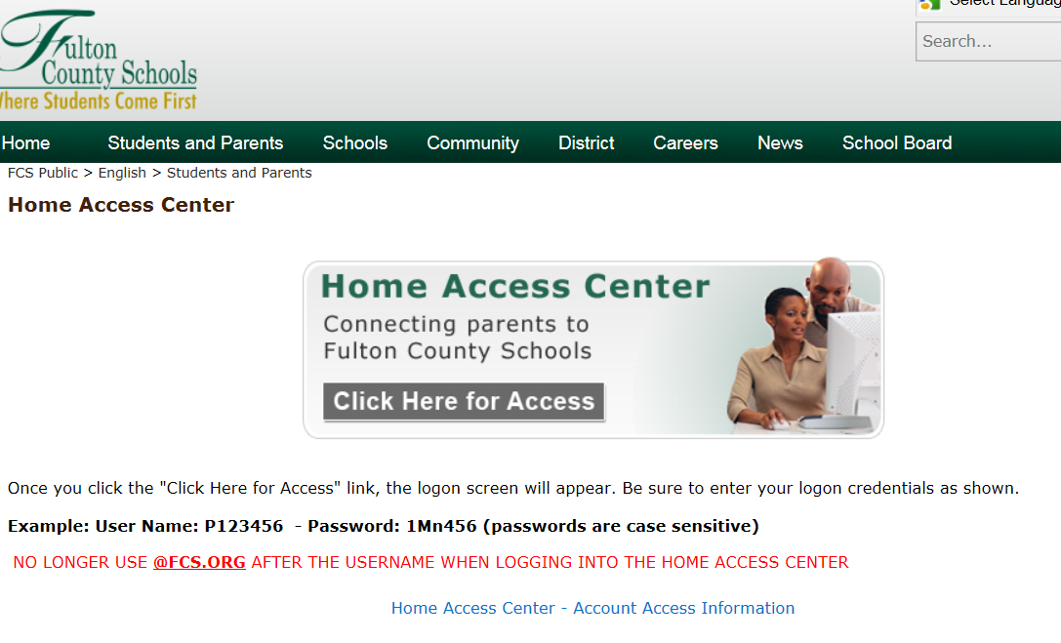
Home Access Center (HAC):
Track assignments, grades, attendance, discipline, etc. during the semester.
Available at www.fultonschools.org under “Students and Parents” Tab – Drop down Menu to “Home Access”

Slide 21
Rising 9th graders: How do they get their courses
Caroline Miley, Assistant Principal
How are Academic courses chosen?
How are elective courses chosen?
What is the process?
Verification Forms – what are they?

Slide 22
Tentative Timeline for Rising 9th grade Courses
01/30 – Holcomb Bridge students visit
01/31 – Haynes Bridge students visit
02/05 – Mrs. Miley and Ms. Graver go to Haynes Bridge
Week of 02/20 – 1st round of Verifications will go home with students
Week 03/01 – 2nd round of Verifications will go home with students
Week of 03/16 – 3rd round of verifications will go home with students

Slide 23
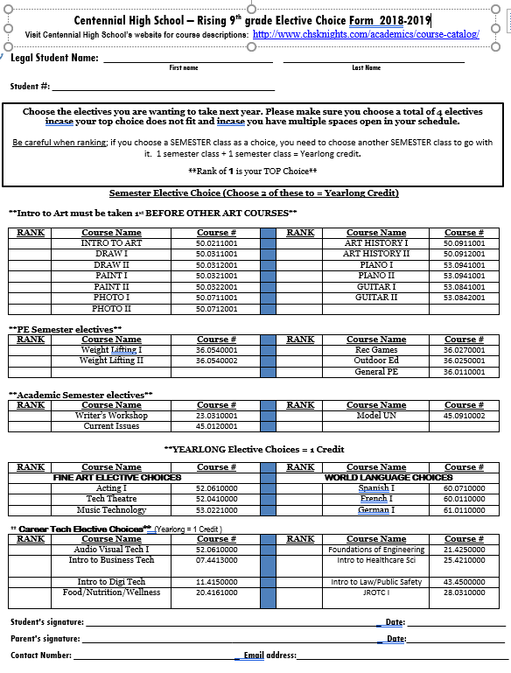
Elective Form Sample

Slide 24


Choosing Your Electives
Review list of available 9th Grade elective options
Use CHS Course Catalog (online) to read the course description of the classes of interest
Choose at least 4 electives
Rank your elective choices on your elective form in order of preference (#1 for top choice, #2 for next choice, etc.)
Changes may be made within the designated registration period (Spring 2018).

Slide 25
Parent Questions & Concerns: Who Is Your Best Point of Contact?
Thru Spring Registration Period & End of the 2017-18 School Year
Academic Recommendations & Placement for 9th Grade: Current 8th Grade Teacher(s) or Middle School Counselor
Course Selection, Options and Scheduling:
Current Middle School Counselor
Questions and/or Concerns after contact has been initiated and made with the teacher: Assigned CHS Administrator
Grades, Assignments, Course Content, Academic Placement, Classroom Consequences, etc: The Classroom Teacher
Coordinating a Conference with All of Your Student’s Teachers: Assigned Centennial HS Counselor
After the 2017-18 School Year has Ended and Beyond
Class Schedules, Academic, Social/Emotional, College/Career Support & Planning: Assigned Centennial HS Counselor
Students with IEPs or served through ESOL: Student’s Assigned Caseload Manager (Teacher)

Slide 26
Guest Speakers from Departments at Centennial High!
Talented and Gifted (TAG):
AP Human Geography:
International Baccalaureate (IB):
CTAE Pathways:
Becky Hostler
Bob Kuhn
Math Pathways (Accelerated):
Honors Biology:
Marchele Nelson
Pam Bullard
Marie Robinson
Music Department/Band:
Tyler Ehrlich
Karina Bennie
Benniek@fultonschools.org
Hostler@fultonschools.org
Kuhn@fultonschools.org
Bullardp@fultonschools.org
NelsonML@fultonschools.org
RobinsonMM@fultonschools.org
EhrlichTL@fultonschools.org

Slide 27
Career and Technical Education
Program Area
Audio-Video Technology and Film | ​Audio and Video Technology and Film Audio-Video Technology and Film II Audio-Video Technology and Film III
Engineering | Foundations of Engineering and Technology Engineering Concepts Engineering Applications
Law and Justice | Introduction to Law, Public Safety, Corrections and Security Criminal Justice Essentials Forensic Science and Criminal Investigations
Program Areas

Slide 28
Career and Technical Education
Program Area
Family and Consumer Science | ​Nutrition and Food Science Food, Nutrition, and Wellness ~Food for Life ~Food Science
Healthcare Science ~4th Science Credit | Therapeutic Services/ Emergency Medical Responder Introduction to Healthcare Science ~Essentials of Healthcare Emergency Medical Responder Therapeutic Services/ Allied Health and Medicine Introduction to Healthcare Science ~Essentials of Healthcare Allied Health and Medicine
JROTC | JROTC I JROTC II JROTC III
Program Areas

Slide 29
Career and Technical Education
Program Area
Business and Computer Science ~4th Science Credit | Financial Services Introduction to Business and Technology Financial Literacy Banking, Investing, & Insurance Programming Introduction to Digital Technology/ ~Computer Science Principles or ~AP Computer Science Principles ~Programming, Games, Apps and Society Computer Science Introduction to Digital Technology/ ~Computer Science Principles ~AP Computer Science Principles ~AP Computer Science *Merged Courses
Program Areas

Slide 30

Moving Forward…
Rising Freshman Enrollment Dates
(Non-Feeder ONLY):
PowerPoint from this program is available on www.MyCentennialCounseling.com under Events Calendar Parent Nights
Check www.CHSKNIGHTS.COM website for information regarding the summer “Knights Camp” and Orientation.
Please complete and return the feedback form. THANK YOU!

