Slide 1


Sophomore/Junior
Parent Night
Classes 2022 & 2021
Tuesday, November 12, 2019
Chs counseling department &
APPLEROUTH TUTORING SERVICES
www.mycentennialcounseling.com
WWW.APPLEROUTH.COM

Slide 2
Agenda
PTSA UPDATES
CHS INFO
  Mrs. Heidi Ruppe and Ms. Hella Peart
COLLEGE ADMISSION PROCESS
  Katie Rose De-Laet
QUESTIONS AND REMARKS
FEEDBACK FORMS

Slide 3
CENTENNIAL COUNSELING
A-Cas Mr. Jones
JonesW3@fultonschools.org
Cat-Harp
Ms. Ekpo EkpoN@fultonschools.org
Harq-Mep Mrs. Ruppe Ruppe@fultonschools.org
Meq-Sal Ms. Freeman
FreemanMA@fultonschools.org
Sam-Z
Ms. Peart Peart@fultonschools.org
Grad Coach Mrs. Rigsbey RigsbeyA@fultonschools.org

Slide 4
www.mycentennialcounseling.com
College Planning
Meeting With College Representatives
Representative Visits to CHS
College Fairs
College Campus Visits
SAT and ACT Prep Opportunities
Scholarships and Financial Aid
Quick Links

Slide 5
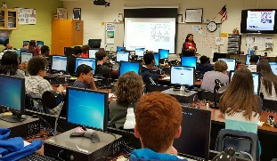

October
2019
Military Panel
College Fair
How to Prep for the SAT
Career Fair
Historically Black College & University Panel
College & Career Month at Centennial HS
Students registered to attend up to 3 sessions
Students registered for their selected sessions via online link
Remind 101
Principal’s Newsletter
Counseling Website

Slide 6
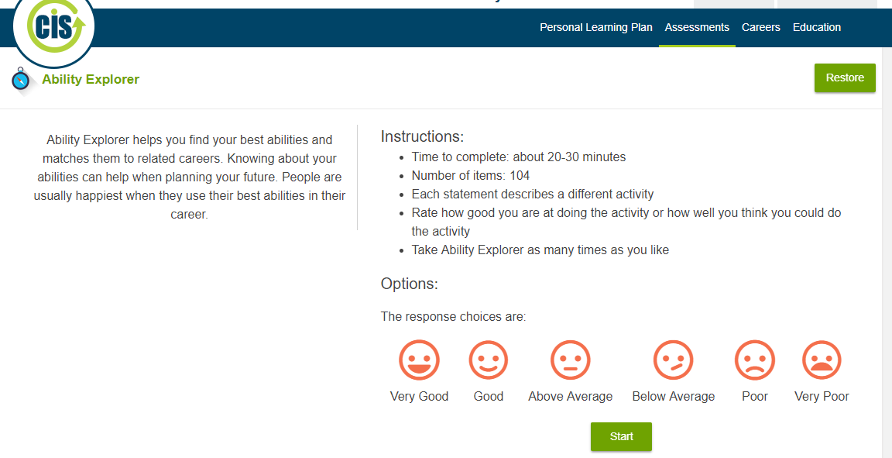
10th Grade Guidance Lesson
GCIS Ability Explorer
Gives students opportunities
to explore their career options
that match their abilities and
Interests
Helps to promote post-secondary
thinking and goal-setting;
choosing high school courses

Slide 7
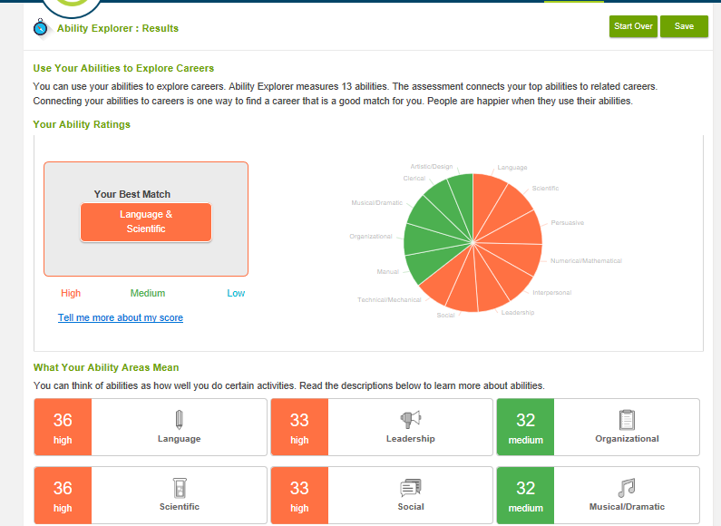

Slide 8
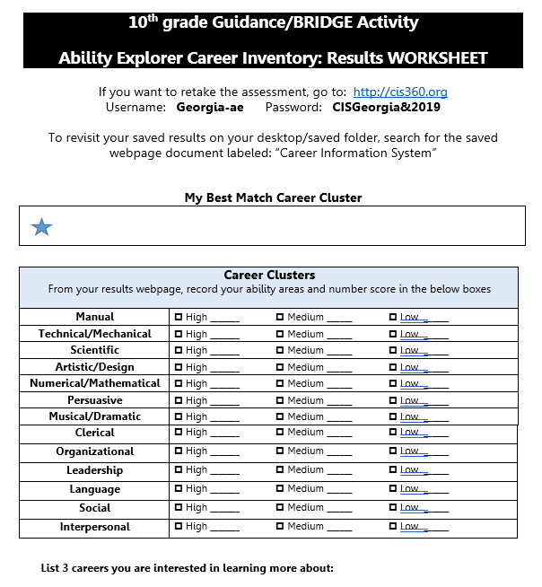
Your 10th grader will come home with a results worksheet highlighting areas of interests for exploring careers

Slide 9
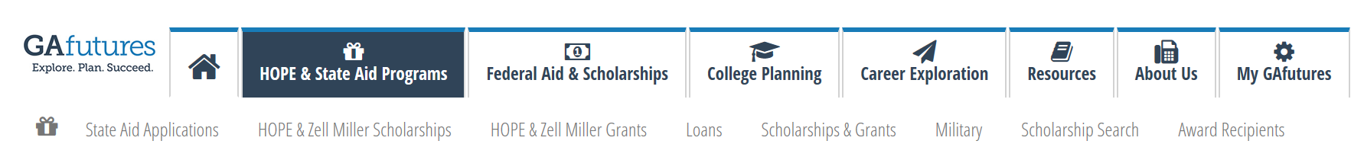
Planning for College -
GAFutures is a great place to start! ☺
www.GAfutures.org
Check your HOPE G.P.A.
Updated semesterly
Student should create their account to keep track of 4 courses of rigor and their HOPE unweighted G.P.A.
Find Scholarships
Information about completing the FAFSA (Free Application for Financial Student Aid)

Slide 10
Graduation Requirements For
Fulton County Schools
Subject Area | Required # of Credits
Language Arts | 4 credits
Math | 4 credits
Science | 4 credits
Social Studies | 3 credits
Health Personal Fitness | .5 credit .5 credit
Pathway Courses | 3 credits
Electives | 4 credits
 | 23 total credits

Slide 11
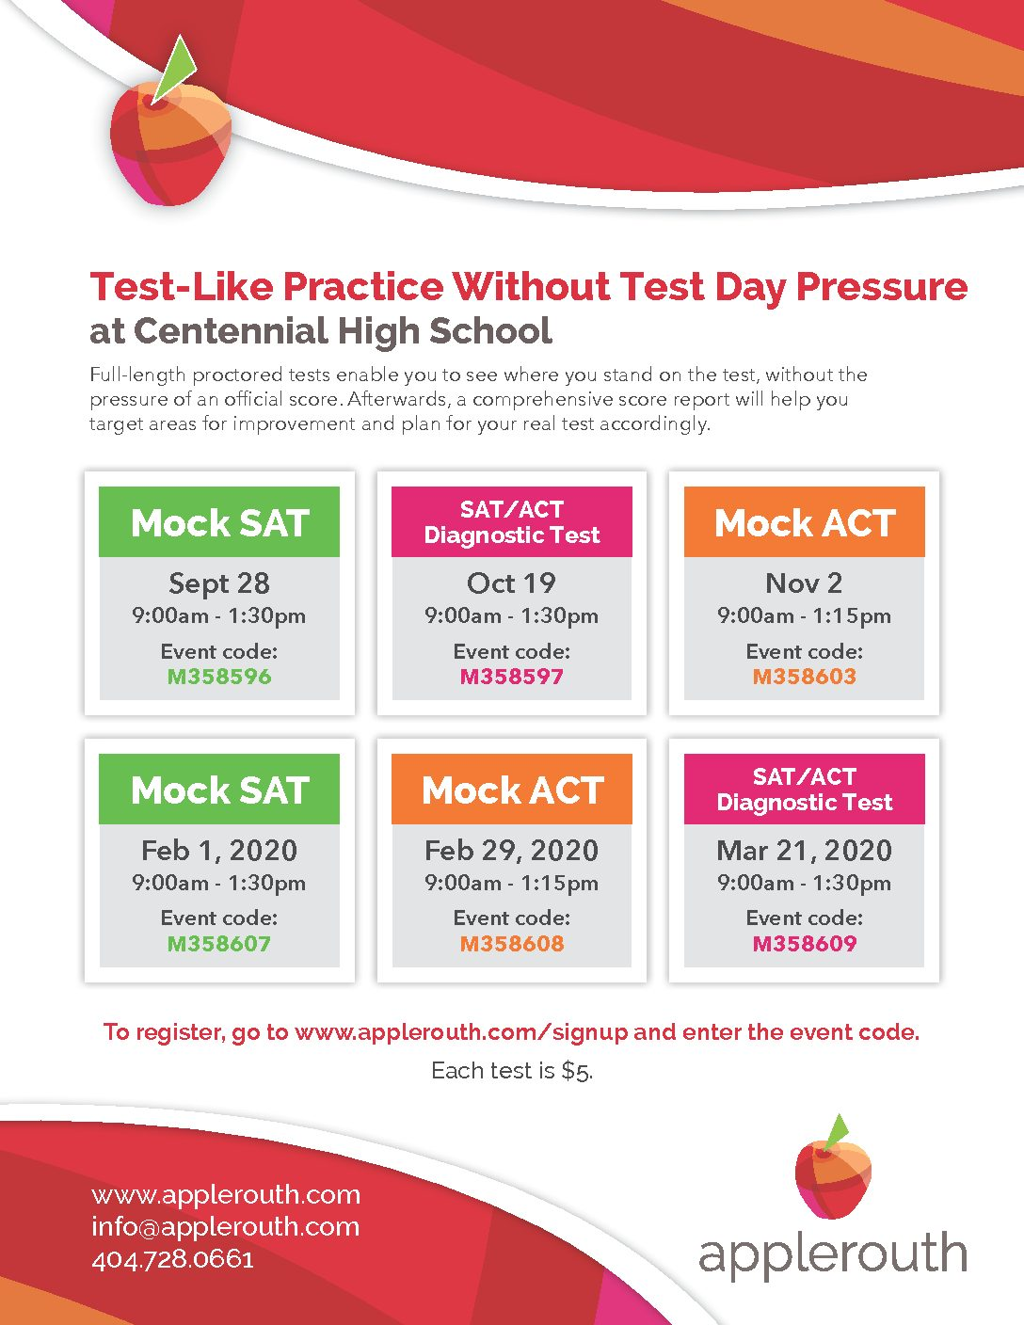
Take a MOCK test –
REAL test without an official score!
Only $5

Slide 12
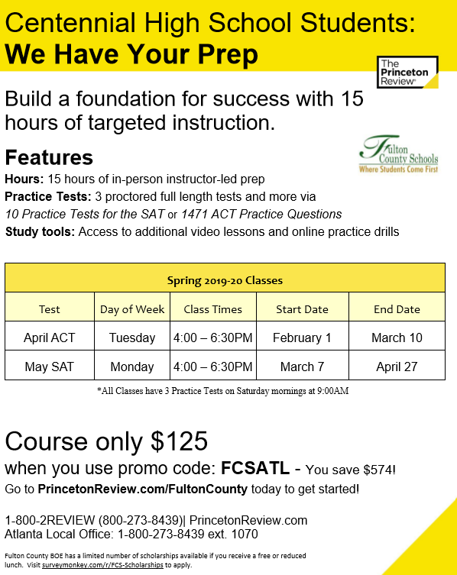
DON’T FORGET TO PREPARE!
SAT AND ACT PREP CLASSES AT CHS AFTER SCHOOL!

Slide 13
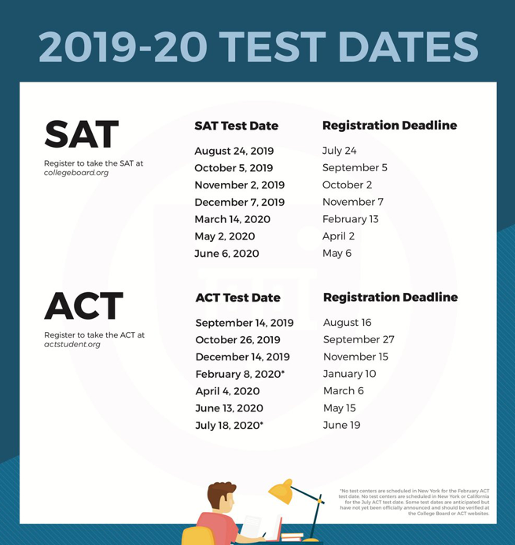
SAT/ACT DATES
.
*Students eligible for fee waivers due to financial hardship can see their counselors

Slide 14
Junior Classroom Guidance Part I
Important Events and Dates for Juniors
What Colleges Look for in Applicants
What Selectivity Means for You
Match, Reach Safety Schools
ACT and SAT exams
College Planning Tips:
College Planning Checklist for Juniors

Slide 15

What Factors are Colleges Considering?
College Admission Activity

Slide 16
CHS Counseling Junior Curriculum
Fall 2019 (Nov 19 ) Topic: College Admission Factors What are colleges looking for?
Classroom Guidance Lessons
Winter 2020 (Jan 31-Feb 2) Topic: Finding the Perfect Fit What factors students should consider to find the best college?
What am I looking for?

Slide 17
CHS Counseling Junior Advisement
Meet with your School Counselor for your Junior Advisement Meeting
November 2019 – March 2020

Slide 18
Important Dates For Students Interested in AP Courses for 2020-21
Advanced Placement (AP) Night
Time TBD

Slide 19
FINANCIAL AID
NIGHT
Wednesday,
November 20, 2019
6:00 PM
Auditorium

Slide 20


Follow Our Social Media Pages!!
Scholarship Opportunities
Counseling Office Updates
Events

Slide 21

Please join REMIND101 to receive important communications from our counseling office!
Text: 81010
In the message box:
      For class of 2021: @chs2021a
      For class of 2022: @6a4aka3

Slide 22

Welcome Applerouth!

Slide 23
  College Admissions Testing for 10th and 11th Grades
Katie Rose-De Laet
Centennial High School
November 12th, 2019

Slide 24

QUESTIONS?

Slide 25
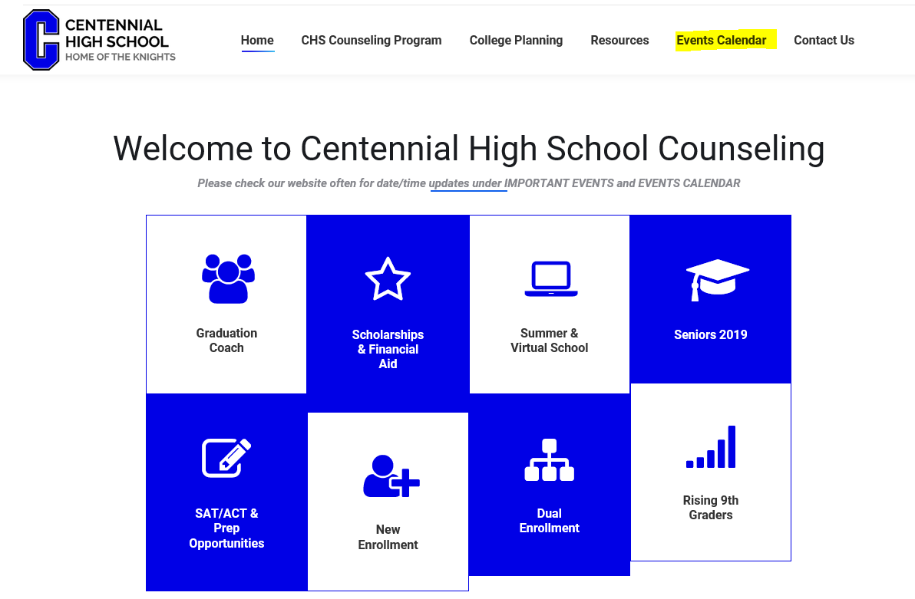
Thank you for attending!
***Don’t forget to turn in your feedback form***
This presentation and other important information is available on our website:
www.mycentennialcounseling.com

