Slide 1


Junior Classroom Guidance: Choosing The Perfect College!
Centennial High School
Counseling Department
March 19, 2020
www.mycentennialcounseling.com

Slide 2
CENTENNIAL COUNSELING
A-Cas Mr. Jones
JonesW3@fultonschools.org
Cat-Harp
Ms. Ekpo EkpoN@fultonschools.org
Harq-Mep Mrs. Ruppe Ruppe@fultonschools.org
Meq-Sal Ms. Freeman
FreemanMA@fultonschools.org
Sam-Z
Ms. Peart Peart@fultonschools.org
Grad Coach Mrs. Rigsbey RigsbeyA@fultonschools.org

Slide 3
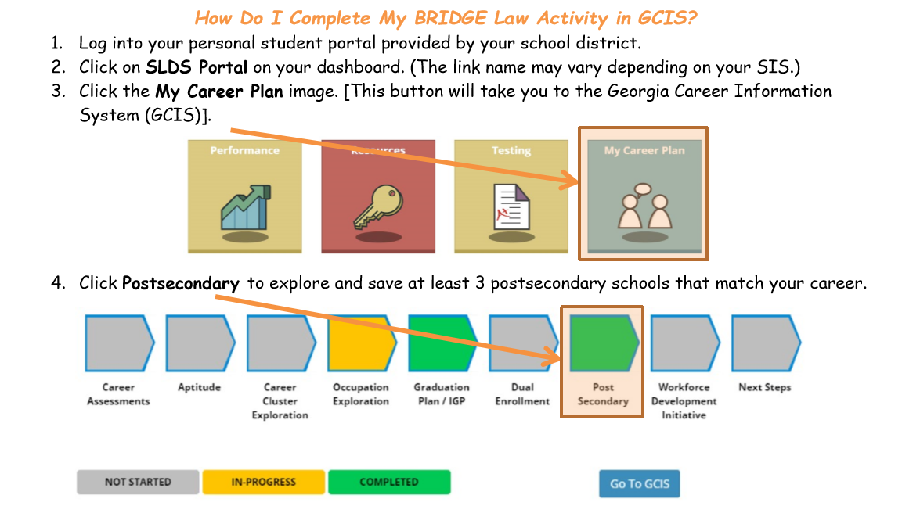
College Searches
Go to Infinitecampus.com or use the app - dashboard and CLICK ON MORE

Slide 4
CHS Counseling Junior Advisement
Meet with your School Counselor for Junior Advisement Conferences November – March

Slide 5
If you were to choose a college today, which one would you choose, and why?

Slide 6
Two Year Technical College
Description | Tuition & Fees | Admission Requirements
Degrees offered: Associates, Certificate, Diploma Provides: Classes and degrees directly aligned with a particular career or job field. GA Technical College System - 99.3% placement rate within 6 months of student graduation. | Approximately $5,600 per year for full-time enrollment (Gwinnett Technical College) | High School Diploma ACCUPLACER typically required SAT / ACT optional

Slide 7
Two Year Junior College
Description | Tuition & Fees | Admission Requirements
Degrees offered: Associates Provides: A cost-effective option to start taking general college classes which could be applied towards a 4 year degree at a college or university Typically have student transfer agreements with four year colleges. | Approximately $6000 per year for full-time enrollment (GA State University at Perimeter College) | High School Diploma GPA may be evaluated (2.0 GPA minimum for GPC) SAT / ACT or other admission test may be required

Slide 8
4-Year Colleges & Universities
Description | Tuition & Fees | Admission Requirements
Degrees offered: Bachelors, Masters and/or Doctoral Provides: A well-rounded college experience. Typically have large selection of course offerings in variety of majors and programs of study | Public (In-State) Average cost: $10,230/year (does not include room/board) Public (Out-of State) Average cost: $26,290/year (does not include room/board) Private Average cost: $35,830/year (does not include room/board) | College Preparatory Curriculum GPA SAT / ACT Essay Extracurricular Activities Letters Of Recommendation

Slide 9
Admission to “Selective” Colleges
Just as colleges search for the best “student fit”, students should search for the best “college fit.”
Students should consider several factors in deciding the best college for them.

Slide 10
Ranking Sheet
Majors / Programs of Study Offered _____
Size _____
Location _____
Social Appeal _____
Residential Appeal _____
Diversity of Students and Professors _____
Reputation _____
Cost _____

Slide 11

Choosing Your
College Priorities
What is important to you?
Majors/Programs of Study Offered
Size
Location
Cost
Social Appeal
Residential Appeal
Diversity of Students & Professors
Reputation

Slide 12
About Admission Tests
SAT
  Length is 3 hours, 50 minutes (with essay)
  Areas tested include Evidence-Based Reading and Writing, Math, and optional essay (2 section scores plus optional essay)
  Total score out of 1600 (2 sections—each up to 800 points)
  Register at https://sat.org/register
ACT
  Length is 3 hours, 35 minutes (with essay)
  Areas tested include English, Math, Reading, Science, and optional essay (4 section scores plus optional essay)
  Total score out of 36 (based on the average of 4 tests)
  Register at http://www.actstudent.org/

Slide 13
ACT and SAT
Colleges will generally take scores from either test and treat them equally
Many colleges have minimum test scores required for admission
Some colleges may “super-score”
Recommended to send all scores---colleges will use the highest

Slide 14
Test Prep Options www.mycentennialcounseling.com
PSAT “Next Steps” Access / Khan Academy
FREE Testing and Educational Reference Center Database in MackinVIA through CHS Learning Commons
FREE March2Success.com Test Prep
SAT Prep Class
Princeton Review Partner Classes (SAT & ACT)
Applerouth, Kaplan, C2, Studyworks, and others
Collegeboard.org – free practice questions
ACTstudent.org – free practice questions
Remember that the best preparation includes taking college prep classes and reading as often as possible!

Slide 15
Types of Financial Aid
GRANTS
Gift-Aid: do not have to be repaid
State or federal money
Predominantly need-based
Ex: Pell Grant, TEACH Grant
SCHOLARSHIPS
Do not have to be repaid
Merit-based (GPA, athletics, community service)
Need-based (family income)
Scholarship info at www.mycentennialcounseling.com
WORK STUDY
Money you earn while working
  On campus
  Designated places of work from the school
Does not have to be repaid
Primarily need-based
LOANS
Must be repaid with interest
Government money
Private – varying terms & conditions

Slide 16
What are the HOPE & Zell Miller Scholarships?
HOPE
Zell Miller
3.0 GPA in core classes
Funding depends on the school with award limits
  Private vs. Public
  DOES NOT COVER 100%
3.7 GPA in core classes
SAT score of 1200 combined (no super score) or ACT of 26 or valedictorian or salutatorian
Award limits
  Public = full tuition
  Private = tuition assistance
BOTH HOPE & Zell Miller
Receive credit for 4 classes that meet the HOPE & Zell Miller rigor requirement.
Complete the FAFSA

Slide 17

Calculating the hope gpa
The HOPE GPA only includes attempted core academic courses taken in grades 9 – 12. (Lang Arts, Math, Science, Soc Studies & World Lang)
Semester numeric grades are converted to a 4.0 scale
* The 7 honors points for Honors, Advanced Placement, and dual enrollment classes are subtracted before grades are converted to the 4.0 scale.
A = 4 points
B = 3 points
C = 2 points
F = 0 points
.5 points added to each AP and Dual Enrollment grade (points cannot go higher than 4)
Course | Semester Grade w/Honors Points | Semester Grade w/out Honors Points | Converted to 4.0 scale points
10th Grade Lit Honors | 95 | 88 | 3
CCGPS Geometry | 80 | 80 | 3
Physical Science | 79 | 79 | 2
AP World History | 88 | 81 | 3.5
French 2 Honors | 99 | 92 | 4
Weight Training | 93 | 93 | —
Add converted points |  |  | 15.5
Divide sum by # of eligible classes |  |  | 15.5 ÷ 5
HOPE GPA |  |  | 3.1

Slide 18
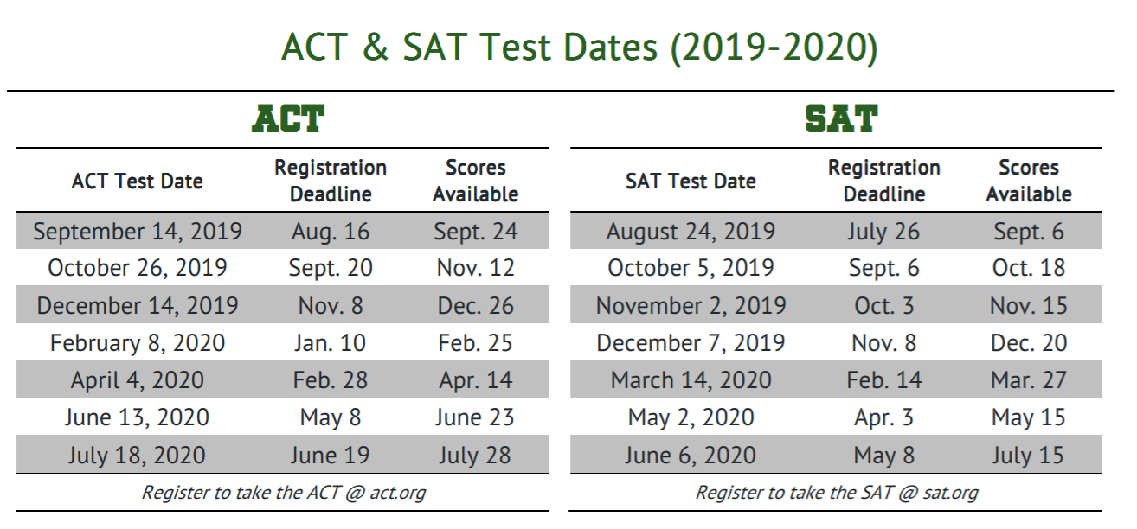
REGISTER FOR ONE OF THE UPCOMING TESTS:

Slide 19
RESOURCES
Junior Guidance Packet & Graduation Status Report (Junior Advisement)
Georgia Career Information System (GCIS)
GA Futures
www.bigfuture.collegeboard.org
www.inlikeme.com
www.unigo.com
www.cappex.com
www.fastweb.com
colleges.niche.com/
collegescorecard.ed.gov/

Slide 20
Presentation
Find it Online: www.mycentennialcounseling.com

Slide 21
Thank you for your attention
CHS Counseling Department
www.mycentennialcounseling.com

