Slide 1
Junior Classroom Guidance: Choosing The Perfect College!
Centennial High School
Counseling Department
January 30-February 3 www.mycentennialcounseling.com

Slide 2
Centennial School Counseling
A-C Ms. Beaty beatyz@fultonschools.org
D-Gol & AVID Ms. Marino MarinoS1fultonschools.org
Gom-Mart Ms. Graver graverH@fultonschools.org
Maru-Sam Ms. Freeman freemanMA@fultonschools.org
San-Z Ms. Peart peart@fultonschools.org
Grad Coach
Ms. Jiram jiramM@fultonschools.org

Slide 3
Materials and Agenda
  Important Events and Dates
  The Junior’s Guide To Planning For College
  Getting Accepted: What Colleges Look for in Applicants
  Searching For Colleges / Discovering Your Options
  Top Questions to Guide you to the Perfect College
  College Admissions Testing and Test Prep (SAT/ACT)
  Move On When Ready (Frequently Asked Questions)

Slide 4

GCIS College Search
www.gcic.peachnet.edu
  Username: student IDs (e.g. 123456789s)
  Password: CHSKnights2018 (cap sensitive)
  *College Week: Juniors completed a GCIS College Sort Activity and saved at least 3 colleges to their profiles

Slide 5
CHS Counseling Junior Advisement
Meet with your School Counselor for Junior Advisement Conferences November – February

Slide 6
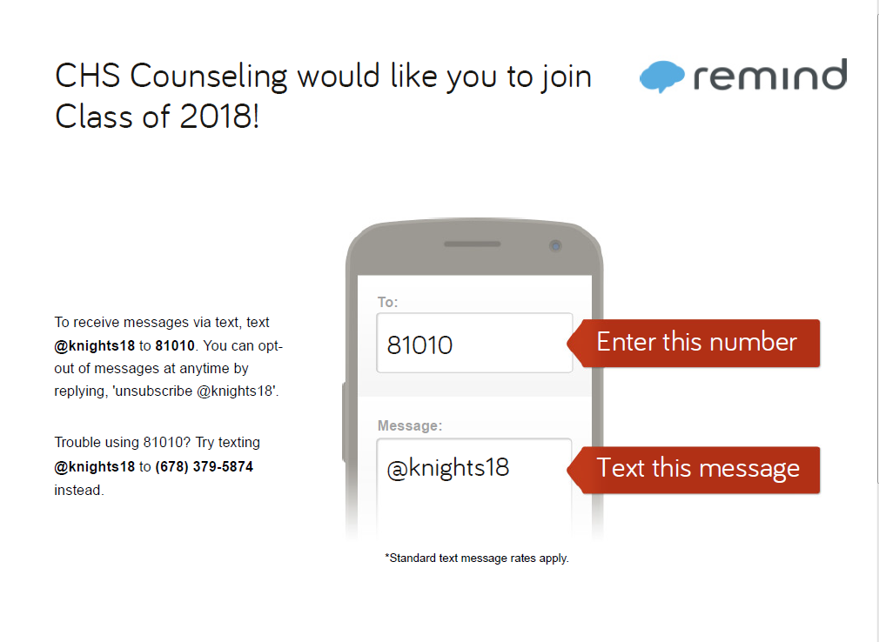
Remind 101 for Class of 2018

Slide 7

Preparing for a College Search

Slide 8
If you were to choose a college today, which one would you choose, and why?

Slide 9
Types of Colleges
Type | Description | Tuition and Fees | Admission Requirements
Two Year Technical Two Year Junior Four Year | Degrees offered: Associates, Certificate, Diploma Provides: Classes and degrees directly aligned with a particular career or job field. GA Technical College System has a 98% placement rate within six months of student graduation. Degrees offered: Associates Provides: A cost-effective option to start taking general college classes which could be applied towards a 4 year degree at a college or university Typically have student transfer agreements with four year colleges. High School Diploma GPA may be evaluated (2.0 CPC minimum for GPC) SAT / ACT or other admission test may be required | Approximately $4000 per year for full-time enrollment (Gwinnett Technical College) Approximately $5000 per year for full-time enrollment (GA State University at Perimeter College Public (In-State): Average approx. $9000 per year (does not include room/board) Public (Out-of-State): Average $23,000/year (does not include room/board) Private: Average $32,000/yea | High School Diploma ACCUPLACER typically required SAT / ACT optional High School Diploma GPA may be evaluated (2.0 CPC minimum for GPC) SAT / ACT or other admission test may be required College Preparatory Curriculum GPA SAT / ACT Class rank Essay Extracurricular Activities Letters Of Recommendation

Slide 10
Admission to “Selective” Colleges
Just as students should search for the best college “fit,” selective colleges search for the best student “fit.”
College admission officers set a goal of crafting a well-rounded freshman class.

Slide 11
College Priorities Activity

Slide 12

Choosing Your
College Priorities
What is important to you?
Majors/Programs of Study
Offered
Size
Location
Cost
Social Appeal
Residential Appeal
Diversity of Students and
Professors
Reputation

Slide 13
Choosing Your
College Priorities
Discovering Your Options:
Websites
Blogs / Social Media
School Faculty
Family and Friends
College Fairs
College Rep Visits to CHS
Campus Visits

Slide 14
About Admission Tests
SAT
  Length is 3 hours, 50 minutes (with essay)
  Areas tested include Evidence-Based Reading and Writing, Math, and optional essay (2 section scores plus optional essay)
  Total score out of 1600 (2 sections—each up to 800 points)
  Register at https://sat.org/register
ACT
  Length is 3 hours, 35 minutes (with essay)
  Areas tested include English, Math, Reading, Science, and optional essay (4 section scores plus optional essay)
  Total score out of 36 (based on the average of 4 tests)
  Register at http://www.actstudent.org/

Slide 15
ACT and SAT
Colleges will generally take scores from either test and treat them equally
Many colleges have minimum test scores required for admission
Some colleges may “super-score”
Recommended to send all scores---colleges will use the highest

Slide 16
Test Prep Options
PSAT “Next Steps” Access / Khan Academy
FREE Testing and Educational Reference Center Database in MackinVIA through CHS Learning Commons
FREE GACollege411.org Test Prep
FREE March2Success.com Test Prep
SAT Prep Class
Princeton Review Partner Classes (SAT & ACT)
Applerouth, Kaplan, C2, Studyworks, and others
Collegeboard.org – free practice questions
ACTstudent.org – free practice questions
Remember that the best preparation includes taking college prep classes and reading as often as possible!

Slide 17
Types of Financial Aid
GRANTS
Gift-Aid: do not have to be repaid
State or federal money
Predominantly need-based
Ex: Pell Grant, TEACH Grant
SCHOLARSHIPS
Do not have to be repaid
Merit-based (GPA, athletics, community service)
Need-based (family income)
Scholarship info at www.mycentennialcounseling.com
WORK STUDY
Money you earn while working
  On campus
  Designated places of work from the school
Does not have to be repaid
Primarily need-based
LOANS
Must be repaid with interest
Government money

Slide 18
What are the HOPE & Zell Miller Scholarships?
HOPE
Zell Miller
3.0 GPA in core classes
Funding depends on the school with award limits
  Private vs. Public
  DOES NOT COVER 100%
3.7 GPA in core classes
SAT score of 1200 combined (no super score) or ACT of 26 or valedictorian or salutatorian
Award limits
  Public = full tuition
  Private = tuition assistance
BOTH HOPE & Zell Miller
Receive credit for 4 classes that meet the HOPE & Zell Miller rigor requirement.
Complete the FAFSA

Slide 19

Calculating the hope gpa
The HOPE GPA only includes attempted core academic courses taken in grades 9 – 12. (Lang Arts, Math, Science, Soc Studies & World Lang)
Semester numeric grades are converted to a 4.0 scale
* The 7 honors points for Honors, Advanced Placement, and MOWR classes are subtracted before grades are converted to the 4.0 scale.
A = 4 points
B = 3 points
C = 2 points
F = 0 points
.5 point added to each AP and Dual Enrollment grade (points cannot go higher than 4)
Course | Semester Grade w/Honors Points | Semester Grade w/out Honors Points | Converted to 4.0 scale points
10th Grade Lit Honors | 95 | 88 | 3
CCGPS Geometry | 80 | 80 | 3
Physical Science | 79 | 79 | 2
AP World History | 88 | 81 | 3.5
French 2 Honors | 99 | 92 | 4
Weight Training | 93 | 93 | —
Add converted points |  |  | 15.5
Divide sum by # of eligible classes |  |  | 15.5 ÷ 5
HOPE GPA |  |  | 3.1

Slide 20
DUAL ENROLLMENT PREVIEW
APPLY TO THE COLLEGE BY MARCH 31 (GPC, GA. TECH, ETC.) – ACCEPTED BY THE COLLEGE, NOT BY CENTENNIAL
MINIMUM GPA REQUIRED
TAKE ACT BY FEBRUARY 2017 AND/OR SAT BY MARCH 2017
NO COST FOR TUITION
COLLEGE CREDITS

Slide 21
Junior Priorities
In School
Stay focused on academics
Do not lighten your academic load for senior year
Attend daily
Stay involved in school activities (commitment/leadership)
Standardized Testing
Prepare for and register for ACT / SAT tests as appropriate
Take AP tests as appropriate
College Exploration
Explore colleges on the Web
Visit colleges
Meet with college representatives
Attend college fairs

Slide 22
Junior Activities current/future
Junior Classroom Guidance (Part 2), February 2017 (college applications and admission factors, GPA computations, HOPE and Financial Aid)
Junior Advisement – Fall 2016/Spring 2017
Senior Classroom Guidance – Fall 2017
Senior Parent Night – Fall 2017

Slide 23
RESOURCES
Junior Guidance Packet and Graduation Status Report (Junior Advisement)
www.mycentennialcounseling.com
Georgia Career Information System (GCIS)
GA Futures

Slide 24
RESOURCES
www.bigfuture.collegeboard.org
www.inlikeme.com
www.unigo.com
www.cappex.com
www.fastweb.com
https://colleges.niche.com/
https://collegescorecard.ed.gov/

Slide 25
RESOURCES
This Presentation May Be Found Online at www.mycentennialcounseling.com

Slide 26
Thank you for your attention
CHS Counseling Department
www.mycentennialcounseling.com

