Slide 1

Junior Classroom Guidance,
Part 1
CHS Counseling Dept.
Spring 2016

Slide 2
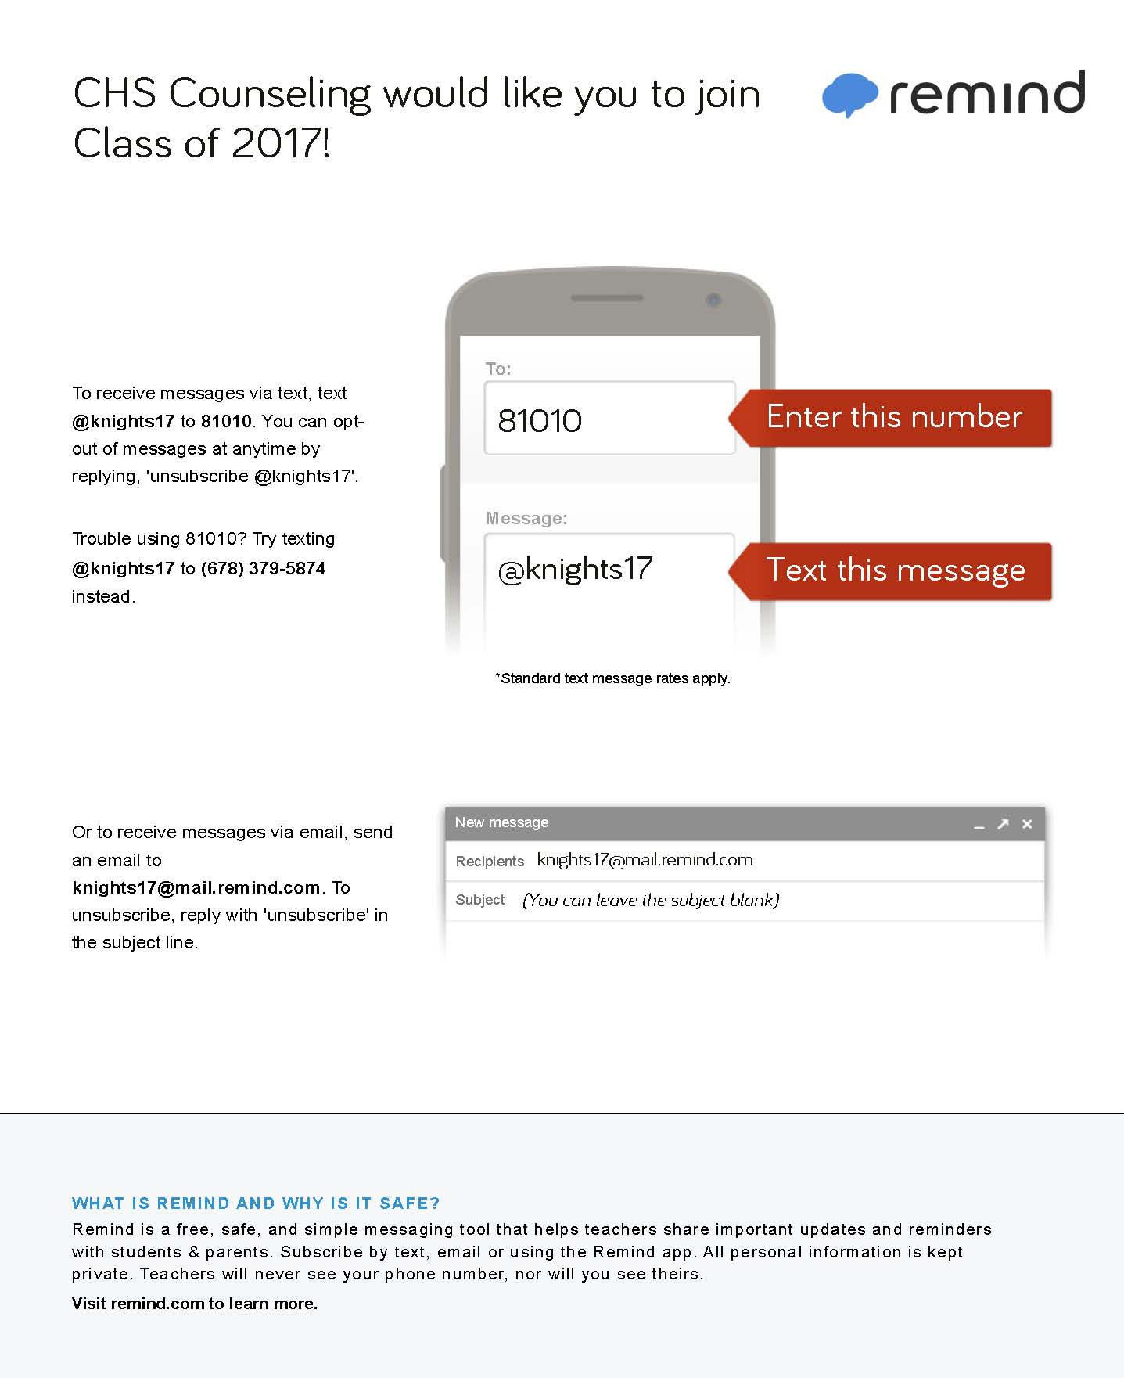

Slide 3

“I want to go to a good college.”
Write down the characteristics of a “good” college.

Slide 4

Ask Yourself….
What
makes
a college
‘good’?

Slide 5
Factors for
YOU to Consider
Majors/Degrees
Location
Cost
School Size
Campus Life
Think about your personal preferences.
What factors are non-negotiable? (Your Must- Haves)

Slide 6


Slide 7

Georgia Probe Fulton County Fair
Monday, March 21
6:00-8:00pm
Cambridge High School

Slide 8

What Factors are Colleges Considering?
College Admission Activity

Slide 9

Courses in progress Senior Year
Rigor of HS Courses
SAT/ACT scores
GPA
Activities & Accomplishments
Your Application
Essentially everything the college will know about you and who you are
Essays
Teacher & Counselor
Recommendation
Class Rank
Interview
Demonstrated Interest

Slide 10
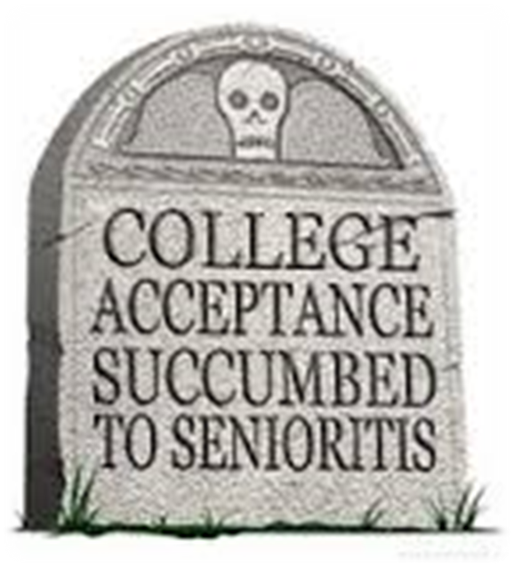
COLLEGES ARE WATCHING!!!
SENIOR YEAR
An acceptance is not official until you have graduated HS
A college acceptance can be revoked
  A decline in academics senior year
  Disciplinary Actions
  Illegal Activity
  Inappropriate Digital Footprint

Slide 11


RIGOR MATTERS!!!
Are you demonstrating “intellectual curiosity”?
What classes have you taken to prepare you for success in college?
Have you maintained high grades in on-level classes but never taken Honors or AP classes?
What is the evidence that you are “college ready”?
There is no magic number of AP classes to get into a college.

Slide 12
ACT and SAT
Colleges will generally take scores from either test and treat them equally
Many colleges have minimum test scores required for admission
Some colleges may “super-score”
Recommended to send all scores---colleges will use the highest

Slide 13
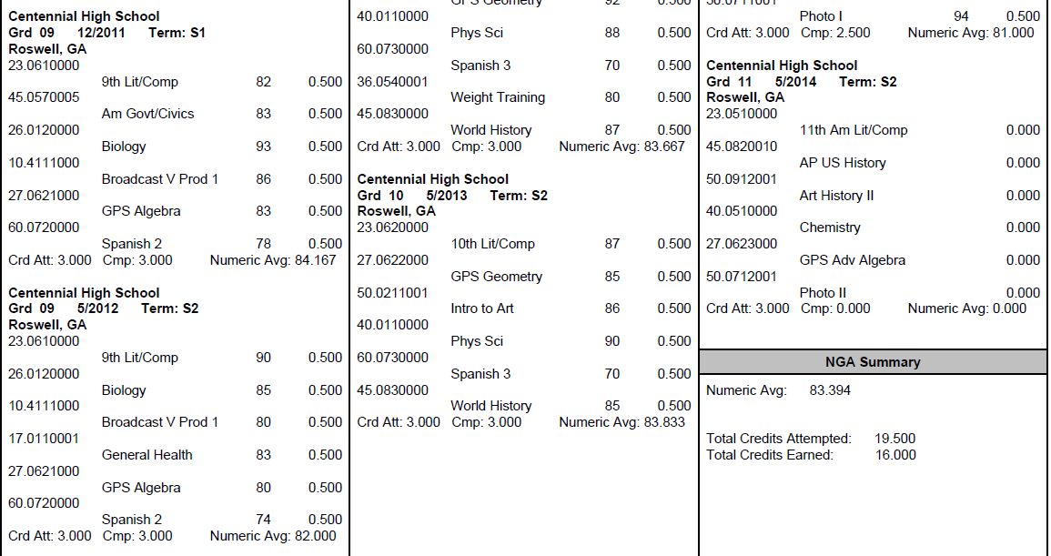
What is my GPA?
The numeric average of semester course grades including EVERY attempted high school course
GPAs are on a 100 pt scale (Fulton does not use a 4.0 scale)
Look up YOUR GPA on Home Access Center

Slide 14
Why an 80 GPA ≠ a 3.0 GPA
Student #1 |  |  | Student #2 |  |  | Student #3
Class Grade | Converted to 4.0 Scale |  | Class Grade | Converted to 4.0 Scale |  | Class Grade | Converted to 4.0 Scale
88 | 3 |  | 85 | 3 |  | 83 | 3
71 | 2 |  | 77 | 2 |  | 92 | 4
80 | 3 |  | 79 | 2 |  | 74 | 2
67 | 0 |  | 75 | 2 |  | 80 | 3
89 | 3 |  | 81 | 3 |  | 81 | 3
85 | 3 |  | 83 | 3 |  | 70 | 2
80.0 GPA on a 100pt scale | 2.33 GPA on a 4.0 scale |  | 80.0 GPA on a 100pt scale | 2.50 GPA on a 4.0 scale |  | 80.0 GPA on a 100pt scale | 2.83 GPA on a 4.0 scale

Slide 15

100 pt Scale vs. 4.0 Scale
Course Grades
81
82
80
70
90
81
3.0 GPA on a 4.0 scale
Course Grade
89
88
89
87
89
89
3.0 GPA on a 4.0 scale
80.66
GPA on a 100pt scale
88.5
GPA on a 100pt scale

Slide 16

Other Potential Factors….
CLASS RANK

Slide 17

Other Potential Factors….
EXTRACURRICULAR ACTIVITIES

Slide 18

Other Potential Factors….
ESSAYS

Slide 19

Other Potential Factors….
LETTERS of RECOMMENDATION

Slide 20

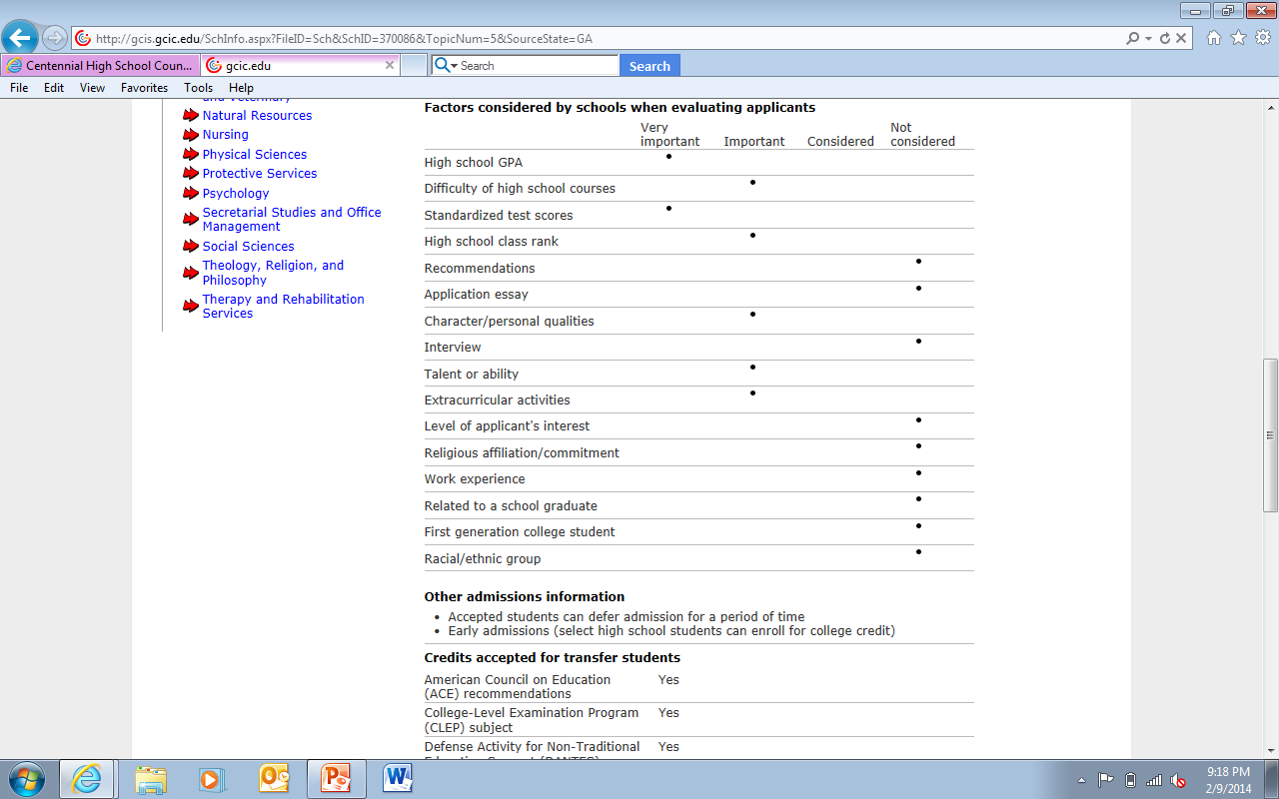
Research potential college options to discover which factors are most important
Factors for Valdosta State University

Slide 21
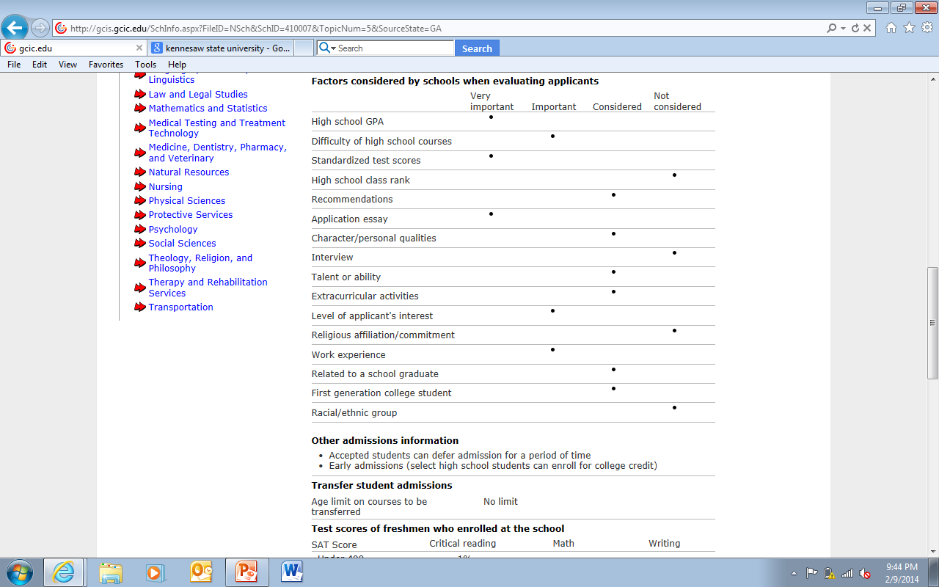
Research potential college options to discover which factors are most important
Factors for Auburn University

Slide 22
Freshman Class Profiles
University of GA
Average GPA: 3.91
GA College
Average GPA: 3.51
Average GPA: 3.15
Average SAT: 1935
Average ACT: 29
Average SAT: 1170
Average ACT: 25
Average SAT: 990
Average ACT: 20
In-State Tuition/Fees: $11622
In-State Tuition/Fees: $9170
In-State Tuition/Fees: $7056
# Freshmen: 5300
# Freshmen: ~1700
# Freshmen: ~1800
Columbus State
Kennesaw State
# Freshmen: ~5600
Average GPA: 3.23
Average SAT: 1085
Average ACT: 23
Top 25% of HS Class Rank: 53%
Top 25% of HS Class Rank: N/A
Top 25% of HS Class Rank: 37%
Top 25% of HS Class Rank: ~91%
Top 10% of HS Class Rank: 52%
Top 10% of HS Class Rank: N/A
Top 10% of HS Class Rank: 27%
In-State Tuition/Fees: $7326
Top 10% of HS Class Rank: 11%

Slide 23
Retention and Graduation
University of GA
GA College
First Year Retention: 86%
First Year Retention: 67%
Columbus State
Kennesaw State
First Year Retention: 79%
First Year Retention: 94%
% graduating in 4 years: 61%
% graduating in 6 years: 84%
% graduating in 4 years: 40%
% graduating in 6 years: 61%
% graduating in 4 years: N/A
% graduating in 6 years: 43%
% graduating in 4 years: 12.4%
% graduating in 6 years: 31%

Slide 24

Paying for College

Slide 25
Cost of Attendance (COA)
Tuition and Fees
Room and Board
Books and Supplies
Transportation and Personal Expenses

Slide 26
Types of
Financial Aid
Scholarships (Free $)
Grants (Free $)
Loans
Work-Study
There are several options to fund your college education

Slide 27
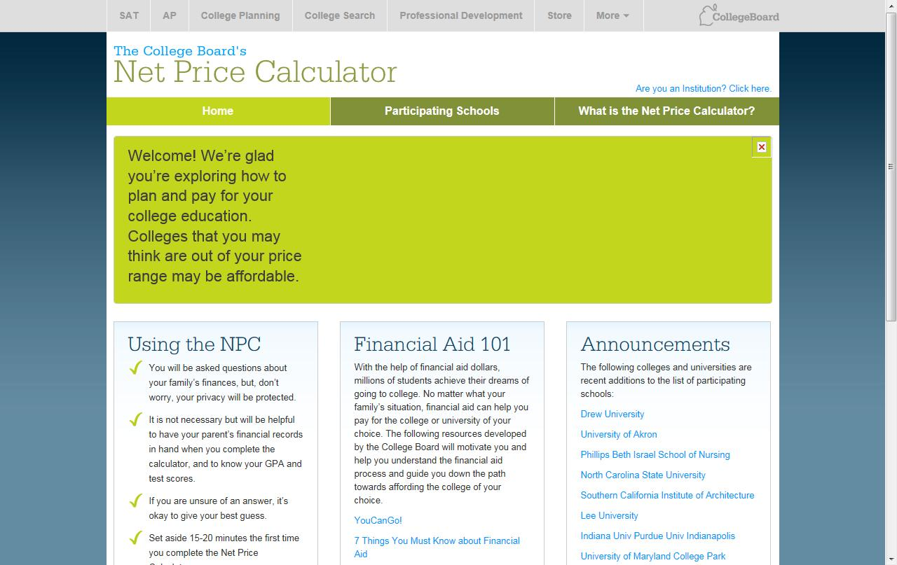

Slide 28

There are scholarships for EVERYONE!!!
Academic-Based
Athletics- Based
Leadership/ Service-Based
Personal Characteristics
Gender, Race, Ethnicity, Religion, etc.
Special Talents & Interests
Arts, Organization Affiliation
Intended Major
Children of Employees
Need-Based

Slide 29

Scholarships/Grants for
Georgia Residents
Zell Miller Scholarship
Pays full standard undergraduate tuition rate at schools in the University System of Georgia
Minimum Eligibility: 3.7 HOPE GPA and combined SAT score of at least 1200 (critical reading and math--no super-scoring) OR ACT composite score of at least 26 and 4 credit rigor requirement
HOPE Scholarship
Pays a percentage amount of the standard tuition rate at schools in the University System of Georgia
Minimum Eligibility: 3.0 HOPE GPA and 4 credit rigor requirement
Private colleges: $2,174 per semester or $1,450 per quarter for full time students
Private colleges: $1,968 per semester or $1,313 per quarter for full time students

Slide 30
Scholarships/Grants for
Georgia Residents
Pays full standard tuition rate for certificate and diploma programs at schools in the Technical College System of Georgia or the University System of Georgia
Minimum Eligibility: No high school graduation requirement (must maintain a cumulative 3.5 GPA or higher in college)
Zell Miller Grant (NEW!)
Pays a percentage amount of the standard tuition rate for certificate and diploma programs at schools in the Technical College System of Georgia or the University System of Georgia
HOPE Grant
Minimum Eligibility: No high school graduation requirement (must maintain a cumulative 2.0 GPA or higher in college)

Slide 31

Calculating the hope gpa
The HOPE GPA only includes attempted core academic courses taken in grades 9 – 12. (Lang Arts, Math, Science, Soc Studies & World Lang)
Semester numeric grades are converted to a 4.0 scale
* The 7 honors points for Honors, Advanced Placement, and MOWR classes are subtracted before grades are converted to the 4.0 scale.
A = 4 points
B = 3 points
C = 2 points
F = 0 points
.5 point added to each AP and Dual Enrollment grade (points cannot go higher than 4)
Course | Semester Grade w/Honors Points | Semester Grade w/out Honors Points | Converted to 4.0 scale points
10th Grade Lit Honors | 95 | 88 | 3
CCGPS Geometry | 80 | 80 | 3
Physical Science | 79 | 79 | 2
AP World History | 88 | 81 | 3.5
French 2 Honors | 99 | 92 | 4
Weight Training | 93 | 93 | —
Add converted points |  |  | 15.5
Divide sum by # of eligible classes |  |  | 15.5 ÷ 5
HOPE GPA |  |  | 3.1

Slide 32

Moving Forward Junior Year
College Exploration
Explore colleges on the Web
Visit colleges
Meet with college representatives
Attend college fairs
In School
Stay focused on academics
Do not lighten your academic load for senior year
Stay involved in school activities (commitment/leadership)
Meet with your school counselor
Standardized Testing
Register for ACT / SAT tests
Prepare for tests via prep courses and online resources

Slide 33

While finalizing your classes for next year, be sure to consider…..
Interest in the Class Content
Motivation
Prerequisites
College Interest
Career Interest
Overall Demand of Schedule
Extracurricular Commitments
Strengths & Weaknesses
HOPE Eligibility

Slide 34
Ongoing/Upcoming in Spring 2016…
Michael Absher A-C
Shellie Marino D-Gol
Heidi Graver Gom-Mart
Melissa Freeman Maru-Sam
Hella Peart San-Z
Maria Jiram Graduation Coach
Registration for Classes for 2016-17
Junior Advisement / Junior “Blitz”
SAT / ACT administrations, test prep, mock tests
Atlanta National College Fair

Slide 35
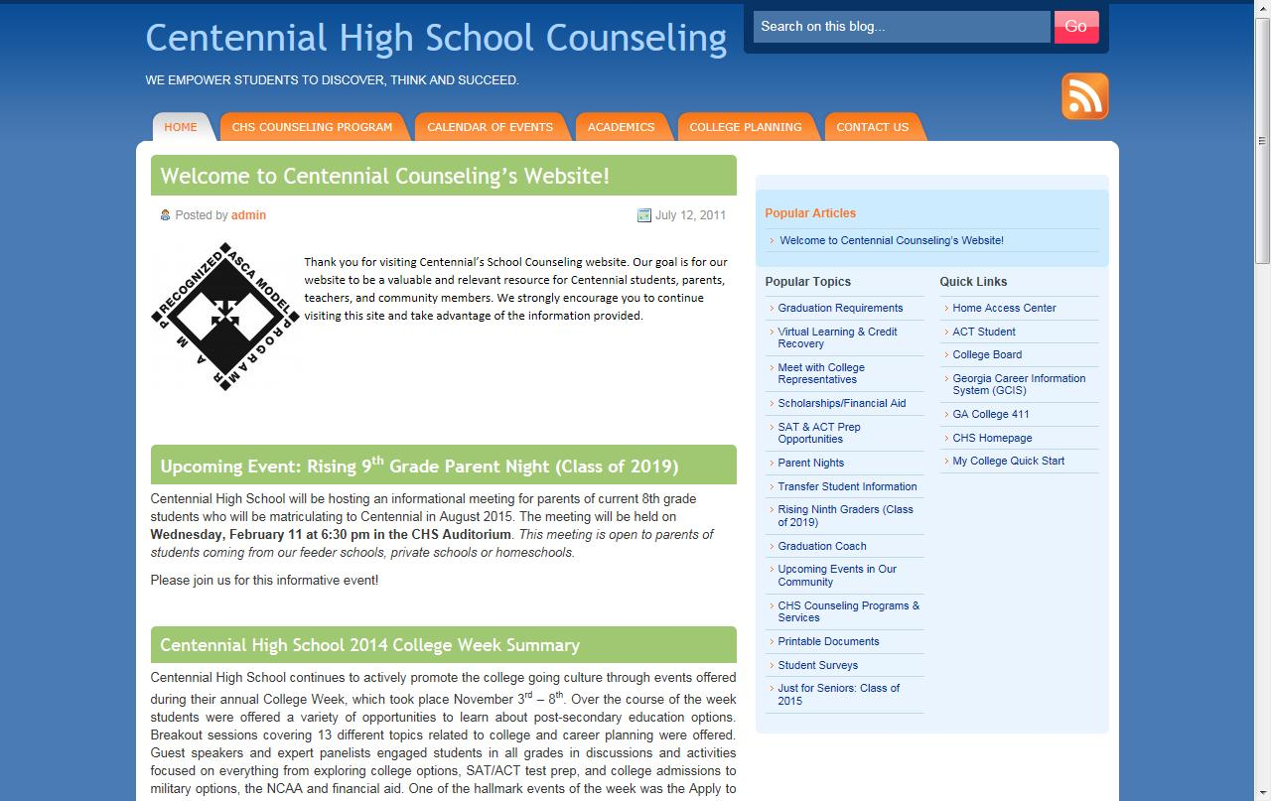
Visit us at www.mycentennialcounseling.com

