Slide 1
What are Colleges Looking For?
Junior Classroom Guidance Part 1
Counseling Department
November 2019
www.mycentennialcounseling.com

Slide 2

Pre-Survey
www.surveymonkey.com/r/BYHY3H2
Notes:
https://research.collegeboard.org/trends/college-pricing/figures-tables/average-published-charges-2017-18-and-2018-19

Slide 3
Materials and Agenda
Important Events and Dates for Juniors
What Colleges Look for in Applicants
What Selectivity Means for You
Match, Reach & Safety Schools
ACT and SAT exams
College Planning Tips:
College Planning Checklist for HS Juniors

Slide 4
CENTENNIAL COUNSELING
A-Cas Mr. Jones
JonesW3@fultonschools.org
Cat-Harp
Ms. Ekpo EkpoN@fultonschools.org
Harq-Mep Mrs. Ruppe Ruppe@fultonschools.org
Meq-Sal Ms. Freeman
FreemanMA@fultonschools.org
Sam-Z
Ms. Peart Peart@fultonschools.org
Grad Coach Mrs. Rigsbey RigsbeyA@fultonschools.org

Slide 5
What different types of colleges are there?

Slide 6
Average Tuition Cost:
Yearly tuition and fees for 2018-2019 according to the College Board:
  $35,830 for private colleges
  $26,290 for public colleges - out-of-state residents
  $10,230 for public colleges – residents
  $3,660 for 2-year college - residents
Notes:
https://research.collegeboard.org/trends/college-pricing/figures-tables/average-published-charges-2017-18-and-2018-19

Slide 7
Two Year Technical College
Description | Tuition & Fees | Admission Requirements
Degrees offered: Associates, Certificate, Diploma Provides: Classes and degrees directly aligned with a particular career or job field. GA Technical College System - 99.3% placement rate within 6 months of student graduation. | Approximately $5,600 per year for full-time enrollment (Gwinnett Technical College) | High School Diploma ACCUPLACER typically required SAT / ACT optional

Slide 8
Two Year Junior College
Description | Tuition & Fees | Admission Requirements
Degrees offered: Associates Provides: A cost-effective option to start taking general college classes which could be applied towards a 4-year degree at a college or university Typically have student transfer agreements with 4-year colleges. | Approximately $3660 per year for full-time enrollment (Perimeter College at Georgia State) | High School Diploma GPA may be evaluated (2.0 GPA minimum for PC) SAT / ACT or other admission test may be required

Slide 9
4-Year Colleges & Universities
Description | Tuition & Fees | Admission Requirements
Degrees offered: Bachelors, Masters and/or Doctoral Provides: A well-rounded college experience. Typically have large selection of course offerings in variety of majors and programs of study | Public (In-State) Average cost: $10,230/year (does not include room/board) Public (Out-of State) Average cost: $26,290/year (does not include room/board) Private Average cost: $35,830/year (does not include room/board) | College Preparatory Curriculum GPA SAT / ACT Class rank Essay Extracurricular Activities Letters Of Recommendation

Slide 10


NEW MINIMUM PLACEMENT REQUIREMENTS
SAT, ACT, ACCUPLACER or MILESTONE ELA SCORES
PSAT SCORES TAKEN AFTER MARCH 2016
HOPE GPA OF 2.6 OR HIGHER, FOR 11TH & 12TH GRADERS
TEST SCORE AGE LIMIT HAS BEEN REMOVED FROM POLICY
ENTRY LEVEL WORKFORCE CERTIFICATES REQUIRES 2.0 MIN GPA
*SOME TECHNICAL COLLEGES MAY STILL REQUEST HIGHER REQUIREMENTS*

Slide 11

Finding Your College Fit
Limiting Factors:
Admissions Difficulty
  Match
  Reach
  Safety
Costs, excluding aid
Specific high school courses required

Slide 12
Admission to “Selective” Colleges
Just as students should search for the best college “fit,” selective colleges search for the best student “fit.”
College admission officers set a goal of crafting a well-rounded freshman class.
The college is looking for evidence that the applicant will be successful at their college.

Slide 13

2019 Freshman Class Profiles
University of GA
Ga Tech
  # Freshmen: 5,852
  Average GPA: 3.95-4.2 (approx. “A”)
  Average SAT: 1300-1460
  Average ACT: 30-34
  In-State Tuition/Fees: $11,818
  # Freshmen: 3,105
  Average GPA: “A”
  Average SAT: 1400-1530
  Average ACT: 31-34
  In-State Tuition/Fees: $12,682

Slide 14
2019 College Freshman Class Profiles
GA State
GA College
Columbus State
Kennesaw State
Average GPA: 3.3 – 3.8 (low - high “B”)
Average SAT: 1070 - 1260
Average ACT: 21-28
In-State Tuition/Fees: $11,076
Average GPA: 3.39 – 3.87 (low - high “B”)
Average SAT: 1140 - 1280
Average ACT: 24-29
In-State Tuition/Fees: $9,530
Average GPA: 3.4 (low “B”)
Average SAT: 490 Math 500 R/W
Average ACT: 18 on sub scores
In-State Tuition/Fees: $7,568
Average GPA: 2.5 (low ”B”)
Average SAT: 440 Math 480 R/W
Average ACT: 17 - E, R, & M
In-State Tuition/Fees: $7334
# Freshmen: ~4631
# Freshmen: ~1647
# Freshmen: ~6500
# Freshmen: ~1800

Slide 15

Courses in progress Senior Year
Rigor of HS Courses
SAT/ACT scores
GPA
Your Application
Activities & Accomplishments
Essentially everything the college will know about you and who you are
Essays
Teacher & Counselor
Recommendation
Interview
Demonstrated Interest

Slide 16
General Admission Factors
Grades/GPA in college prep courses
Strength of course selections
Courses in progress Senior year
SAT / ACT Score(s)

Slide 17


RIGOR MATTERS
Are you demonstrating “intellectual curiosity”?
What classes have you taken to prepare you for success?
Have you maintained high grades in on-level classes but never taken Honors or AP courses?
What is the evidence that you are “college ready”?
There is no magic number of AP classes to get into a college.

Slide 18
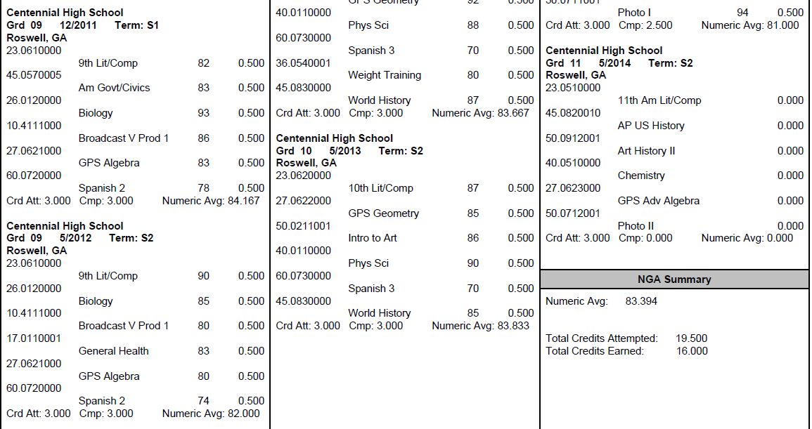
What is my GPA?
The numeric average of semester course grades including EVERY attempted high school course
GPAs are weighted and on a 100 pt scale (Fulton does not use a 4.0 scale)
Look up YOUR GPA on Home Access Center

Slide 19
Why an 80 GPA ≠ a 3.0 GPA
Student #1 |  |  | Student #2 |  |  | Student #3
Class Grade | Converted to 4.0 Scale |  | Class Grade | Converted to 4.0 Scale |  | Class Grade | Converted to 4.0 Scale
88 | 3 |  | 85 | 3 |  | 83 | 3
71 | 2 |  | 77 | 2 |  | 92 | 4
80 | 3 |  | 79 | 2 |  | 74 | 2
67 | 0 |  | 75 | 2 |  | 80 | 3
89 | 3 |  | 81 | 3 |  | 81 | 3
85 | 3 |  | 83 | 3 |  | 70 | 2
80.0 GPA on a 100pt scale | 2.33 GPA on a 4.0 scale |  | 80.0 GPA on a 100pt scale | 2.50 GPA on a 4.0 scale |  | 80.0 GPA on a 100pt scale | 2.83 GPA on a 4.0 scale

Slide 20

100 pt Scale vs. 4.0 Scale
Course Grades
81
82
80
70
90
81
3.0 GPA on a 4.0 scale
Course Grade
89
88
89
87
89
89
3.0 GPA on a 4.0 scale
80.6
GPA on a 100pt scale
88.5
GPA on a 100pt scale

Slide 21
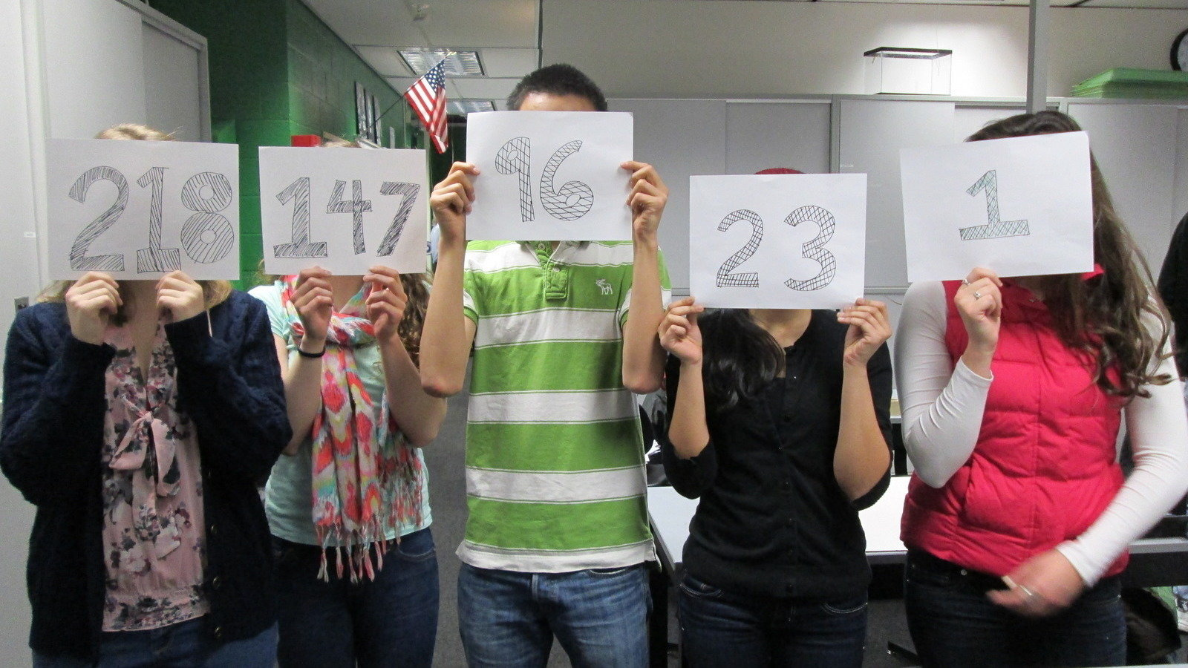

What Factors are Colleges Considering?
College Admission Activity

Slide 22
ACT & SAT
Colleges will generally take scores from either test and treat them equally
Many colleges have minimum test scores required for admission
Some colleges may “super-score”
Recommended to send all scores---colleges will use the highest

Slide 23
Differences of ACT vs SAT
ACT
  Length is 3 hours, 35 minutes (with essay)
  Areas tested include English, Math, Reading, Science, and optional essay (4 section scores plus optional essay)
    Students can retake Individual Sections (Sep. 2020)
  Register at https://www.act.org/
SAT
  Length is 3 hours, 50 minutes (with essay)
  Areas tested include Evidence-Based Reading and Writing, Math, and optional essay (2 section scores plus optional essay)
  Register at https://www.sat.org

Slide 24

Prep for the Test!
Test Prep Classes (Princeton Review at Centennial!!)
Online Test Prep Resources (*Khan Academy)
Practice Mock Tests
ACT/SAT Diagnostic Tests
Test Prep Apps
Test Prep Books
Collegeboard.org – free practice questions
ACTstudent.org – free practice questions
Remember that the best preparation includes taking college prep classes and reading as often as possible!

Slide 25
Other Admission Factors…
Activities and accomplishments (leadership, commitment, uniqueness)
Letters of Recommendations
(Counselor, Teacher, Other)
Application Essay(s)
Student’s demonstrated interest

Slide 26

Extracurricular Activities

Slide 27

LETTERS of RECOMMENDATION

Slide 28

Junior Priorities & Next Steps
In School
Stay focused on academics
Do not lighten your academic load for senior year
Attend daily
Stay involved in school activities (commitment/leadership)
Standardized Testing
Prepare for and register for ACT / SAT tests as appropriate
Take AP tests as appropriate
College Exploration
Explore colleges on the Web
Visit colleges
Meet with college representatives
Attend college fairs

Slide 29
CHS Counseling Junior Advisement
Meet with your School Counselor for your Junior Advisement Meeting November – February

Slide 30
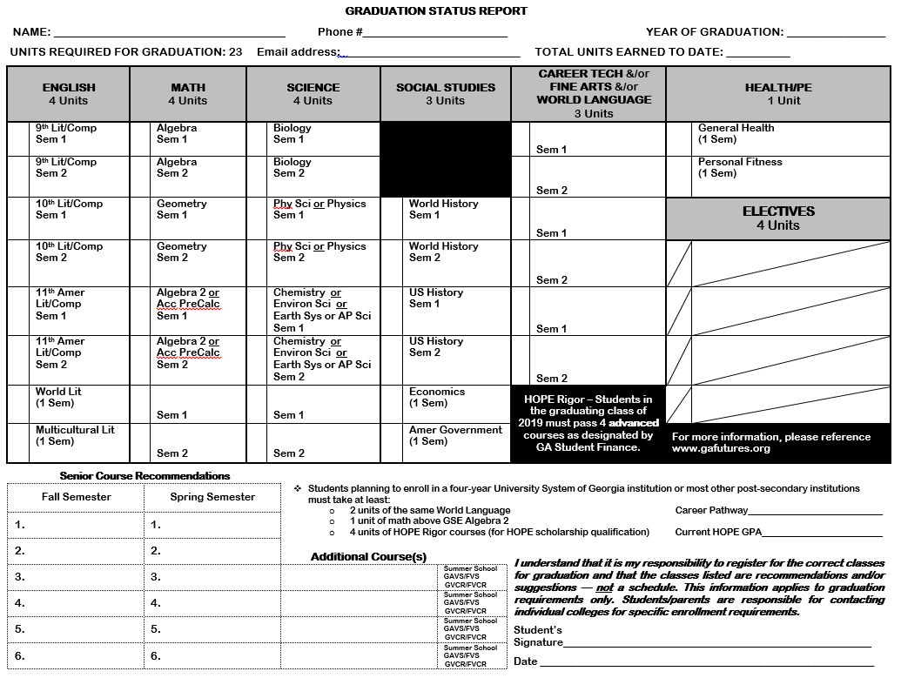

Slide 31
FINANCIAL AID
NIGHT
Wednesday
November 20, 2019
6:00 PM
Auditorium

Slide 32
CHS Counseling
Important Dates For Juniors 2019-20
Advanced Placement (AP) Night
TBA

Slide 33
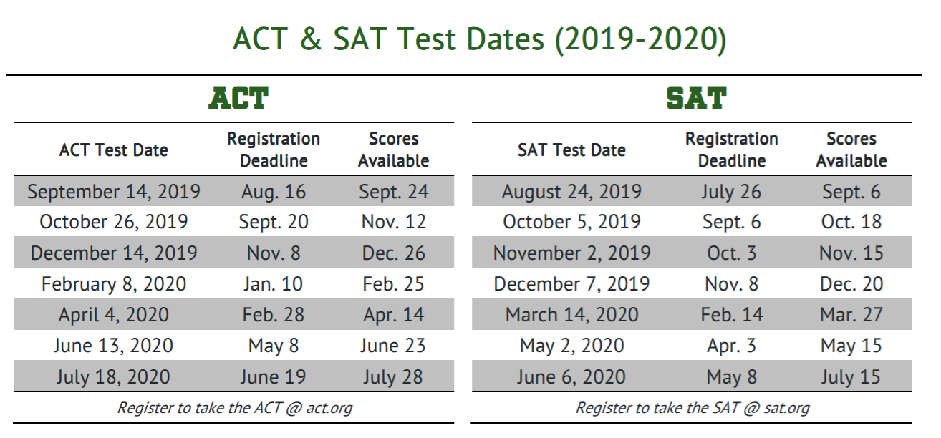
REGISTER FOR ONE OF THE UPCOMING TESTS:

Slide 34
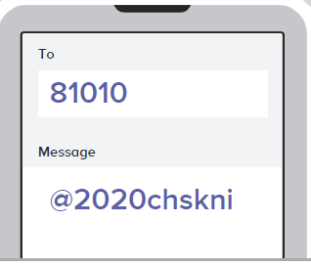
REMIND 101

Slide 35

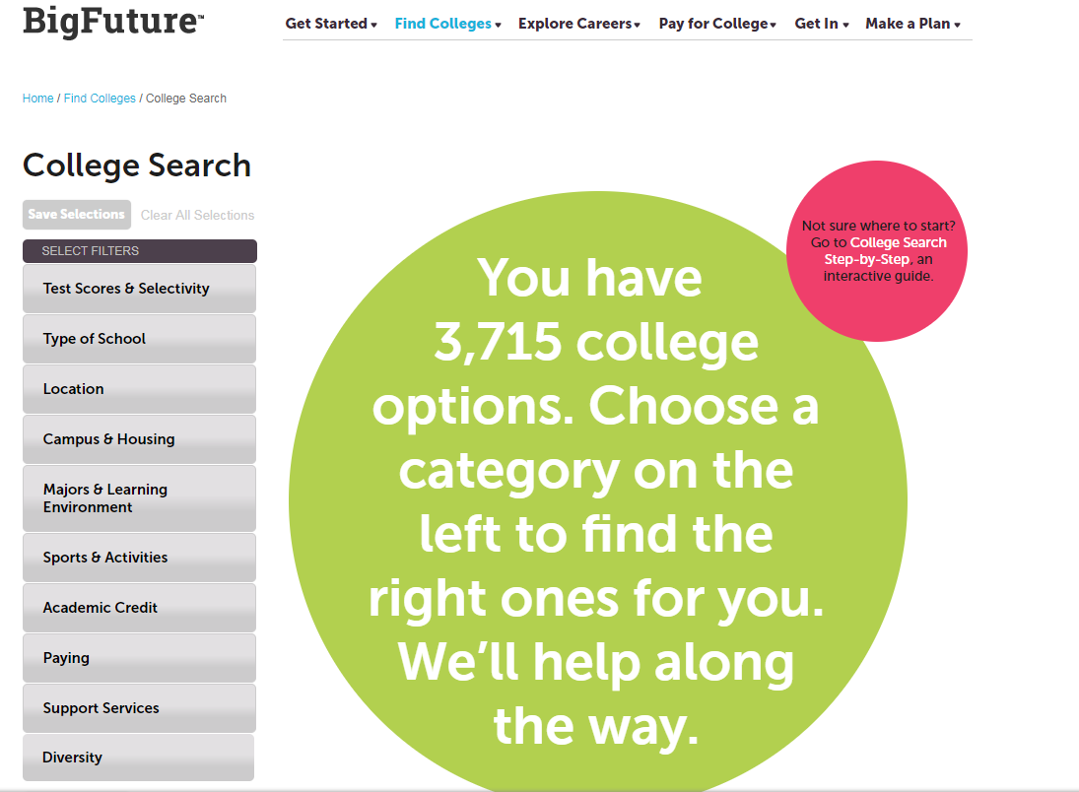
https://bigfuture.collegeboard.org

Slide 36
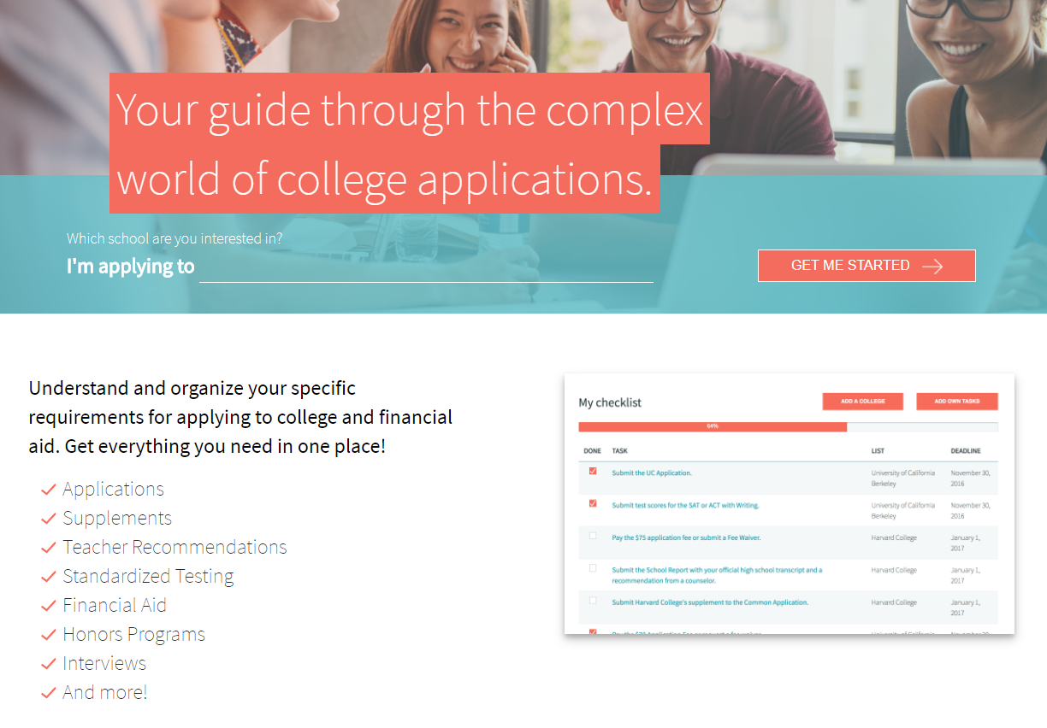
http://www.makemeafreshman.com

Slide 37


Follow Our Social Media Pages!!
*Scholarship Opportunities and Updates

Slide 38

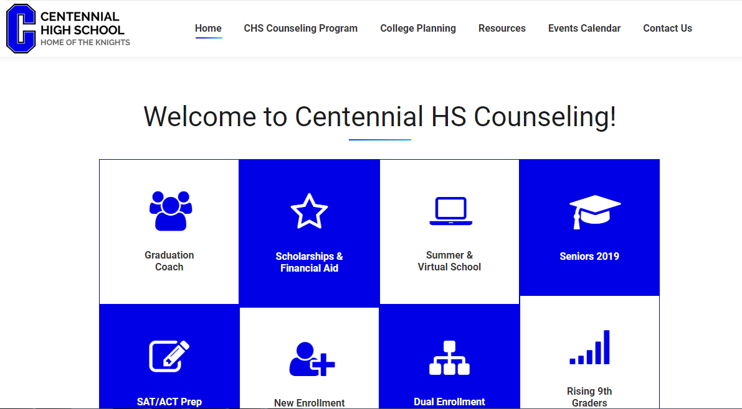
www.mycentennialcounseling.com

Slide 39

January 2020
Majors/Degrees
Location
Cost
School Size
Campus Life
JUNIOR CLASSROOM GUIDANCE LESSON
Part 2!

Slide 40
Post-Survey
www.surveymonkey.com/r/BCKKMXH
Notes:
https://research.collegeboard.org/trends/college-pricing/figures-tables/average-published-charges-2017-18-and-2018-19

