Slide 1
What are Colleges Looking For?
Junior Classroom Guidance Part 1
Counseling Department
November, 2018
www.mycentennialcounseling.com

Slide 2
Materials and Agenda
Important Events and Dates for Juniors
What Colleges Look for in Applicants
What Selectivity Means for You
Match, Reach & Safety Schools
ACT and SAT exams
College Planning Tips:
College Planning Checklist for HS Juniors

Slide 3
CENTENNIAL COUNSELING DEPARTMENT
A-Cas Ms. Beaty beatyz@fultonschools.org
Cat-Harp
Ms. Ekpo EkpoN@fultonschools.org
Harq-Mep
Ms. Graver graverH@fultonschools.org
Meq-Sal
Ms. Freeman freemanMA@fultonschools.org
Sam-Z
Ms. Peart peart@fultonschools.org
Grad Coach
Mrs. Rigsbey RigsbeyA@fultonschools.org

Slide 4
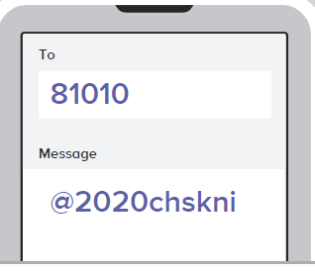
REMIND 101

Slide 5


Follow Our Social Media Pages!!
*Scholarship Opportunities and Updates

Slide 6
What different types of colleges are there?

Slide 7
Two Year Technical College
Description | Tuition & Fees | Admission Requirements
Degrees offered: Associates, Certificate, Diploma Provides: Classes and degrees directly aligned with a particular career or job field. GA Technical College System has a 99.3% placement rate within six months of student graduation. | Approximately $5000 per year for full-time enrollment (Gwinnett Technical College) | High School Diploma ACCUPLACER typically required SAT / ACT optional

Slide 8
Two Year Junior College
Description | Tuition & Fees | Admission Requirements
Degrees offered: Associates Provides: A cost-effective option to start taking general college classes which could be applied towards a 4 year degree at a college or university Typically have student transfer agreements with four year colleges. | Approximately $7000 per year for full-time enrollment (GA State University at Perimeter College) | High School Diploma GPA may be evaluated (2.0 GPA minimum for GPC) SAT / ACT or other admission test may be required

Slide 9
Four Year Colleges & Universities
Description | Tuition & Fees | Admission Requirements
Degrees offered: Bachelors, Masters and/or Doctoral Provides: A well-rounded college experience. Typically have large selection of course offerings in variety of majors and programs of study | Public (In-State): Average approx. $9,970 per year (does not include room/board) Public (Out-of-State): Average $25,620/year (does not include room/board) Private: Average $34,740/year | College Preparatory Curriculum GPA SAT / ACT Class rank Essay Extracurricular Activities Letters Of Recommendation

Slide 10
Average Tuition Cost:
According to the College Board, the average cost of tuition and fees for the 2017–2018 school year was $34,740 at private colleges, $9,970 for state residents at public colleges, and $25,620 for out-of-state residents attending public universities.

Slide 11


NEW MINIMUM PLACEMENT REQUIREMENTS
SAT, ACT, ACCUPLACER or MILESTONE ELA SCORES
PSAT SCORES TAKEN AFTER MARCH 2016
HOPE GPA OF 2.6 OR HIGHER, FOR 11TH & 12TH GRADERS
TEST SCORE AGE LIMIT HAS BEEN REMOVED FROM POLICY
ENTRY LEVEL WORKFORCE CERTIFICATES REQUIRES 2.0 MIN GPA
*SOME TECHNICAL COLLEGES MAY STILL REQUEST HIGHER REQUIREMENTS*

Slide 12
Admission to “Selective” Colleges
Just as students should search for the best college “fit,” selective colleges search for the best student “fit.”
College admission officers set a goal of crafting a well-rounded freshman class.
The college is looking for evidence that the applicant will be successful at their college.

Slide 13

Courses in progress Senior Year
Rigor of HS Courses
SAT/ACT scores
GPA
Activities & Accomplishments
Your Application
Essays
Essentially everything the college will know about you and who you are
Teacher & Counselor
Recommendation
Interview
Demonstrated Interest

Slide 14
General
College Admission Factors
Grades/GPA in college prep courses
Strength of high school course selections
Courses in progress Senior year
SAT / ACT Score(s)

Slide 15


RIGOR MATTERS!!
Are you demonstrating “intellectual curiosity”?
What classes have you taken to prepare you for success in college?
Have you maintained high grades in on-level classes but never taken Honors or AP classes?
What is the evidence that you are “college ready”?
There is no magic number of AP classes to get into a college.

Slide 16
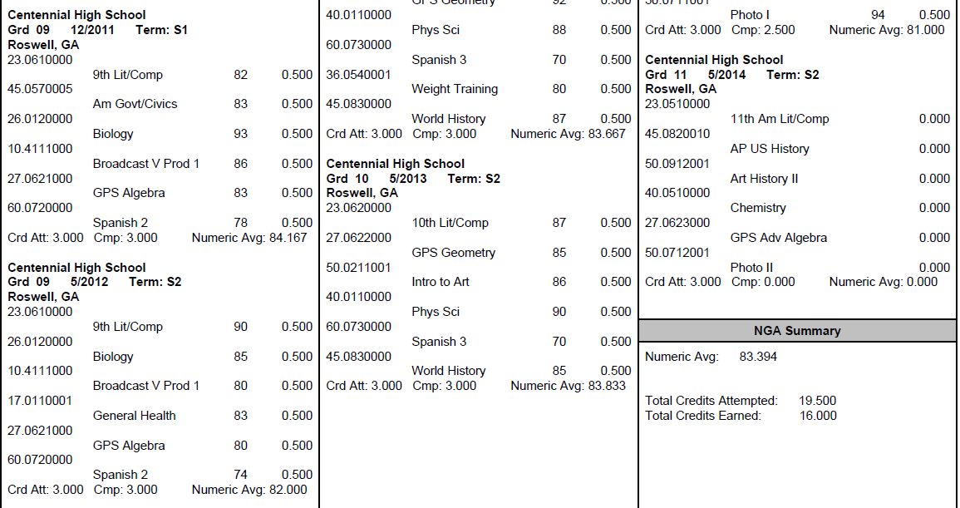
What is my GPA?
The numeric average of semester course grades including EVERY attempted high school course
GPAs are weighted and on a 100 pt scale (Fulton does not use a 4.0 scale)
Look up YOUR GPA on Home Access Center

Slide 17
Why an 80 GPA ≠ a 3.0 GPA
Student #1 |  |  | Student #2 |  |  | Student #3
Class Grade | Converted to 4.0 Scale |  | Class Grade | Converted to 4.0 Scale |  | Class Grade | Converted to 4.0 Scale
88 | 3 |  | 85 | 3 |  | 83 | 3
71 | 2 |  | 77 | 2 |  | 92 | 4
80 | 3 |  | 79 | 2 |  | 74 | 2
67 | 0 |  | 75 | 2 |  | 80 | 3
89 | 3 |  | 81 | 3 |  | 81 | 3
85 | 3 |  | 83 | 3 |  | 70 | 2
80.0 GPA on a 100pt scale | 2.33 GPA on a 4.0 scale |  | 80.0 GPA on a 100pt scale | 2.50 GPA on a 4.0 scale |  | 80.0 GPA on a 100pt scale | 2.83 GPA on a 4.0 scale

Slide 18

100 pt Scale vs. 4.0 Scale
Course Grades
81
82
80
70
90
81
3.0 GPA on a 4.0 scale
Course Grade
89
88
89
87
89
89
3.0 GPA on a 4.0 scale
80.6
GPA on a 100pt scale
88.5
GPA on a 100pt scale

Slide 19

What Factors are Colleges Considering?
College Admission Activity

Slide 20
ACT & SAT
Colleges will generally take scores from either test and treat them equally
Many colleges have minimum test scores required for admission
Some colleges may “super-score”
Recommended to send all scores---colleges will use the highest

Slide 21
ACT vs SAT : What’s the Difference?
ACT
  Length is 3 hours, 35 minutes (with essay)
  Areas tested include English, Math, Reading, Science, and optional essay (4 section scores plus optional essay)
  Register at http://www.actstudent.org/
SAT
  Length is 3 hours, 50 minutes (with essay)
  Areas tested include Evidence-Based Reading and Writing, Math, and optional essay (2 section scores plus optional essay)
  Register at https://sat.org/register

Slide 22

Prep for the Test!
Test Prep Classes (Princeton Review at Centennial!!)
Online Test Prep Resources (*Khan Academy)
Practice Mock Tests
ACT/SAT Diagnostic Tests
Test Prep Apps
Test Prep Books
Collegeboard.org – free practice questions
ACTstudent.org – free practice questions
Remember that the best preparation includes taking college prep classes and reading as often as possible!

Slide 23
Other Admission Factors…
Activities and accomplishments (leadership, commitment, uniqueness)
Letters of Recommendations
(Counselor, Teacher, Other)
Application Essay(s)
Student’s demonstrated interest

Slide 24

Other Potential Factors….
EXTRACURRICULAR ACTIVITIES

Slide 25

Other Potential Factors….
LETTERS of RECOMMENDATION

Slide 26

Finding Your College Fit
Limiting Factors:
Admissions Difficulty
  Match
  Reach
  Safety
Costs, excluding aid
Specific high school courses required

Slide 27

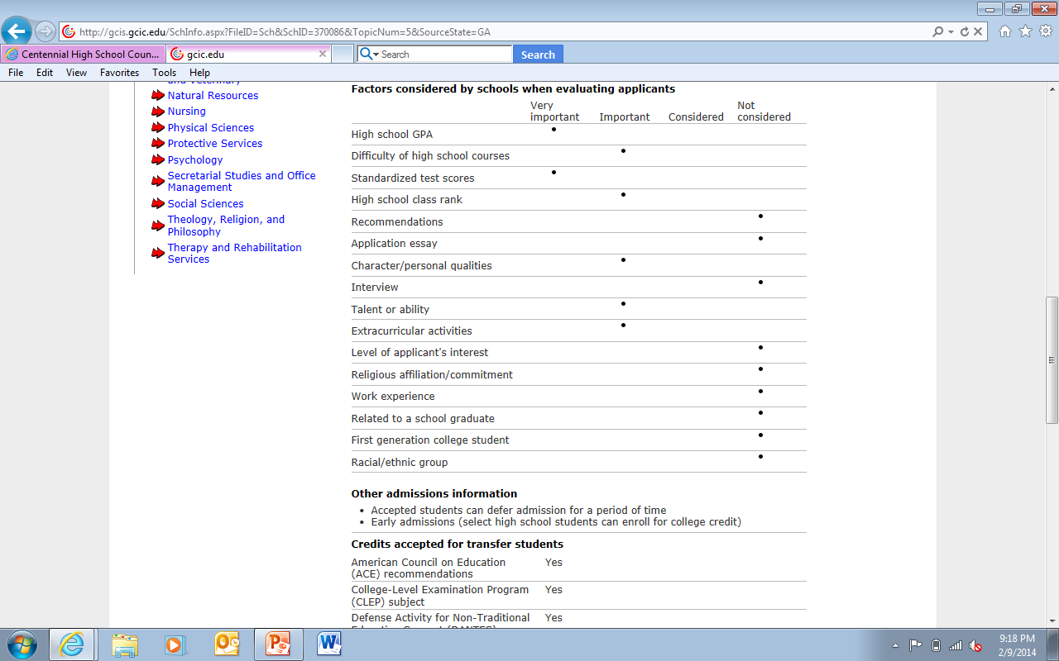
Research potential college options to discover which factors are most important
Factors for Valdosta State University

Slide 28
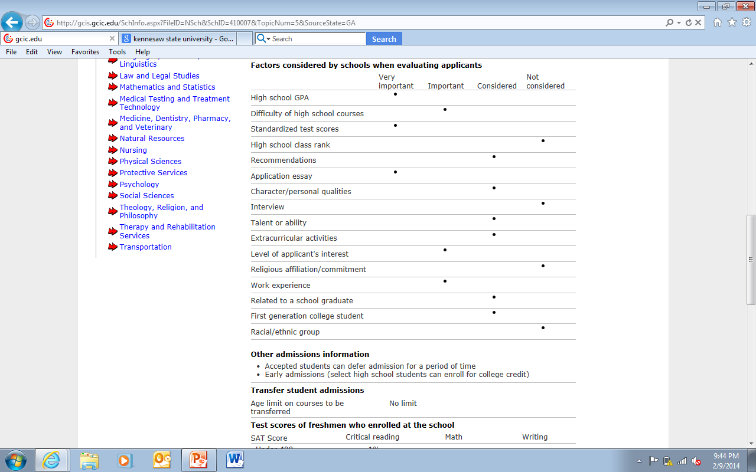
Research potential college options to discover which factors are most important
Factors for Auburn University

Slide 29

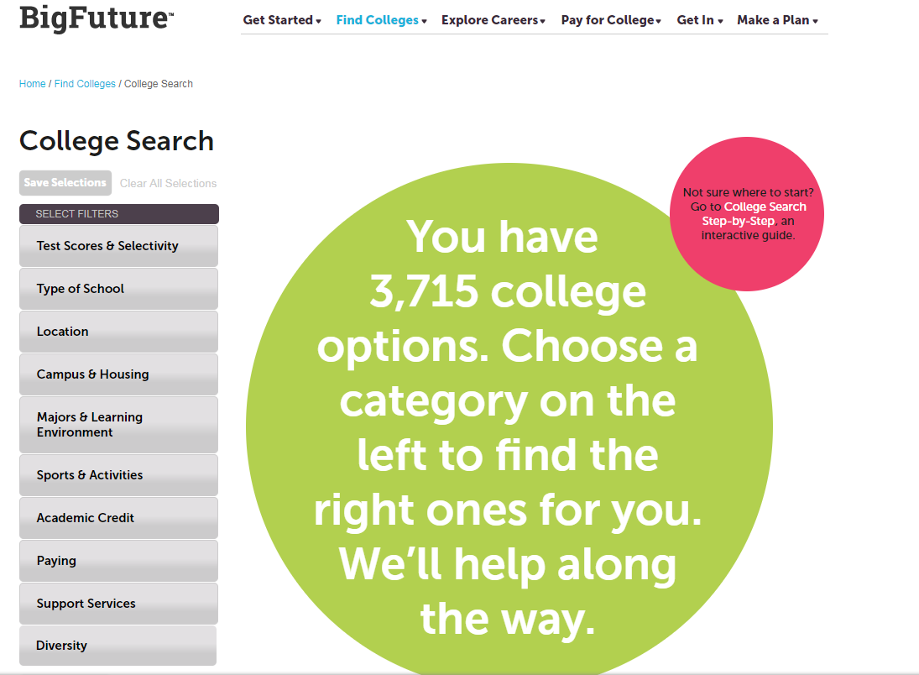
https://bigfuture.collegeboard.org

Slide 30

http://www.makemeafreshman.com

Slide 31

2018 Freshman Class Profiles
University of GA
In-State Tuition/Fees: $11,830
Top 10% of HS Class Rank: 52%
Top 25% of HS Class Rank: ~91%
Average ACT: 28-33
Average SAT: 1320-1490
Average GPA: 3.99-4.22 (approx. “A”)
# Freshmen: 5,852
Ga Tech
# Freshmen: 2,800
Average GPA: “A”
Average SAT: 1400-1520
Average ACT: 31-34
Top 25% of HS Class Rank: N/A
Top 10% of H.S. Class Rank: N/A
In-State Tuition/Fees: $12,424

Slide 32
College2018 College Freshman Profiles Class Profiles
GA State
GA College
Average GPA: 3.58 (high “B”)
Average GPA: 3.13 (low ”B”)
Average SAT: 1054
Average ACT: 24
Average SAT: 1221
Average ACT: 27
Average SAT: 981
Average ACT: 21
In-State Tuition/Fees: $10,858
In-State Tuition/Fees: $9,346
In-State Tuition/Fees: $7200
# Freshmen: ~4600
# Freshmen: ~1608
# Freshmen: ~1800
Columbus State
Kennesaw State
# Freshmen: ~4500
Average GPA: 3.25 (low “B”)
Average SAT: 1160
Average ACT: 23
Top 25% of HS Class Rank: 53%
Top 25% of HS Class Rank: N/A
Top 25% of HS Class Rank: 37%
Top 25% of HS Class Rank: ~N/A
Top 10% of HS Class Rank: N/A
Top 10% of HS Class Rank: N/A
Top 10% of HS Class Rank: 27%
In-State Tuition/Fees: $7,432
Top 10% of HS Class Rank: 11%
Average GPA: 3.4
(low - high “B”)

Slide 33

UGA BLOG: ugaadmissions.blogspot.com
:
UGA Admissions Deadlines
Top Ten Hints for Applying to College
Suggestions for Writing Admission Essays
Top Ten UGA Admissions Urban Legends
Transfer Admission FAQ
UGA on the Road

Slide 34


Georgia Tech Admission Blog:
http://pwp.gatech.edu/admission-blog/
You may have plotted the perfect course for your college experience, but you might have to change direction if those plans do not work out. I recommend students always ask colleges about their transfer options, especially if their ultimate goal is to enroll at a highly selective institution.

Slide 35

Junior Priorities & Next Steps
In School
Stay focused on academics
Do not lighten your academic load for senior year
Attend daily
Stay involved in school activities (commitment/leadership)
Standardized Testing
Prepare for and register for ACT / SAT tests as appropriate
Take AP tests as appropriate
College Exploration
Explore colleges on the Web
Visit colleges
Meet with college representatives
Attend college fairs

Slide 36
CHS Counseling Junior Advisement
Meet with your School Counselor for your Junior Advisement Meeting November – March

Slide 37
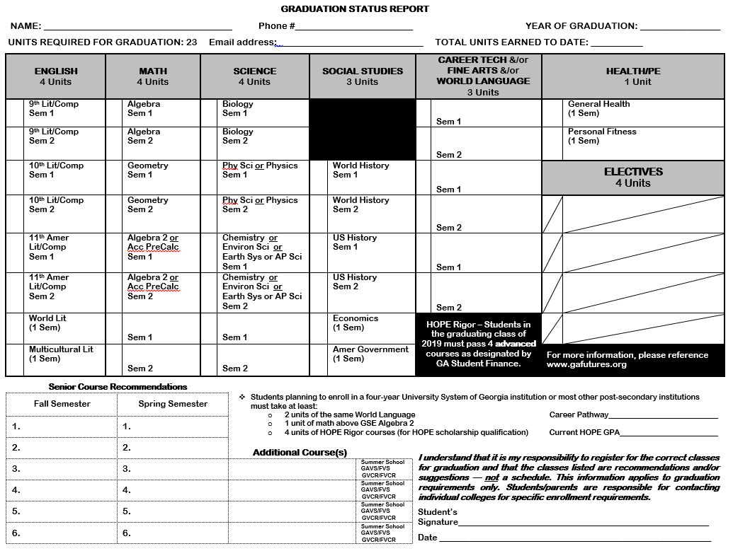

Slide 38
CHS Counseling
Important Dates For Juniors 2018-19
Advanced Placement (AP) Night
TBA

Slide 39
FINANCIAL AID
NIGHT
Wednesday
December 5, 2018
6:00 PM
Auditorium

Slide 40
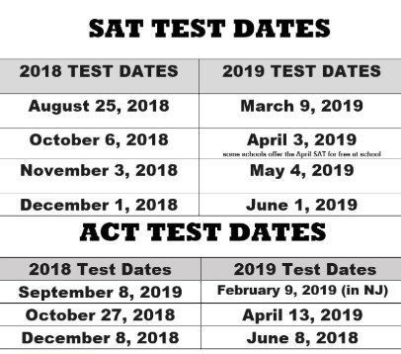
REGISTER FOR ONE OF THE UPCOMING TESTS:

Slide 41

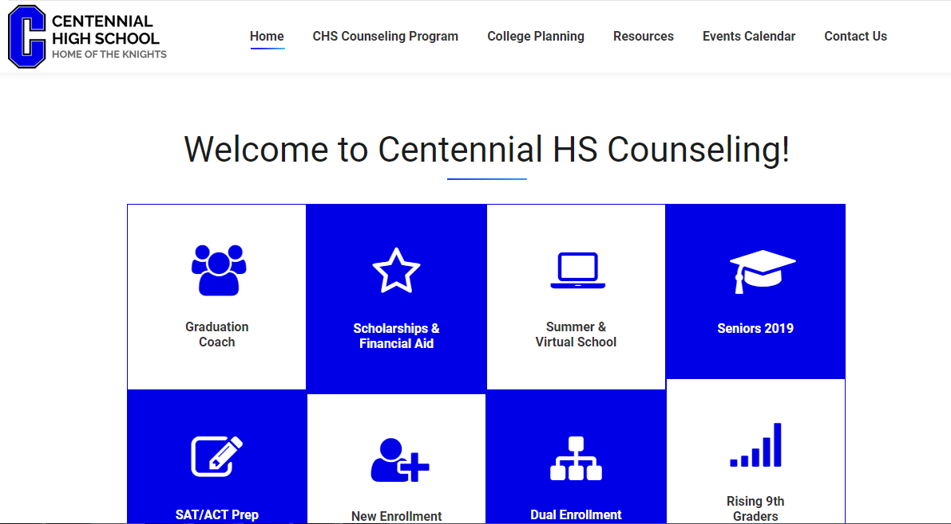
www.mycentennialcounseling.com

Slide 42

January 2019
Majors/Degrees
Location
Cost
School Size
Campus Life
JUNIOR CLASSROOM GUIDANCE LESSON
Part 2!

