Slide 1
What are Colleges Looking For?
Junior Classroom Guidance Part 1
Counseling Department
November, 2017
www.mycentennialcounseling.com

Slide 2
Materials and Agenda
Important Events and Dates for Juniors
What Colleges Look for in Applicants
What Selectivity Means for You
Match, Reach Safety Schools
ACT and SAT exams
College Planning Tips:
College Planning Checklist for HS Juniors

Slide 3
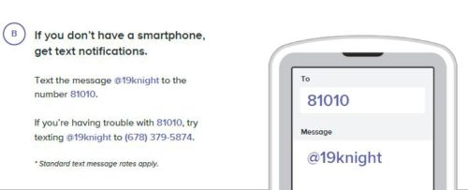
Remind 101 for Class of 2019

Slide 4


Follow Our Social Media Pages!!
*Scholarship Opportunities and Updates

Slide 5
What different types of colleges are there?

Slide 6
Two Year Technical College
Description | Tuition & Fees | Admission Requirements
Degrees offered: Associates, Certificate, Diploma Provides: Classes and degrees directly aligned with a particular career or job field. GA Technical College System has a 98% placement rate within six months of student graduation. | Approximately $4000 per year for full-time enrollment (Gwinnett Technical College) | High School Diploma ACCUPLACER typically required SAT / ACT optional

Slide 7
Two Year Junior College
Description | Tuition & Fees | Admission Requirements
Degrees offered: Associates Provides: A cost-effective option to start taking general college classes which could be applied towards a 4 year degree at a college or university Typically have student transfer agreements with four year colleges. | Approximately $6000 per year for full-time enrollment (GA State University at Perimeter College) | High School Diploma GPA may be evaluated (2.0 GPA minimum for GPC) SAT / ACT or other admission test may be required

Slide 8
Four Year Colleges & Universities
Description | Tuition & Fees | Admission Requirements
Degrees offered: Bachelors, Masters and/or Doctoral Provides: A well-rounded college experience. Typically have large selection of course offerings in variety of majors and programs of study | Public (In-State): Average approx. $9000 per year (does not include room/board) Public (Out-of-State): Average $23,000/year (does not include room/board) Private: Average $32,000/year | College Preparatory Curriculum GPA SAT / ACT Class rank Essay Extracurricular Activities Letters Of Recommendation

Slide 9
Admission to “Selective” Colleges
Just as students should search for the best college “fit,” selective colleges search for the best student “fit.”
College admission officers set a goal of crafting a well-rounded freshman class.
The college is looking for evidence that the applicant will be successful at their college.

Slide 10

Courses in progress Senior Year
Rigor of HS Courses
SAT/ACT scores
GPA
Activities & Accomplishments
Your Application
Essays
Essentially everything the college will know about you and who you are
Teacher & Counselor
Recommendation
Class Rank
Interview
Demonstrated Interest

Slide 11
General
College Admission Factors
Grades/GPA in college prep courses
Strength of high school course selections
Courses in progress Senior year
SAT / ACT Score(s)

Slide 12


RIGOR MATTERS!!
Are you demonstrating “intellectual curiosity”?
What classes have you taken to prepare you for success in college?
Have you maintained high grades in on-level classes but never taken Honors or AP classes?
What is the evidence that you are “college ready”?
There is no magic number of AP classes to get into a college.

Slide 13
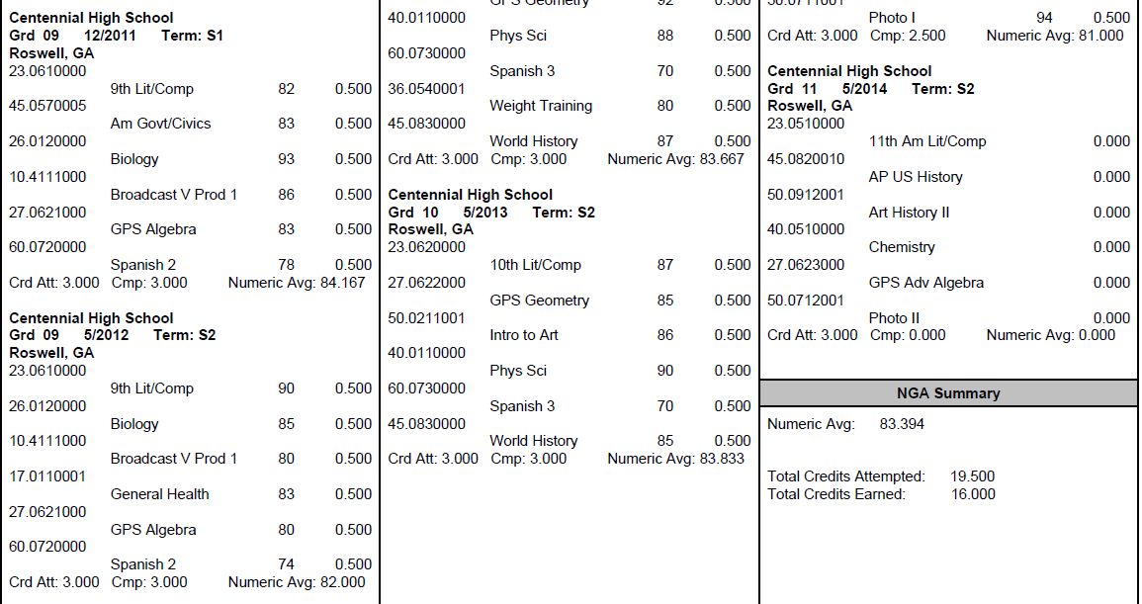
What is my GPA?
The numeric average of semester course grades including EVERY attempted high school course
GPAs are weighted and on a 100 pt scale (Fulton does not use a 4.0 scale)
Look up YOUR GPA on Home Access Center

Slide 14
Why an 80 GPA ≠ a 3.0 GPA
Student #1 |  |  | Student #2 |  |  | Student #3
Class Grade | Converted to 4.0 Scale |  | Class Grade | Converted to 4.0 Scale |  | Class Grade | Converted to 4.0 Scale
88 | 3 |  | 85 | 3 |  | 83 | 3
71 | 2 |  | 77 | 2 |  | 92 | 4
80 | 3 |  | 79 | 2 |  | 74 | 2
67 | 0 |  | 75 | 2 |  | 80 | 3
89 | 3 |  | 81 | 3 |  | 81 | 3
85 | 3 |  | 83 | 3 |  | 70 | 2
80.0 GPA on a 100pt scale | 2.33 GPA on a 4.0 scale |  | 80.0 GPA on a 100pt scale | 2.50 GPA on a 4.0 scale |  | 80.0 GPA on a 100pt scale | 2.83 GPA on a 4.0 scale

Slide 15

100 pt Scale vs. 4.0 Scale
Course Grades
81
82
80
70
90
81
3.0 GPA on a 4.0 scale
Course Grade
89
88
89
87
89
89
3.0 GPA on a 4.0 scale
80.6
GPA on a 100pt scale
88.5
GPA on a 100pt scale

Slide 16

What Factors are Colleges Considering?
College Admission Activity

Slide 17
ACT & SAT
Colleges will generally take scores from either test and treat them equally
Many colleges have minimum test scores required for admission
Some colleges may “super-score”
Recommended to send all scores---colleges will use the highest

Slide 18
ACT vs SAT : What’s the Difference?
ACT
  Length is 3 hours, 35 minutes (with essay)
  Areas tested include English, Math, Reading, Science, and optional essay (4 section scores plus optional essay)
  Register at http://www.actstudent.org/
SAT
  Length is 3 hours, 50 minutes (with essay)
  Areas tested include Evidence-Based Reading and Writing, Math, and optional essay (2 section scores plus optional essay)
  Register at https://sat.org/register

Slide 19

Prep for the Test!
Test Prep Classes (Princeton Review at Centennial!!)
Online Test Prep Resources (*Khan Academy)
Practice Mock Tests
ACT/SAT Diagnostic Tests
Test Prep Apps
Test Prep Books
Collegeboard.org – free practice questions
ACTstudent.org – free practice questions
Remember that the best preparation includes taking college prep classes and reading as often as possible!

Slide 20
Other Admission Factors…
Activities and accomplishments (leadership, commitment, uniqueness)
Letters of Recommendations
(Counselor, Teacher, Other)
Application Essay(s)
Student’s demonstrated interest

Slide 21

Other Potential Factors….
EXTRACURRICULAR ACTIVITIES

Slide 22

Other Potential Factors….
LETTERS of RECOMMENDATION

Slide 23

Other Potential Factors….
ESSAYS

Slide 24

Finding Your College Fit
Limiting Factors:
Admissions Difficulty
  Match
  Reach
  Safety
Costs, excluding aid
Specific high school courses required

Slide 25

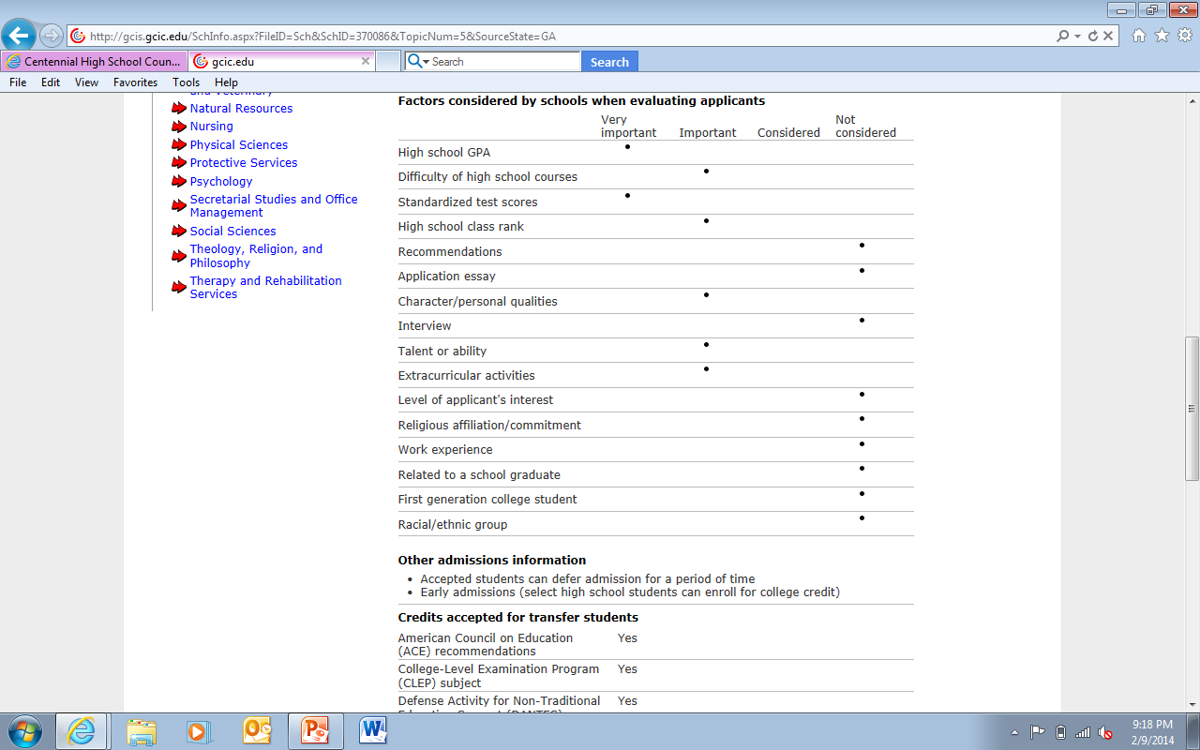
Research potential college options to discover which factors are most important
Factors for Valdosta State University

Slide 26
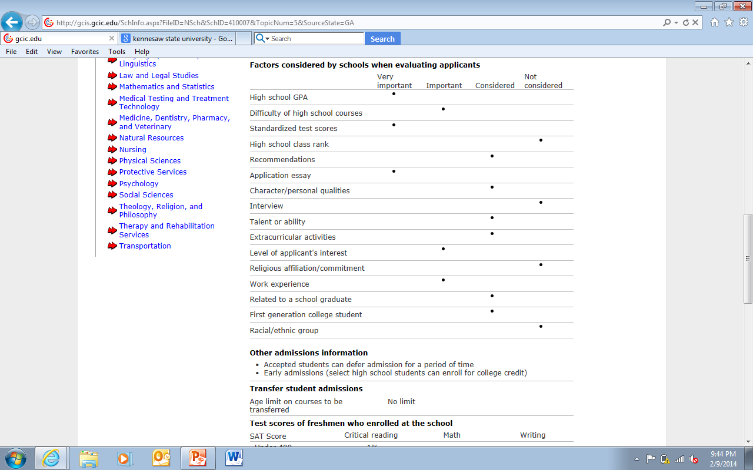
Research potential college options to discover which factors are most important
Factors for Auburn University

Slide 27

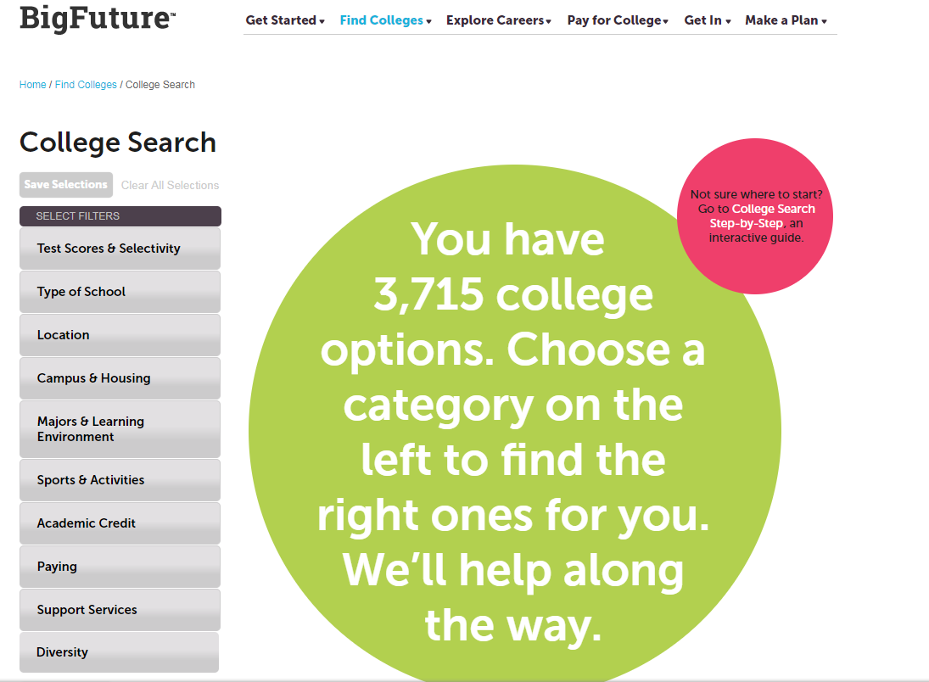
https://bigfuture.collegeboard.org

Slide 28
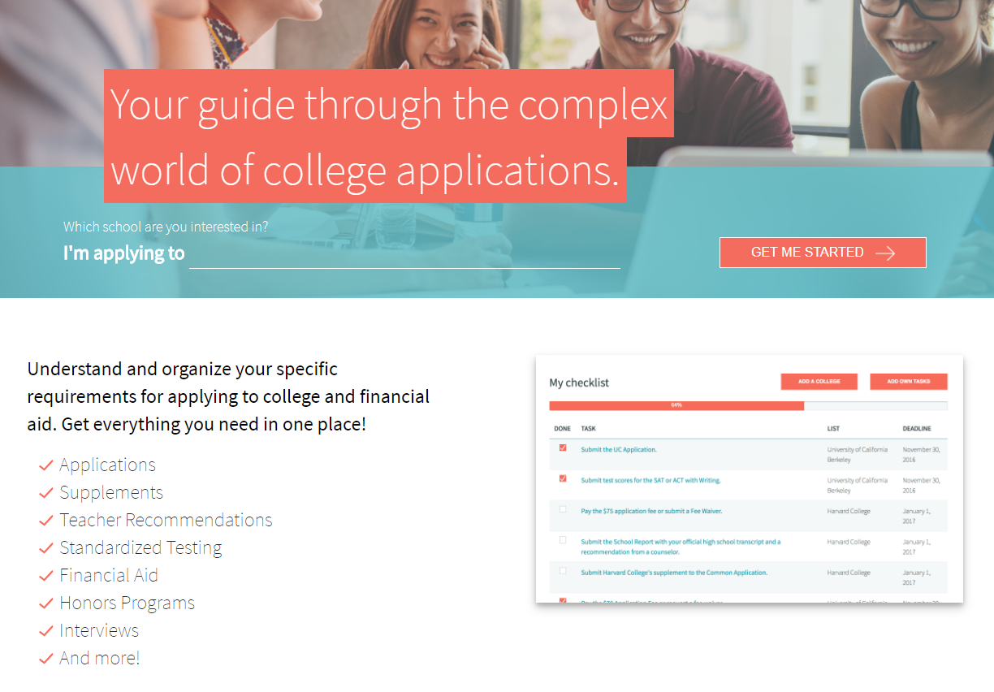
http://www.makemeafreshman.com

Slide 29

2017 Freshman Class Profiles
University of GA
In-State Tuition/Fees: $11,818
Top 10% of HS Class Rank: 52%
Top 25% of HS Class Rank: ~91%
Average ACT: 28-32
Average SAT: 1220-1360
Average GPA: 3.88-4.13 (approx. “A”)
# Freshmen: 5,839
Ga Tech
# Freshmen: 2,800
Average GPA: “A”
Average SAT: 1360-1490
Average ACT: 30-34
Top 25% of HS Class Rank: N/A
Top 10% of H.S. Class Rank: N/A
In-State Tuition/Fees: $12,418

Slide 30
2017 Freshman Class Profiles
GA State
GA College
Average GPA: 3.58 (low to high “B”)
Average GPA: 3.15 (low ”B”)
Average SAT: 1030-1230
Average ACT: 20-25
Average SAT: 1150-1270
Average ACT: 26
Average SAT: 990
Average ACT: 20
In-State Tuition/Fees: $10,686
In-State Tuition/Fees: $9346
In-State Tuition/Fees: $7200
# Freshmen: ~3900
# Freshmen: ~1450
# Freshmen: ~1800
Columbus State
Kennesaw State
# Freshmen: ~4500
Average GPA: 3.23 (low “B”)
Average SAT: 1070-1250
Average ACT: 21-26
Top 25% of HS Class Rank: 53%
Top 25% of HS Class Rank: N/A
Top 25% of HS Class Rank: 37%
Top 25% of HS Class Rank: ~N/A
Top 10% of HS Class Rank: N/A
Top 10% of HS Class Rank: N/A
Top 10% of HS Class Rank: 27%
In-State Tuition/Fees: $7432
Top 10% of HS Class Rank: 11%
Average GPA: 3.2-3.7
(low to high “B”)

Slide 31

Junior Priorities & Next Steps
In School
Stay focused on academics
Do not lighten your academic load for senior year
Attend daily
Stay involved in school activities (commitment/leadership)
Standardized Testing
Prepare for and register for ACT / SAT tests as appropriate
Take AP tests as appropriate
College Exploration
Explore colleges on the Web
Visit colleges
Meet with college representatives
Attend college fairs

Slide 32
CHS Counseling Junior Advisement
Meet with your School Counselor for your Junior Advisement Meeting November – February

Slide 33
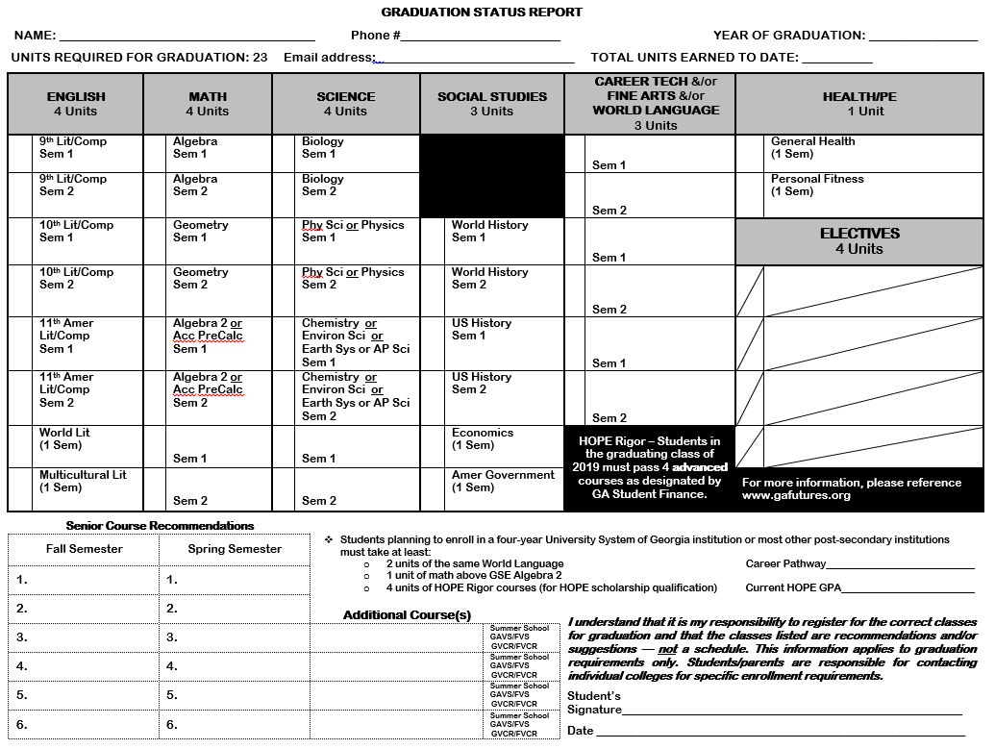

Slide 34
FINANCIAL AID
NIGHT
Tuesday
November 28, 2017
6:30 PM
Auditorium

Slide 35
CHS Counseling
Important Dates For Juniors 2017-18
Dual Enrollment Night
Wednesday, November 8
6:00pm CHS Auditorium
Advanced Placement (AP) Night
January 30th
Time 6:00 pm

Slide 36

January 2018
Majors/Degrees
Location
Cost
School Size
Campus Life
JUNIOR CLASSROOM GUIDANCE LESSON
Part 2!

