Slide 1
Centennial High School College Week
November 14th – 18th, 2011
Event Summary
By: Shellie Caplinger
Professional School Counselor/Dept Chair

Slide 2
Fostering the College Going Culture at CHS
Teachers promoted the importance of Post-Secondary Education
Hispanic Scholarship Fund Presentation
Engaging in Classroom Discussions
Showing their Alma-Mater pride
Making connections via staff bulletin board
HSF Presentations for 11th and 12th grade Latino students
Providing access to scholarship opportunities for students, regardless of documentation status

Slide 3
CHS’ Georgia Apply to College Event: An Opportunity for EVERY Centennial Senior!
Students accessed the event in various computer labs during their English class
Participating students received hands-on assistance from college representatives, school counselors, parent & community volunteers.
Volunteers provided information, clarification and reassurance to students.
Representatives from Georgia Perimeter College Transition Services spoke with students w/special needs about accessing student services at the college level.
Students asked questions about the college application process.

Slide 4
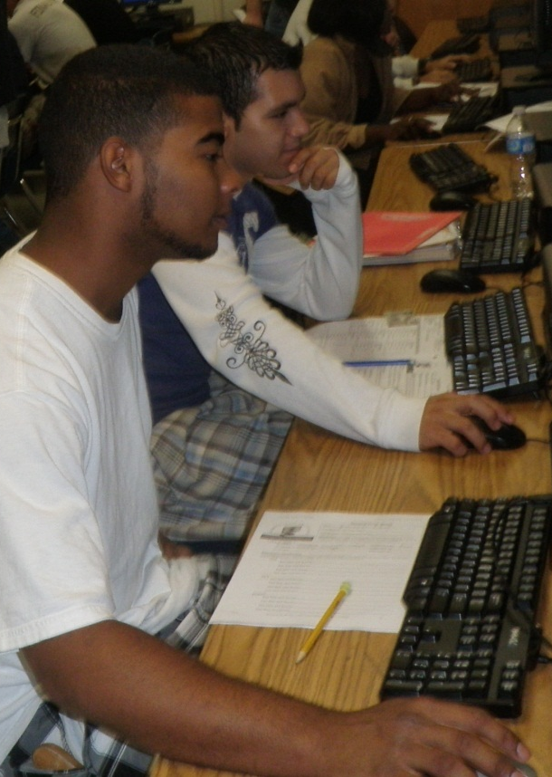
Student Feedback
The most helpful or best aspect of this event was….
“having people answer questions about technicalities and application questions”
“being able to sit down and focus on my application with NO distractions”
“being able to apply with the school’s help”
“it put me in front of a computer and made the time for me to apply to college”
“Any questions or concerns I had were answered and made the process easier”
“it shows students how important is college”
“there were many volunteers to aid students with any questions pertaining the to college applications”
“I learned how to apply to college now, it really helps”
“Being able to get the application done in one class period! Plus with all the great helpers”

Slide 5
GA Apply to College Event Outcome Data:
166 CHS Seniors participated in the event on November 17th
83.3% of surveyed students reported the event encouraged them to apply earlier than they would have otherwise
52.6% of surveyed students reported he event influenced their decision to apply to college
95% of surveyed students recommended that Centennial continue to offer this event in the future

Slide 6
College Week Outcome Results:
As of November 22nd, over 300 of CHS Seniors had completed college applications.
This is a 33% increase as compared to # of students who had applied by the end of 1st semester each of the past 2 school years

Slide 7
For additional information about this event and/or the Centennial HS School Counseling Program, please contact:
Shellie Caplinger
Professional School Counselor/ Head Counselor
Centennial High School
9310 Scott Road
Roswell, GA 30076
770-650-4260
Email: caplinger@fultonschools.org

