Slide 1


Class of 2020 Senior Classroom Guidance
Centennial HS Counseling

Slide 2

POST-SECONDARY OPTIONS:
2-YEAR OR 4-YEAR COLLEGE/UNIVERSITY
TECHNICAL COLLEGE/TRADE SCHOOL
MILITARY ENLISTMENT
EMPLOYMENT

Slide 3
CENTENNIAL COUNSELING DEPARTMENT
A-Cas Mr. Jones JonesW3@fultonschools.org
Cat-Harp
Ms. Ekpo EkpoN@fultonschools.org
Harq-Mep Mrs. Ruppe Ruppe@fultonschools.org
Meq-Sal
Ms. Freeman freemanMA@fultonschools.org
Sam-Z Ms. Peart peart@fultonschools.org
Grad Coach
Mrs. Rigsbey RigsbeyA@fultonschools.org

Slide 4

QUESTION….
What fears do you have about applying to college?
On a scale of 1-10 rank your
level of anxiety
(10 being the most anxious)

Slide 5

OVERCOMING THE FEARS ABOUT COLLEGE
ONE STEP AT A TIME
THE APPLICATION
REQUESTING A TRANSCRIPT
Letters of Recommendation
SAT/ACT/ACCUPLACER tests
Essay
Track Your Progress

Slide 6
REVIEW:
SELECTING A COLLEGE

Slide 7
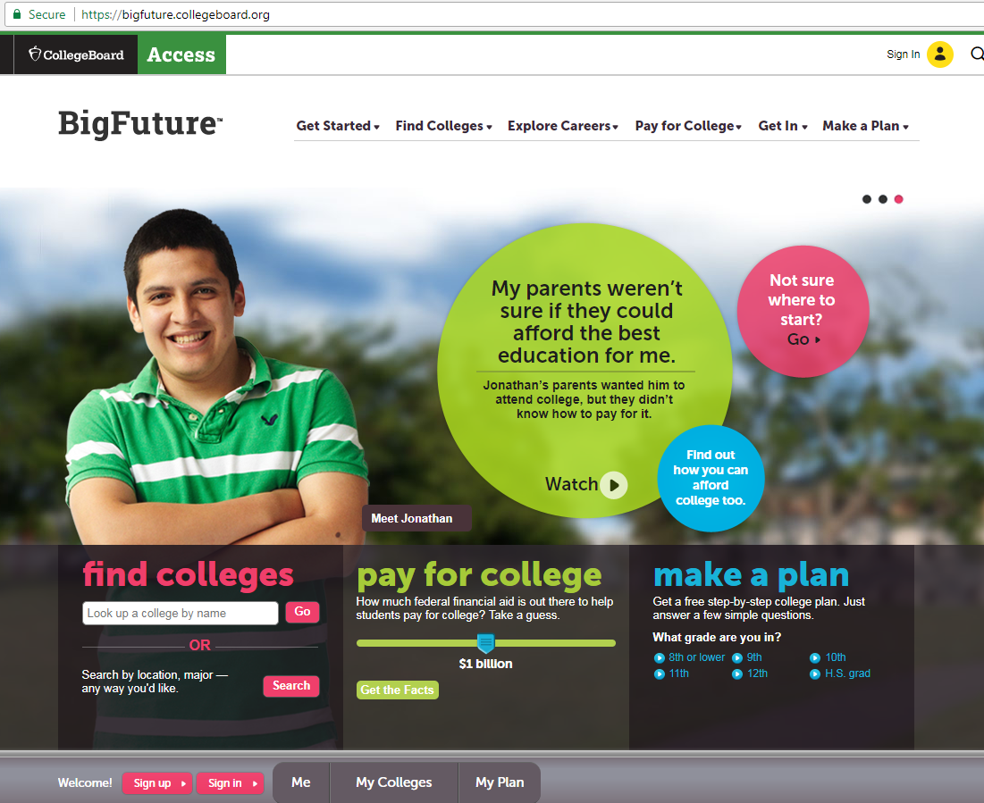
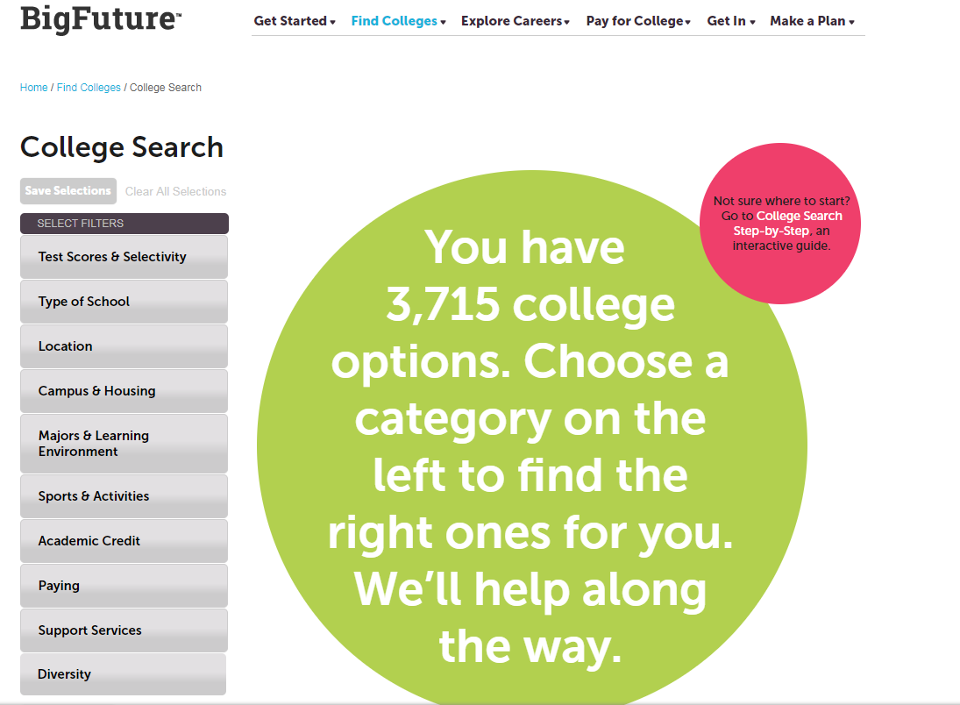
HELPFUL RESOURCE
https://bigfuture.collegeboard.org

Slide 8


Slide 9


NEW MINIMUM PLACEMENT REQUIREMENTS
SAT, ACT, ACCUPLACER or MILESTONE ELA SCORES
PSAT SCORES TAKEN AFTER MARCH 2016
HOPE GPA OF 2.6 OR HIGHER, FOR 11TH & 12TH GRADERS
TEST SCORE AGE LIMIT HAS BEEN REMOVED FROM POLICY
ENTRY LEVEL WORKFORCE CERTIFICATES REQUIRES 2.0 MIN GPA
*SOME TECHNICAL COLLEGES MAY STILL REQUEST HIGHER REQUIREMENTS*

Slide 10
The Online Application
Step 1:

Slide 11



THE APPLICATION PORTALS
Create an account
Review the list of required documents
Use your application checklist
Parts of an application are not typically sent or received at the same time

Slide 12
Meeting Your Deadline = ALL Required Documents have been Submitted
KNOW YOUR DEADLINES
Early Decision
Binding (Cannot Apply to Other Colleges)
Early Action
Not Binding
UGA and GA Tech *UGA will require an essay; counselors will need your senior profile/resume*
Regular Decision
Not Binding
Rolling Admissions
Review of application is on-going
Kennesaw State; May deadline/notifications on-going
Open Admissions
Review of application is on-going
Deadlines and Notifications vary
UGA and Georgia Tech
Emory
If DEFERRED, student can reapply under Regular Decision

Slide 13

COMPLETING THE APPLICATION
Personal Data (address, citizenship, demographic info)
Education (schools you attended)
Test Info
Family History
Extracurricular Activities
Academic Honors
Work Experience
Essay/Personal Statement
Digital Signature

Slide 14

for Completing your application
Print out a hard copy to fill out as a rough draft
Have all info you need on hand
resume
Save your work as you go
Check Spelling and Grammar
list of school & community activities
contact info for letters of recommendations
family/parent history
SUBMIT!
Include Application Fee
GPA on a 100-point scale

Slide 15

HELPFUL RESOURCE
http://www.makemeafreshman.com

Slide 16
Official Transcripts
Step 2:

Slide 17

REQUESTING TRANSCRIPTS
THE PROCESS
ALL TRANSCRIPTS WILL BE REQUESTED & RELEASED THROUGH PARCHMENT

Slide 18
REQUESTING TRANSCRIPTS
THE PROCESS
STEP ONE:
ENTER THE PARCHMENT WEBSITE VIA www.Parchment.com
STEP TWO:
FOLLOW THE SCREEN INSTRUCTIONS FOR ACCOUNT REGISTRATION AND
TRANSCRIPT RELEASE
STEP THREE:
TRACK YOUR COLLEGE APPLICATIONS TO ENSURE THAT COLLEGES HAVE RECEIVED YOUR TRANSCRIPT

Slide 19

REQUESTING TRANSCRIPTS
THE PROCESS
PARCHMENT PREVIEW:
START HERE
& CLICK
‘ORDER MY TRANSCRIPT OR CREDENTIALS’

Slide 20
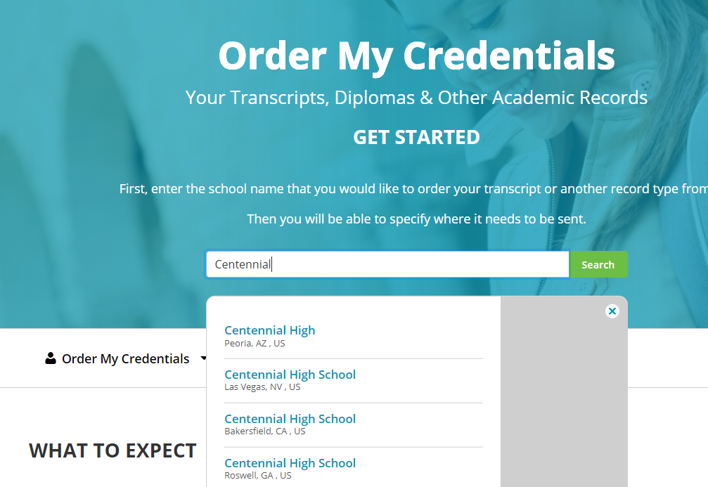
REQUESTING TRANSCRIPTS
THE PROCESS
PARCHMENT PREVIEW:
ENTER CENTENNIAL
HIGH SCHOOL
IN THE SEARCH
BOX.
BE SURE TO CLICK THE CHS OF ROSWELL, GA

Slide 21
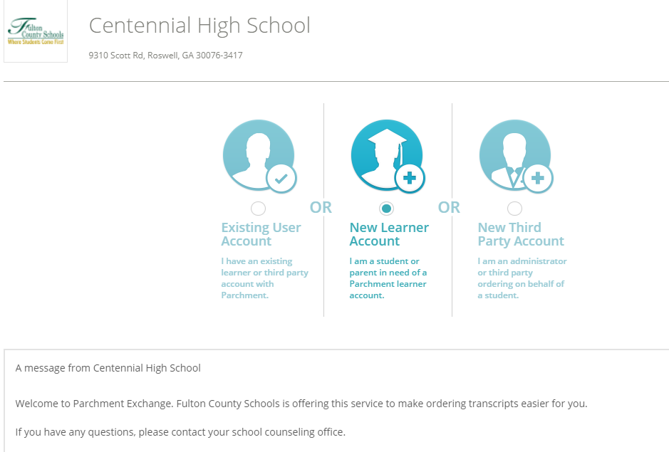
REQUESTING TRANSCRIPTS
THE PROCESS
PARCHMENT PREVIEW:
REQUEST A NEW LEARNER ACCOUNT

Slide 22
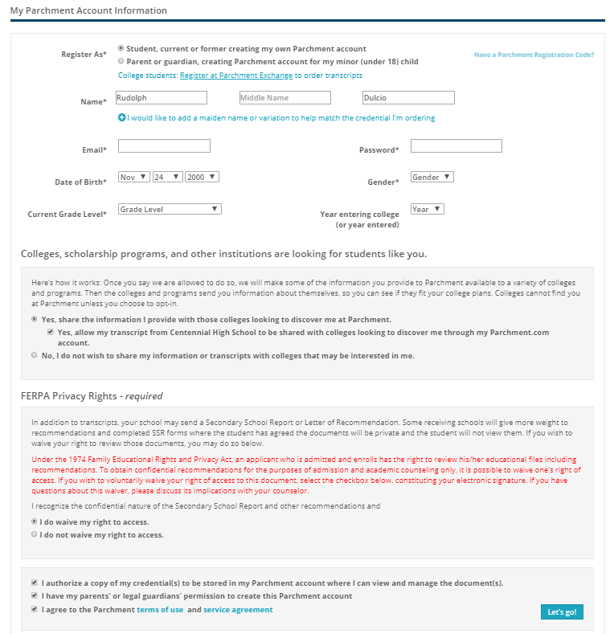
REQUESTING TRANSCRIPTS
THE PROCESS
PARCHMENT PREVIEW:
ALLOW CHS
TO SEND YOUR TRANSCRIPT TO COLLEGES OF YOUR CHOICE
ANSWER THE
FERPA QUESTION
REGARDING PRIVACY RIGHTS

Slide 23
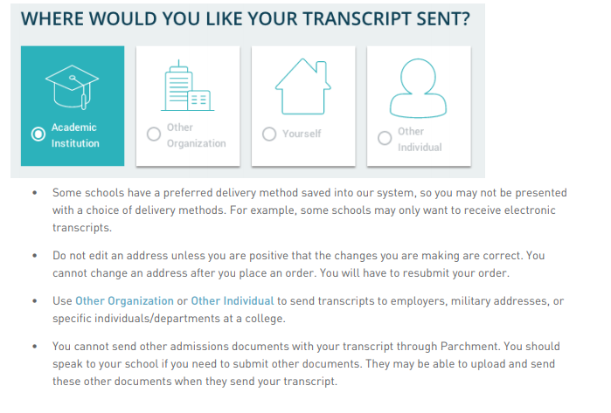
REQUESTING TRANSCRIPTS
THE PROCESS
PARCHMENT PREVIEW:

Slide 24
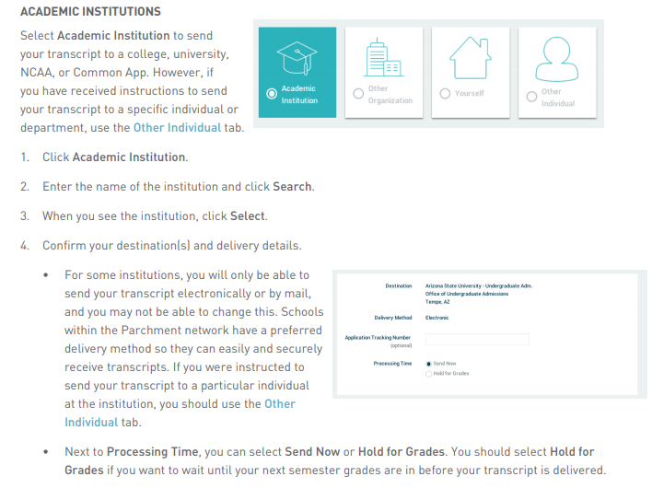
REQUESTING TRANSCRIPTS
THE PROCESS
PARCHMENT PREVIEW:
SELECT THE INSTITUTION(S)
THAT SHOULD RECEIVE
YOUR TRANSCRIPT AND THEN SELECT
‘CHECKOUT’ TO COMPLETE YOUR REQUEST

Slide 25
Letters of recommendation
Step 3:

Slide 26
REQUESTING
LETTERS OF RECOMMENDATION
THE PROCESS
Enter your counselor’s name & e-mail address in the college application where counselor information is requested
Present a copy of your SENIOR PROFILE to your counselor

Slide 27
REQUESTING
LETTERS OF RECOMMENDATION
THE RULES
Requests must be made AT A MINIMUM OF 10 school days before the deadline
It is YOUR responsibility to follow up with the college to make sure they have received the transcript & LOR
A hard copy of an official transcript is available for pick up

Slide 28
REQUESTING
LETTERS OF RECOMMENDATION
THE RULES
Track the delivery of your transcript & LORs through your college account
Counselors will not complete a
recommendation letter without a written or
electronic request

Slide 29

OTHER RECOMMENDATION WRITERS
Teachers, Coaches/Club Sponsors, Mentors, Administrators, etc. may serve as recommenders
Ask the recommender for permission first
Provide the recommender a copy of your senior profile
Provide a MINIMUM notice of 10 School Days
Submit recommenders name & e-mail into online application
If the college does not require a letter of recommendation, they will not accept or review any letters submitted.

Slide 30
Entrance exams
Step 4:

Slide 31

ENTRANCE EXAMS:
SAT, ACT & ACCUPLACER
SAT (www.collegeboard.org) and ACT (www.actstudent.org)
Register for the test (select a date and location, upload a picture, and make the payment)
Receive test scores
Send scores to selected colleges (before and/or after exam)
Create your account
ACCUPLACER Test
Placement test accepted at most 2-year colleges
Colleges proctor this exam on their campuses

Slide 32

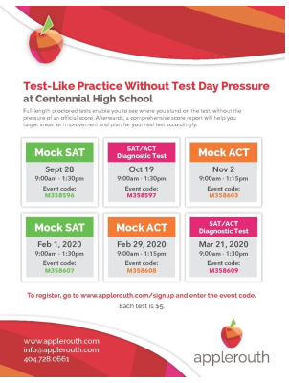
SAT/ACT PREP

Slide 33

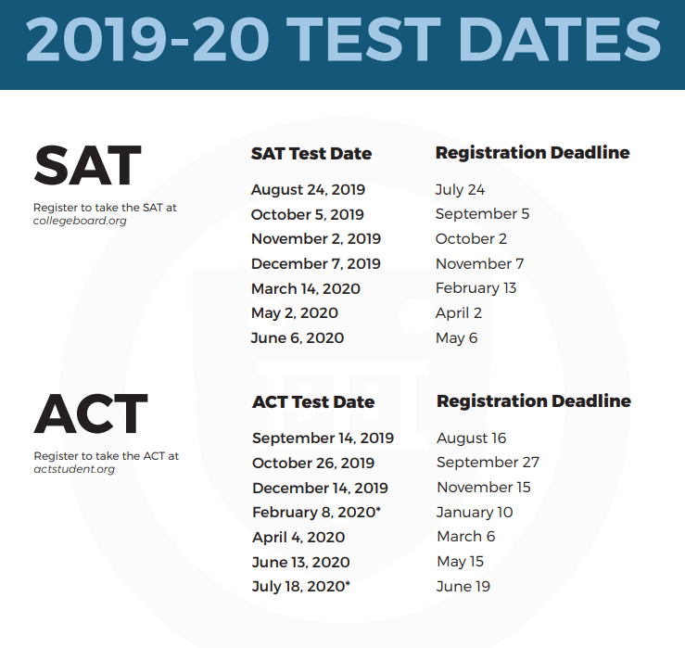
I HAVEN’T TESTED YET…CAN I STILL APPLY?
REGISTER FOR ONE OF THE UPCOMING TESTS:
YES
NO
Applications are incomplete until EVERYTHING has been received by the college, INCLUDING TEST SCORES

Slide 34
The Essay
Step 5:

Slide 35

The College Application Essay
Tips
Select the Best Topic & Subject for you
Answer the Question
Check Your Ego at the Door
Accentuate the Positive
Research the College Before Writing the Essay
Invest in a Strong Intro
Mistakes
Don’t Exceed the Requested Essay Length
Don’t Appear Self-Interested or Materialistic
Don’t Rely on Your Computer’s Spell Check
Don’t Rehash the Resume
Don’t Fall in Love with the Thesaurus
Don’t Wait until the Last Minute

Slide 36
WHAT IS YOUR NEXT STEP…
Finalizing Your List of Colleges?
College Reps
College Campus Visits
College Fairs
Preparing to Apply?
Fill in College Application Checklist for each college
Ready to Get Started?
Designate a time to complete the application
Create a timeline to complete each required component
Follow up on any areas you have not started yet
Submit each separate application requirement
After you submit the application, monitor your application status
Contact the college’s office of admissions with application status questions
www.makemeafreshman.com is a useful tool to keep track of deadlines
Websites
Financial Aid Questions?
Counselors will be entering senior classrooms again in January for a Financial Aid lesson
Complete FAFSA (starting in October)
www.finaid.org has a lot of great information regarding financial aid options
FINANCIAL AID NIGHT: NOVEMBER 20, 2019 @ 6PM

Slide 37


2019 COLLEGE/CAREER MONTH:
OCTOBER 2019
CHS Apply to College Day
OCTOBER 24, 2019
All Senior English Classes
College Month Events
of Special Interest to Seniors

Slide 38

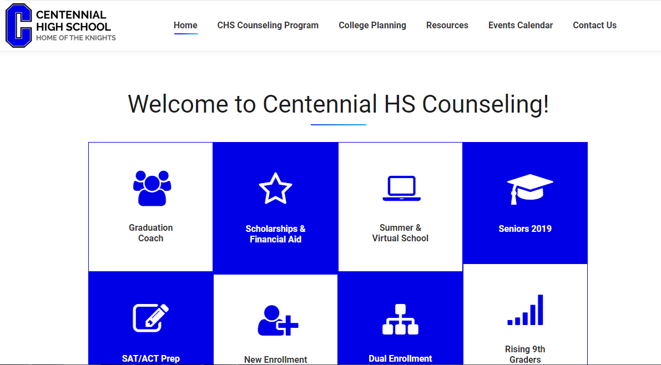

www.mycentennialcounseling.com

Slide 39
JOIN THE CLASS OF 2020 REMIND & GOOGLE CLASS
JOIN Counseling Remind 101 for Class 2020 – Text @2020CHSkni to 810-10 to get important senior updates from the Counseling office on your phone!
Join Senior Class Google Classroom –
Use Class Code: mcyffn to get information on Senior Treats, Senior Week, Graduation & more

Slide 40

SUMMATIVE CLASS ACTIVITY:
PUTTING THE TOOLS INTO ACTION

Slide 41


We are looking forward to a great year!

