Slide 1
Class of 2021 Freshman Class Room Guidance
Freshman Classroom Guidance – Part 2
February 20, 2018
Presented by:
The Centennial High School Counseling Department and Mr. Bray

Slide 2
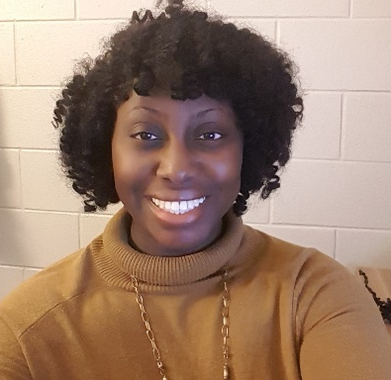
2017-18 Counseling Dept. Staff
Zyer Beaty
A - Cas
Nsikan Ekpo
Cat - Harp
Heidi Graver
Harq - Mep

Slide 3

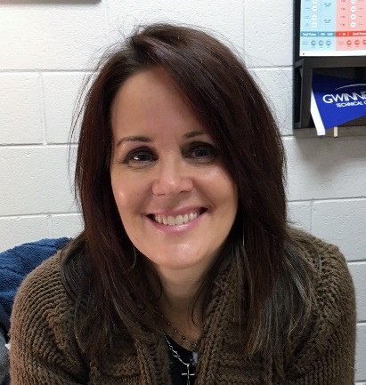
2017-18 Counseling Dept. Staff
Melissa Freeman
Meq - Sal
Hella Peart
Sam - Z
Anne Rigsbey
Graduation Coach

Slide 4
Graduation Requirements
Subject Area | Required # of Credits
Language Arts | 4 credits
Math | 4 credits
Science | 4 credits
Social Studies | 3 credits
Health Personal Fitness | .5 credit .5 credit
Pathway Courses | 3 credits
Electives | 4 credits
 | 23 total credits

Slide 5
Graduation Requirements
Carnegie Units
1 Semester class = .5 credit
1 Yearlong class = 1 credit (.5 earned per semester)
HS credits earned in Middle School
Students can earn HS credit for English, Math, Physical Science, World Language, Art, Digital Tech, and/or Engineering. Count towards overall GPA but not HOPE/Zell Miller.
7th and 8th grade World Language equals 1.0 HS credit.
Promotion
Freshmen: 0 – 4.5 credits
Sophomores: 5.0 – 10.5 credits
Juniors: 11.0 – 16.5 credits
Seniors: ≥ 17.0 credits
Grade of 70 or higher is required to pass a course (grades are not averaged across semesters)
Per county policy, students will remain with their graduating class, regardless of credits (unless credit-deficient).

Slide 6

Rigor of High School Courses
Grade Point Average (GPA)
SAT/ACT scores
Essays
Activities & Accomplishments
College Admissions 101
Senior Year Courses
Essentially everything the college will know about you and who you are.
Teacher & Counselor
Recommendations
Interview
Demonstrated Interest

Slide 7

Factors in Course Selection
Motivation
Interest
HOPE/Zell Miller (GPA, rigor, and test score requirements)
Prerequisites
College/ Career Goals
Schedule as a whole
Extracurricular commitments
Teacher Recs
Inside scoop: Look at this year’s schedule/grades/stress level and compare it to proposed schedule for 2018-2019, taking into account any changes in commitments outside of school.

Slide 8
4 Year Academic Plan
A Map to Your Future

Slide 9

Required Academic Classes
Language Arts (4 Credits)
9th Grade Lit
10th Grade Lit
11th Grade Lit
Multicultural Lit (.5) / World Lit (.5)
  *Required Summer Reading for all Honors and AP level Lang Arts courses.

Slide 10
Required Academic Classes
Language Arts (4 Credits)
Recommended Sequence
AP Lang (10)
AP Lit (11)
Non-Recommended Sequence
Required Social Studies Courses
World Lit H (10)
11th Lit H or AP Lang (11)
AP Lit or College English (12)
US History or AP US History (11)
Econ / Government or AP (12)
College English (12)
10th Lit H (9)
N/A
World History H or AP World History (10)
10th Lit H (9)

Slide 11

Required Academic Classes
Mathematics (4 Credits)
On-Level
Accelerated Geometry Hon (10)
Accelerated Pre-Calculus Hon (11)
Accelerated
Honors
Geometry (10)
Algebra 2 (11)
Approved 4th Math Course (12)
Algebra 2 (10)
PreCalculus Honors (11)
AP Math or Dual Enrollment Math
Algebra (9)
Algebra Honors (8)
Geometry Honors (9)
Accelerated Algebra Hon (9)
● Honors Level: Same pace and content as on-level courses; but students are 1 year ahead in math (starts in 8th Grade).
● Accelerated: Very rigorous/fast paced; students complete 3 years of math courses in 2 years.

Slide 12

Required Academic Classes
Science (4 Credits)
Biology
Physical Science or Physics
Chemistry, Environmental Science, Earth Systems or an AP Science class
Approved 4th Science Course

Slide 13

Required Academic Classes
Social Studies (3 Credits)
World History
US History
Economics (1 semester)*
American Government
(1 semester)*
* AP Economics and AP Government are both offered as yearlong courses.

Slide 14


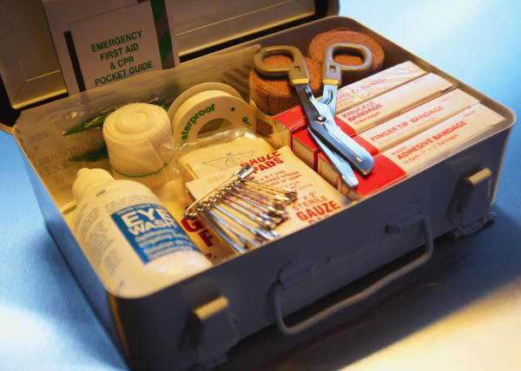
Additional Required Classes
Physical Education (1 credit)
General Health
(1 semester)
Personal Fitness
(1 semester)

Slide 15


Centennial’s Personal Fitness Exemption
Exempt Personal Fitness through participation in 1 of 3 possible CHS activities:
● Athletics  Marching Band  JROTC
Once criteria has been met, student will pick up a Personal Fitness Exemption form outside of room H-75.
The Personal Fitness Exemption form requires a signature from the designated school staff for their activity verifying the student completed the participation criteria.
Intent to Exempt Contract: In 8th Grade, students indicated their intent to exempt Personal Fitness. Those students will not be scheduled for a Personal Fitness course in grades 9-11.
Deadline to meet criteria and submit completed Exemption Form to H-75: Last Day of School Junior Year

Slide 16
Additional Required Courses
3 Credits are required in any of the following areas: Credits can all be in the same area or mix & matched
World Languages
Career Tech (CTAE) Courses
Fine Arts

Slide 17
Completing a Pathway:
What is a pathway?
Why become a pathway completer?
A pathway is a sequence of 3 specific courses focusing on an area of study.
Students are strongly encouraged and expected to complete a pathway in an area of interest and/or which relates to future college and career goals.

Slide 18
Pathway Offerings at Centennial
Advanced Academics
Allied Health Services
Audio/Video Tech & Film
Computer Science
Emergency Responder Services
Engineering & Technology
Food & Nutrition
Journalism
JROTC
Law Enforcement Services
Performing Arts
Programming
Visual Arts
Game Design
World Languages
Financial Services

Slide 19

Career Focused
Pathways
(CTAE)
Allied Health Services (Health Science)
Audio/Video Tech & Film
Financial Services
Engineering & Technology
Food & Nutrition
JROTC (ARMY)
Computer Science
Programming
Game Design
Law Enforcement Services
Emergency Responder Services (Health Science)

Slide 20

Fine Arts
Art
Chorus
Drama
Band
Orchestra

Slide 21

World Languages
French: 1, 2, 3, 4, 5, AP
Spanish 1, 2, 3, 4, 5, AP
German 1, 2, 3, 4, AP
*GA Board of Regents requires a minimum of 2 credits of the same World Language to meet 4 year college admissions criteria.

Slide 22
Registering for Classes for 2018-19 School Year
Consult with current teacher(s) and/or potential AP teacher(s)
IMPORTANT DATES (Tentative)
SCHEDULE CHANGES & FINALIZING COURSE REQUESTS for 2018-19
February 13-27: Verification #1 will be reviewed during Scheduling Blitz.
March 5: Verification #2 will be distributed to students. Due back to counselors March 8.
Students/parents make schedule corrections and changes on the form and turn in to the bins outside of the Assistant Principal’s office
Review course catalog on www.chsknights.com
Includes course descriptions, pre-requisites, and placement guidelines
March 19: Verification #3 will be distributed to students (parent signature requested).

Slide 23
Spring Registration Deadlines for 2018-19 School Year
COURSE PLACEMENT WAIVERS: AP waivers are due February 9th. Honors waivers are due March 8th.
Course Waiver requires parent/teacher consultation.
AP Waiver forms will be provided by the AP teacher. Students should complete and upload AP Waiver form to Google Classroom.
ONLINE COURSE REQUEST CONTRACTS: Online Course Request contracts are due March 8th.
Students planning to take an online course during Summer 2018 or during the 2018-19 school year.
Online course registration will not be approved without an “Online Course Request” contract on file.
Forms for Non-AP classes available in AP and Counseling office.
Complete and return forms to Counseling Office.
Students will confirm on the verification form that they want to take an online class.
Students register for the course on the online platform.

Slide 24
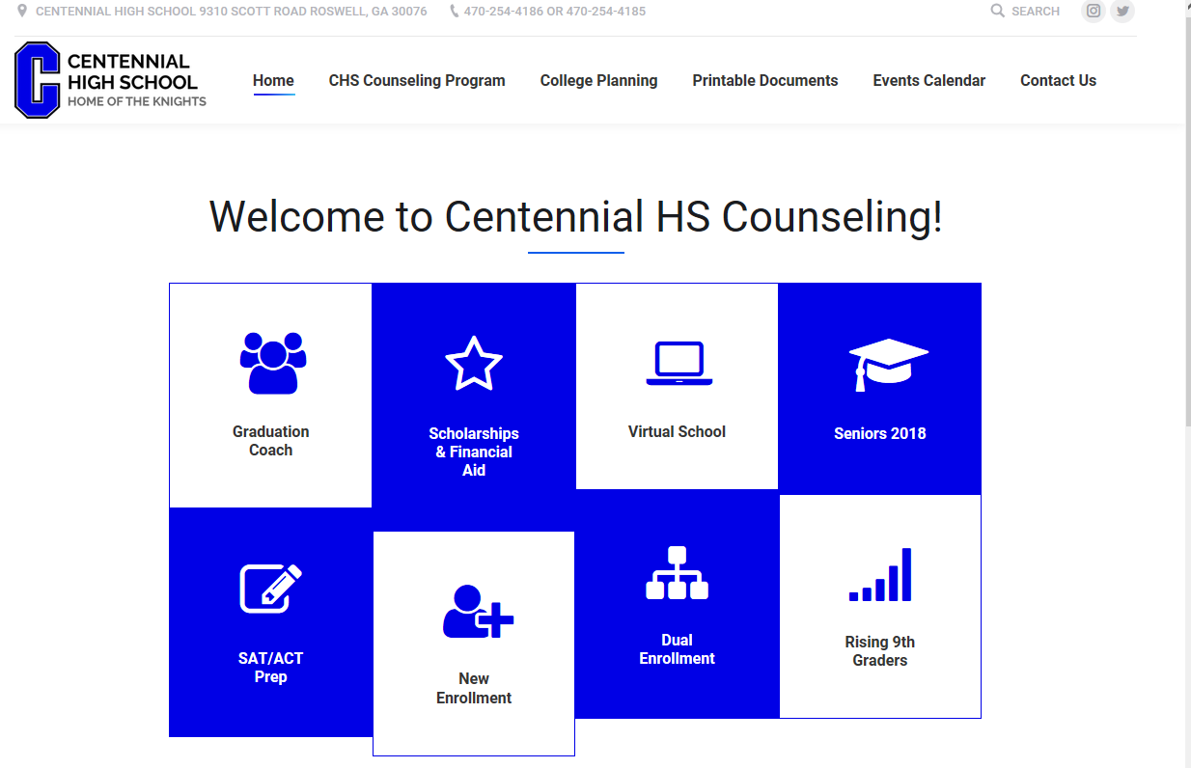
Visit us at www.mycentennialcounseling.com

Slide 25
Resources
School: www.chsknights.com
Counseling: www.mycentennialcounseling.com
GCIS: www.gcic.peachnet.edu
PTSA: www.centsptsa.org
GA Futures: www.gafutures.org

Slide 26
Moving Forward
This is a PLAN…it is subject to change
Course Registration
Transcript Issues

