Slide 1

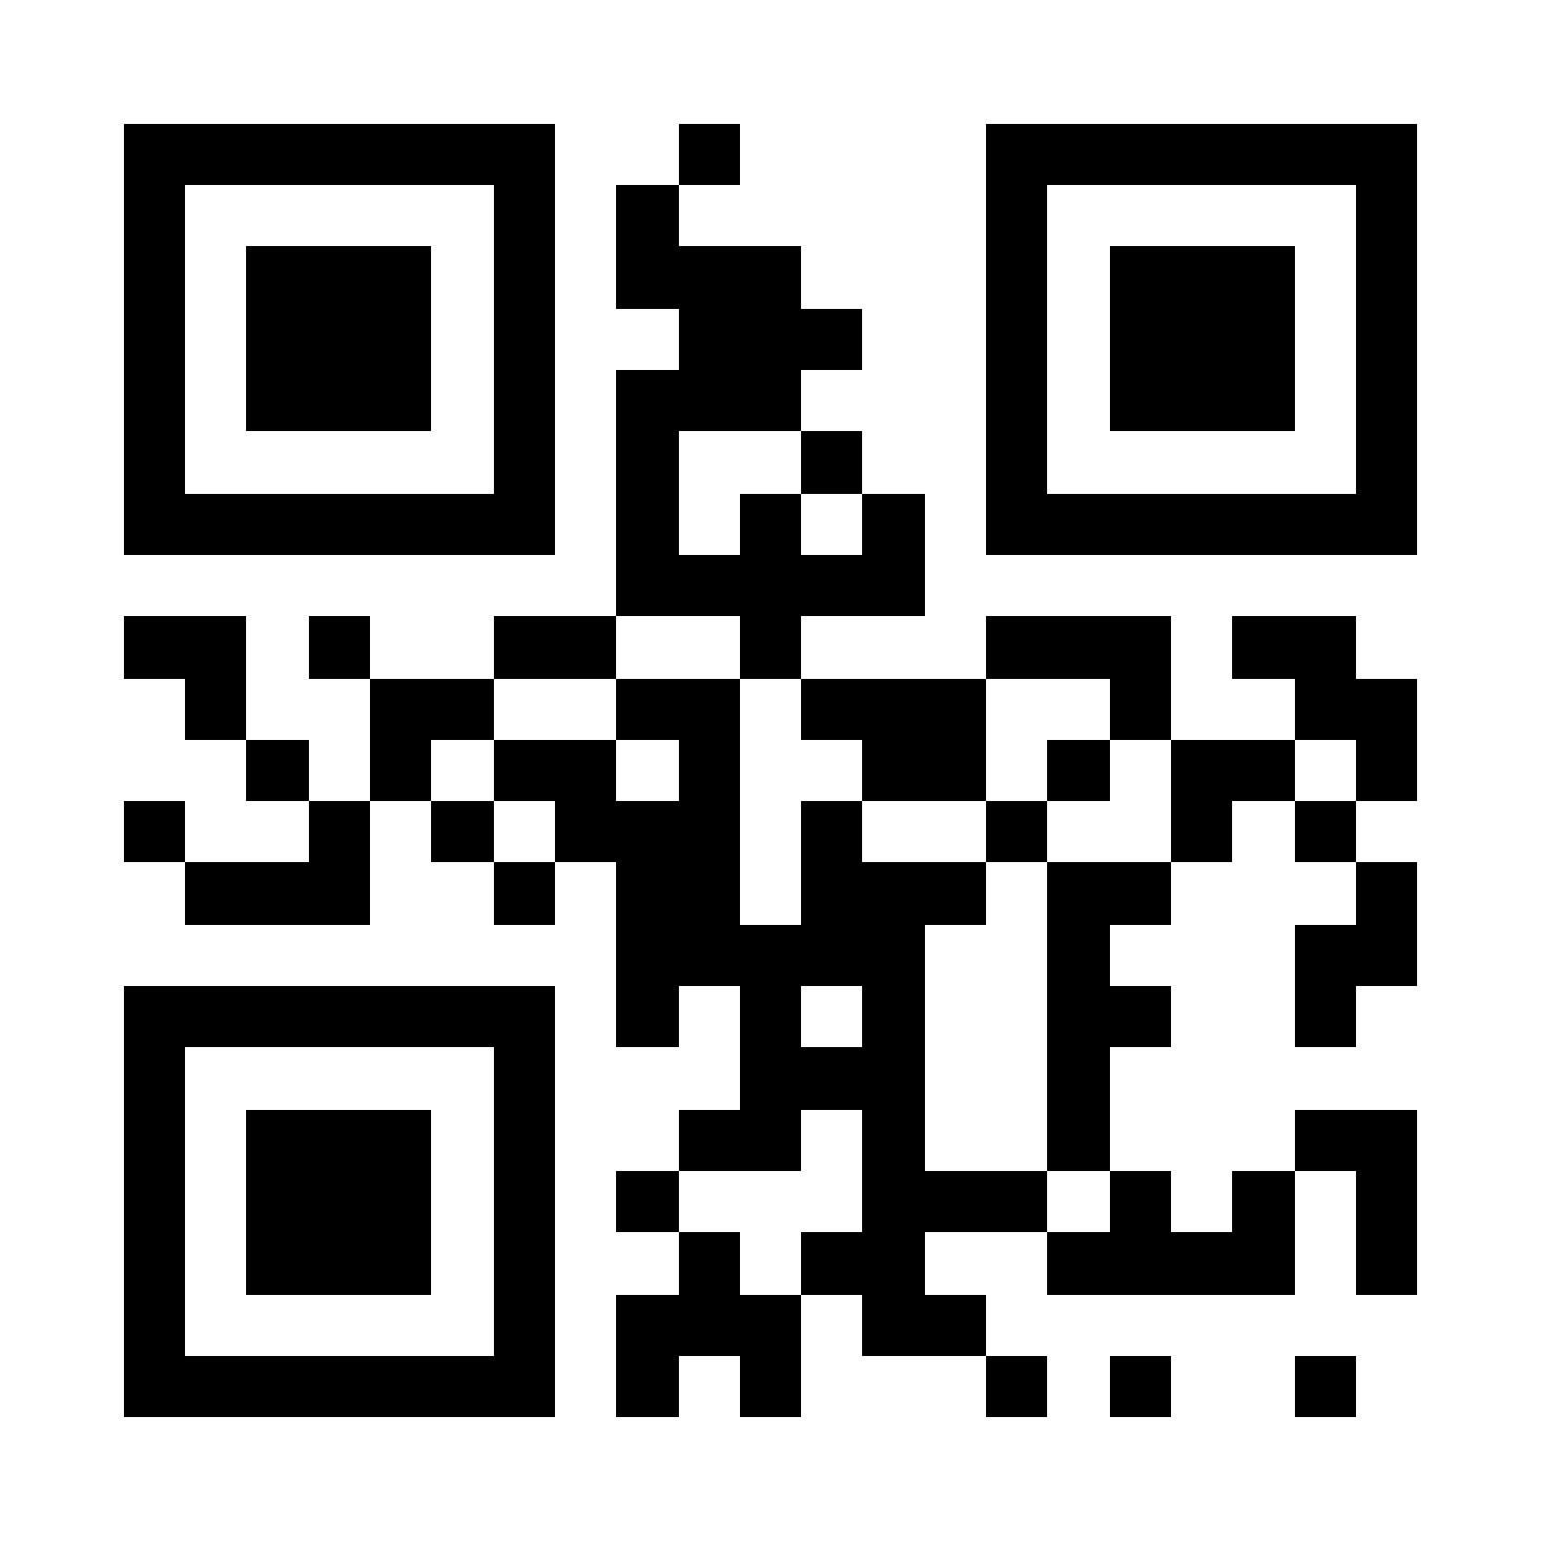
Georgia Probe College Tour
August 27, 2024 –
November 22, 2024
Meet with college and university representatives from around the world.
RegisterProbe.com

