Slide 1

cyber safety
Centennial Counseling Department

Slide 2
Class of 2020 Remind 101: Register Now!
Text “@2020chskni” to 81010

Slide 3


Follow us!
@Knights_scholar

Slide 4
Your School Counselors
A-Cas Ms. Beaty beattyz@fultonschools.org
Cat-Harp
Ms. Ekpo
EkpoN@fultonschools.org
Harq-Mep Ms. Graver graverh@fultonschools.org
Meq-Sal
Ms. Freeman freemanma@fultonschools.org
Sam-Z Ms. Peart peart@fultonschools.org
Grad Coach
Ms. Jiram jiramm@fultonschools.org

Slide 5

How do I protect myself? Let’s talk about it…
Protecting Your Identity
Online Relationships
Online Presence
Sexting
Cyberbullying
Safety tips

Slide 6
What social media sites do you use?
https://www.polleverywhere.com/free_text_polls/tlSkBlW7OJS29aK

Slide 7
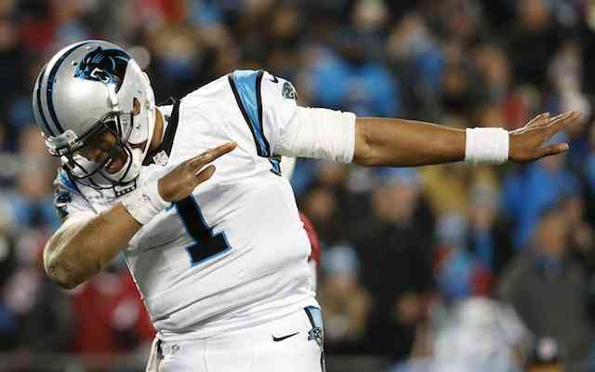


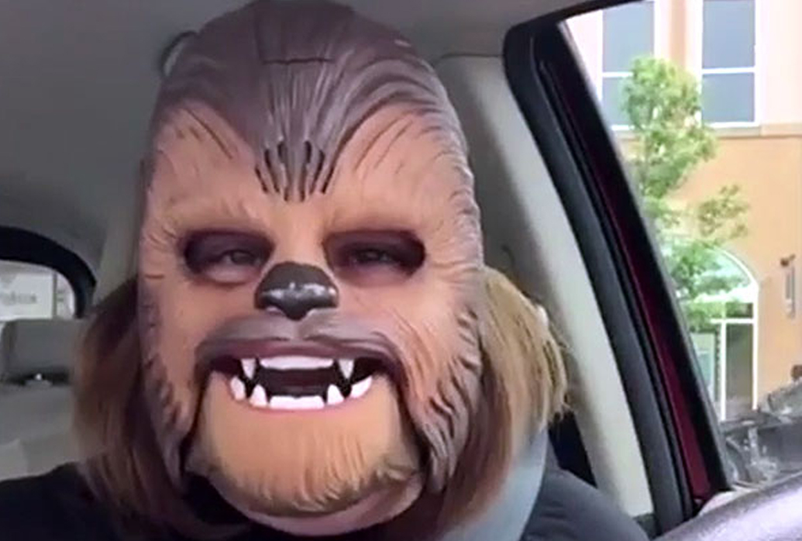
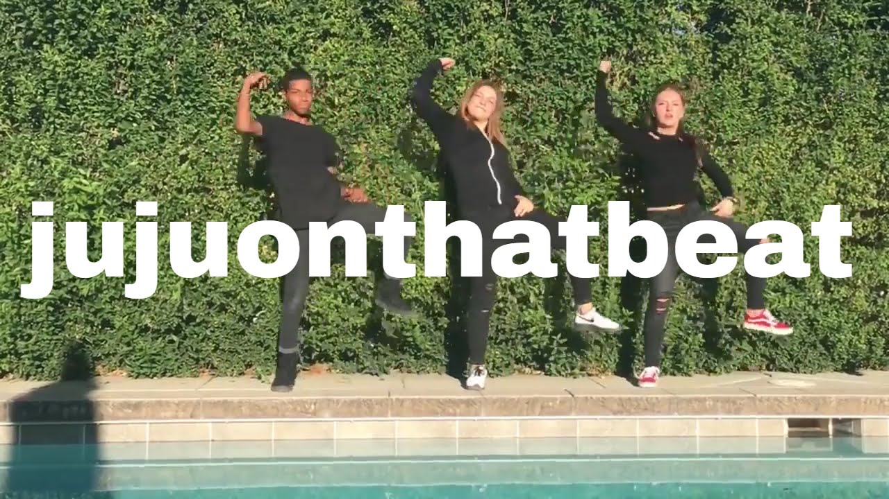
Internet Fame…

Slide 8

Protecting Your Identity
Secure your profile
  Know who can/cannot see your profile
  Approve ANYTHING that can be posted on your site
  Know one simple rule: WHATEVER GOES ON THE INTERNET, STAYS ON THE INTERNET!!
NEVER provide personal information when requested by an unknown email
Notes:
Without security settings, EVERYTHING would be visible to everyone. Whatever goes on the internet, stays on the internet UNLESS you go into social mediums with security in mind. Without these options, you could be at risk for identity theft, predators, and unwanted communication.

Slide 9
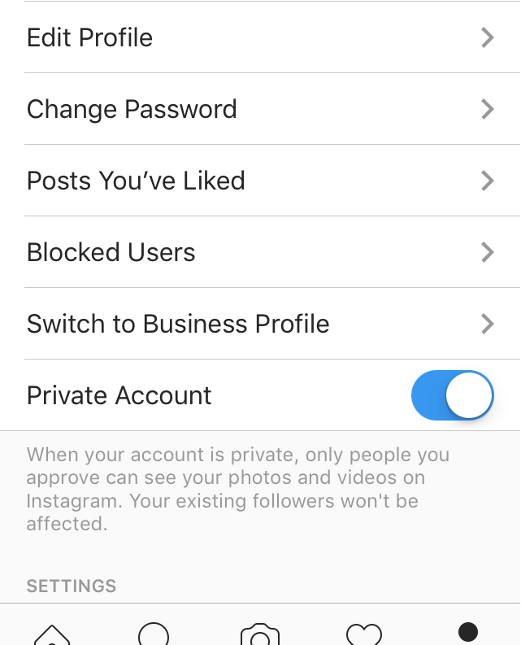

Privacy Settings
For Instagram:
  Go to your settings in the top right corner of your profile
  Go down to “Account”
  Find “Private Account”
  Switch ON

Slide 10

Online relationships are… tricky
Can be both good and bad
  Created through chat rooms, games, dating sites
Can you ever truly know someone you haven’t met?
  Remember: Over the internet, a 16 year old girl can be a 66 year old woman/man

Slide 11
Warning Signs
If someone tries to:
  isolate you from your family or friends
  turn you against your parents
  convince you to keep secrets
  send inappropriate material or talk about explicit subjects
  threaten you in any way
TELL AN ADULT!
  There is a HUGE difference between “snitching” and reporting!
  REPORTING things that are making you feel uncomfortable contributes to your SAFETY.

Slide 12

Your online presence
What is an online presence?
Will colleges and employers look at my social media presence?
  YES!
  Think of it as a tiebreaker…
Notes:
Your “online reputation” or “online identity”

Slide 13

Remember…
Remember any picture uploaded to the Web can be downloaded
  Example: Screenshots
  This includes Snapchat…
PROTECT YOUR REPUTATION!

Slide 14

Sexting: Don’ts & DON’TS
Sexting: sending sexually explicit images, videos, texts, emails.. usually by cell phone
Some see it as “cute”, most see it as ILLEGAL
Some people may even re-distribute the photos that someone sent them, which is ILLEGAL
There can be pressure involved as well
Consequences:
  Conviction of Felony– dissemination of child pornography
  Registered as a sex offender
  Difficulty getting a job AND going to college
    Can lose scholarships
    Job applications ask if you have been convicted of a felony before

Slide 15

IMPORTANT!!!
If anyone makes you feel UNCOMFORTABLE on the internet, do not reply to them
If they continue to contact you, take screenshots of the messages and show your parent/guardian
If this becomes even bigger, the proper authorities may need to be involved (police, principal)

Slide 16
Cyberbullying

Slide 17
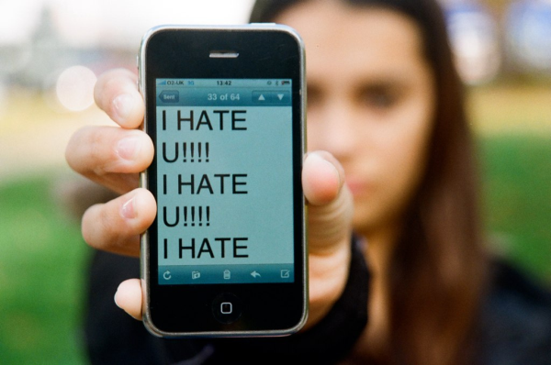
What is cyberbullying?
An action to harass or bully others through technology or the Internet
Twitter, Facebook, Instagram, Snapchat, etc.
Examples:
  mean text messages or emails
  rumors sent by email or posted on social networking sites
  embarrassing pictures, videos, websites
  fake profiles

Slide 18
Fulton County Code of Conduct
b. Bullying: Bullying is strictly prohibited. Bullying includes the following:
Willful attempt or threat to inflict injury on another person, when accompanied by an apparent present ability to do so; or
Intentionally exhibiting a display of force such as would give the victim reason to fear or expect immediate bodily harm; or
Any intentional written, verbal, or physical act, which a reasonable person would perceive as being intended to threaten, harass or intimidate that:
- Causes substantial physical harm or bodily harm capable of being perceived by a person other than the victim and may include, but is not limited to, substantially blackened eyes, substantially swollen lips or other facial or body parts, or substantial bruises to body parts;
- Has the effect of substantially interfering with the victim student’s education;
- Is so severe, persistent or pervasive that it creates an intimidating or threatening educational environment; or
- Has the effect of substantially disrupting the orderly operation of the school.

Slide 19
But what if it happened outside of school?
Bullying applies to acts which occur on school property or through school technology resources, and also applies to acts which occur through the use of electronic communication, whether or not that communication originated on school property or with school technology resources, if the electronic communication:
(1) is directed specifically at students or school personnel,
(2) is maliciously intended for the purpose of threatening the safety of those specified or substantially disrupting the orderly operation of the school, AND
(3) creates a reasonable fear of harm to the students' or school personnel's person or property or has a high likelihood of succeeding in that purpose.

Slide 20
Consequences
Tier 1 Offense (1st offense)
  1 Day of AD/SS up to 3 days ISS
Tier 2 Offense (2nd Offense)
  Up to 10 days OSS
Tier 3 Offense (3rd offense)
  Student assigned to an alternative education program
Notes:
Varies!!!!!

Slide 21
How to handle cyberbullying
Try not to respond
  Some bullies get satisfaction from your response
Try not to retaliate
  On the one hand, you want to hurt this person like they have hurt you, but on the other hand, you may get in trouble for your retaliation or play into the trap
  Per Fulton County: Students who retaliate against others for reports of bullying behavior are subject to discipline which may include enhanced consequences
SAVE THE EVIDENCE!
Report to someone you trust at school/home/work

Slide 22

Safety Tips
Secure your profile(s)
Change your passwords (often)
Make sure you read and understand the security settings
Try not to give out personal information over the Internet
Protect your reputation!
Let someone know if you feel uncomfortable or hurt

Slide 23

Questions?

