Slide 1
A Lesson in Cybersafety
Ms. Falcone and Ms. Johnson

Slide 2
Follow CHS Counseling on Twitter and Instagram !
@knights_scholar

Slide 3
Your School Counselors
A-Cas Ms. Beaty beatyz@fultonschools.org
Cat-Harp
Ms. Ekpo EkpoN@fultonschools.org
Harq-Mep Ms. Graver graverH@fultonschools.org
Meq-Sal
Ms. Freeman freemanMA@fultonschools.org
Sam-Z Ms. Peart peart@fultonschools.org
Grad Coach
Mrs. Rigsbey RigsbeyA@fultonschools.org

Slide 4
CHECK-IN
Directions:
Ms. Falcone and Ms. Johnson will read a statement.
If the statement applies to you, you will stand up.
If it does not apply, stay seated.

Slide 5
Stand up if the following statement applies to you.
If you have any form of social media (Facebook, Snapchat, Instagram, Twitter, etc.)
You have read personal information about a friend online that you know was shared as a secret.
You have been tagged in photos someone else has posted online.
You have ever asked someone for permission to post a picture of them online.
If you or someone you know has been cyberbullied.

Slide 6
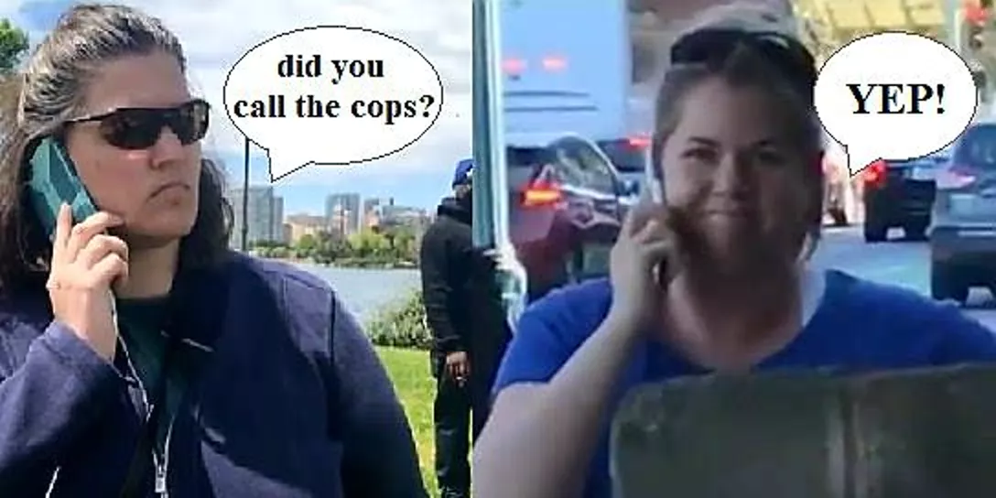
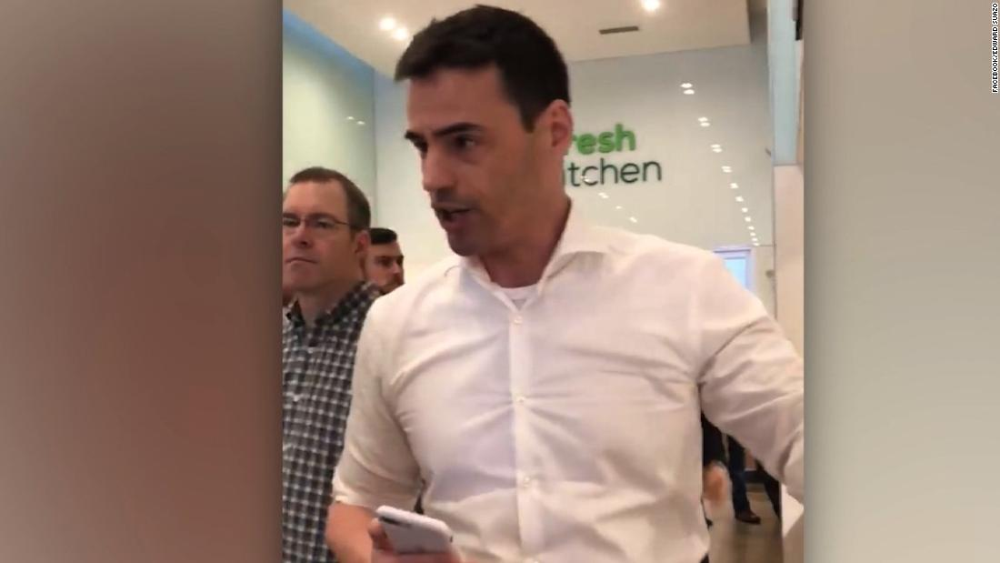
"Instafamous" People Turned into Permanent Memes
Notes:
Today we’re going to talk about cyber safety. What it is, how it affects you and others, and what some of the consequences are or could be.

Slide 7
What is Cybersafety and why is it important?
What is Cybersafety?
Cybersafety is being safe and responsible when using the internet.
Why is it important?

Slide 8
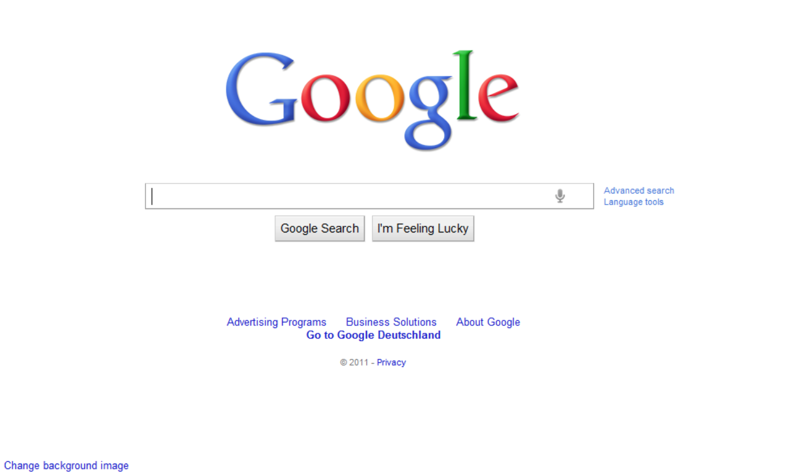
What are the most common devices that people use to abuse cybersafety?
Computers
Cell phones
Cameras

Slide 9
What are some examples of the ways that people abuse cybersafety?
Cyberbullying
Sexting
Catfishing
Viral Videos
Inappropriate Tagged Photos

Slide 10
The Hazards of Sexting
Sexting: sending sexually explicit images, videos, texts, emails.. usually by cell phone​
Some people may even re-distribute the photos that someone sent them, which is ILLEGAL​
Consequences:​
Conviction of Felony– dissemination of child pornography​
Registered as a sex offender​
Difficulty getting a job, obtaining scholarships, or going to college​

Slide 11
Wisconsin Teens Face Felony Charges for Sexting
https://www.wisn.com/article/juveniles-caught-sexting-face-felony-child-porn-charges-but-should-they-hiu4mfpx/9098709

Slide 12
What is Cyberbullying?
An action to harass or bully others through technology or the Internet​
Twitter, Facebook, Instagram, Snapchat, etc.​
Examples: ​
Mean or threatening text messages/emails/social media posts​
rumors sent by email or posted on social networking sites​
embarrassing pictures, videos, websites​
fake profiles​

Slide 13
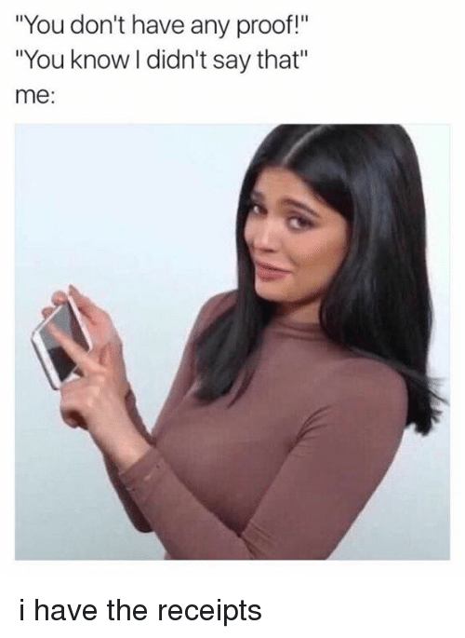
How to Handle a Cyberbully
Try not to respond​ or retaliate​
On the one hand, you want to hurt this person like they have hurt you, but on the other hand, you may get in trouble for your retaliation.
Per Fulton County: Students who retaliate against others for reports of bullying behavior are subject to discipline which may include enhanced consequences​
SAVE THE EVIDENCE! ​
Report to someone you trust at school/home/work

Slide 14
Consequences
Tier 1 Offense (1st offense)​
1 Day of AD/SS up to 3 days ISS​
​
Tier 2 Offense (2nd Offense)​
Up to 10 days OSS​
​
Tier 3 Offense (3rd offense)​
Student assigned to an alternative education program

Slide 15
Permanency
If you delete a post, does that mean that it's gone forever?
Social Media Pros:
https://www.youtube.com/watch?v=XJy6Pkb3mh0
What are the pros and cons of using social media?
*Decreased concentration and focus!!*
*Decrease in face to face social skills*
Social Media Cons:
https://www.youtube.com/watch?v=gLQJgYUoBxI

Slide 16
Social Media
What are ways cyber safety can be improved when using social media or other applications/websites?

Slide 17
How Can I Protect Myself?
Secure your profile​
Know who can/cannot see your profile​
Approve ANYTHING that can be posted on your site​
Know one simple rule: WHATEVER GOES ON THE INTERNET, STAYS ON THE INTERNET!!​
NEVER provide personal information when requested by an unknown email

Slide 18
Cyber Safety Tips
*Stop at Smokey the Bear

Slide 19
Questions?

