Slide 1
College Admissions Testing for 10th and 11th Grades
Katie Rose-De Laet
Centennial High School
November 12th, 2019

Slide 2
US schools still put a premium on testing
NACAC Survey 2019: Factors influencing admissions decisions
Importance | Considerable | Moderate | Limited | None
Grades in All Courses | 74.5% | 15.0% | 5.5% | 5.0%
Grades in College Prep | 73.2 | 16.8 | 5.9 | 4.1
Strength of Curriculum | 62.1 | 21.9 | 8.7 | 7.3
SAT/ ACT Test Scores | 45.7 | 37.1 | 12.2 | 5.0
Essay or Writing Sample | 23.2 | 33.2 | 24.1 | 19.5
Demonstrated Interest | 16.1 | 23.9 | 28 | 32.1
Counselor Recommendation | 15.1 | 40.4 | 26.6 | 17.9
Teacher Recommendation | 14.2 | 40.2 | 26.5 | 19.2
Class Rank | 9.1 | 29.1 | 34.1 | 27.7

Slide 3
However, the test-optional movement is growing
The University of California system is currently debating whether to go test-optional. This would have seismic implications for testing nationwide.
?

Slide 4
The SAT and the ACT
A quick look at the tests

Slide 5
Today the SAT and ACT are universally accepted
Colleges will accept either test without prejudice.

Slide 6
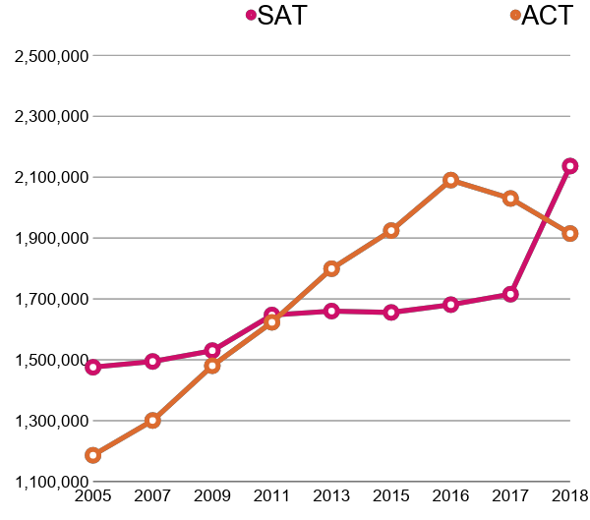
For the first time in 7 years, the SAT leads the testing landscape
 | SAT | ACT | Gap
2012 | 1,664,479 | 1,666,209 | -1,730
2013 | 1,660,047 | 1,799,243 | -139,196
2014 | 1,672,395 | 1,845,787 | -173,392
2015 | 1,655,557 | 1,924,436 | -224,436
2016 | 1,681,134 | 2,090,342 | -409,208
2017 | 1,715,481 | 2,030,038 | -314,557
2018 | 2,136,539 | 1,914,817 | 221,722
Sources: ACT, CollegeBoard, EducationWeek

Slide 7
Drastic ACT changes scheduled for September 2020
Last month, ACT, Inc announced major changes coming to the ACT in September 2020:
CBT option
Students will have the option of taking a computer-based test (CBT) on national ACT dates.
They will need to register and choose a CBT-enabled testing site. It is currently unclear how many CBT-enabled testing sites the ACT will have, or how many students can be served by each.
Benefit of CBT test: students will have their multiple-choice scores in 2 business days.

Slide 8
ACT changes: Superscore reports
Superscore reports
The ACT had not previously given superscored reports.
Starting in September 2020, colleges will receive a superscored report (which will include any tests the student took dating back to September 2016).
The ACT hopes this will encourage more colleges to accept superscored ACTs.

Slide 9
ACT changes: section re-testing
Section retesting
Students will be able to register and retake individual sections on national test dates.
They will need to have first taken at least one full ACT to qualify for retesting. However, they won’t have to take the essay first to take that section individually, just the full ACT.
The ACT has said that accommodations will carry over into retesting.

Slide 10
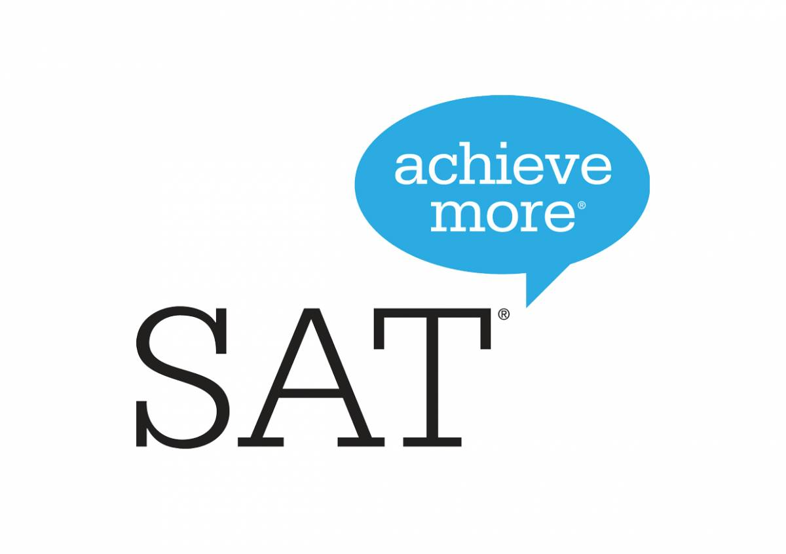
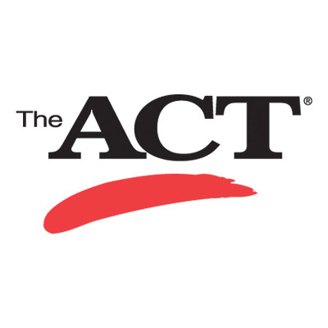
Structurally, the two tests appear nearly identical
{
Reading
English
}
Math
Writing & Language
Math—No Calculator
2:55
3:00
Reading
Math—Calculator
Science
{
Essay (optional)
Essay (optional)
{
:40
:50
Testing time: 3:50
Testing time: 3:35

Slide 11
Overall, 75-80% of the test content overlaps
More advanced reading
Reading skills
More advanced science
English and Grammar skills
More math word problems
More advanced math
Science graph reading and interpretation
Algebra, stats, some geometry

Slide 12
The amount of time per question is a profound difference.
Section | ACT | SAT | % Difference
Writing | 36.0 | 47.7 | 33%
Reading | 52.5 | 75.0 | 43%
Math | 60.0 | 84.2 | 40%
Science | 52.5 | N/A | N/A
The SAT has a more forgiving timing structure, which can benefit some students, but as we’ll see, it’s also a more complicated test.

Slide 13
Math on SAT vs. ACT - an overview
Interpreting is often more important than solving
More straightforward
More heuristics-rule based
More of an applied math test
Tests concepts in isolation
More overlapping content, problems using multiple skills
Always allows a calculator
More reading intensive
Pulls from a broader range of concepts

Slide 14
Digging Deeper: ACT vs. SAT Math content areas*
 | ACT | SAT
Algebra | 46% | 62%
Geometry | 23% | 6%
Arithmetic/ Data Analysis | 24% | 30%
Trigonometry | 7% | 2%
As you can see, the math content is much more evenly distributed on the ACT than it is on the SAT, which relies heavily on Algebra.
*Using SAT categories, which are slightly different from ACT math categories

Slide 15
Digging Deeper: SAT vs ACT Reading
SAT
narrative fiction
science
science
humanities
humanities
ACT
Although the ACT forces students to go faster, the difficulty level is more consistent. Students should be prepared for the spikes in difficulty on the SAT.
prose fiction
social sciences
natural sciences
humanities

Slide 16
ACT Science section has no SAT equivalent
The SAT’s Reading test has some science content, but nothing like this. Students must move quickly through complicated passages full of graphs and charts.
Source: Applerouth’s Guide to the ACT, 4th Ed.

Slide 17
SAT/ACT Essays
The majority of students who take the SAT (70%) take the test with the essay, while 50% of ACT-takers complete the essay.
However, less than two dozen schools require SAT or ACT essay scores!
Some big essay hold-outs include the entire University of California system and Benedictine college.
It’s important to have a general college list when you go in to take your SAT or ACT - if any of the schools on your list require or recommend the essay (like Stanford or Duke or Tech), you should prepare for and take the essay!

Slide 18
Additional Tests
The PSAT and SAT Subject Tests

Slide 19
SAT Subject Tests
The SAT Subject tests are additional standardized tests on a variety of subjects.
Fewer than 100 colleges use Subject Tests for admission, and some accept the SAT + ACT as a replacement for SAT + SAT Subject Tests.
Some schools require tests for admission into specific programs (like Math 2 for finance or engineering).
If your student needs to take SAT Subject Tests, the best time to take them is May or June of the year they take the subject—the same time as AP Exams!

Slide 20
SAT Subject Tests are in a state of decline
According to the Washington Post, about 220,000 students in the class of 2017 took SAT Subject Tests - that’s a 30% drop from the SAT Subject Tests’ program peak in 2011.
By comparison, 1.3 million students in the class of 2017 took AP exams.

Slide 21
The PSAT
The PSAT is a slightly easier, scaled-down version of the SAT that is given in schools to 10th- and 11th-graders.
In 11th grade, students who take the PSAT are eligible for National Merit recognition, which can bring in scholarship money and an edge in college admissions.
Merit Scholars only make up 0.05% of students taking the NMSQT, but Finalists and Semi-finalists can use their NMSQT status to earn scholarships from private organizations and universities.

Slide 22
Should my student prep for the PSAT?
You should only invest in PSAT prep if your student is on the cusp of National Merit—that is, if they scored at the top of the class when they took the PSAT in 10th grade.
As we discussed, National Merit can translate into significant scholarship money, but the PSAT does not factor into college admissions. If your student is not National-Merit-bound, use the PSAT as another way to practice for the SAT and focus your prep on the SAT or ACT!

Slide 23
Crafting a Testing Plan
Scheduling, timelines and more

Slide 24
Find your best test first!
Take a practice ACT and SAT to establish dual baselines. You can also use the sophomore year PSAT scores to get a baseline comparison.
By converting ACT scores to the SAT scale, you can compare apples to apples:
If your scores are different by 70 SAT points or more, that means you have a significant strength in one test. Prep for the higher-scoring test.
If your scores are within 60 SAT points of each other, then you are within the margin of error for each test. Choose the one you’d like to focus on.

Slide 25
Testing is typically a junior year activity
Some students may need SAT or ACT scores early, while others should wait. Here’s a short guide:
Sophomores:
Fall of Junior Year:
Spring of Junior Year:
You need the scores for AP courses, dual enrollment, or athletic recruitment.
You are in advanced math and English and you have scheduling issues in the spring like sports or theater.
You are in Algebra 2 in Junior year, or you have commitments in the fall.
Even if you test sophomore year for these reasons, you can and should still take an SAT/ACT later for college admissions!
Students can continue to take the ACT and SAT for college admissions into their senior year (Sept/Oct for early admissions; Nov/Dec for regular admissions), but you shouldn’t wait until senior year to start.

Slide 26
The importance of multiple test dates
It’s a good idea to plan for multiple test dates; we recommend families plan for three separate testings of the same test. Here’s why:
Superscoring potential
Plan for three and stop once you reach your goal!
Gains in confidence over time
Negates any test difficulty or scoring fluctuation
Allows student and tutor to set incremental goals

Slide 27
You have lots of opportunities to take either test!
Aug
Sep
Oct
Nov
Dec
Feb
Mar
Apr
May
Jun
Jul
PSAT
Remember that registration for any given test (except for PSAT) closes about a month before the test date. Registering earlier than that is smart - the earlier you register, the more likely you’ll be able to take the test at your first-choice location.

Slide 28
Prep commitment by the numbers
1:1
50-70
Hours instruction to hours homework
Average hours total in prep process, including homework and mock tests.
6
10-12
Hours of instruction per timed practice test.
Weeks to prepare before first test.

Slide 29
Choose a testing timeline that works for your student
Summer Prep
Back in Spring
July Test
Prep
Refresh
content
Mar
May
Jun
Subjects
Summer Prep
Winter Testing
Jan- Mar
Test Prep
Mar
Jun
Aug
Spring Prep
Summer-Fall
Testing
Mar-May
Test Prep
Jun
Aug
Oct
Winter Prep
Spring Testing
Jan-Feb
Test Prep
Feb
Apr
Jun
Jun
Subjects
Spring Prep
Summer Testing
Apr-Jun
Test Prep
Jun
Jul
Sep

Slide 30
Our Services
SAT & ACT prep (online, private, group)
SAT Subject and AP prep
HS subject assistance
Study Skills
Helping prepare students for higher scores and grades since 2001

Slide 31
Sources
ACT, Inc, 2019.
Applerouth’s Guide to the ACT, 4th Ed. 2018.
Applerouth’s Guide to the SAT, 2nd Ed. 2018.
Brown University, 2018.
The Chronicle of Higher Education, 2018.
The College Board, 2018.
Cornell University, 2018.
EducationWeek, 2018. Georgia Tech, 2018.
Harvard University, 2018.
IECA, 2018.
Inside Higher Ed 2019
Survey of College and University Admissions Directors
NACAC State of College Admissions, 2017.
U.S. News & World Report, 2018.

