Slide 1
Welcome to Centennial H.S. Overview of the Advanced Placement (AP) Program
Monday, January 28th, 2019
6:00PM

Slide 2
What is AP? The Advanced Placement Program® (AP) enables willing and academically prepared students to pursue college-level studies while still in high school. The program consists of college-level courses developed by the AP Program that high schools can choose to offer, and corresponding exams that are administered once a year.
Fast Fact: There are 38 AP courses in seven subject categories.

Slide 3
Our AP Courses 29/38
Arts:
Art History
Music Theory
Studio Art: 2-D Design
Studio Art: 3-D Design
Studio Art: Drawing
English:
English Language & Composition
English Literature & Composition
History & Social Sciences:
Comparative Government & Politics
European History
Human Geography
Macroeconomics
Microeconomics
Psychology
United States Government & Politics
United States History
World History
Math & Computer Science:
Calculus AB
Calculus BC
Computer Science A
Computer Science Principles
Statistics
Sciences:
Biology
Chemistry
Environmental Science
Physics C: Electricity & Magnetism
Physics C: Mechanics
Physics 1: Algebra –Based
Physics 2: Algebra - Based
World Languages & Cultures:
Chinese
French
German
Italian
Japanese
Latin
Spanish Language
Spanish Literature
AP Capstone:
Research
Seminar

Slide 4
AP at Centennial High School
Top Exams Given
117 World History
112 English Language
69 Psychology
512 Students take 1,065 AP exams
84% Pass rate across all of the exams (3 or higher)(State is 61%)
42% Of exams taken achieved 4 or 5
AP Scholars demonstrate superior college-level achievement through AP courses and exams. This achievement is acknowledged on any AP score report that is sent to colleges the following fall.
AP Scholar – 89 students with average score of 3.09
AP Scholar with Honor – 40 students with average score of 3.72
AP Scholar with Distinction – 58 students with average score 4.19
National AP Scholar – 17 students with average score 4.45
4

Slide 5
AP: the Benefits The Advanced Placement Program® (AP) enables willing and academically prepared students to pursue college-level studies while still in high school. Opportunity to earn valuable credit and placement in FLEXIBILITY AND COST SAVINGS. Taking AP is valued in the college admission process.

Slide 6
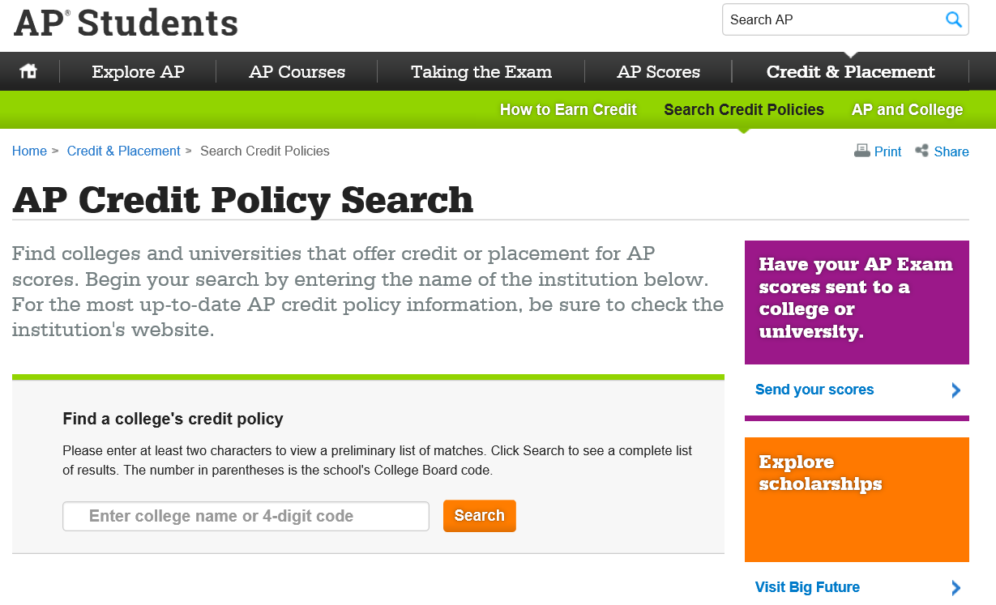
Each college and universities have its own policies regarding AP credit and placement. The College Board offers information about AP credit at thousands of colleges and universities. For the most up-to-date AP credit policy information, be sure to check the institution's website.
6

Slide 7
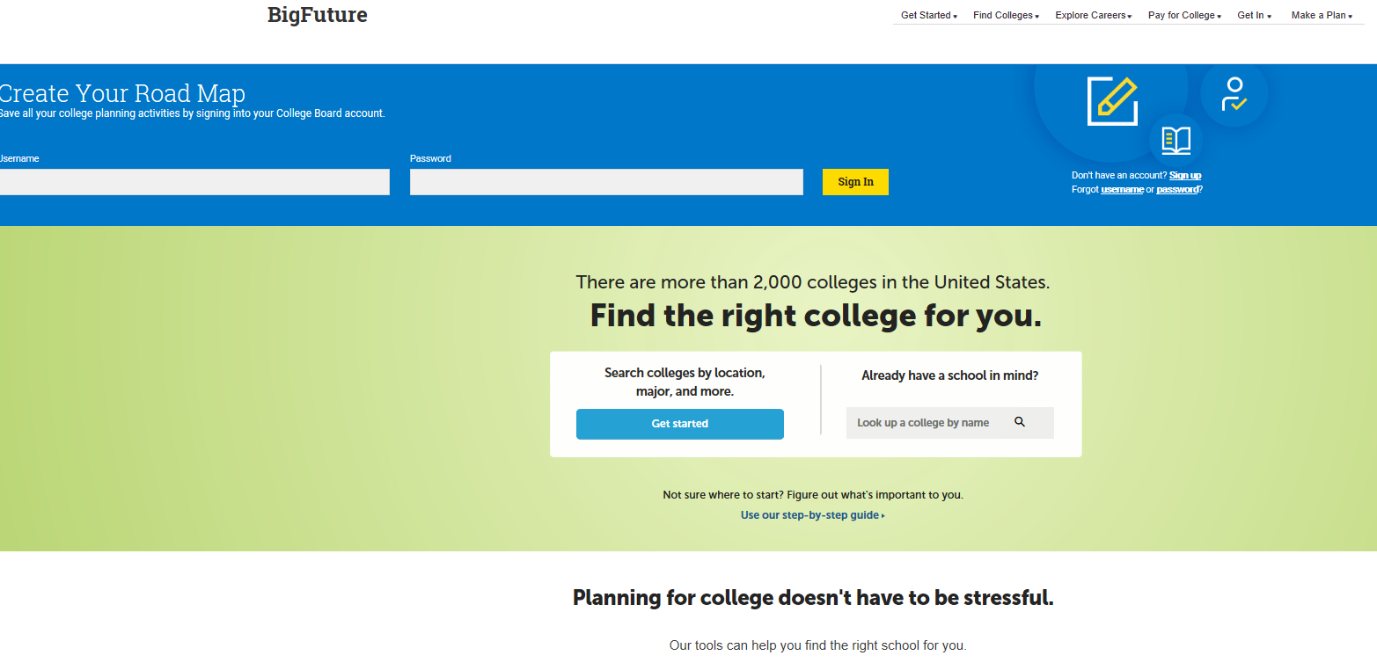
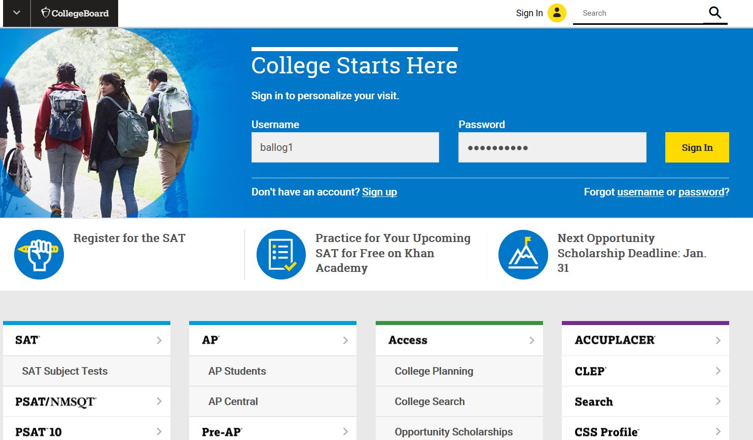
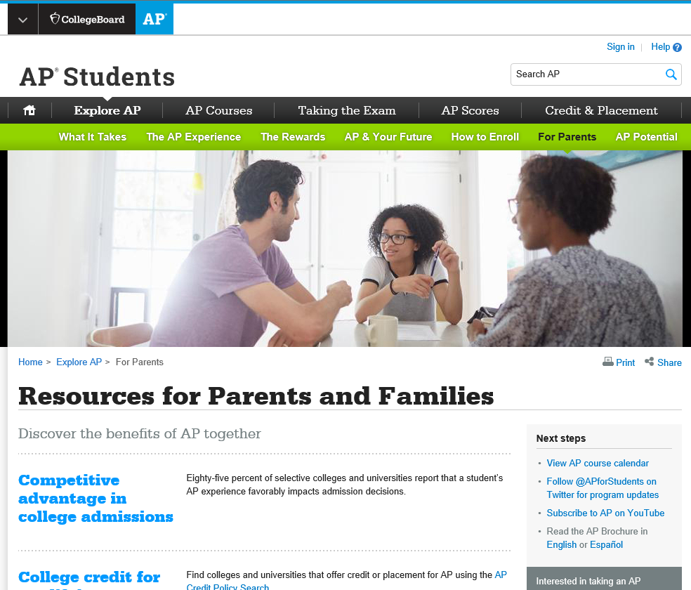
AP Resources World Exploring for Students and Families
AP Information:
https://apstudent.collegeboard.org/exploreap
https://apstudent.collegeboard.org/exploreap/for-parents
College and Career Planning, Personalized Feedback, practice and college planning
based on PSAT.NMSQT results: https://www.collegeboard.org/
7

Slide 8
AP Registration for 2019-2020
Teachers and Counselors will have conversations with their current students and process recommendations.
Students will fill out an AP Intent Google form per class, and students will need information handy to fill out the form. The AP teachers will explain.
Students will receive verification and can elect to take AP if not recommended.
AP class waivers will be required to override teacher recommendation instances when a student has not me the FCS High School Placement guidelines requirements.
Serious consideration should be given by the student and the parent to elect into an AP course if not recommended.
Registration is based upon space availability. Some courses may not actually “make” if a minimum number of students are not registered.

Slide 9
Students must understand the following:
The fee for the AP exam MAY OR MAY NOT be funded by the state or county. Typically costs $94 per exam.
AP courses require in depth study and a willingness to go beyond usual class requirements and preparation (including summer reading). The student must be willing to invest the time and effort.
The student is making a comment, and if the student is accepted into an AP class, he/she WILL NOT BE ALLOWED TO DROP THE CLASS.
9

Slide 10
Changes in the College Board:
The College Board, creators of Advanced Placement, recently announced significant changes to the AP exam ordering process, deadlines, late fees and cancellation fees that will be mandated for all schools and all students in the 2019-2020 school year. Next year, all students will decide whether or not to take exams and order their exams by Nov 15, 2019. All students in 1st semester or yearlong AP classes who register after Nov 15, 2019, will be assessed $40.00/exam late fee. In addition, a $40.00/exam cancellation fee will be assessed for any exam order canceled after Nov 15, 2019. The ordering deadline for second semester only courses will be March 13, 2020.
It is important that all families are aware of these looming changes, especially as students begin registering for their 2019-2020 courses. We understand that these changes may cause concern for students, parents and teachers. Please keep in mind that these changes are being mandated by the College Board and were not decided by the school. Additional details regarding the College Board’s new process will be made available once we have more information.
10

Slide 11
Course | Target Grade | Sessions Available | Room | Teacher
Art History | 10th - 12th | 4 | E-52 | Mr. Riggins
Studio Art - 2D, 3D, Drawing | 10th - 12th | 1-3
Biology | 10th - 12th | 1-4 | H-04 | Mr. Kuhn
Cal AB & BC | 11th - 12th | 1-4 | G-65 | Dr. Shih
Chemistry | 11th - 12th | 1-4 | G-56 | Mr. Harhay
Computer Science A | 10th - 12th | 1,3 | G-69 | Mr. Bartholomew
Computer Science Principals | 10th - 12th | 2,4
Microeconomics & Macroeconomics | 12th | 1-4 | H-65 | Mr. Dale
English Language & Comp | 11th | 1-4 | Learning Commons | Ms. Jones
English Literature & Comp | 12th | 1-4 | G-59 | Ms Scenna
Environmental Science | 10th - 12th | 1-4 | G-58 | Ms. Van Tassel
French | 11th - 12th | 1-4 | H-22 | Ms. Wiesendanger
German | 11th - 12th | 1-4 | H-26 | Ms. McCarty
Comparative Government & Politics | 12th | 1,2 | H-60 | Dr. Medwed
US Government & Politics
Human Geography | 12th | 1-4 | H-53 | Ms. Vaughn
Music Theory | 11th - 12th | 1-4 | E-10 | Ms. Landreau
Physics C: Mechanics | 11th - 12th | 1-4 | G-64 | Mr. Davis
Physics 1: Algebra - Based | 10th - 12th | 1-4 | I-56 | Mr. Hardee
Physics 2: Algebra - Based | 11th - 12th | 1-4 | G-64 | Mr. Davis
Psychology | 11th - 12th | 1-4 | E-41 | Ms. Schindler
Spanish | 11th - 12th | 1-4 | H-19 | Ms. Diaz
Statistics | 11th - 12th | 1-4 | G-53 | Mr. Corriveau
US History | 11th | 1-4 | CAFÉ | Ms. Skelton
World History | 10th | 1-4 | Auditorium | Mr. Hennessey Mr. Wroblewski
AP Night Video
6:00 – 6:15 | Auditorium – AP Presentation
6:20 – 6:35 | Session 1
6:40 – 6:55 | Session 2
7:00 – 7:15 | Session 3
7:20 – 7:35 | Session 4
11

Slide 12
THANK YOU
Heidi Morrison
Assistant Principal
470-254-4230
MorrisonH@fultonschools.org
http://chsknights.com/

