Slide 1

Welcome to Freshman parent night – part 1
This is a MS Live Event.
Questions remain private between you and the presenter.
This presentation is being recorded.
The link to the recording is the same link you used to gain access to this event.

Slide 2
AGENDA
Grading Policies and Expectations
CHS Counseling Program Overview
Introduction to Choosing Classes for 2021-2022 School Year

Slide 3
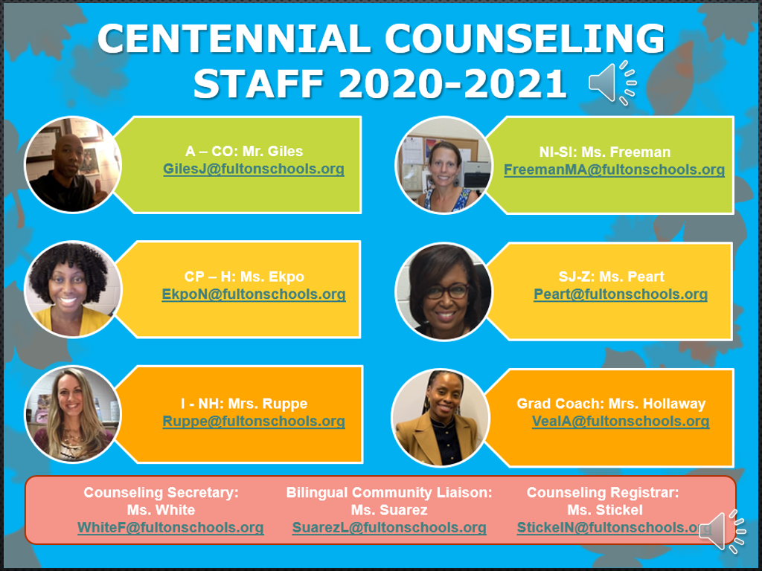

CHS Counseling Dept
Counselors work with students based upon first letter of students’ last names:
A – Cas
Cat – Harp
Harq – Mep
Meq – Sal
Sam – Z
Will Jones
Nsikan Ekpo
Heidi Ruppe
Melissa Freeman
Hella Peart
Graduation Coach
Anne Rigsbey

Slide 4
How to Earn Credits
In middle school, grades are calculated using a system of averages.
In high school, grades are not averaged… Each semester is independent.
Example 9th grade English Semester 1 (Aug-Dec): 60 (F)
Example 8th grade English Semester 1 (Aug-Dec):60 (F) Semester 2 (Jan-May): 80 (B)
Student fails 1st semester; passes 2nd semester (earns ½ credit)
Student passes class for the year (earns 1 full credit)
Semester 2 (Jan-May): 80 (B)
*No Yearly Average
*Yearly Ave: 70 (C)

Slide 5
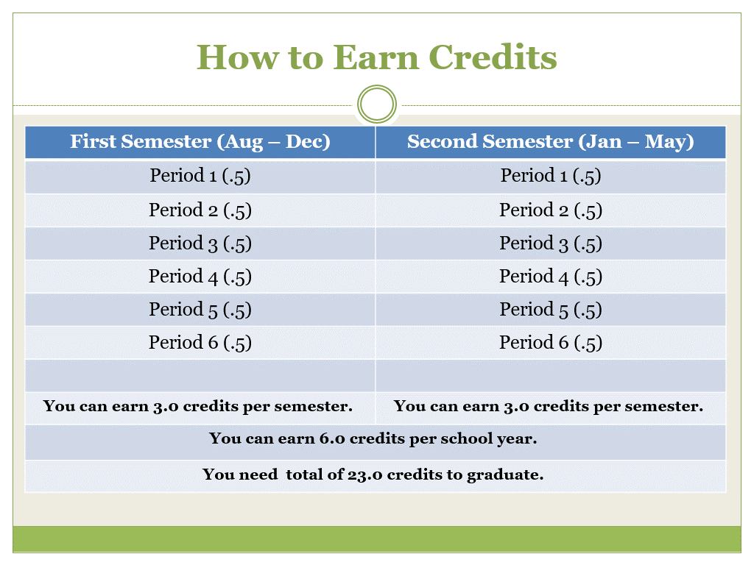
Centennial 101
Carnegie Units
1 Semester Class = .5 credit
Students take six credit bearing courses per semester (students typically earn 3.0 credits per semester)
Grading Scale
7 additional points are added to a final grade of 70 or above in approved Honors, AP, and College courses
A (90-100)
B (80-89)
C (70-79)
F (<70)

Slide 6
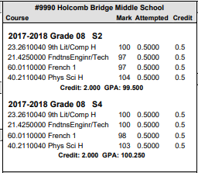
Middle School Credits
High School credits earned in Middle School
Students can earn HS credits for math, science, world languages, and/or certain electives. 7th and 8th grade world language equals 1.0 HS credit.

Slide 7
GPA Calculation
To calculate Fulton County GPA:
  By Semester
    Add final course grades for semester
    Divide by total courses taken
  Cumulative GPA
    Add final grades for each course
    Divide by total courses taken
To calculate HOPE/Zell Miller GPA:
  Includes core courses taken in HIGH SCHOOL
  Determined annually by the GA Student Finance Commission
  Visit www.GAFutures.org for details

Slide 8
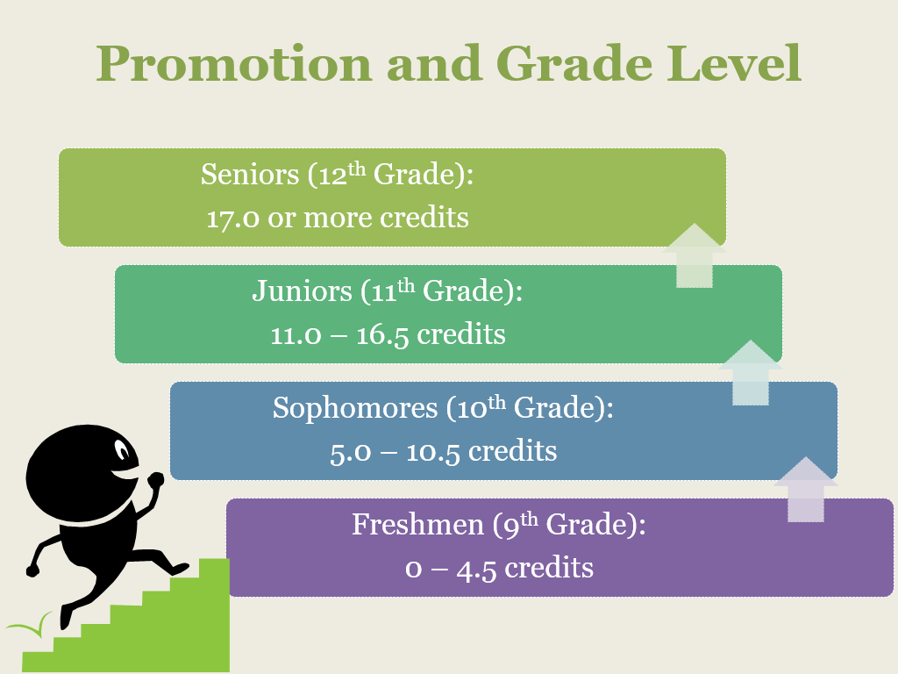
Centennial 101
Promotion
Freshmen: 0 – 4.5 credits *
Sophomores: 5.0 – 10.5 credits
Juniors: 11.0 – 16.5 credits
Seniors: 17.0 or more credits
* Students who come in with HS credit for MS courses will remain with their original year of graduation
Progress Reports and Report Cards
Progress Reports provide student’s status at the 6 and 12 week marks
Report Cards provide the student’s final grades for the semester
Infinite Campus (IC)

Slide 9
Accessing Grades
Parents and students can monitor grades, attendance, and discipline through Infinite Campus (IC).
Go to https://www.fultonschools.org/infinitecampus

Slide 10
Parent Concerns
Questions about student grades, assignments, course content, classroom consequences, etc. should be directed to the teacher first.
The counselor can be contacted for support in scheduling meetings with all teachers or general academic support.
Administrators are available for academic support after contact has been initiated with the teacher.

Slide 11
Graduation Requirements
23 credits required
English – 4 credits
Math – 4 credits
Science – 4 credits
Social Studies – 3 credits
CTAE/World Language/Fine Arts* – 3 credits
*Note: 2 or 3 years of World Language credits may be required for college admission
Health/Personal Fitness – 1 credit (each .5)
Electives – 4 credits

Slide 12

Required Academic Classes
Language Arts (4 Credits)
9th Grade Lit & Comp
10th Grade Lit &Comp
11th Grade/American Lit
Senior Level Lang Arts Course
  AP Literature
  College English
  Dramatic Writing
  1 Semester of World Lit and 1 Semester of Multicultural Lit
  *Required Summer Reading for all Honors and AP level Lang Arts courses.

Slide 13

Required Academic Classes
Mathematics (4 Credits)
On-Level
Accelerated Geometry B/Algebra 2 Honors (9 or 10)
Accelerated Pre-Calculus Honors (10 or 11)
Accelerated
Honors
Geometry (10)
Algebra 2 (11)
Approved 4th Math Course (12)
Algebra 2 Honors (10)
PreCalculus Honors (11)
AP Math or Dual Enrollment Math
Algebra (9)
Algebra Honors (8)
Geometry Honors (9)
Accelerated Algebra/Geometry A Honors (8 or 9)

Slide 14

Required Academic Classes
Science (4 Credits)
Biology
Physical Science or Physics
Chemistry, Environmental Sci, Earth Systems or an AP Science class
Approved 4th Science Course

Slide 15

Required Academic Classes
Social Studies (3 Credits)
World History
US History
Government (1 semester)
Economics (1 semester)

Slide 16

Fine Arts
Art
Chorus
Drama
Band
Orchestra

Slide 17
Pathway Offerings at Centennial
Advanced Academics
Allied Health Services
Audio/Video Tech & Film
Business Accounting
Computer Science
Emergency Responder Services
Engineering & Technology
Food & Nutrition
Journalism
JROTC
Law Enforcement Services
Performing Arts
Programming
Visual Arts
Web & Digital Design
World Languages

Slide 18

World Languages
French: 1, 2, 3, 4, 5, AP
Spanish: 1, 2, 3, 4, 5, AP
German: 1, 2, 3, 4, 5, AP
Honors courses exist in level II and higher

Slide 19


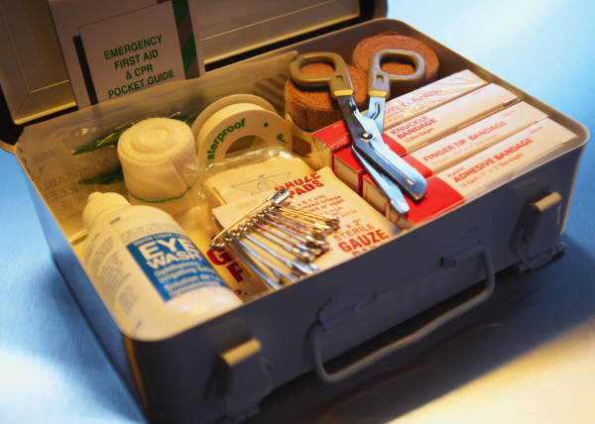
Additional Required Classes
Physical education (1 credit)
General Health
(1 semester)
Personal Fitness
(1 semester)

Slide 20


Centennial’s Personal Fitness Exemption
Exempt Personal Fitness through participation in 1 of 3 possible CHS activities:
● Athletics/Fencing  Marching Band  JROTC
Once criteria has been met, student will pick up a Personal Fitness Exemption form from Coach Burch in the cafeteria.
Exemption Form requires a signature from the designated school staff for their activity verifying the student completed the participation criteria.
Intent to Exempt Contract: Indicates student’s plan to exempt course. Student will not be scheduled for Personal Fitness course in grades 9-11.
Deadline to meet criteria and submit completed Exemption Form to Coach Burch’s office: Last Day of School Junior Year

Slide 21
2021-2022 Course Selection
Teachers will recommend students for academic placement during the spring semester. Students will also learn more information about AP and IB courses.
Parents/students will be given the opportunity to review recommended placements; questions should be directed to the teacher and/or counselor prior to enrollment in the course.
Students will be given opportunities to select elective courses; changes may be made within the designated enrollment period (Feb – May).
After the verification period, students are expected to complete courses in which they enroll.
Changes after the verification period will be rare and will require administrative approval.

Slide 22
Student Support Programs
New Student Group
AP Access Group
Bridge Law Benchmark Activities
Partnership with CHRIS 180 Counseling
Grades 9 - 12

Slide 23
Counseling Program Resources
Counseling Website www.mycentennialcounseling.com
Scholarship Information Blasts
Parent Nights
College Representative Visits
SAT/ACT Test-Prep Opportunities
Credit Recovery Options
Consultations & Collaboration

Slide 24
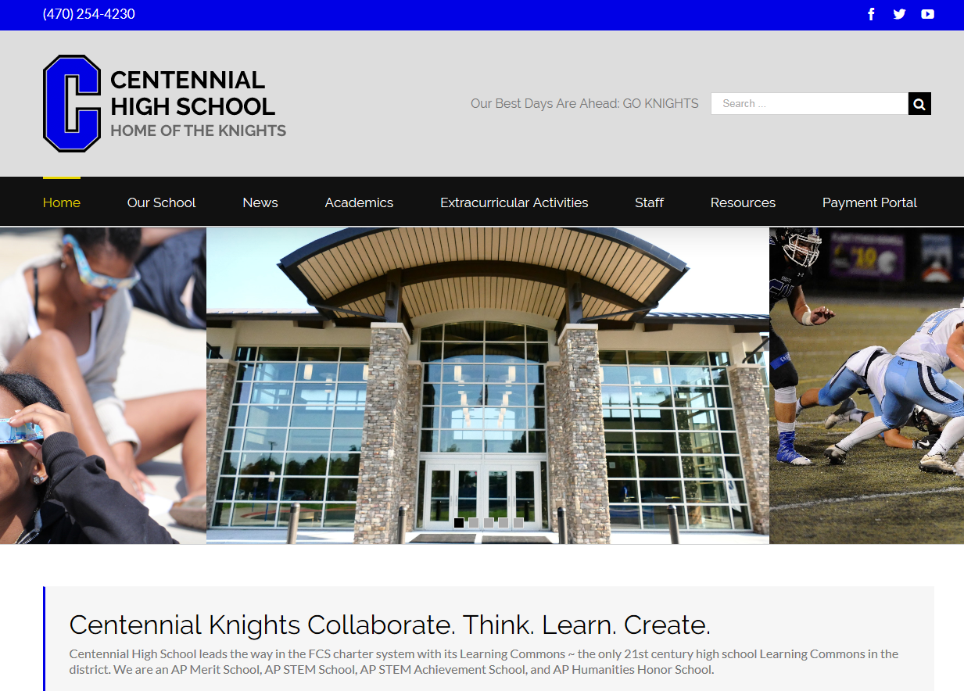
Visit us at www.chsknights.com

Slide 25
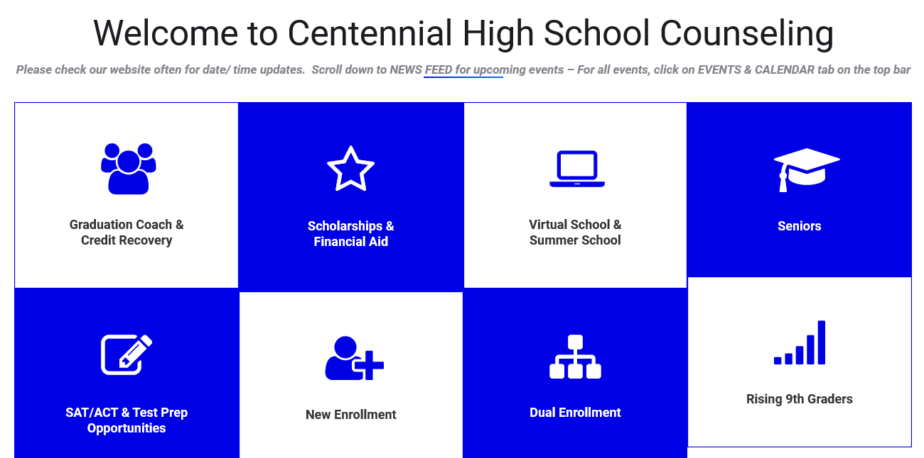
Visit us at www.mycentennialcounseling.com

Slide 26
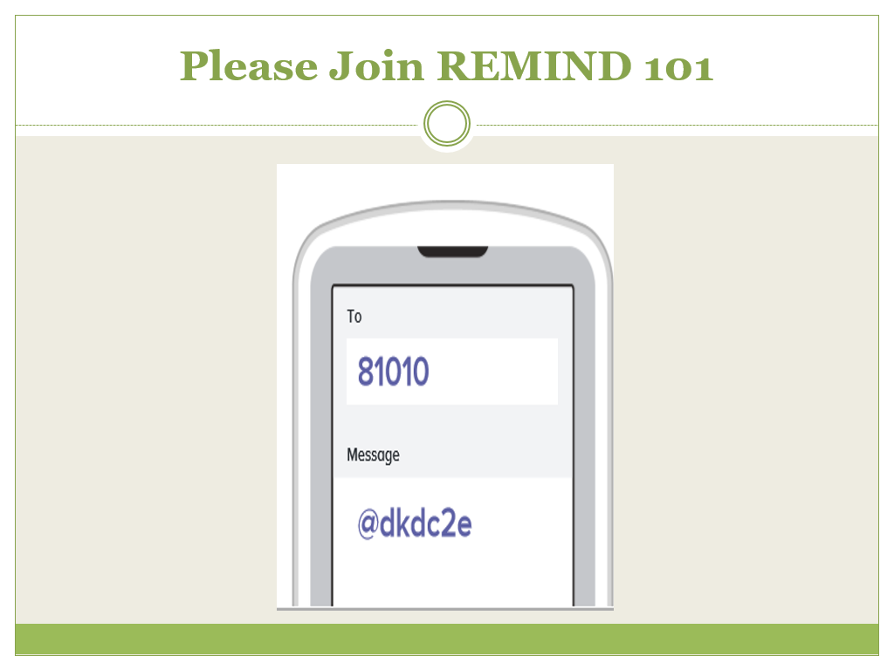
Moving Forward
The Power Point and handouts will be posted on www.mycentennialcounseling.com.
9th Grade Guidance – Week of October 1
IB Night – October 3 at 6:00 pm
Spring Freshman Parent Night – February 5 at 6:00 pm.
Please complete and return the feedback form. Thank you!

Slide 27
Moving Forward
The Power Point will be posted on www.mycentennialcounseling.com.
Freshman Parent Night – Part 2 February 10, 2021
Please complete and return the feedback form. Thank you!

Slide 28
PSAT

