Slide 1
Freshman Classroom Guidance – Part 2
The Centennial High School Counseling Department
* The Presentation and handouts are posted on www.mycentennialcounseling.com

Slide 2
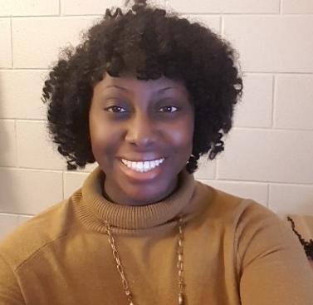
2019-20 Counseling Department
Will Jones
A – Cas, AVID
Nsikan Ekpo
Cat - Harp
Heidi Ruppe
Harq - Mep

Slide 3

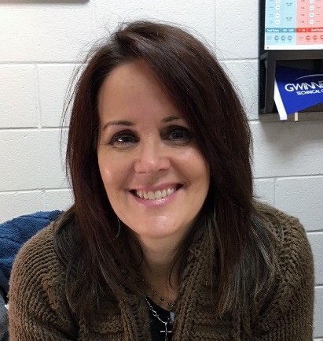
2019-20 Counseling Department
Melissa Freeman
Meq - Sal
Hella Peart
Sam - Z
Anne Rigsbey
Graduation Coach

Slide 4
Graduation Requirements
Subject Area | Required # of Credits
Language Arts | 4 credits
Math | 4 credits
Science | 4 credits
Social Studies | 3 credits
Health Personal Fitness | .5 credit .5 credit
Pathway Courses | 3 credits
Electives | 4 credits
 | 23 total credits

Slide 5
Graduation Requirements
Carnegie Units
1 Semester class = .5 credit
1 Yearlong class = 1 credit (.5 earned per semester)
HS credits earned in Middle School
Students can earn HS credit for English, Math, Physical Science, World Language, Art, IDT, HCS, and/or Engineering.
Promotion
Freshmen: 0 – 4.5 credits
Juniors: 11.0 – 16.5 credits
Seniors: ≥ 17.0 credits
Per county policy, students will remain with their graduating class, regardless of credits (unless credit-deficient).
Grade of 70 or higher required to pass a course (grades are not averaged across semesters)
Count towards overall GPA but not HOPE/Zell
7th and 8th grade World Language equals 1.0 HS credit.
Sophomores: 5.0 – 10.5 credits

Slide 6

Rigor of High School Courses
Grade Point Average (GPA)
SAT/ACT scores
Essays
Activities & Accomplishments
College Admissions 101
Senior Year Courses
Essentially everything the college will know about you and who you are.
Teacher & Counselor
Recommendations
Interview
Demonstrated Interest

Slide 7

Factors in Course Selection
Motivation
Interest
HOPE/Zell Miller (GPA, rigor, and test score requirements)
Prerequisites
College/ Career Goals
Schedule as a whole
Extracurricular commitments
Teacher Recs
Inside scoop: Look at this year’s schedule/grades/stress level and compare it to proposed schedule for 2020-2021, taking into account any changes in commitments outside of school.

Slide 8
4 Year Academic Plan
A Map to Your Future

Slide 9
Required Academic Classes
Language Arts (4 Credits)
9th Lit or 9th Lit H
10th World Lit or 10th World Lit H
11th Lit or 11th Lit H or AP Lang
12th Multi Lit or Dramatic Writing or AP Lit or College English
  More information to come re: placement for 9th graders who are currently taking 10th Lit H. Please put 10th Lit H in 9th grade and “English” for 10th-12th grade.
  Summer Reading may be required for Honors and AP level Lang Arts courses.

Slide 10

Required Academic Classes
Mathematics (4 Credits)
On-Level
Accel Geom B/Alg II Honors (10)
Accel Pre-Calculus Honors (11)
Accelerated
Honors
Geometry (10)
Algebra 2 (11)
Approved 4th Math Course (12)
Algebra 2 Honors (10)
PreCalculus Honors (11)
AP Math or Dual Enrollment Math
Algebra (9)
Algebra Honors (8)
Geometry Honors (9)
Accel Algebra/Geom A Honors (9)
● Honors Level: Same pace and content as on-level courses; but students are 1 year ahead in math (starts in 8th Grade).
● Accelerated: Very rigorous/fast paced; students complete 3 years of math courses in 2 years.

Slide 11

Required Academic Classes
Science (4 Credits)
Biology (H)
Physical Science (H) or Physics
Chemistry (H), Environmental Science, Earth Systems or an AP Science class
Approved 4th Science Course

Slide 12

Required Academic Classes
Social Studies (3 Credits)
World History (or AP)
US History (or AP)
Economics (1 semester)*
American Government
(1 semester)*
* AP Economics and AP Government are both offered as yearlong courses.

Slide 13


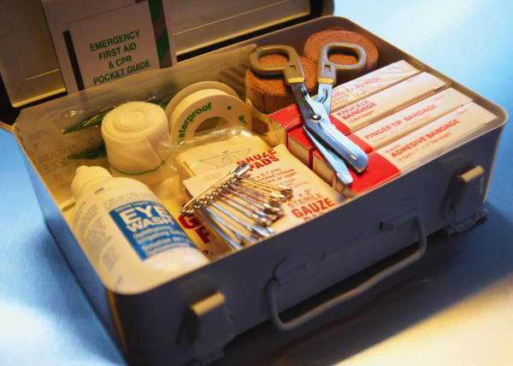
Additional Required Classes
Physical Education (1 credit)
General Health
(1 semester)
Personal Fitness
(1 semester)

Slide 14


Centennial’s Personal Fitness Exemption
Exempt Personal Fitness through participation in 1 of 3 possible CHS activities:
● Athletics  Marching Band  JROTC
Once criteria has been met, student will pick up a Personal Fitness Exemption form outside of room H-75.
The Personal Fitness Exemption form requires a signature from the designated school staff for their activity verifying the student completed the participation criteria.
Intent to Exempt Contract: In 8th Grade, students indicated their intent to exempt Personal Fitness. Those students will not be scheduled for a Personal Fitness course in grades 9-11.
Deadline to meet criteria and submit completed Exemption Form Coach Burch: Last Day of School Junior Year

Slide 15
Additional Required Courses
Pathway Courses (3 credits)
3 Credits of courses in any the following areas: Credits can all be in the same area or mix & matched
Career Tech (CTAE) Courses
Fine Arts
World Languages

Slide 16

Career Focused
Pathways
(CTAE)
Allied Health Services (Health Science)
Audio/Video Tech & Film
Financial Services and Business Accounting
Engineering and Technology
Food & Nutrition
JROTC (ARMY)
Computer Science
Programming
Game Design
Law Enforcement Services
Emergency Responder Services (Health Science)
Business and Accounting

Slide 17

Fine Arts
Art
Chorus
Drama
Band
Orchestra

Slide 18

World Languages
French: 1, 2, 3, 4, 5, AP
Spanish 1, 2, 3, 4, 5, AP
German 1, 2, 3, 4, AP
*GA Board of Regents requires a minimum of 2 credits of the same World Language to meet 4-year college admissions criteria.

Slide 19
International Baccalaureate (IB)
Two Options: IB Diploma Candidate (“full program”)
IB Course Candidate (students take individual courses).
IB courses typically start in 11th grade.
Most students who take IB courses are in honors courses in 9th and 10th grade.
Colleges typically view AP and IB courses as equally rigorous.

Slide 20
Course Registration for 2020-2021
February 2020 – Teacher course placement recommendations.
Mid-Late February 2020 – Student will make elective choices and will have multiple opportunities to make changes to course requests.
Early March 2020 – Student portal view will open for student/parent final review and sign-off on courses for 2020-21 school year.

Slide 21


Choosing Electives
Review list of available elective options
Use CHS Course Catalog (online) to read the course description of the classes of interest
Choose at least 5 elective courses – 2 will be in your schedule
Changes may be made within the designated registration period (Feb-March 2020)

Slide 22
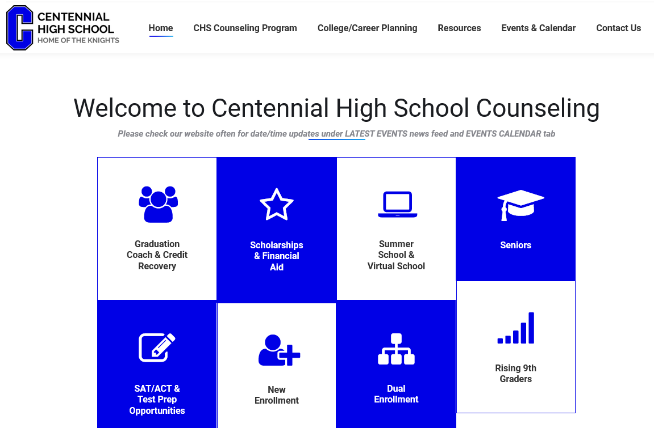
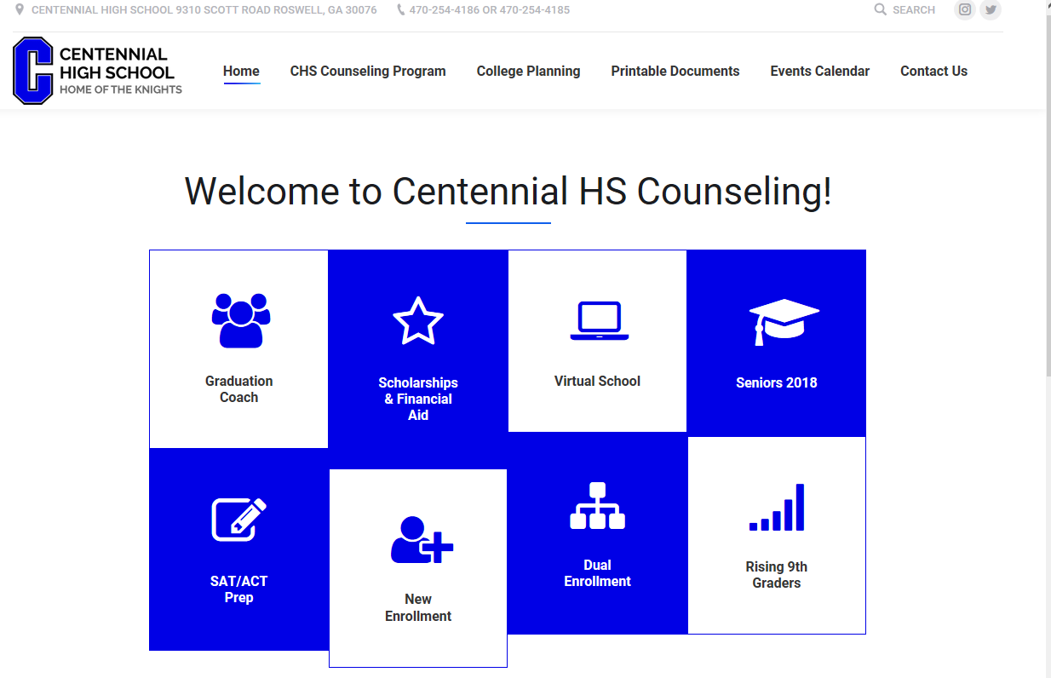
Visit us at www.mycentennialcounseling.com

Slide 23
Moving Forward
This is a PLAN… it is subject to change
Course Registration on Infinite Campus
Transcript Issues? Turn in your transcript today

