Slide 1

Freshman Classroom Guidance – Part 1
Centennial
High School
Class of 2023

Slide 2
AGENDA
Review Handout
Education and Income
Graduation Requirements and Counting Credits
Roadblocks and Detours

Slide 3

CHS Counseling Dept
Counselors work with students based upon first letter of students’ last names:
A – Cas
Cat – Harp
Harq – Mep
Meq – Sal
Sam – Z
Will Jones
Nsikan Ekpo
Heidi Ruppe
Melissa Freeman
Hella Peart
Graduation Coach
Anne Rigsbey

Slide 4
Grading Policies
In middle school, grades are calculated using a system of averages.
In Fulton County, high school grades are not averaged… Each semester is independent.
Example 9th grade English Semester 1 (Aug-Dec): 60 (F)
Example 8th grade English Semester 1 (Aug-Dec):60 (F) Semester 2 (Jan-May): 80 (B)
Student fails 1st semester; passes 2nd semester (earns ½ credit)
Student passes class for the year (earns 1 full credit)
Semester 2 (Jan-May): 80 (B)
*No Yearly Average
*Yearly Ave: 70 (C)

Slide 5
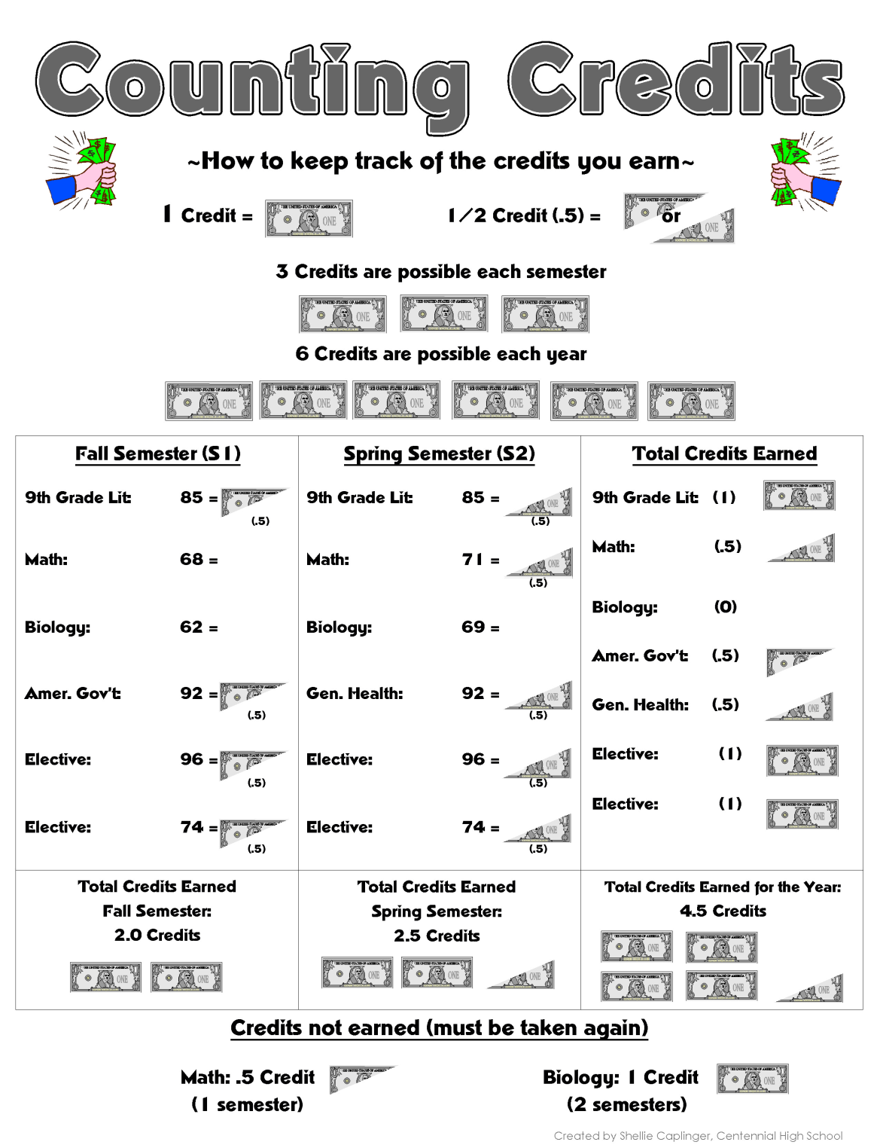
Per. Fitness
Per. Fitness

Slide 6
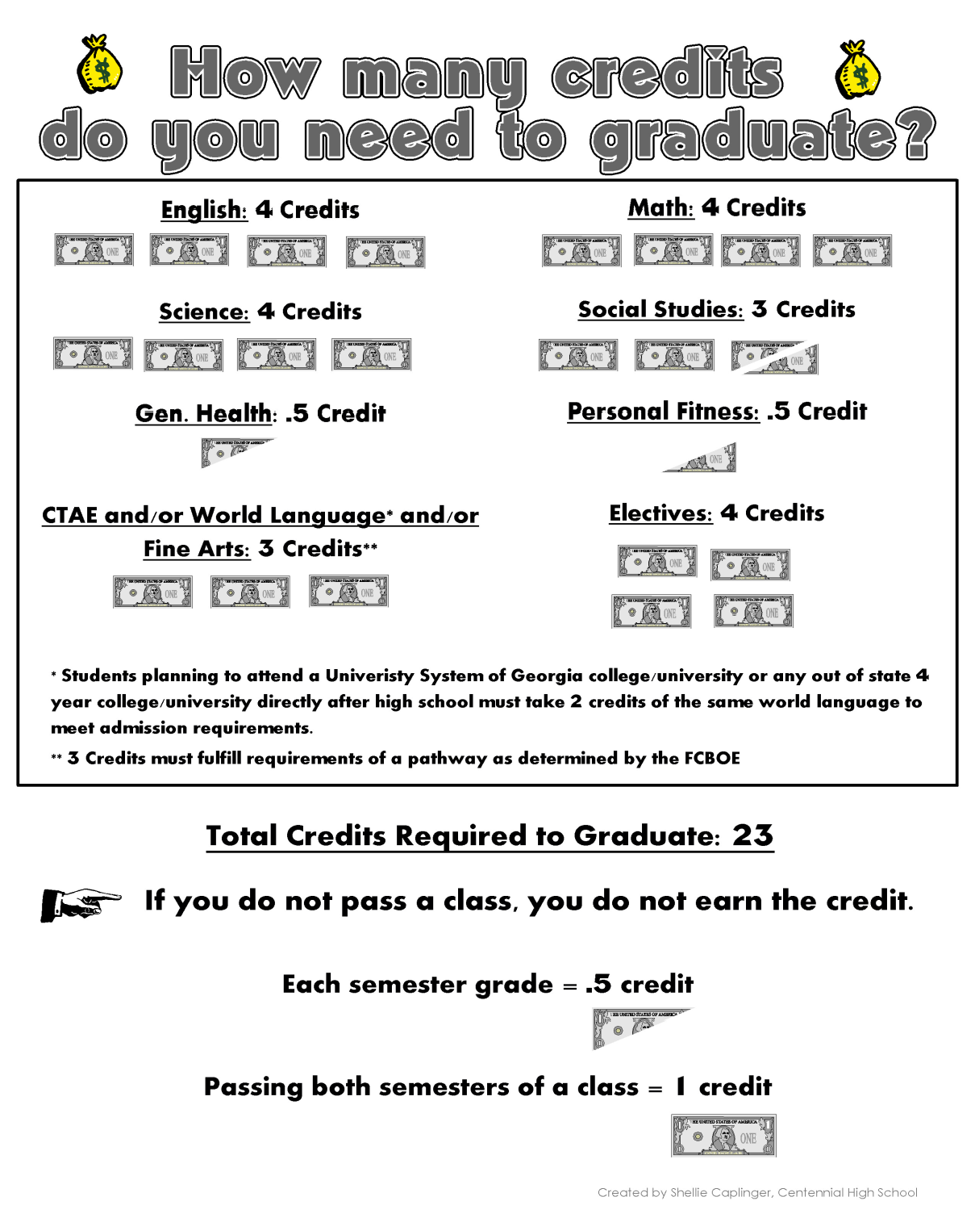

Slide 7
Grade Promotion and Athletics
Seniors (12th Grade):
17.0 or more credits
Juniors (11th Grade):
11.0 – 16.5 credits
Freshmen (9th Grade):
0 – 4.5 credits
Sophomores (10th Grade):
5.0 – 10.5 credits

Slide 8
College2019 College Freshman ProfilesClass Profiles
GA State
GA College
Columbus State
Kennesaw State
Average GPA: 3.3 – 3.8 (low - high “B”)
Average SAT: 1070 - 1260
Average ACT: 21-28
In-State Tuition/Fees: $11,076
Average GPA: 3.39 – 3.87 (low - high “B”)
Average SAT: 1140 - 1280
Average ACT: 24-29
In-State Tuition/Fees: $9,530
Average GPA: 3.4 (low “B”)
Average SAT: 490 Math 500 R/W
Average ACT: 18 on sub scores
In-State Tuition/Fees: $7,568
Average GPA: 2.5 (low ”B”)
Average SAT: 440 Math 480 R/W
Average ACT: 17 - E, R, & M
In-State Tuition/Fees: $7334
# Freshmen: ~4631
# Freshmen: ~1647
# Freshmen: ~6500
# Freshmen: ~1800

Slide 9
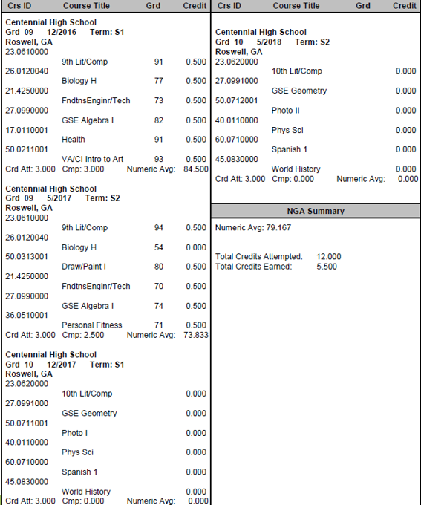
Group Activity
How many credits did the student have at the end of first semester?
How many credits did the student have at the end of 9th grade?
Will the student have enough credits to be promoted to 10th grade?

Slide 10
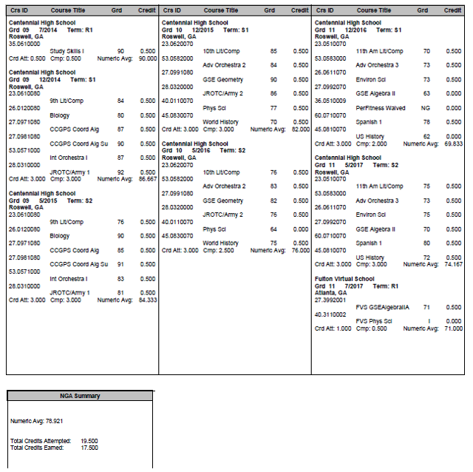
Transcript A
How many credits did the student have at the end of first semester?
How many credits did the student have at the end of 9th grade?
Did the student have enough credits to be promoted to 10th grade?
Do you think this student will get into the college of her choice? Why or why not?
What do you think this student’s senior year schedule will look like?

Slide 11
Transcript A:
Senior Year Schedule
12th GRADE LITERATURE
MATH
SCIENCE
SOCIAL STUDIES
SPANISH 2
S1 of US History / ELECTIVE

Slide 12
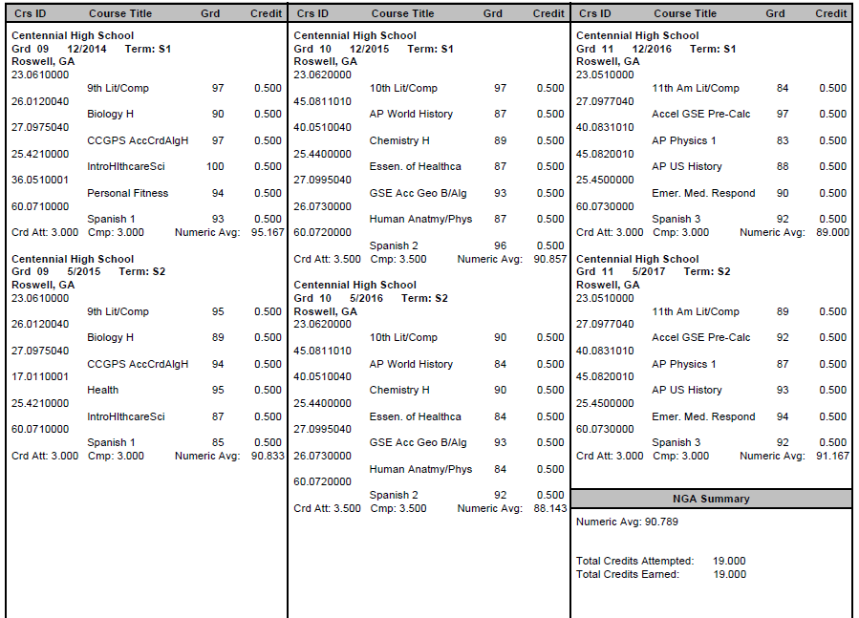
Transcript B
How many credits did the student have at the end of first semester?
How many credits did the student have at the end of 9th grade?
Did the student have enough credits to be promoted to 10th grade?
Do you think this student will get into the college of her choice? Why or why not?
What do you think this student’s senior year schedule will look like?

Slide 13
Transcript B:
Senior Year Schedule
12th GRADE LITERATURE
MATH
SCIENCE
SOCIAL STUDIES
ELECTIVE
ELECTIVE

Slide 14

Roadblocks and Detours to Earning the Money
Being absent and not making up work, tests, and quizzes
Not completing homework and projects
Not studying
Not seeking additional help
Poor time management
Zeroes!!!

Slide 15
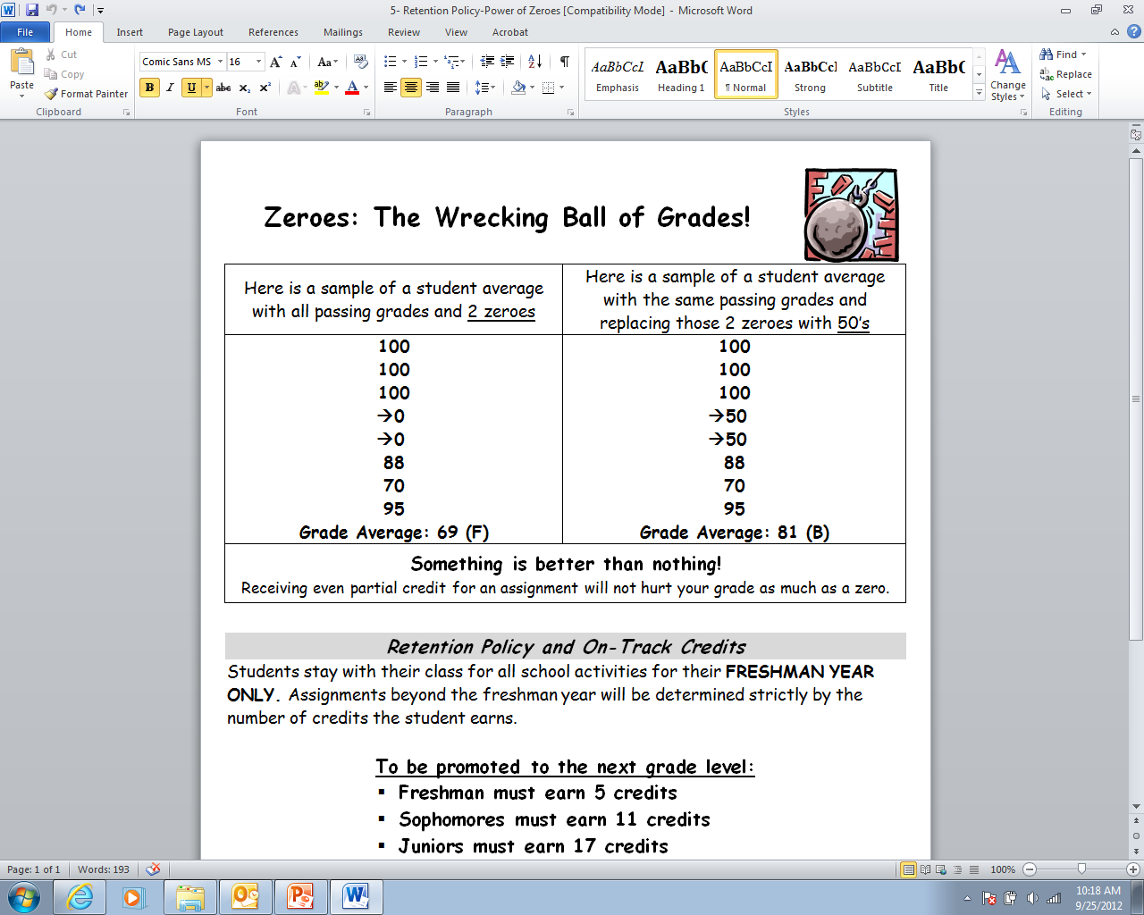

Slide 16
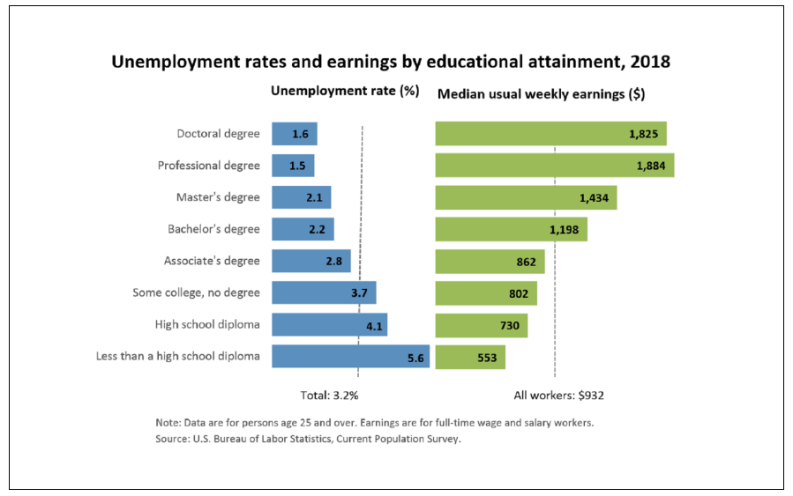
Education and Income

Slide 17
Don’t Let Your Freshman Year Turn Sour!
Avoid Zeros (Turn in all of your assignments.)
Ask for Help (If you don’t understand something, ask a teacher or friend to help you.)
No Tardies (Get to class on time.)
Get Organized (Use your agenda to keep track of upcoming tests and projects. Also keep your assignments neat in a folder or binder.)
Manage Your Time Wisely (Set up a plan for studying and doing homework every night.)
Get Involved (Find a club or activity of interest and join it.)
Believe in Yourself (Set high goals and go for it! You can do anything you set your mind to!)

Slide 18
Moving Forward
PSAT
October 16
12-week Progress Reports
November 11
Semester Exams
Start mid-December

