Slide 1

Freshman Parent Night – Part 1
Welcome to Centennial
High School

Slide 2

Agenda
Grading Policies and Expectations
Credits and Graduation Requirements
Intro to Choosing Courses for 2019-2020 School Year

Slide 3
Centennial 101
Carnegie Units
1 Semester Class = .5 credit
Students take six credit bearing courses per semester (students typically earn 3.0 credits per semester)
Grading Scale
7 additional points are added to a final grade of 70 or above in approved Honors, AP, and College courses
A (90-100)
B (80-89)
C (70-79)
F (<70)

Slide 4
Centennial 101: Grading
In middle school, grades are calculated using a system of averages.
In Fulton County, high school grades are not averaged… Each semester is independent.
Example 9th grade English Semester 1: 60 (F) Semester 2: 80 (B) *No Yearly Average
Example 8th grade English Semester 1: 60 (F) Semester 2: 80 (B) *Yearly Ave: 70 (C)
Student fails 1st semester; passes 2nd semester (earns ½ credit)
Student passes class for the year (earns 1 full credit)

Slide 5
Georgia Milestones Tests
9th Grade
Biology
9th Lit/Comp
Algebra
10th Grade:
Physical Science
Geometry
11th Grade
11th Lit/Comp
U.S. History
12th Grade
Economics
Count 20% of a student’s final grade
Non-Milestones courses have a final exam that counts 20% of a student’s final grade in the course
Milestones are taken S2 (Economics EOC can be taken either S1 or S2, depending on when the student is taking Economics)

Slide 6
GPA Calculation
To calculate Fulton County GPA:
  By Semester
    Add final course grades for semester
    Divide by total courses taken
  Cumulative GPA
    Add final grades for each course
    Divide by total courses taken
HOPE/Zell Miller GPA
  Determined annually by the GA Student Finance Commission
  Visit www.GAFutures.org for details

Slide 7
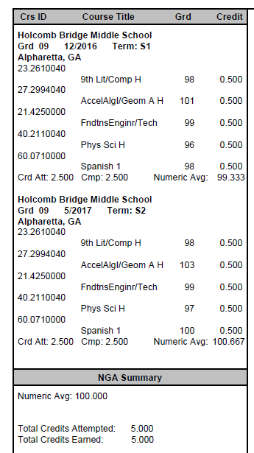
Centennial 101
High School credits earned in Middle School
Students can earn HS credits for math, science, world languages, and/or certain electives. 7th and 8th grade world language equals 1.0 HS credit.

Slide 8
Centennial 101
Promotion
Freshmen: 0 – 4.5 credits *
Sophomores: 5.0 – 10.5 credits
Juniors: 11.0 – 16.5 credits
Seniors: 17.0 or more credits
* Students who come in with HS credit for MS courses will remain with their original year of graduation
Progress Reports and Report Cards
Progress Reports provide student’s status at the 6 and 12 week marks
Report Cards provide the student’s final grades for the semester
Home Access Center (HAC)

Slide 9
Home Access Center
Parents and students can monitor grades, attendance, and discipline through Home Access Center (HAC).
Parents can pick up their user name and password for HAC in the front office with an ID.
Students can also access their grades through Student Access Center.
User name –xxxxxxxxxx (x represents student’s 10-digit student ID) Password – DOB (MMDDYYY format)
Go to www.fultonschools. org -> Students and Parents -> Click on “Home Access Center” link.

Slide 10
Parent Concerns
Questions about student grades, assignments, course content, classroom consequences, etc. should be directed to the teacher first.
The counselor can be contacted for support in scheduling meetings with all teachers or general academic support.
Administrators are available for academic support after contact has been initiated with the teacher.

Slide 11
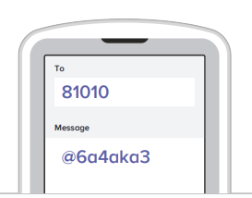
CLASS OF 2022 REMIND 101

Slide 12
Graduation Requirements
23 credits required
English – 4 credits
Math – 4 credits
Science – 4 credits
Social Studies – 3 credits
CTAE/World Language/Fine Arts* – 3 credits
  *Note: 2 or 3 years of World Language credits may be required for college admission
Health/Personal Fitness – 1 credit (each .5)
Electives – 4 credits

Slide 13
Sample High School Schedule
Start Time 8:20 Dismissal 3:30
Period | Fall Semester (Aug – Dec) | Spring Semester (Jan – May)
1st | 9th Grade Lit. | 9th Grade Lit.
2nd | Biology | Biology
3rd | General Health | Personal Fitness
4th | Algebra/ A, B, or C Lunch | Algebra/ A, B, or C Lunch
5th | German 1 | German 1
6th | Chorus | Chorus
 | Advisement | Advisement

Slide 14

Required Academic Classes
Language Arts (4 Credits)
9th Grade Lit & Comp
10th Grade Lit &Comp
11th Grade/American Lit
Senior Level Lang Arts Course
  AP Literature
  College English
  1 Semester of World Lit and 1 Semester of Multicultural Lit
  *Required Summer Reading for all Honors and AP level Lang Arts courses.

Slide 15

Required Academic Classes
Mathematics (4 Credits)
On-Level
Accelerated Geometry B/Algebra 2 Honors (9 or 10)
Accelerated Pre-Calculus Honors (10 or 11)
Accelerated
Honors
Geometry (10)
Algebra 2 (11)
Approved 4th Math Course (12)
Algebra 2 Honors (10)
PreCalculus Honors (11)
AP Math or Dual Enrollment Math
Algebra (9)
Algebra Honors (8)
Geometry Honors (9)
Accelerated Algebra/Geometry A Honors (8 or 9)

Slide 16

Required Academic Classes
Science (4 Credits)
Biology
Physical Science or Physics
Chemistry, Environmental Sci, Earth Systems or an AP Science class
Approved 4th Science Course

Slide 17

Required Academic Classes
Social Studies (3 Credits)
World History
US History
Government (1 semester)
Economics (1 semester)

Slide 18

Fine Arts
Art
Chorus
Drama
Band
Orchestra

Slide 19
Pathway Offerings at Centennial
Advanced Academics
Allied Health Services
Audio/Video Tech & Film
Business Accounting
Computer Science
Emergency Responder Services
Engineering & Technology
Food & Nutrition
Journalism
JROTC
Law Enforcement Services
Performing Arts
Programming
Visual Arts
Web & Digital Design
World Languages

Slide 20

World Languages
French: 1, 2, 3, 4, 5, AP
Spanish: 1, 2, 3, 4, 5, AP
German: 1, 2, 3, 4, 5, AP
Honors courses exist in level II and higher

Slide 21


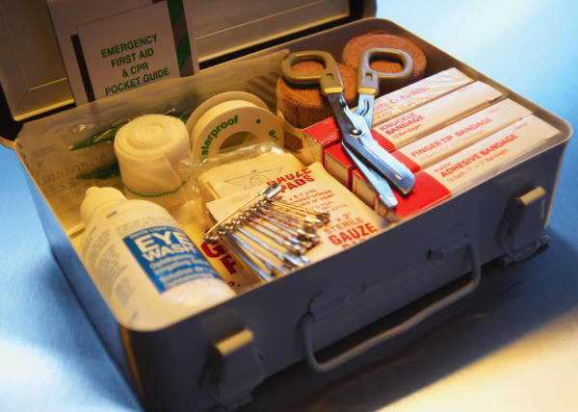
Additional Required Classes
Physical education (1 credit)
General Health
(1 semester)
Personal Fitness
(1 semester)

Slide 22


Centennial’s Personal Fitness Exemption
Exempt Personal Fitness through participation in 1 of 3 possible CHS activities:
● Athletics/Fencing  Marching Band  JROTC
Once criteria has been met, student will pick up a Personal Fitness Exemption form from Coach Burch in room H-75.
Exemption Form requires a signature from the designated school staff for their activity verifying the student completed the participation criteria.
Intent to Exempt Contract: Indicates student’s plan to exempt course. Student will not be scheduled for Personal Fitness course in grades 9-11.
Deadline to meet criteria and submit completed Exemption Form to Coach Burch’s office (H-75): Last Day of School Junior Year

Slide 23
2019-2020 Course Selection
Teachers will recommend students for academic placement during the spring semester.
Parents/students will be given the opportunity to review recommended placements; questions should be directed to the teacher and/or counselor prior to enrollment in the course.
Students will be given opportunities to select elective courses; changes may be made within the designated enrollment period (Feb – May).
After the verification period, students are expected to complete courses in which they enroll.
Changes after the verification period will be rare and will require administrative approval.

Slide 24
CHS Counseling Dept
Counselors work with students based upon first letter of students’ last names:
A – CAS
CAT – HARP
HARQ – MEP
MEQ – SAL
SAM – Z
Zyer Beaty
Nsikan Ekpo
Heidi Graver
Melissa Freeman
Hella Peart
Graduation Coach
Anne Rigsbey

Slide 25
Student Support Programs
New Student Group
AP Access Group
Bridge Law Benchmark Activities
Grades 9 - 12

Slide 26
Counseling Program Resources
Counseling Website www.mycentennialcounseling.com
Scholarship Information Blasts
Parent Nights
College Representative Visits
SAT/ACT Test-Prep Opportunities
Credit Recovery Options
Consultations & Collaboration

Slide 27
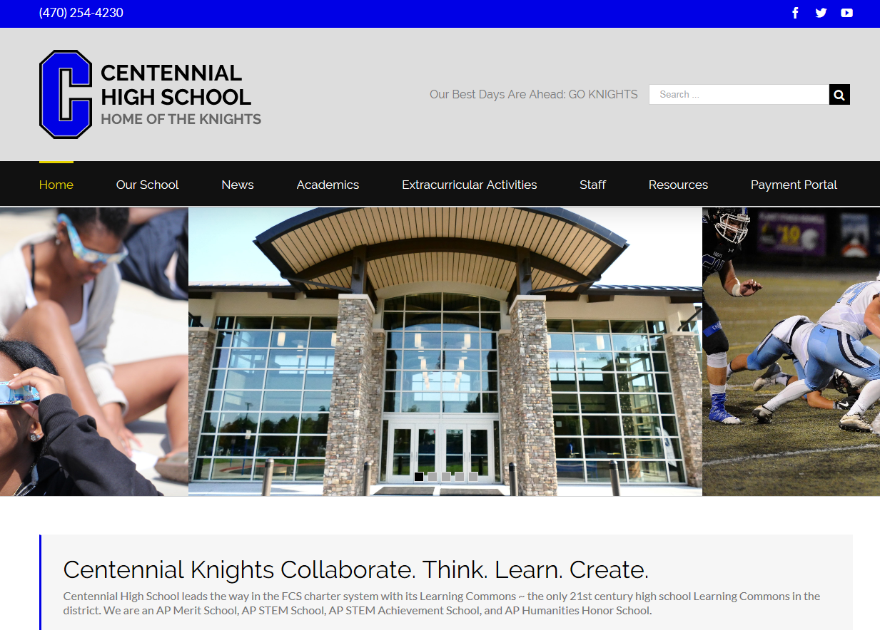
Visit us at www.chsknights.com

Slide 28
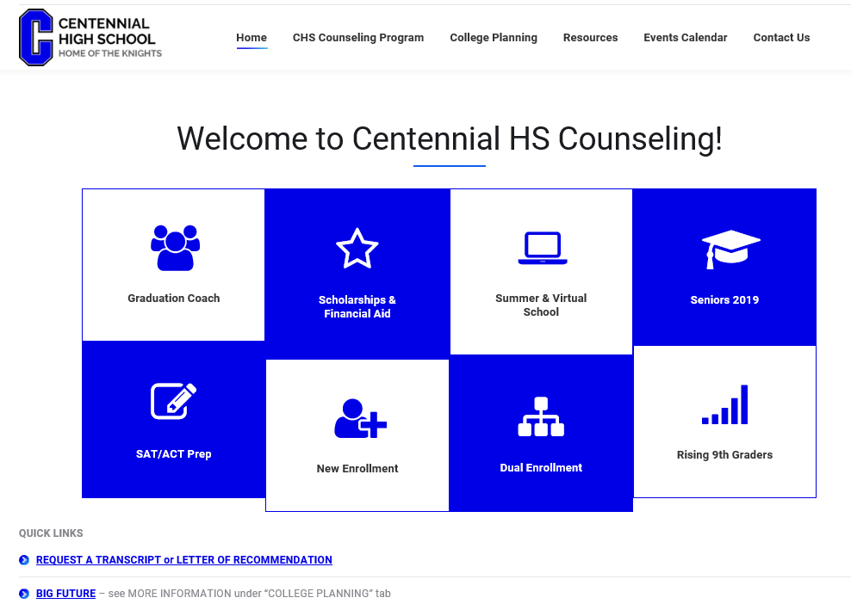
Visit us at www.mycentennialcounseling.com

Slide 29

POP QUIZ TIME

Slide 30
Moving Forward
The Power Point and handouts will be posted on www.mycentennialcounseling.com.
9th Grade Guidance – Week of October 1
Spring Freshman Parent Night –Wednesday, February 6 at 6:00 pm.
Please complete and return the feedback form. Thank you!

