Slide 1

Freshman Classroom Guidance – Part 1
Centennial
High School
Class of 2021

Slide 2
AGENDA
Review Handout
Education and Income
Graduation Requirements and Counting Credits
Roadblocks and Detours

Slide 3

CHS Counseling Dept
Counselors work with students based upon first letter of students’ last names:
A – Cas
Cat – Harp
Harq – Mep
Meq – Sal
Sam – Z
Zyer Beaty
Nsikan Ekpo
Heidi Graver
Melissa Freeman
Hella Peart
Graduation Coach
Maria Jiram

Slide 4
Grading Policies
In middle school, grades are calculated using a system of averages.
In Fulton County, high school grades are not averaged… Each semester is independent.
Example 9th grade English Semester 1 (Aug-Dec): 60 (F)
Example 8th grade English Semester 1 (Aug-Dec):60 (F) Semester 2 (Jan-May): 80 (B)
Student fails 1st semester; passes 2nd semester (earns ½ credit)
Student passes class for the year (earns 1 full credit)
Semester 2 (Jan-May): 80 (B)
*No Yearly Average
*Yearly Ave: 70 (C)

Slide 5
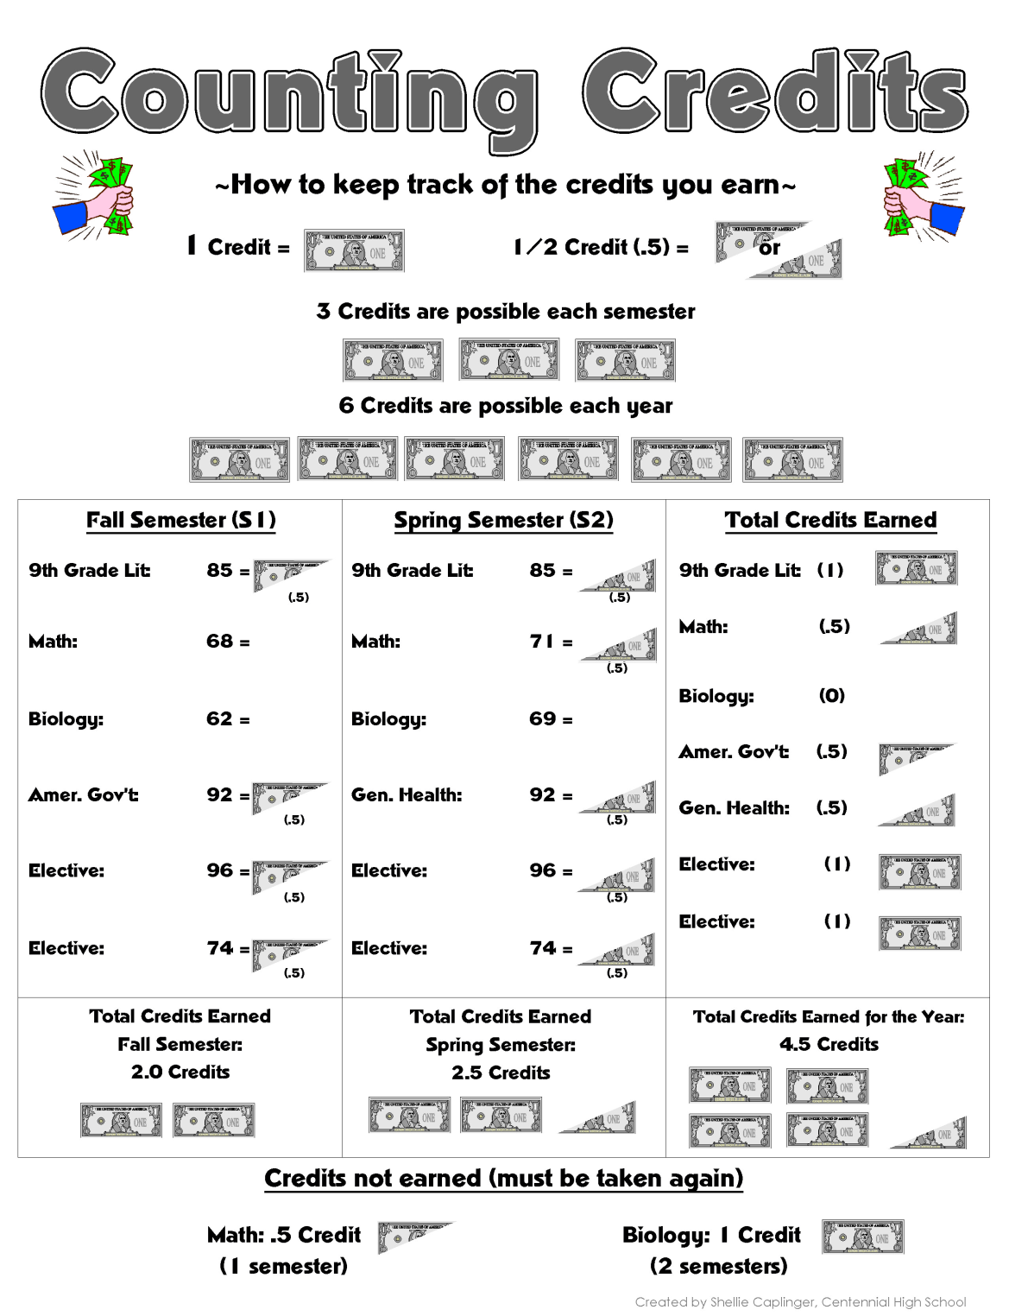
Per. Fitness
Per. Fitness

Slide 6
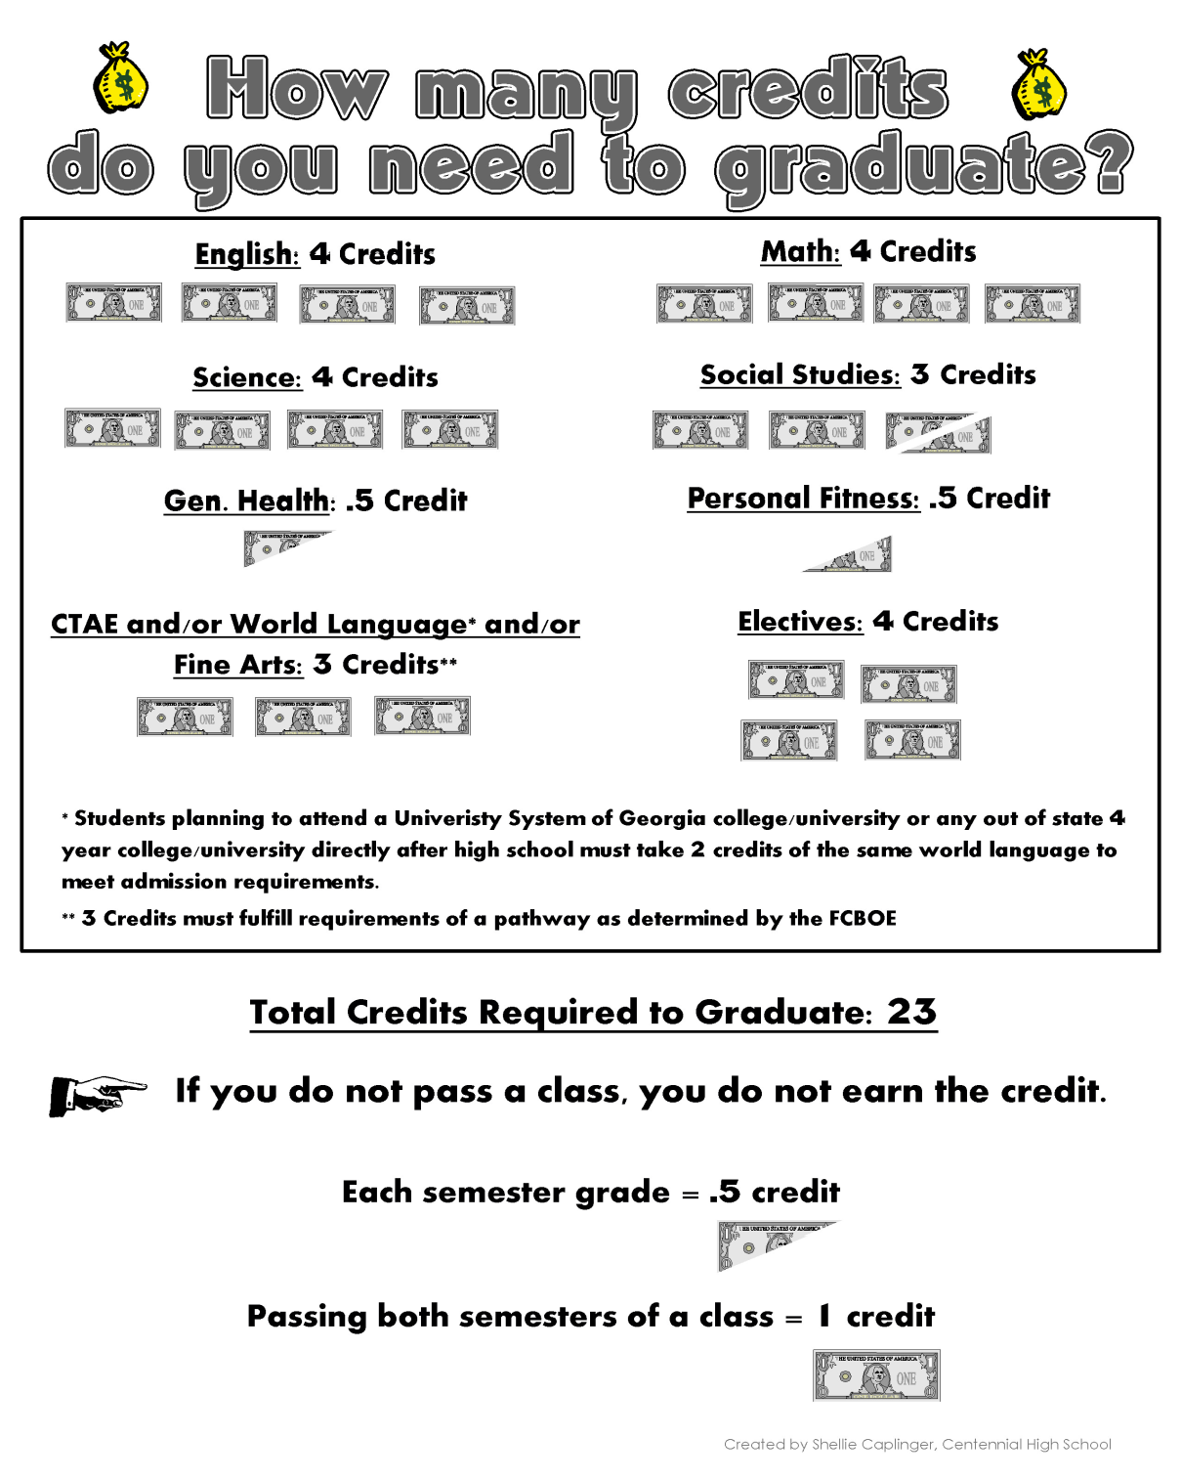

Slide 7
Grade Promotion and Athletics
Seniors (12th Grade):
17.0 or more credits
Juniors (11th Grade):
11.0 – 16.5 credits
Freshmen (9th Grade):
0 – 4.5 credits
Sophomores (10th Grade):
5.0 – 10.5 credits

Slide 8
College2017 College Freshman ProfilesClass Profiles
GA State
GA College
Average GPA: 3.58 (high “B”)
Average GPA: 3.15 (low ”B”)
Average SAT: 1030-1230
Average ACT: 20-25
Average SAT: 1150-1270
Average ACT: 26
Average SAT: 990
Average ACT: 20
In-State Tuition/Fees: $10,686
In-State Tuition/Fees: $9346
In-State Tuition/Fees: $7200
# Freshmen: ~3900
# Freshmen: ~1450
# Freshmen: ~1800
Columbus State
Kennesaw State
# Freshmen: ~4500
Average GPA: 3.31 (low “B”)
Average SAT: 1070-1250
Average ACT: 21-26
Top 25% of HS Class Rank: 53%
Top 25% of HS Class Rank: N/A
Top 25% of HS Class Rank: 37%
Top 25% of HS Class Rank: ~N/A
Top 10% of HS Class Rank: N/A
Top 10% of HS Class Rank: N/A
Top 10% of HS Class Rank: 27%
In-State Tuition/Fees: $7432
Top 10% of HS Class Rank: 11%
Average GPA: 3.2-3.7
(low - high “B”)

Slide 9
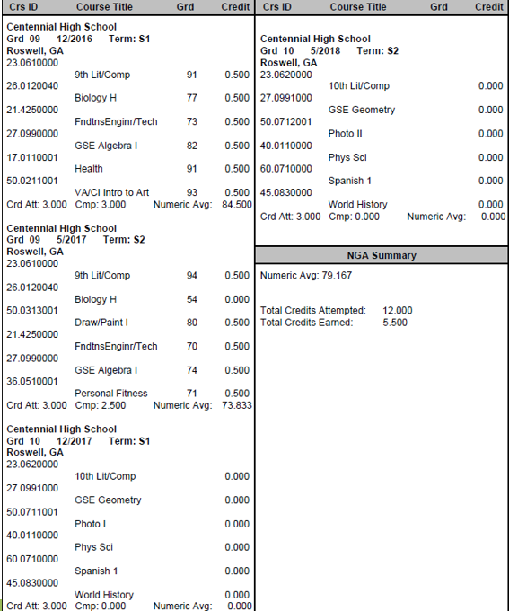
Group Activity
How many credits did the student have at the end of first semester?
How many credits did the student have at the end of 9th grade?
Will the student have enough credits to be promoted to 10th grade?

Slide 10
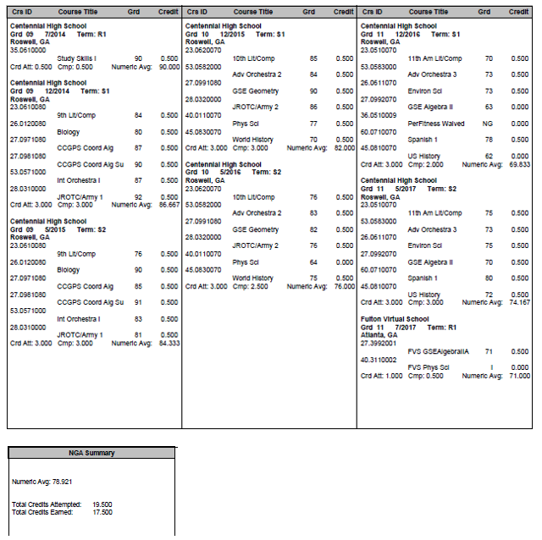
Transcript A
How many credits did the student have at the end of first semester?
How many credits did the student have at the end of 9th grade?
Did the student have enough credits to be promoted to 10th grade?
Do you think this student will get into the college of her choice? Why or why not?
What do you think this student’s senior year schedule will look like?

Slide 11
Transcript A:
Senior Year Schedule
12th GRADE LITERATURE
MATH
SCIENCE
SOCIAL STUDIES
SPANISH 2
S1 of US History / ELECTIVE

Slide 12
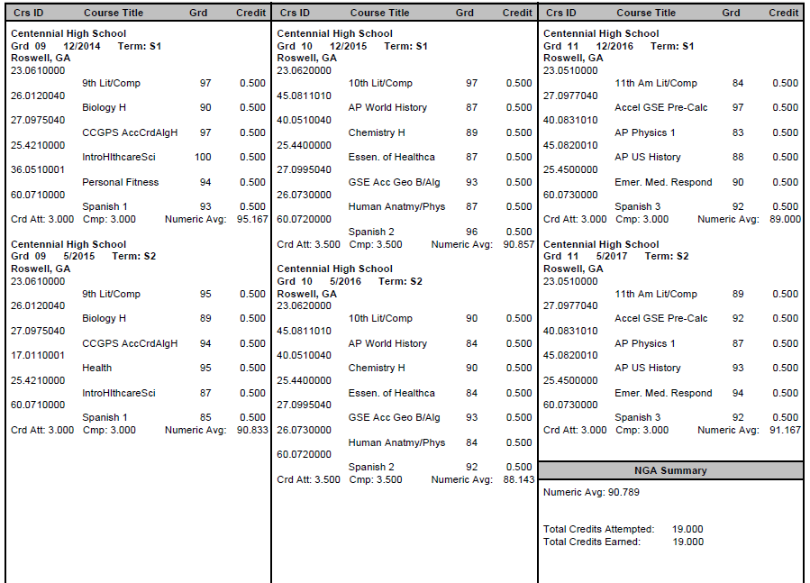
Transcript B
How many credits did the student have at the end of first semester?
How many credits did the student have at the end of 9th grade?
Did the student have enough credits to be promoted to 10th grade?
Do you think this student will get into the college of her choice? Why or why not?
What do you think this student’s senior year schedule will look like?

Slide 13
Transcript B:
Senior Year Schedule
12th GRADE LITERATURE
MATH
SCIENCE
SOCIAL STUDIES
ELECTIVE
ELECTIVE

Slide 14

Roadblocks and Detours to Earning the Money
Being absent and not making up work, tests, and quizzes
Not completing homework and projects
Not studying
Not seeking additional help
Poor time management
Zeroes!!!

Slide 15
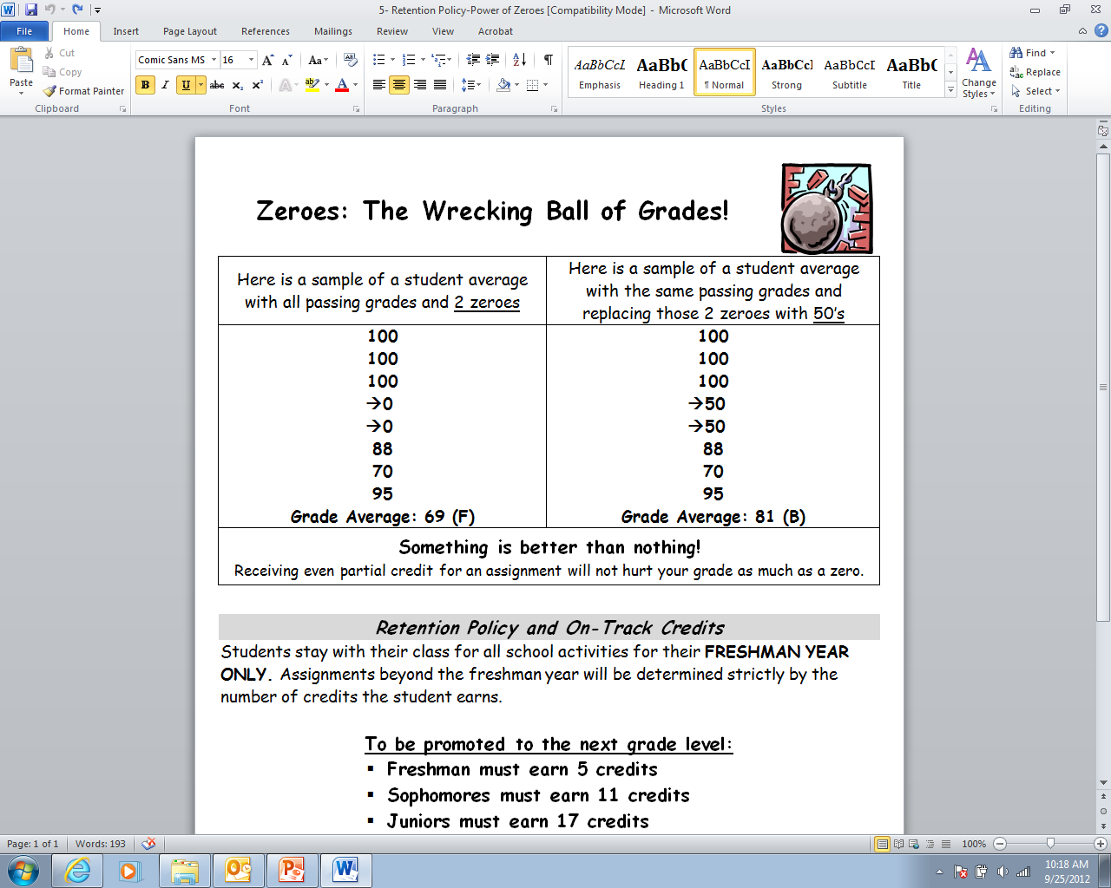

Slide 16
Recovery Policy
Students may request to redo missing work or work which resulted in a zero for a maximum grade of 70%, within the six weeks in which the assignment occurred.
Contact your teacher for additional information.
After the student has completed/redone all work, the student may request a teacher -determined alternate assignment that is designed to bring up the student’s grade.
Recovery work should be completed within 10 days prior to the end of the semester.

Slide 17
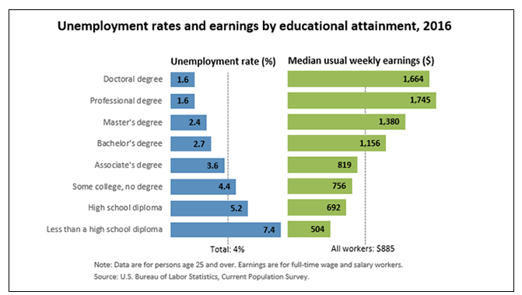

Slide 18
Student Access Center
Parents and students can monitor grades, attendance, and discipline through Home Access Center (HAC).
Parents can pick up their user name and password for HAC in the front office with an ID.
Students can also register for Student Access Center.
User name –xxxxxxxxxx@fcs.org (x represents student’s 10-digit student ID) Password – DOB (MMDDYYYY format)
Go to www.fultonschools. org -> Students and Parents -> Click on “Home Access Center” link

Slide 19
Moving Forward
PSAT
October 11
College Week
October 23-27
12-week Progress Reports
November 6
Semester Exams
Start mid-December

