Slide 1
Agenda & Feedback Forms
Grab an agenda packet and feedback form from one of the carts
After the presentation, please complete the feedback form
Turn in your feedback form to one of the crates
as you leave
Thank you!

Slide 2
Rising Freshman Parent Night
Class of 2021

Slide 3

Agenda
Priscilla Cole, Assistant Principal
Kristin Sharpe, PTSA Co-President
Heidi Graver, School Counselor
CHS Teachers: AP Human Geography, Honors Science, Accelerated Math, TAG Program, IB Program, CTAE Department
Jeff Burch, Athletic Director
Caroline Miley, Assistant Principal
Tonight’s PowerPoint will be posted on CHS’s counseling website under ‘Parent Nights’:
www.mycentennial counseling.com

Slide 4
Welcome to Centennial High School!
Holcomb Bridge Middle School
Haynes Bridge Middle School
Private Schools
Home Schools
Fulton County Non-Feeder Schools
Non-Fulton County Public Schools

Slide 5
Centennial High School PTSA
Welcome Parents
of the
Class of 2021

Slide 6
Some Current Programs:
  Mini grants
  Teacher appreciation
  Mock SAT/ACT
  Accident Avoidance Workshop
  Red Ribbon Week
  Senior Treats
  Student Council Liaisons for each class
  Front Office/Learning Commons Volunteers

Slide 7
Communications
eNewsletter emailed to parents monthly
Special edition for incoming freshman parents in July
Website: www.centptsa.org
Facebook:
Centennial High School – Home of the Knights
  Twitter: @GoCHSKNIGHTS

Slide 8
Ways to Contribute
Join CHS PTSA
Add Centennial PTSA to your Publix card
Volunteer to help out weekly, monthly or annually

Slide 9
Membership Information
Watch for email over the summer
Join early to secure a top locker

Slide 10

Beyond Measure
February 23
Parent Book Club – January 26 morning and evening
Follow up to Race to Nowhere
Explores alternative assessment & PBL

Slide 11


Want a SNEAK PEEK into life at Centennial High School?
Visit centptsa.org
Press this button
Register to receive the monthly eNews – the #1 news source at CHS!

Slide 12
Class of 2021
Be Informed
Be Engaged
Be PTSA

Slide 13


Coach Jeff Burch, Athletic Director
Centennial’s Personal Fitness Exemption
Exempt Personal Fitness through participation in 1 of 3 possible CHS activities:
● Athletics/Fencing  Marching Band  JROTC
Once criteria has been met, student will pick up a Personal Fitness Exemption form in the Centennial High School Assistant Principal’s Office.
Exemption Form requires a signature from the designated school staff for their activity verifying the student completed the participation criteria.
Intent to Exempt Contract: In 8th Grade, students indicate their plan to exempt on the back of their elective sheet. Those students will not be scheduled for Personal Fitness course in grades 9-11.
Deadline to meet criteria and submit completed Exemption Form to the CHS Assistant Principal’s Office: Last Day of School Junior Year

Slide 14

Curriculum FAQs
Credits and Graduation Requirements
Heidi Graver,
School Counselor

Slide 15
Graduation Requirements
Students must earn a total of 23 credits:
4 English
4 Mathematics
4 Science
3 Social Studies
1 Health/Physical Education
3 “Pathway” Credits: CTAE and/or World Language and/or Fine Arts
4 additional elective credits
CHS Counselors deliver classroom guidance lessons and supplementary parent nights to support students in meeting these requirements.

Slide 16
General Grading Policies
Interim progress reports will be issued to students at the 6 week and 12 week progress marks.
A = 90 or higher
B = 80-89
C = 70-79
F = 69 or below
Grade Level Placement:
Freshmen = Less than 5 credits
Sophomore = 5 – 10.5 credits
Junior = 11 – 16.5 credits
Senior = 17 or more credits
Honors, AP, and college courses receive an additional 7 points added to the final passing grade.
Fulton County Grading Scale:

Slide 17
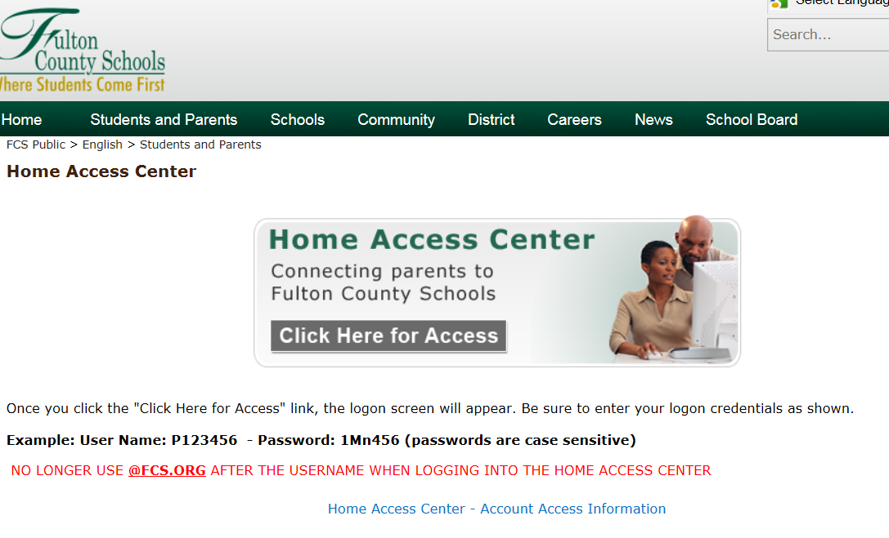
Home Access Center (HAC):
Track assignments, grades, attendance, discipline, etc. during the semester.

Slide 18
Rising 9th graders: How do they get their courses
Academic Courses vs Elective Courses
Visits to Middle Schools
Verification Forms

Slide 19
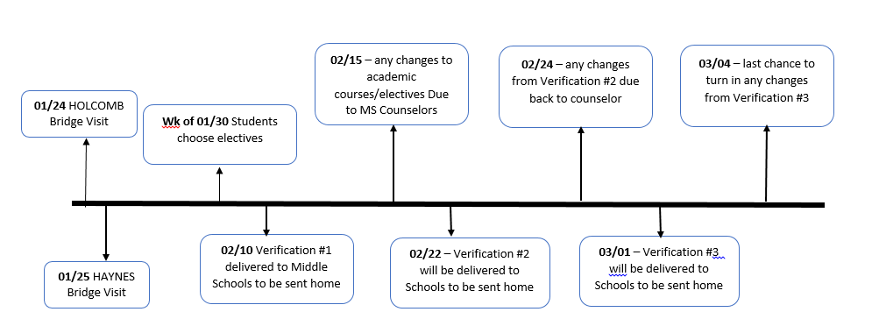
Tentative Timeline for Rising 9th grade Courses

Slide 20
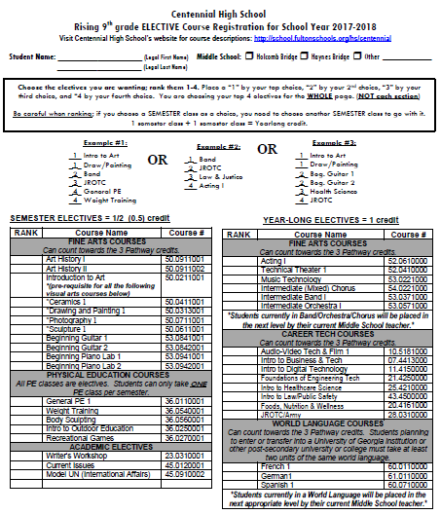
Elective Form Sample

Slide 21


Choosing Your Electives
Review list of available 9th Grade elective options
Use CHS Course Catalog (online) to read the course description of the classes of interest
Choose at least 4 electives
Rank your elective choices on your elective form in order of preference (#1 for top choice, #2 for next choice, etc.)
Changes may be made within the designated registration period (Spring 2017).

Slide 22
Parent Questions & Concerns: Who Is Your Best Point of Contact?
Thru Spring Registration Period & End of the 2016-17 School Year
Academic Recommendations & Placement for 9th Grade: Current 8th Grade Teacher(s) or Middle School Counselor
Course Selection, Options and Scheduling:
Current Middle School Counselor
Questions and/or Concerns after contact has been initiated and made with the teacher: Assigned CHS Administrator
Grades, Assignments, Course Content, Academic Placement, Classroom Consequences, etc: The Classroom Teacher
Coordinating a Conference with All of Your Student’s Teachers: Assigned Centennial HS Counselor
After the 2016-17 School Year has Ended and Beyond
Class Schedules, Academic, Social/Emotional, College/Career Support & Planning: Assigned Centennial HS Counselor
Students with IEPs or served through ESOL: Student’s Assigned Caseload Manager (Teacher)

Slide 23
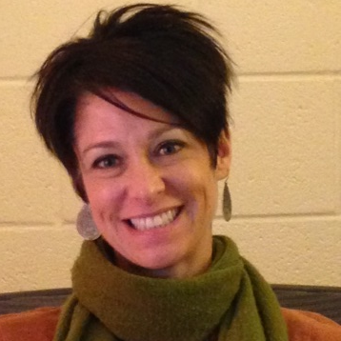
2016-17 Counseling Dept Staff
Zyer Beaty A – Cz
Shellie Marino
D – Gol, AVID
Heidi Graver
Gom- Mart

Slide 24
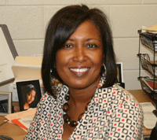
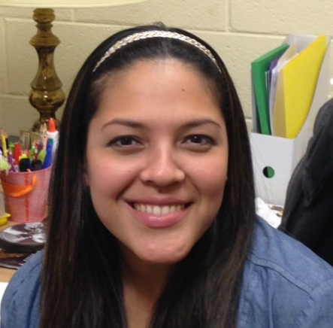
2015-16 Counseling Dept Staff
Melissa Freeman
Maru-Sam
Hella Peart
San - Z
Maria Jiram
Graduation Coach

Slide 25
CHS Counseling Curriculum
9th Grade
10th Grade
11th Grade
4-Year Academic Plan
Signs of Suicide
Counseling Services; Goal Setting
Career Exploration; Online Resources
College Admissions Criteria
College Search Process
12th Grade
College Application Process
Junior Advisement
Georgia “Apply to College Day”
Fall and Spring Parent Nights
Spring Parent Night
Fall Parent Night
Fall Parent Night
Financial Aid Night
Move On When Ready (MOWR)/Dual Enrollment
PSAT Score Review
Senior Blitz

Slide 26
Counseling Program Resources
www.mycentennialcounseling.com
Scholarship Information
College Representative Visits
SAT/ACT Test-Prep Opportunities
Credit Recovery/Virtual Learning
Consultations & Collaboration

Slide 27
Guest Speakers from Departments at Centennial High!
Talented and Gifted (TAG):
AP Human Geography:
International Baccalaureate (IB):
CTAE Pathways:
Allison Scenna
Becky Hostler
Bob Kuhn
Math Pathways (Accelerated):
Honors Biology:
Marchele Nelson
Pam Bullard
Marie Robinson

Slide 28
Career and Technical Education
Program Area
Audio-Video Technology and Film | ​Audio and Video Technology and Film Audio-Video Technology and Film II Audio-Video Technology and Film III
Engineering | Foundations of Engineering and Technology Engineering Concepts Engineering Applications
Law and Justice | Introduction to Law, Public Safety, Corrections and Security Criminal Justice Essentials Forensic Science and Criminal Investigations
Program Areas

Slide 29
Career and Technical Education
Program Area
Family and Consumer Science | ​Nutrition and Food Science Food, Nutrition, and Wellness ~Food for Life ~Food Science
Healthcare Science ~4th Science Credit | Therapeutic Services/ Emergency Medical Responder Introduction to Healthcare Science ~Essentials of Healthcare Emergency Medical Responder Therapeutic Services/ Allied Health and Medicine Introduction to Healthcare Science ~Essentials of Healthcare Allied Health and Medicine
JROTC | JROTC I JROTC II JROTC III
Program Areas

Slide 30
Career and Technical Education
Program Area
Business and Computer Science ~4th Science Credit | Financial Services Introduction to Business and Technology Financial Literacy Banking, Investing, & Insurance Web Development Introduction to Digital Technology/ ~Computer Science Principles ~Web Development Programming Introduction to Digital Technology/ ~Computer Science Principles ~Programming, Games, Apps and Society Computer Science Introduction to Digital Technology/ ~Computer Science Principles ~AP Computer Science *Merged Courses
Program Areas

Slide 31

Moving Forward…
Rising Freshman Enrollment (Non-Feeder): Thursday, April 13 & Thursday, April 20
PowerPoint from this program is available on www.mycentennialcounseling.com under “Parent Nights”
Check www.CHSKNIGHTS.COM website for information regarding the summer “Knights Camp” and Orientation.
Please complete and return the feedback form. THANK YOU!

