Slide 1
10th grade Town Hall & BRIDGE survey
Centennial HS Counseling
www.mycentennialcounseling.com

Slide 2
CENTENNIAL
COUNSELING TEAM
A - DN Ms. Ekpo
EkpoN@fultonschools.org
DO - KN Mrs. Ruppe
Ruppe@fultonschools.org
College & Career
Mrs. Truax
TruaxC1@fultonschools.org
KO - RI Ms. Freeman
FreemanMA@fultonschools.org
RJ - Z Ms. Peart
Peart@fultonschools.org
Graduation Coach Mrs. Hollaway
HollawayA@fultonschools.org

Slide 3
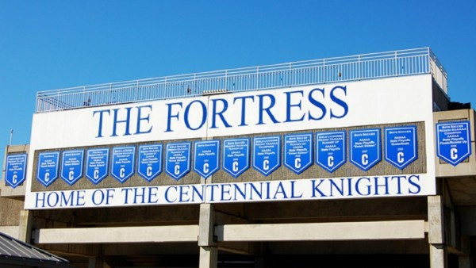
Student Support
Individual counseling
Group counseling
Classroom lessons and parent nights at all grade levels
Partnerships with mental health professionals & resources
Academic support and advisement
College and Career preparation
Grades 9 - 12

Slide 4
Mental Health Resources
You are IMPORANT
and You are NOT ALONE!
Resources to reach out for help
for you, a friend, or family member
Call or Text 988

Slide 5
YOUScience
Bridge Bill Required Tasks For 10th graders
10th grade bridge bill and post- secondary options SURVEY

Slide 6
Go to Class Link – Log In – Find the Naviance-stu app

Slide 7
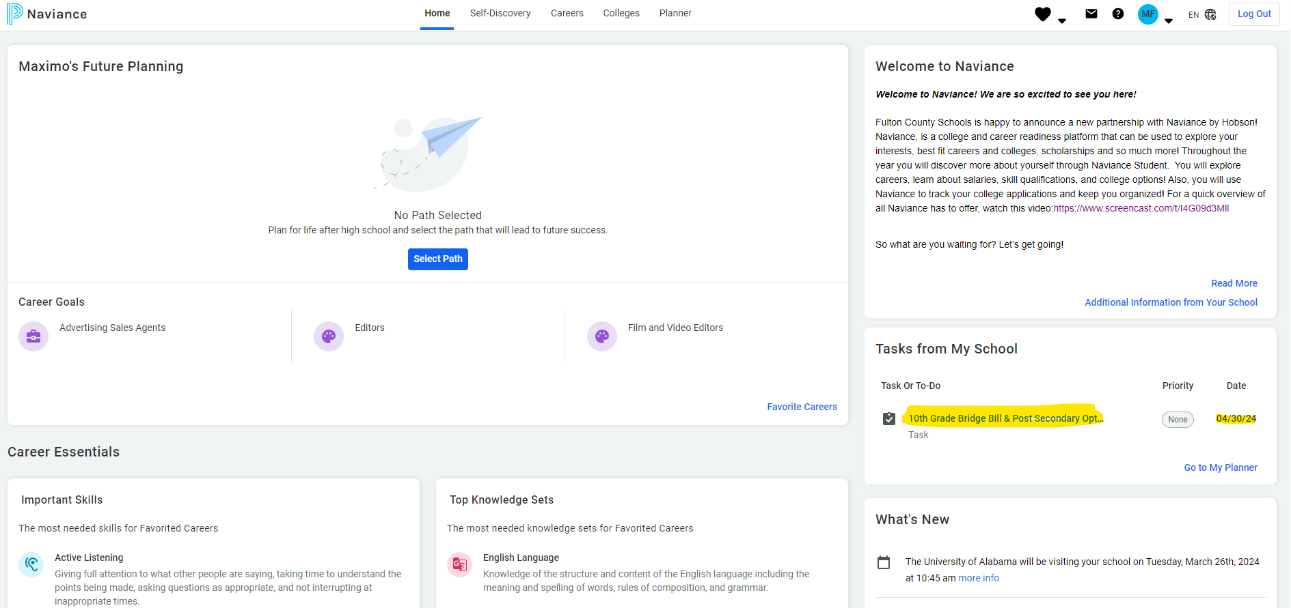
When you login, it will take you to the Homepage

Slide 8
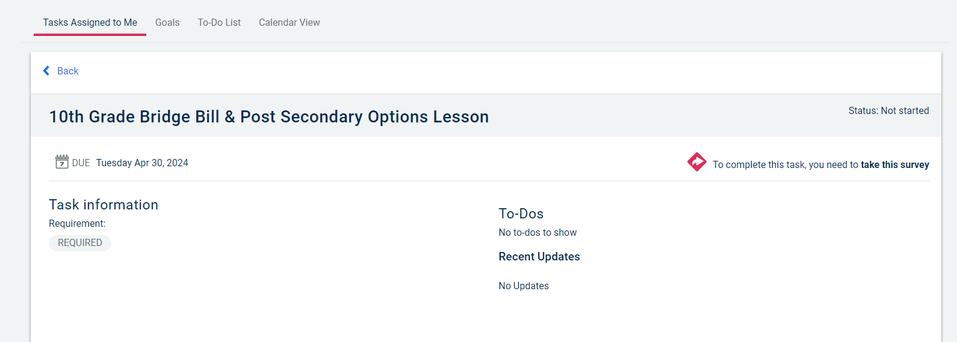
Georgia Bridge Bill Requirements
Under TASKS ASSIGNED TO ME
Complete the required survey(s)
and click SUBMIT RESPONSES
Click on words – take this survey

Slide 9
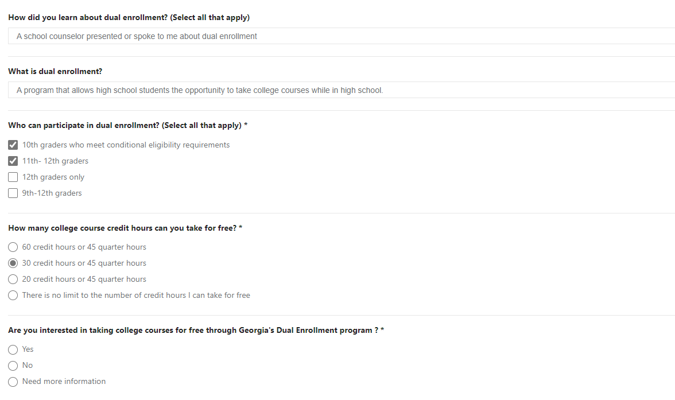
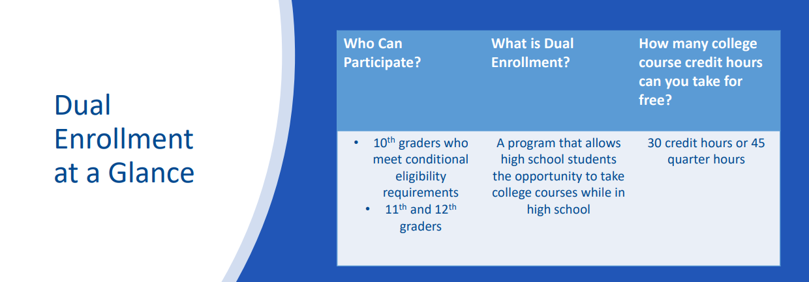
What is Dual enrollment?

Slide 10
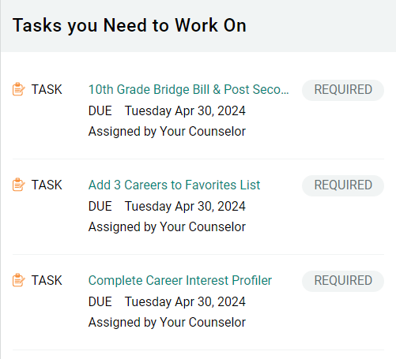
Complete other tasks that say REQUIRED
*** When you completed ALL required tasks,
everything will be listed under

Slide 11
YOUScience
YOUSCIENCE
Every path is personal!
YOUScience measures your APTITUDES (what you naturally do well) and INTERESTS (what you like doing)
This information helps to match you to:
your personalized best-fit career path
recommended jobs
careers you may never have considered you are good at!
ALL 10th graders need to complete YouScience by the last day of school!

Slide 12
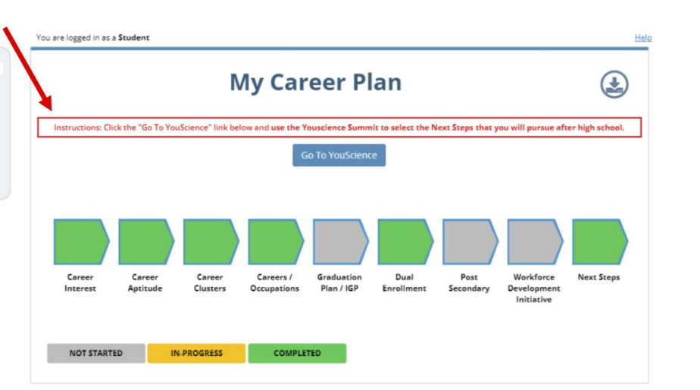
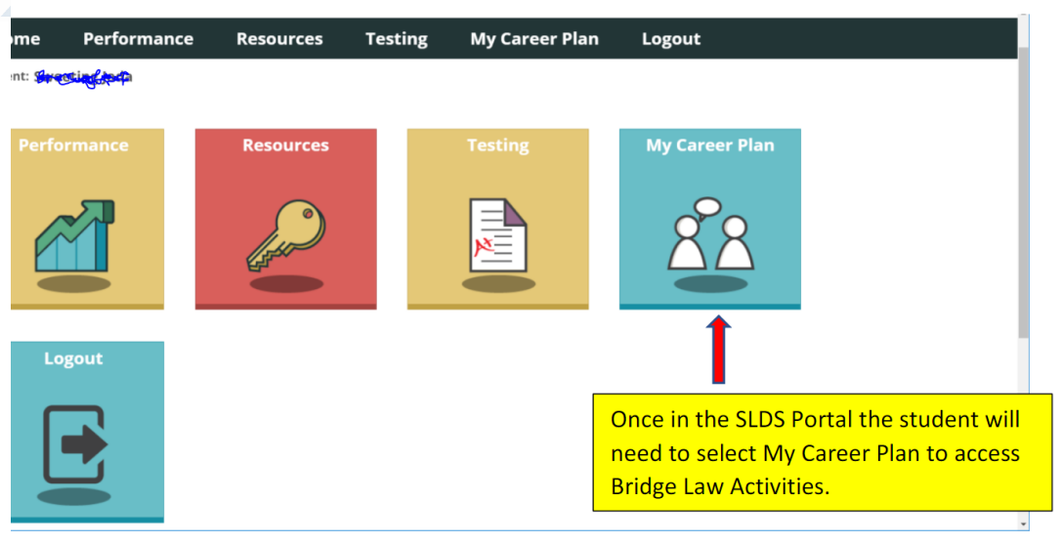
How to access YOUScience in Infinite Campus
2
Step 1
3
Step 4

Slide 13
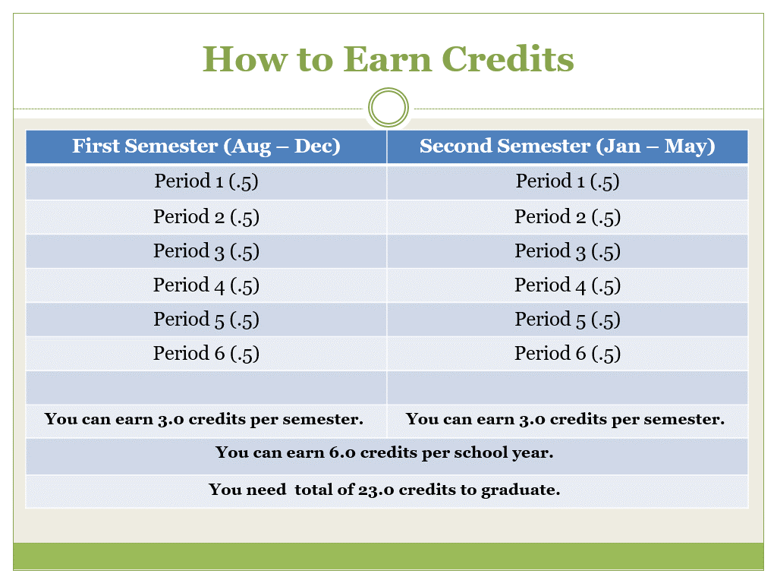
Grades and Credits

Slide 14
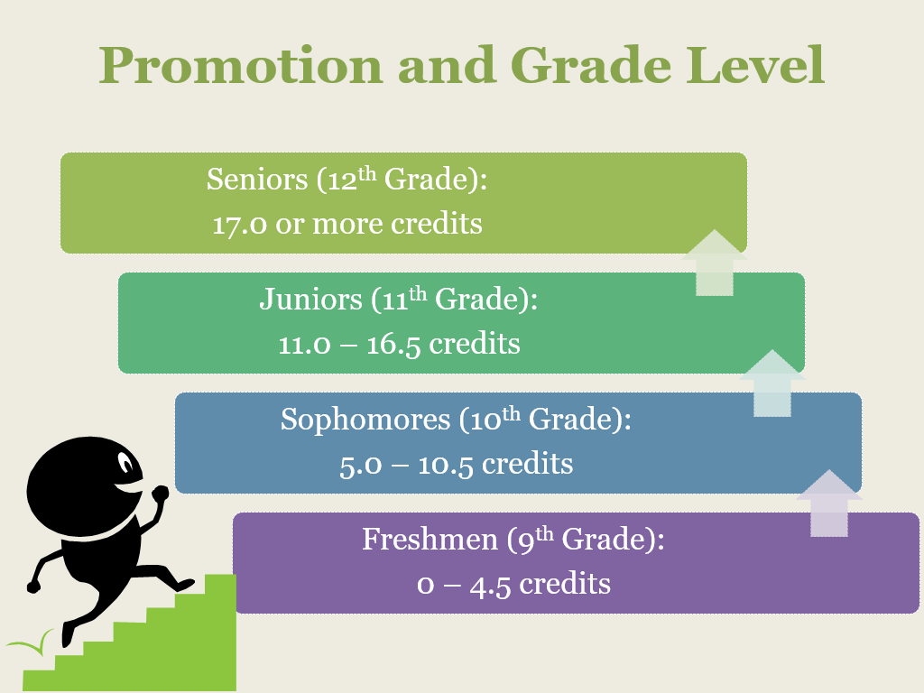
Promotion
Freshmen: 0 – 4.5 credits *
Sophomores: 5.0 – 10.5 credits
Juniors: 11.0 – 16.5 credits
Seniors: 17.0 or more credits
* Students who come in with HS credit for MS courses will remain with their original year of graduation
Progress Reports and Report Cards
Progress Reports provide student’s status at the 6 and 12 week marks
Report Cards provide the student’s final grades for the semester
Infinite Campus (IC)

Slide 15
23 credits needed to graduate

Slide 16
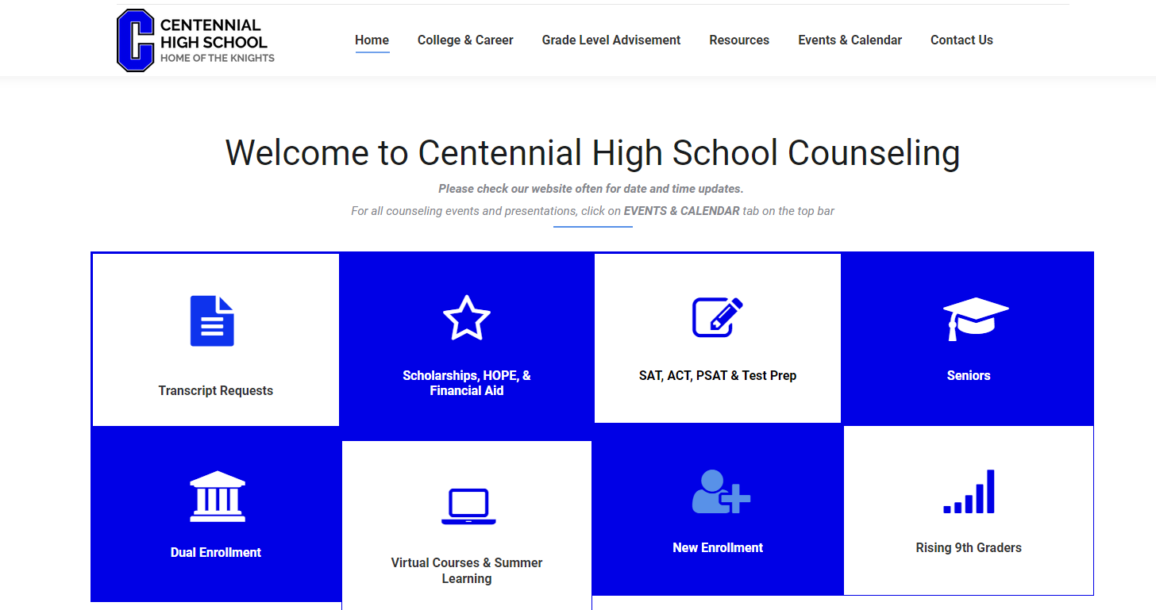
Thank you for your attention!
Summer School Information is located on our website.
Face-to-Face OR Virtual Summer School available for summer 2024
www.mycentennialcounseling.com

Slide 17
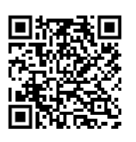
Student Safety Survey
1.) Students- Scan or go to the website below to access student safety survey
Website for survey- https://tinyurl.com/SAFETYSUR24
2.) Once completed, please show your completed screen to receive 3 PBIS community points.

