Slide 1
Exploring Your Abilities!
Class of 2022
Sophomore Classroom Guidance
Centennial Counseling Dept
Spring, 2020

Slide 2
CENTENNIAL COUNSELING DEPARTMENT
www.MyCentennialCounseling.com
A - Cas & AVID Mr. Jones
Cat - Harp
Ms. Ekpo
Harq - Mep
Mrs. Ruppe
Meq - Sal
Ms. Freeman
Sam - Z
Ms. Peart
Grad Coach
Mrs. Rigsbey

Slide 3
Time to start thinking about your future!
Grades
&
Rigorous Academics
SAT & ACT
Extracurricular Activities
&
Leadership
Moving forward to 11th grade: maintaining a healthy balance and staying involved is most important

Slide 4
Where will you be in 2022-2023?
How do I plan for my future?
Who can assist me with my plan?

Slide 5
Match your skills to a career cluster Explore careers in YOUR level of interest and abilities Find out what type of school or training is needed for careers Look at careers’ salaries Find out “hot jobs” that are in-demand and growing
The ABILITIES EXPLORER inventory can help get you there!

Slide 6
Options after High School
Work
Apprenticeship
Military (Navy, Army, Coast Guard, Marines, Air Force)
Technical colleges (Gwinnett Tech)
Two-year colleges (Georgia University at Perimeter: GPC)
Four-year colleges (University of GA, Georgia State, University of North Georgia, etc.)

Slide 7
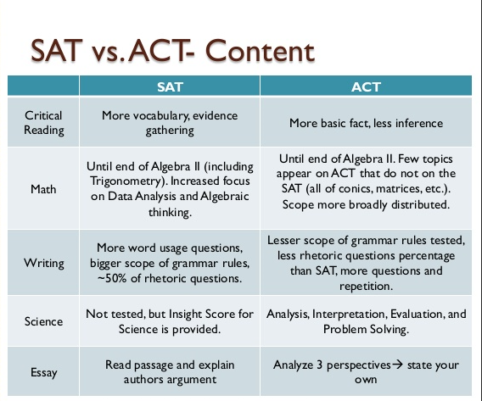
SAT & ACT information to attend a Four-year college
Find information on how to PREPARE and REGISTER for these college entry exams on our website:
www.mycentennialcounseling.com

Slide 8
What do you think you’re good at? What unique skills do you possess?
What are your interests?
Take a minute and think about these questions…
What are your academic areas of strength?
What kinds of jobs/careers sound interesting to you?

Slide 9
When you know yourself…
You can make better decisions about:
What you want to study in high school
What future careers you want to pursue
What jobs you want to shadow or get an internship in
All of these are important to consider as you move towards graduation!

Slide 10
Here’s what the CIS Ability Explorer looks like: →

Slide 11
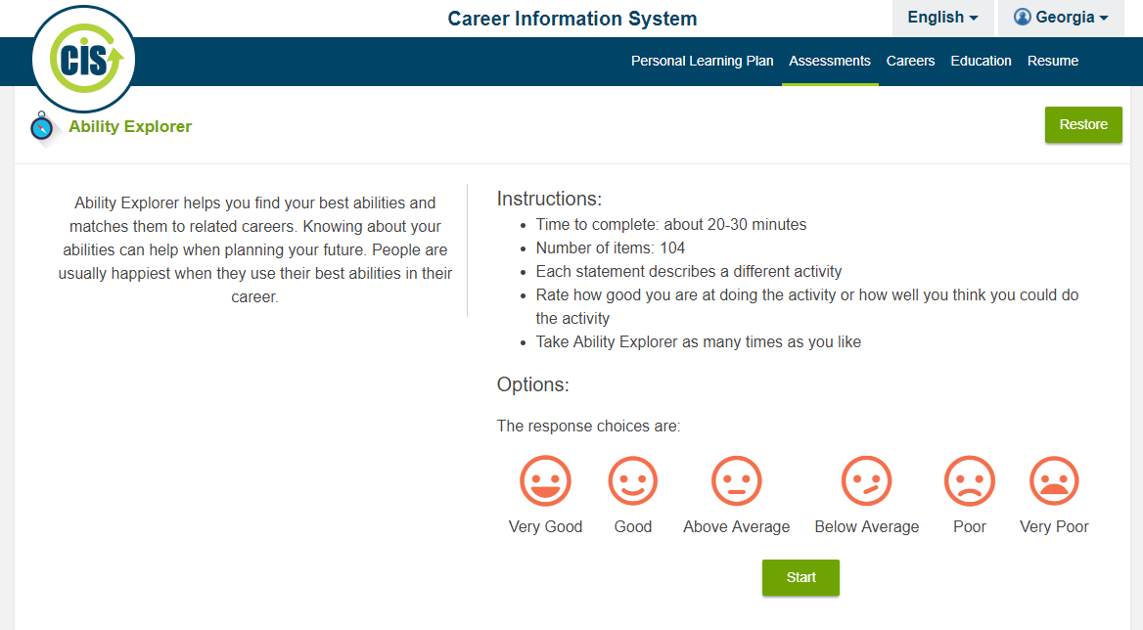
CIS Ability Explorer
Choose the smiley face that matches how YOU would rate
How good you are at that activity OR How well you think you could do that activity
This assessment will help you find
the best matched careers
by looking at your abilities and interests.
People are happiest when they use their best skills in a career!
104 statements
20-30 minutes to complete

Slide 12
A few items to remember:
Use the back green arrow to go back to a previous statement
**DO NOT CLOSE the web browser at any time, or you will lose your work!**
Please read each statement carefully
Answer Honestly!
If you have any questions understanding what the statement means, Raise your hand
There are no wrong answers ☺
When you get to the RESULTS screen, please raise your hand.
A counselor will check you off for completion.

Slide 13
Understanding your results → Right click and SAVE this webpage!
Your Ability Rating Clusters
Orange = High ability area
What were the areas you scored the HIGHEST?
What area is
YOUR BEST MATCH?
What were the areas you scored the LOWEST?
Green = Medium ability area
Blue = Low ability area
13 career clusters
Record all of your results on the worksheet

Slide 14
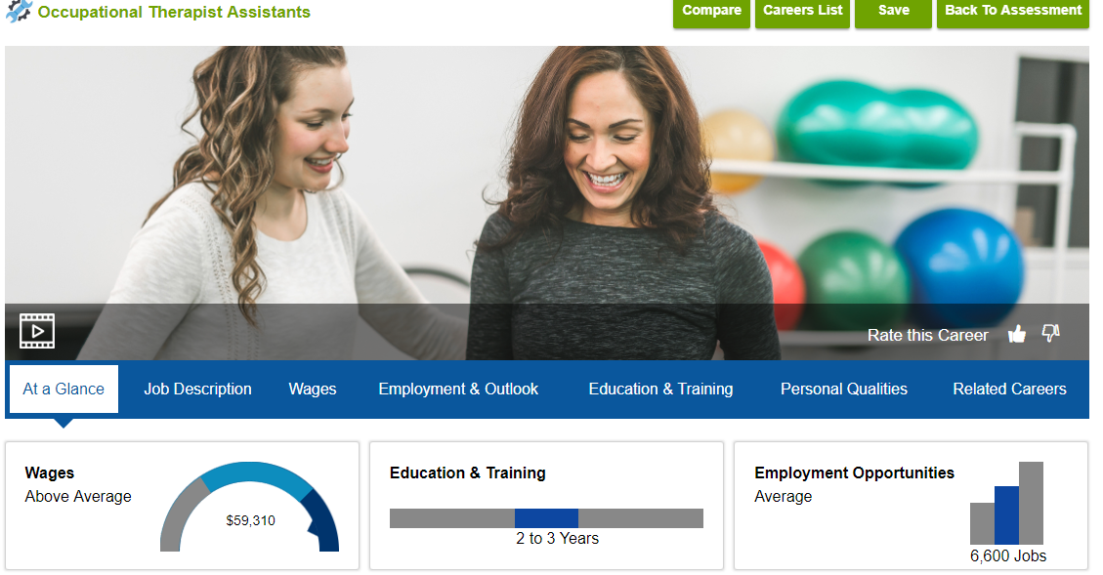
Exploring individual careers
At the bottom of the page, go to Careers on Your List
Click on a career to get more detailed information
What are 3 careers you’re interested in learning more about?
Record them on the worksheet

Slide 15
Let’s Get Started! CIS Ability Explorer
Open CHROME and go to http://CIS360.org
Follow the Step by Step Instructions sheet

Slide 16
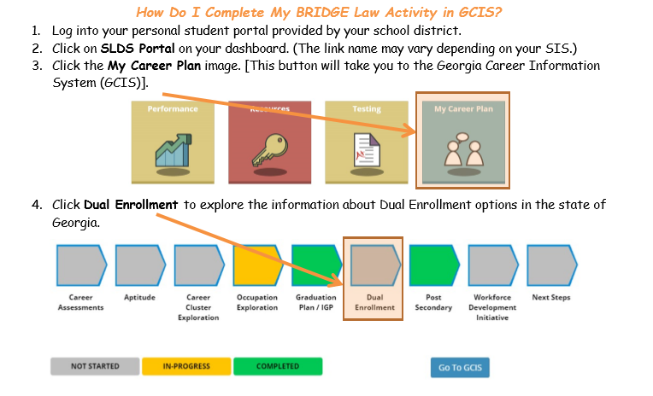
Activity 2 - 10th Grade BRIDGE Law: “Dual Enrollment”
https://www.fultonschools.org/infinitecampus - click on Campus Student and LOGIN –> Click on “MORE” on the left hand side

Slide 17
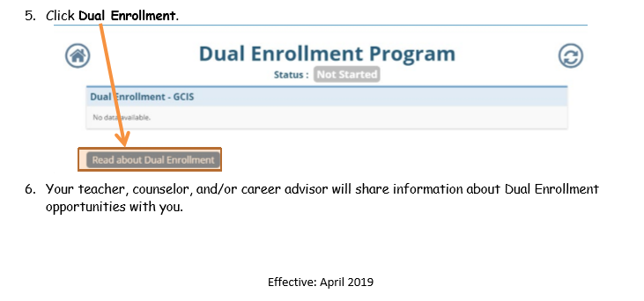

Slide 18
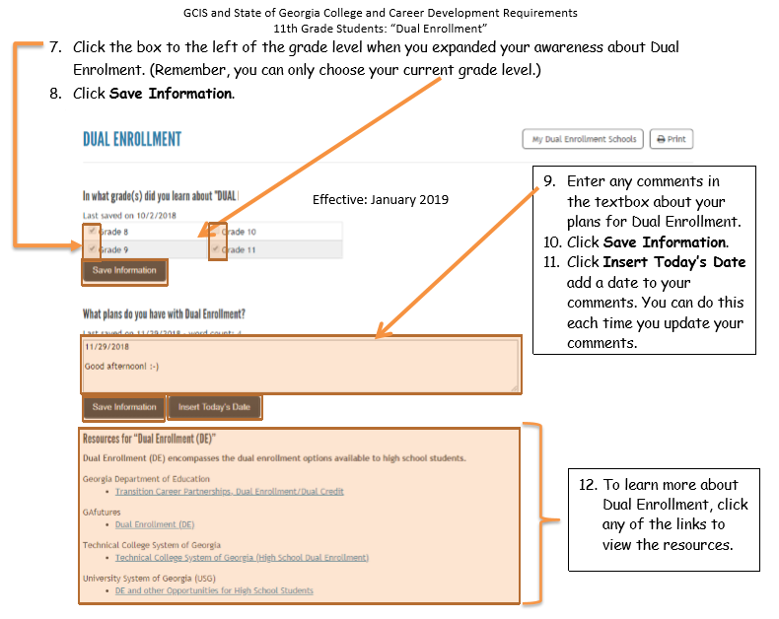
Click the box for GRADE 10
and SAVE INFORMATION
Enter comments and INSERT TODAY’S DATE
and click SAVE INFORMATION

Slide 19
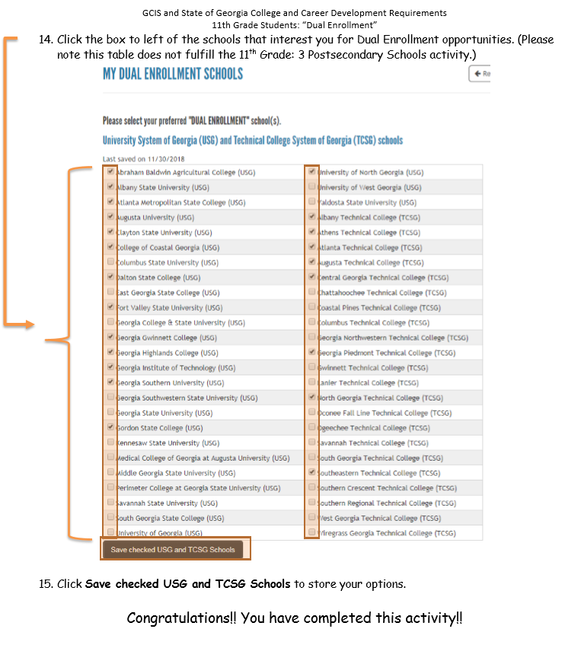
Check off the schools that may interest you for Dual Enrollment –
then click SAVE

Slide 20
It’s not too early to explore your career interests!
Try to meet an individual who works in the field you are interested in (& shadow them at their job!)
Speak with your counselor and teachers about your career interests
College Visit
Apprenticeship (ex. culinary, body art, laser hair technology)
CTE classes (Pathway classes)

Slide 21
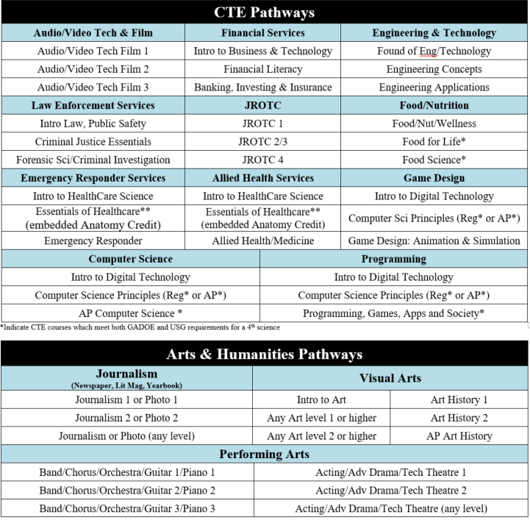
Need 3.0 credits of a Pathway classes to Graduate (Foreign Language, Arts & Humanities and/or CTE)

Slide 22
If you haven’t yet… Join REMIND101 Don’t miss out on important information from the counseling office to YOU!
Text: 81010
In the message box:
@6a4aka3
Download the app for easy notifications and to see past notifications!

Slide 23
Thank you for your attention!
Please turn in your INSTRUCTIONS sheet before you leave today!
This presentation will be posted on www.mycentennialcounseling.com
under “Events Calendar: Classroom Guidance Presentations”

